Slide 1
PDCWG Report to ROS
Chair: Chad Mulholland, NRG
Vice Chair: Jimmy Jackson, CPS
ROS
September 02, 2021

Slide 2
Report Overview & Notes
Report Overview
Meeting Minutes
Frequency Control Report

Slide 3
Meeting Minutes
PDCWG Meeting 08/11/2021
Review of emergency conditions list from ROS
ERCOT Ancillary Service Methodology (Part1, Introduction)
ERCOT reports

Slide 4
Frequency Measurable Events Performance

Slide 5
Frequency Measurable Events
There was 1 FME in July
7/20/2021 08:46:05
Loss of 801 MW generation
Interconnection Frequency Response: 1313 MW/0.1 Hz
6 of 52 Evaluated Generation Resources had less than 75% of their expected Initial Primary Frequency Response.
6 of 52 Evaluated Generation Resources had less than 75% of their expected Sustained Primary Frequency Response.

Slide 6
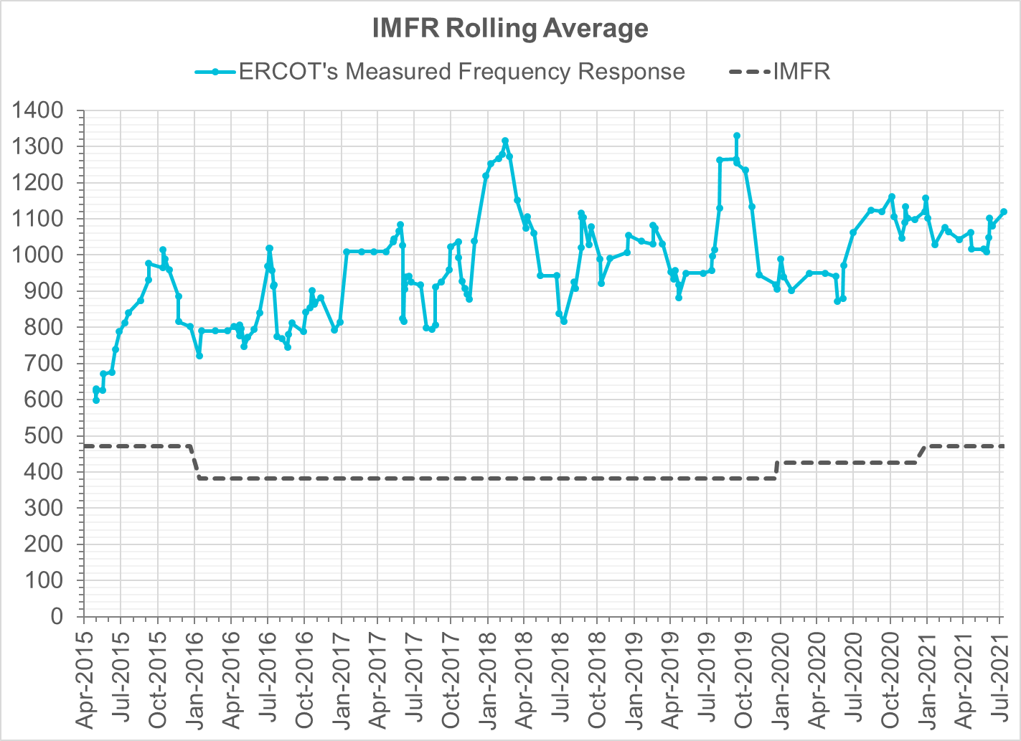
Interconnection Minimum Frequency Response (IMFR) Performance
IMFR Performance currently
1119.24 MW/0.1HZ
Frequency Response Obligation (FRO): 471 MW/0.1 Hz

Slide 7
Questions?

Slide 8
Frequency Control Report
July 2021

Slide 9
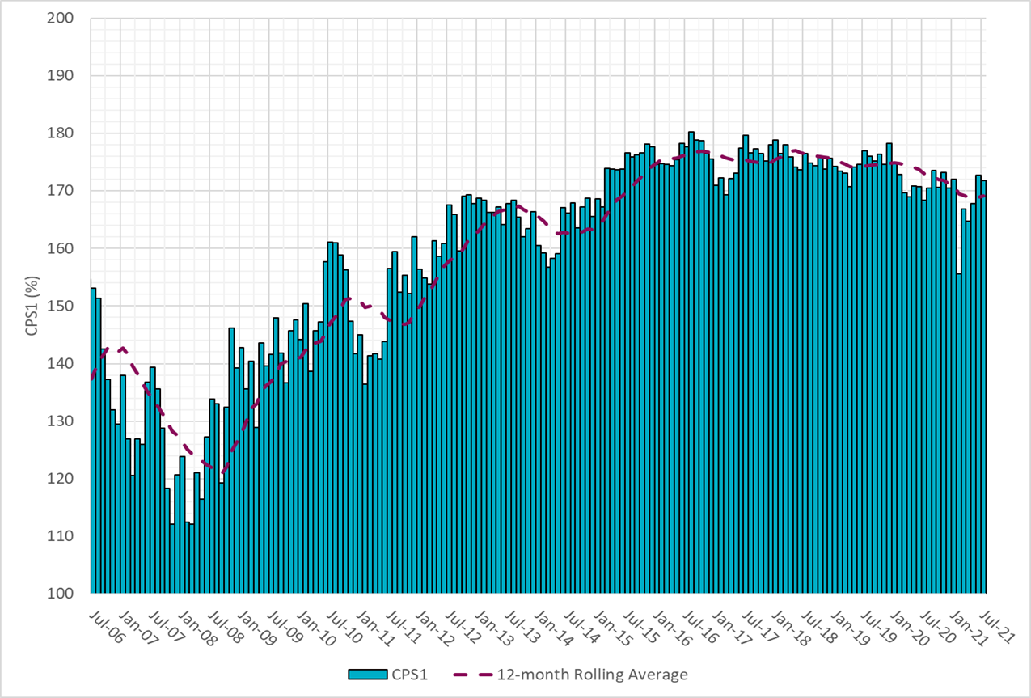
CPS1 Performance

Slide 10
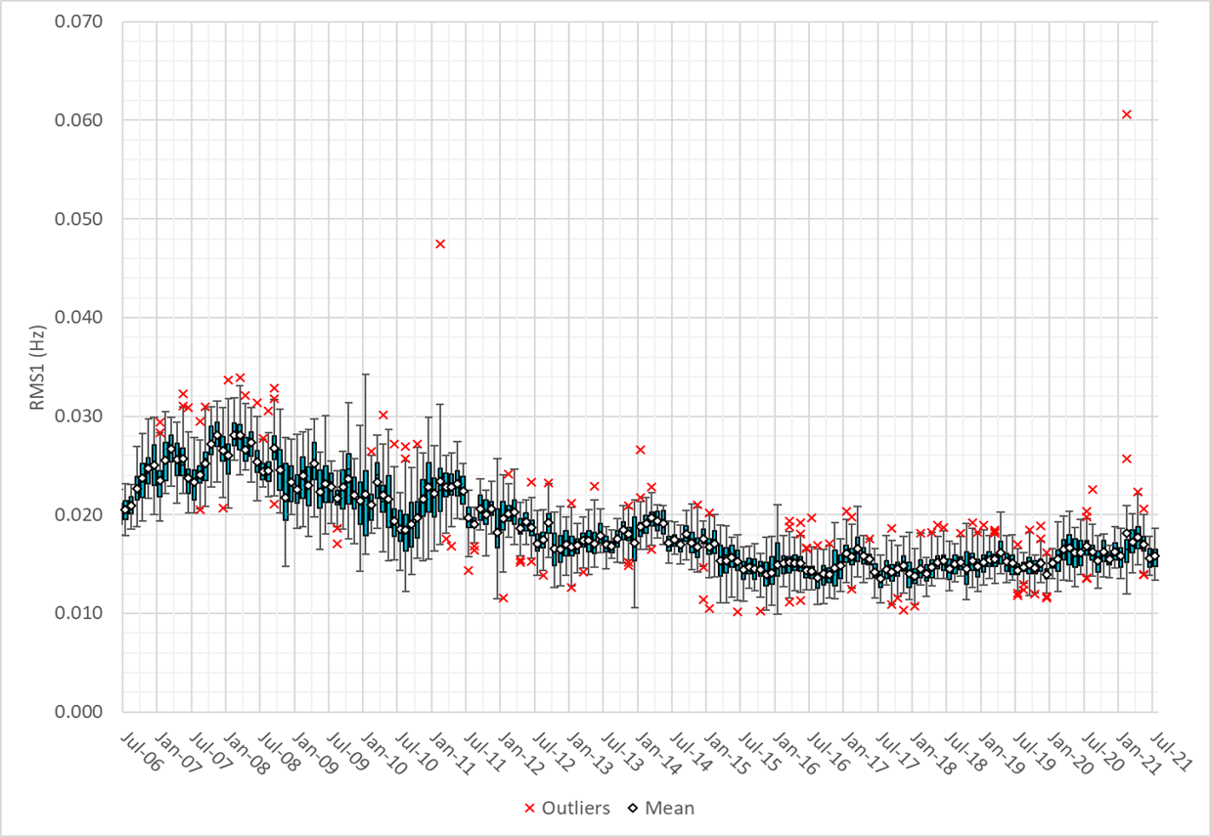
RMS1 Performance of ERCOT Frequency

Slide 11
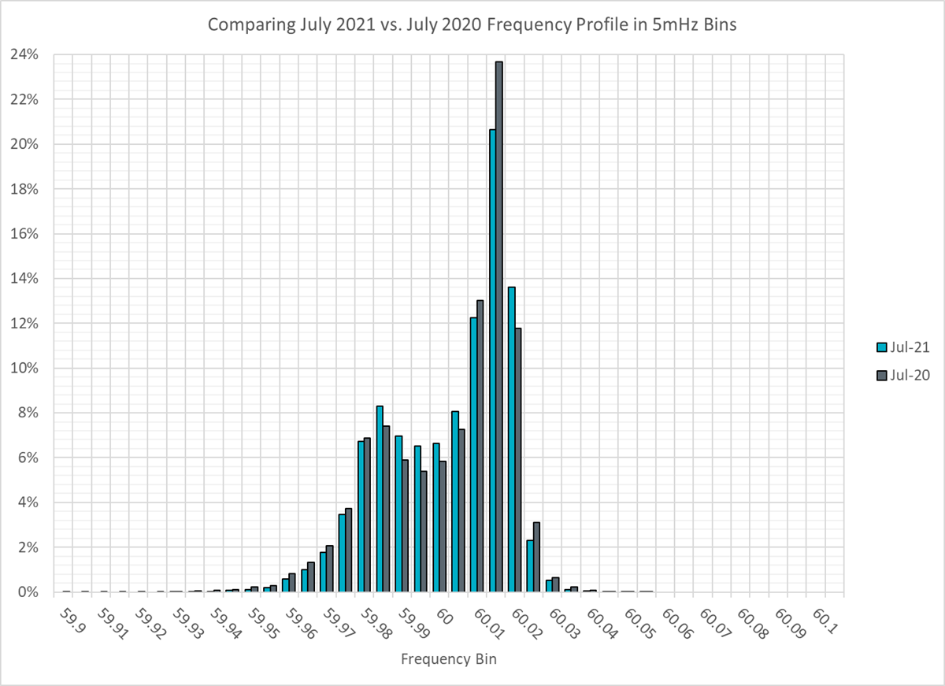
Frequency Profile Analysis

Slide 12
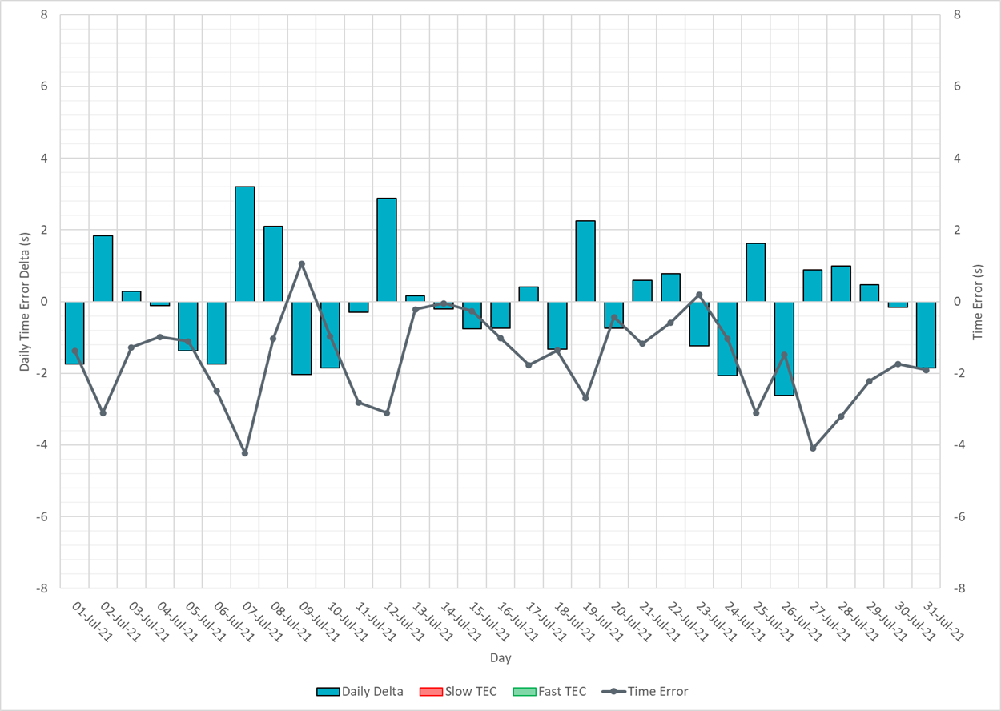
Time Error Corrections

Slide 13
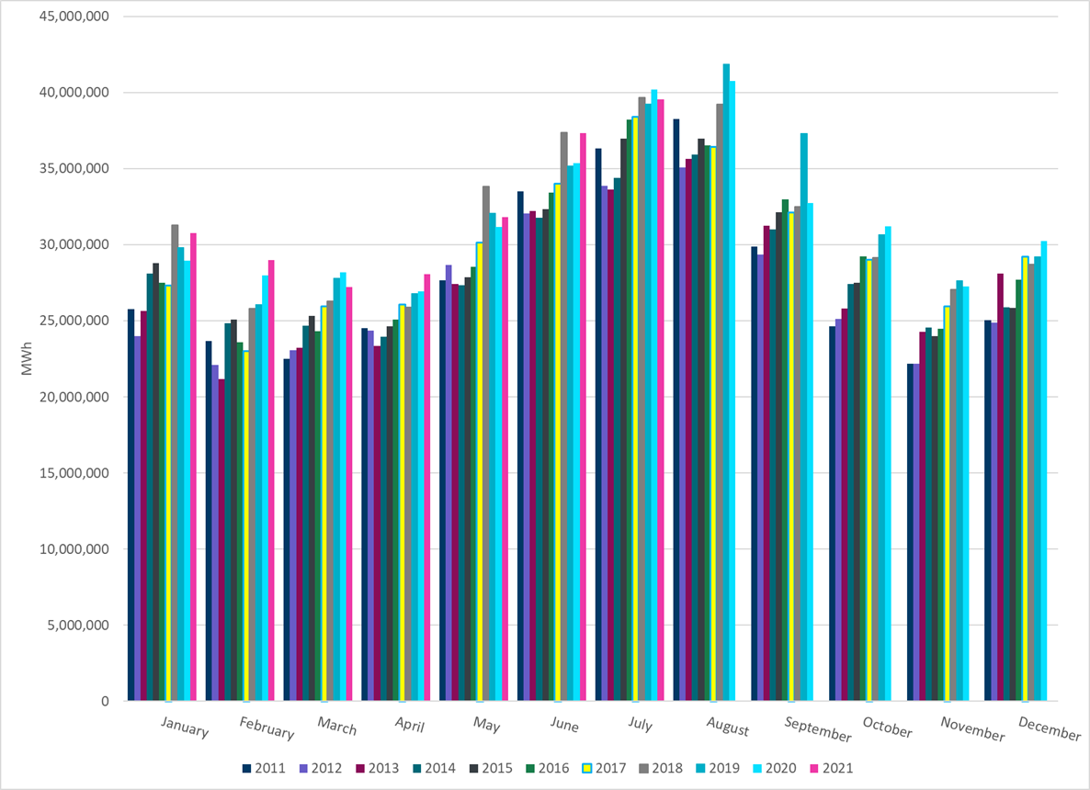
ERCOT Total Energy
Notes:
37,331,144 MWh

Slide 14
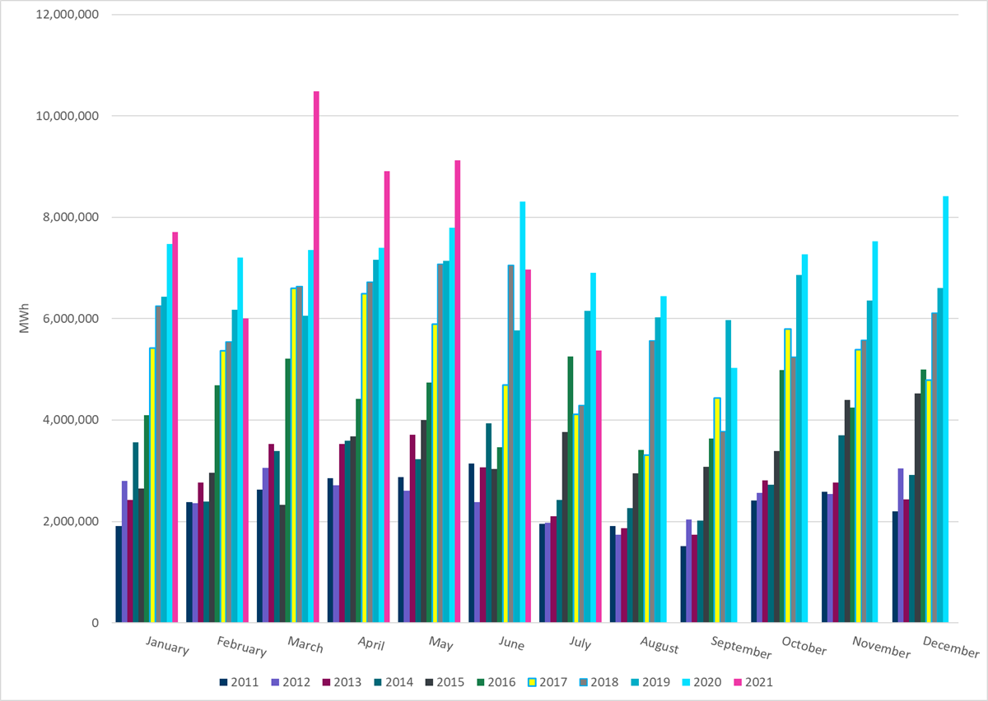
ERCOT Total Energy from Wind Generation
Notes:
6,965,821 MWh

Slide 15
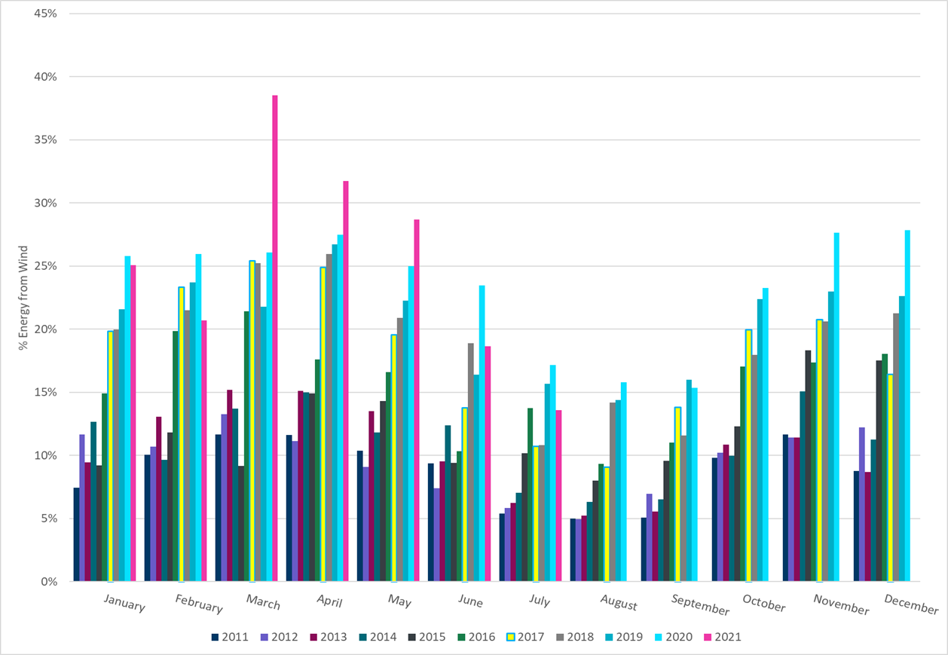
ERCOT % Energy from Wind Generation
Notes:
18.66%

Slide 16
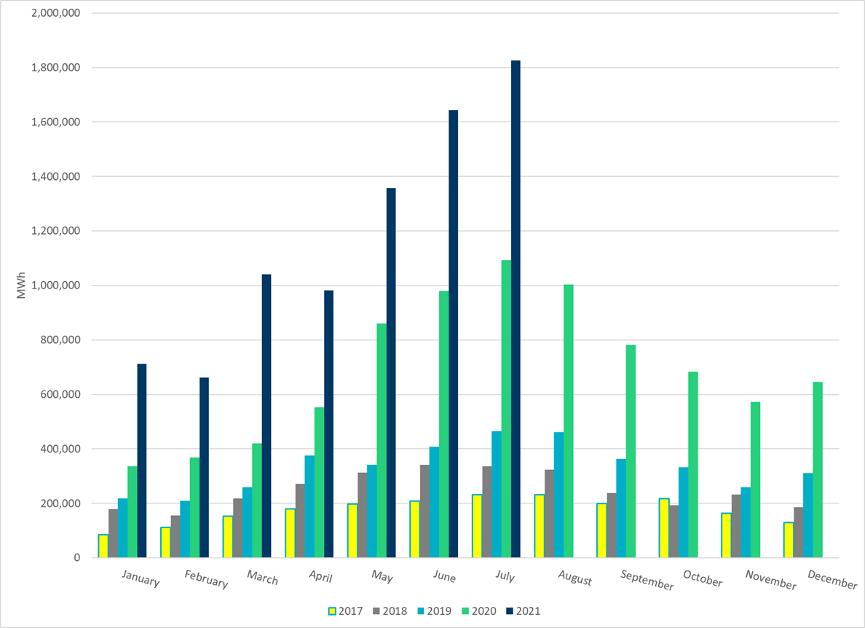
ERCOT Total Energy from Solar Generation
Notes:
1,643,972 MWh

Slide 17
ERCOT % Energy from Solar Generation
Notes:
4.40%

