Slide 1
Supply Analysis Working Group Report to WMS
September 1, 2021
Caitlin Smith, Chair
Ian Haley, Vice Chair
Pete Warnken, Vice Chair

Slide 2
August SAWG Topics - Synchronized Planned Projects Analysis
Synchronized planned projects can generate to their maximum capability after providing an attestation of full plant controls and passing a curtailment test by ERCOT.
Synchronized wind and solar units have generated large amounts of generation during recent peak load conditions.
The accuracy of planned project forecasts in the CDR/SARA reports is much higher than reported in the previous SAWG analysis if we consider the capacity contribution from synchronized units.

Slide 3
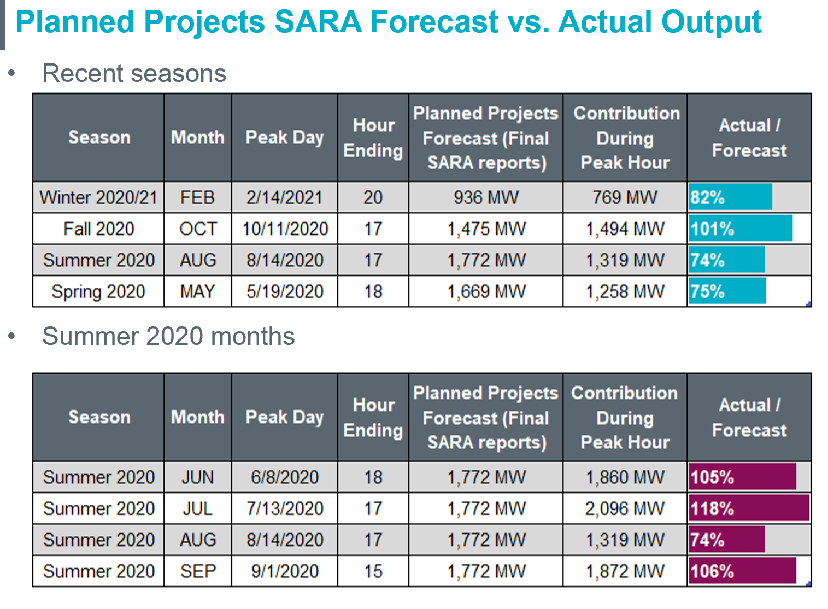
August SAWG Topics - Synchronized Planned Projects Analysis

Slide 4
August SAWG Topics - Comparison of Renewable Capacity Contribution Methods
Methods Evaluated – Summer Season Examples
Current Protocol approach: Average telemetered High Sustained Limits for the highest 20 seasonal peak load hours, averaged over the past seven seasons.
Current Protocols approach using Net Peak Loads: Average telemetered High Sustained Limits for the highest 20 net peak load hours (load minus wind output), averaged over the past seven seasons. Effective Load Carrying Capability: A measure of the incremental load that the system can meet with renewable capacity, with no net change in reliability
Median (P50) Value of the Profile Distributions for HE 13-20: The median of all values of the UL Renewables profile distributions for summer 2021 SARA operation/planned resources (covering HE 13-20), as a percentage of the nameplate capacity
Current Protocol Approach, but calculated for individual hours, HE 16-18
Current Protocols approach using Net Peak Loads, but calculated for individual hours, HE 16-18
Median (P50) Value of the Profile Distributions for individual hours, HE 16-18

Slide 5
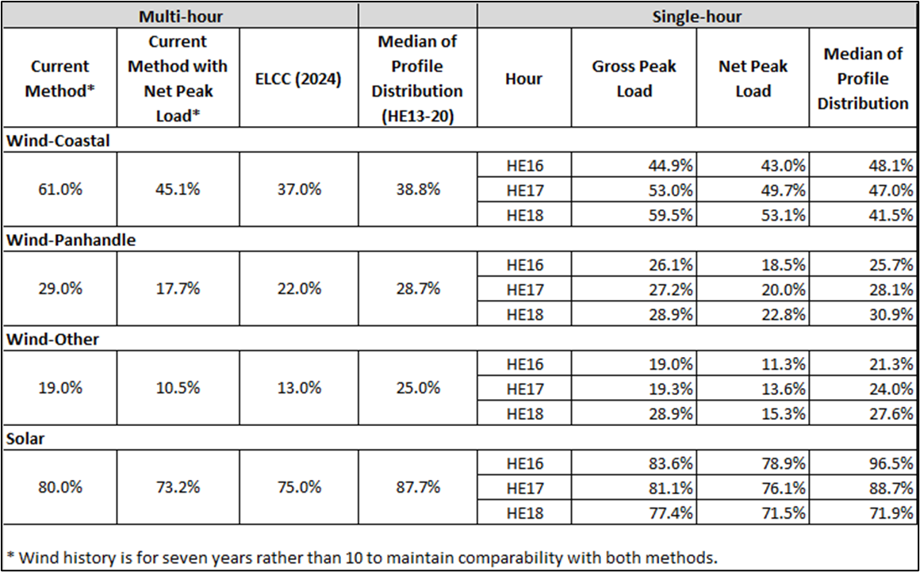
August SAWG Topics - Comparison of Renewable Capacity Contribution Methods
Methods Evaluated – Summer Season Examples
Next steps:
Evaluate Winter Peak
Look at different methods, including different HE and different profiles

Slide 6
August SAWG Topics – SARA Probabilistic Model Summer 2021
Changes from 2020 Model:
New 1980-2020 hourly wind and solar profiles from UL Renewables
Widened the probability distributions for demand and thermal forced outages to encompasses the Extreme Scenarios in the 2021 Final Summer SARA
Incorporated the Summer 2021 SARA peak demand forecast and resource updates
Updated resource quantities available to respond to Energy Emergency Alerts (down by 350 MW overall)
Modified price-responsive demand (PRD) uncertainty modeling
Model now determines a distribution for each hour’s “pre-EEA” reserve margin: Reserve Margin % = ((Total Resources – Outages) - Net Demand) / Net Demand
Next steps:
Evaluate Winter Peak
Look at different methods, including different HE and different profiles

Slide 7
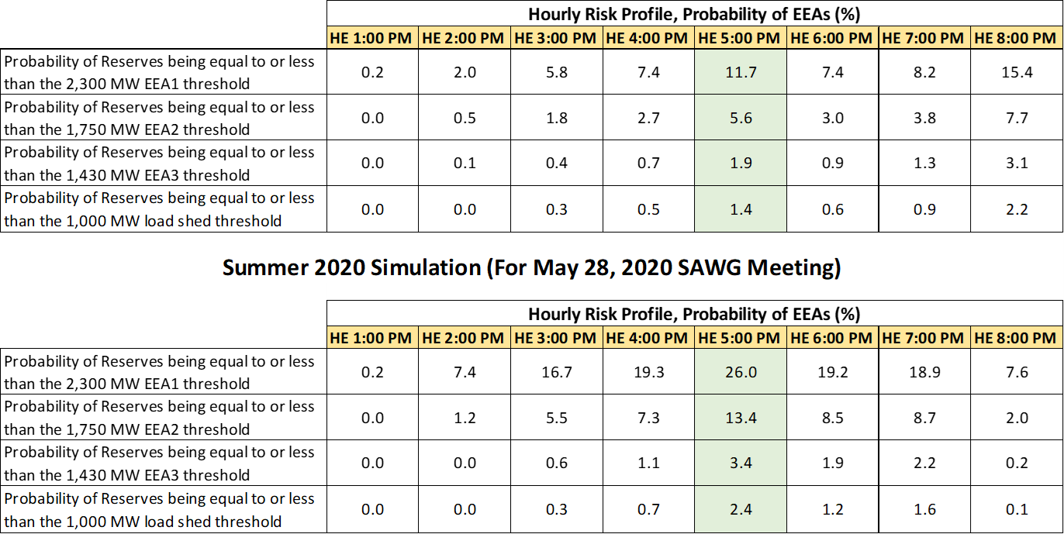
August SAWG Topics – SARA Probabilistic Model Summer 2021
Hourly Risk Profiles, Summer 2021 vs. 2020
Additions of new renewable resources, particularly solar, reduces the risk of EEA events for all hours relative to summer 2020 model results, except for HE 8:00 PM
Drop-off of solar to zero MW during HE 8:00 PM now causes higher EEA risk than for all other hours; the effect of this drop-off is amplified by the doubling of installed solar capacity relative to what was reported in the summer 2020 SARA

Slide 8
Emergency Conditions List from TAC/WMS
61. How should capacity reports be modified to include gas market coincident and offsetting risks with electric system?
Status: Assigned to Lori Simpson & Caitlin Smith; spoke with Gas-electric working group leadership
Long-term item, awaiting related PUCT project 51839
119. Develop and implement updated methodology used to determine cost of new entry (CONE)
Status: Developed an NPPR with study timeline for developing new CONE values 2019-2020
Currently on hold for PUCT action; if ERCOT needs to update CONE for EORM or MERM in the meantime, will bring methodology to SAWG

Slide 9
Emergency Conditions List from TAC/WMS
Items that are ongoing at SAWG and related to recurring CDR and SARA reports:
41. DC Ties: Review performance of DC ties during the event and consideration of how this impacts planning assumptions and other policies related to DC ties.
106. How did DC ties perform during the event? Are there any impacts to planning assumptions and other DC tie policies as a result of this event?
87. What changes are needed to the reserve margin target, reserve margin calculation methodologies used for the CDR and SARA, and planning reserve margin studies including EORM and MERM to account for impacts from this event? Should CDR be changed to better reflect climate change and extremes such as the 2011 heat events and the 2021 Polar Vortex. – average Vs extreme sensitivities Vs worst case scenarios? How to reflect reliability risk in CDR and SARA?
88. Request to accelerate ongoing efforts to improve the CDR and SARA and incorporate probabilistic modeling approach to evaluate the risk of various magnitudes of ERCOT emergency events. If existing deterministic scenario is retained, consider revisions to account for more extreme and overlapping events. Consider actions to be taken based on resource adequacy report results.

Slide 10
Emergency Conditions List from TAC/WMS
Items for consideration at joint SAWG/PLWG (planned for September 17th)
93. Are adjustments to the load forecasting methodology, scenario analysis and trend analysis needed in light of this event?
94. How should we revise extreme winter cases for planning assessments? Would like to start with review of changes made to March SARA
Proposing to remove from SAWG:
96. How did DR perform? Should UFR deployed beyond the period of it obligation be compensated for the deployment? Should A/S Imbalance Charge to deployed Load Resources be revisited?
105. How did SODG perform?
112. Are changes to the use/applicability of Peaker Net Margin methodology needed to protect ratepayers during extended scarcity events? Outside of stakeholder purview

Slide 11
SAWG Open Action Items
Review of Resource Adequacy forecasts and development of a Net Load forecast
include possible evaluation and implementation of possible supplemental forecasts to CDR and SARA
Status: ongoing; Performed Summer 2021 Probabilistic SARA; ERCOT presented Multi-hour CDR Example using Alternative Wind/Solar Capacity Contribution Calculations at August SAWG
TAC Assignment: Develop and implement updated methodology used to determine cost of new entry (CONE)
Status: on hold for PUCT action; if ERCOT needs to update CONE for EORM or MERM in the meantime, will bring methodology to SAWG
Evaluate different options for reflecting reliability risk in CDR or through other mechanisms
Status: ongoing; ERCOT presented Multi-hour CDR Example using Alternative Wind/Solar Capacity Contribution Calculations at August SAWG

