Slide 1
Market Credit Working Group update to the Wholesale Market Subcommittee
Brenden Sager, Austin Energy, Chair
Seth Cochran, DC Energy, Vice Chair
2 June 2021

Slide 2
MCWG update to WMS
General Update
  18 Aug 2021 Joint MCWG/CWG WEBEX Meeting
  1 NPRRs reviewed for their credit impacts, 1088

Slide 3
MCWG update to WMS
Review NPRR 1088 Elimination of RFAF
Elimination of Real-Time Forward Adjustment Factor (RFAF) and the Day-Ahead Forward Adjustment Factor (DFAF) from being applied to prior market positions and instead applies the RFAF and DFAF to ongoing market positions
Currently, a short market position in June can cause credit to cap out in August, even if no market position is taken for the entire following month
A Market Participant’s estimated exposure should not fluctuate when they do not have a market position
ERCOT credit staff not in favor of such changes as they will reduce credit requirements
MCWG/CWG will continue to discuss possible changes. No action planned on this NPRR

Slide 4
ISO/RTO Default Allocation Practices
 | ERCOT | MISO | SPP | CAISO | PJM
Activity base used in default allocation: | Based on previous month Max activity buckets: -Metered --Generation/DCT Imp -Metered Load -Bilateral sales -Bilateral purchases -DAM sales -DAM purchases -CRR Sales & ownership in DAM -CRR Auction Purchases | Based on invoice activity during the same period of time as the unpaid invoice(s) of the MP whose unpaid Past Due Amount has been declared an Uncollectible Obligation. Allocated to each MP that had been invoiced during the same period of time as the unpaid invoice(s) of the MP whose unpaid Past Due Amount has been declared an Uncollectible Obligation. % Loss for MPA = MPA Market Charges + Market Credits in weekly invoicing cycle/MPALL (Market Charges + Market Credits) in weekly invoicing cycle Loss Obligation of MPA = (% Loss for MPA) x $ Amt of Uncollectible Obligation, where: MP = Market Participant -Market Charges = The absolute value of all charge amounts associated with invoices for Market Activities. -Market Credits = The absolute value of all credit amounts associated with invoices for Market Activities. -MPALL = All Market Participants other than MPs with Uncollectible Obligations. | Based on Invoice activity during the same period of time as the unpaid invoice(s) of the MP whose Unpaid Obligation has been declared an Uncollectible Obligation. The Uncollectible Obligation is allocated to all Non-Defaulting MPs who conducted business in the market during the time covered by the invoice(s) containing the Uncollectible Obligation(s). =% Loss for MPA = MPA Market Charges + Market Credits in weekly invoicing cycle/ MPALL (Market Charges + Market Credits) in weekly invoicing cycle. -Loss Obligation of MPA = ((% Loss for MPA) x $ Amt of Uncollectible Obligation) minus (-) (Reduction of Payments + Pro rata share of partial payment(s)) Where: -MP = Market Participant --Market Charges = The absolute value of all charge amounts associated with invoices for Market Services. -Market Credits = The absolute value of all credit amounts associated with invoices for Market Services. -MPALL = All Market Participants other than MPs with Uncollectible Obligations. -Reduction of Payment = The amount of the Unpaid Obligation originally assessed to MP -Pro rata share of partial payment(s) = Any partial payments received during cure period | Hybrid approach based on dollar and MW activity: Based on quarterly percentage shares calculated based on quarterly average over rolling four-quarter look-back period: –20% of payment default amount allocated in proportion to net amounts payable –30% of payment default amount allocated in proportion to sum of absolute values of dollar amounts shown on invoices payable or receivable after certain dollar amount exclusions for GMC, RMR, and Wheeling Access Charge costs and exclusions for billing of Access Charges and payment of Transmission Revenue Requirements to Participating Transmission Owners –50% of payment default amount allocated in proportion to largest of the following amounts calculated in MWh for every month in each applicable calendar quarter •Cleared DA Schedules to supply Energy… •Metered Generation… •Cleared DA Schedules for demand… •Metered Load x 103%... •The greater of the quantity of CRRs or Inter-SC Trades of Energy… | Activity component is based on on last three months gross activity Default Allocation Assessment shall be equal to (0.1(1/N) + 0.9(A/Z)) Dissection of calculation: % share to total number of participants weighted at 10% (not exceeding $10,000); and % share to total market over last 3 months weighted at 90% A = for Members comprising factor "N" above, the Member's gross activity as determined by summing the absolute values of the charges and credits for each of the Activity Line Items identified in section 15.2.2(b) below as accounted for and billed pursuant to Operating Agreement, Schedule 1, section 3 for the month of default and the two previous months. Z = the sum of factor A for all Members excluding ex officio Members, State Consumer Advocates , Emergency and Economic Load Response Program Special Members , and municipal electric system Members that have been granted a waiver under Operating Agreement, section 17.2.
Default Uplift Billing Timeline | no earlier than 90 days | no prescribed timeline |  |  | next practicable invoices

Slide 5
All ISO Credit Exposure Methods
DC Energy supports the PJM model and will present later why they think it works better than the ERCOT model
Growth in value from settlement invoices as opposed to MW value
Goal: to spread risk across all the market “to make a risk pool that makes sense”
Smooth out settlement bumps
PJM is time-tested, worked through Greenhat (large default) and “it’s still standing”
The core of the methodology is gross value invoices, MISO, SPP, PJM

Slide 6
MCWG update to WMS
Market-wide average TPE increased from $ 610.6 million in June to $ 704.3 million in July
  TPE increased mainly due to higher Forward Adjustment Factors in July compared to June
Discretionary Collateral is defined as Secured Collateral in excess of TPE,CRR Locked ACL and DAM Exposure
  Average Discretionary Collateral increased from $1,791.3 million to $2,081.8 million
  The increase in Discretionary Collateral is largely due to increase in Secured Collateral.
Short pay entities are excluded from the above calculations to remove data skew
No unusual collateral call activity

Slide 7
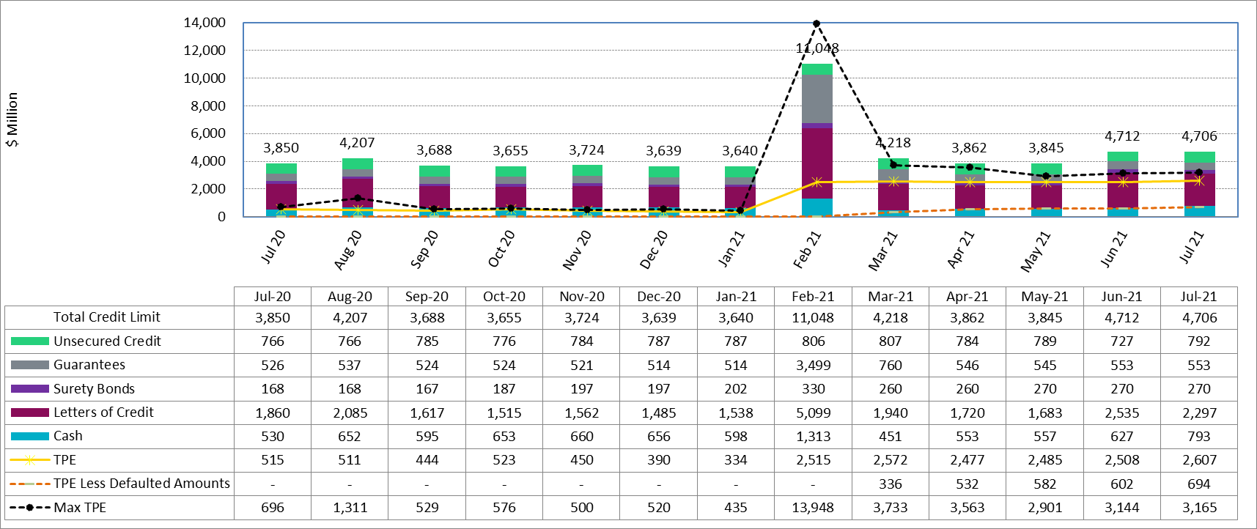
Collateral by Type vs TPE

Slide 8
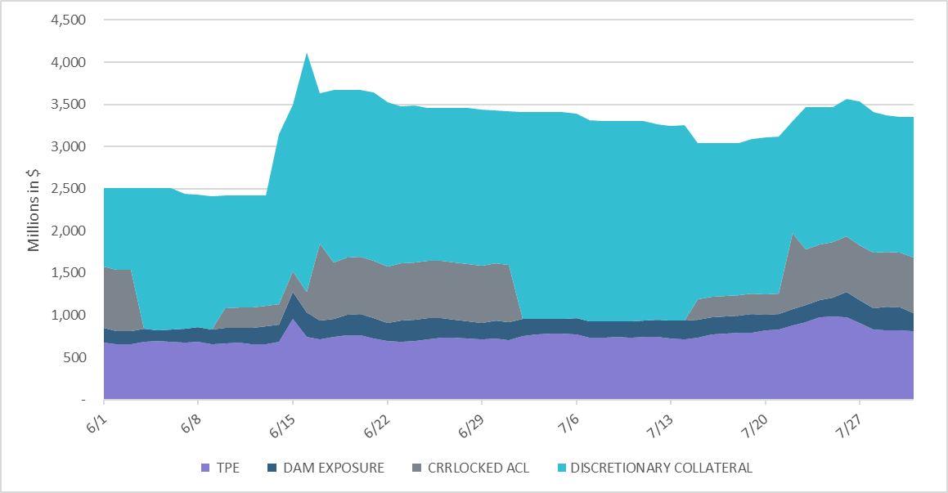
Collateral Posted by Type

