Slide 1
PUC Project 46304 Directive 8 - Voltage Support Service
Jeff Billo
Transmission Planning

Slide 2
PUC Project 46304 Order, Directive 8
“ERCOT shall (a) study and determine whether Southern Cross Transmission or any other entity scheduling flows across the Southern Cross DC tie should be required to provide or procure voltage support service or primary frequency response, or their technical equivalents, (b) implement any necessary revisions to its standards, guides, systems, and protocols, as appropriate, and (c) certify to the Commission when it has completed these actions.”
Primary Frequency Response component resolved by ERCOT Board in August 2018.
Voltage Support Service component of directive essentially requires determination as to whether Southern Cross Transmission LLC (SCT) should be required to provide some quantity of reactive power capability to facilitate imports and exports over that DC Tie.
This question should be considered in context of policy for other potential new DC Ties.
Because question involves equity and market design considerations, ERCOT is seeking stakeholder input on the determination.

Slide 3
Southern Cross Transmission – Planning Study
Southern Cross DC Tie equipment is not currently planned to have any reactive capability to support ERCOT system voltage.
Southern Cross DC Tie imports and exports at any level will cause reactive losses on the ERCOT system.
Study conditions and results:
Summer peak imports: thermal limits will be reached before voltage limits
High wind/low load exports: the ERCOT system has enough margin to support up to 1,289 MW of export before voltage limits are reached. Additional voltage support is needed to export at higher levels.
Report link: http://www.ercot.com/mktrules/puctDirectives/southernCross/159973#keydocs

Slide 4
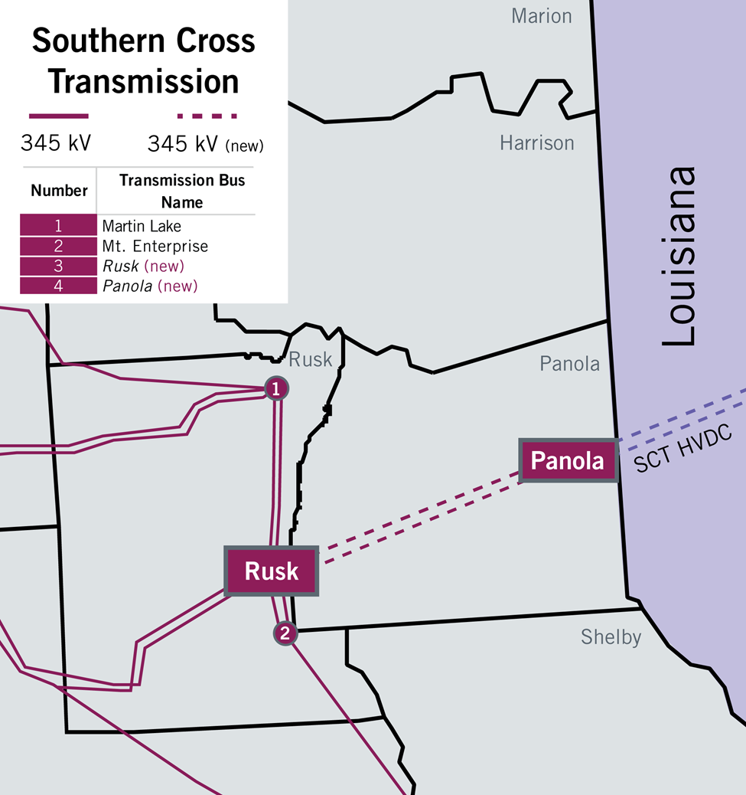
Southern Cross Transmission – Planning Study Results
The Planning study illustrated differences in the upgrades that would be needed to achieve full export capability with and without SCT providing 0.95 power factor reactive capability.

Slide 5
Policy Considerations
Generation Resources are required to provide reactive capability in accordance with Protocol Section 3.15 (typically +/- 0.95 power factor).
Though future system needs are unknown, the Generation Resource’s obligation remains the same for the life of the asset.
Like power injections from Generation Resources, DC Tie flows require reactive support.
Directive 6 involves identifying needed transmission upgrades for Southern Cross. As shown in the Planning study, the decision of whether or not new DC ties should be required to provide voltage support will have an impact on what transmission is necessary to allow for assumed Southern Cross flows. Thus, Directive 6 resolution must follow Directive 8.
PGRR077, DC Tie Planning Assumptions, which was approved by the ERCOT Board in October 2020, is indirectly related to this discussion because it codifies that planners should assume DC Tie flows can be curtailed when DC Tie flows cause reliability criteria violations.

Slide 6
ERCOT’s proposal
Any DC Tie facility that has an initial energization date after January 1, 2021, and any DC Tie facility that is replaced after that date, shall have at least 0.95 power factor leading/lagging reactive power capability.

Slide 7
ROS
ERCOT respectfully requests ROS endorse the proposal:
Any DC Tie facility that has an initial energization date after January 1, 2021, and any DC Tie facility that is replaced after that date, shall have at least 0.95 power factor leading/lagging reactive power capability.
Next Step: ERCOT will present this recommendation to TAC.

