Slide 1
Performance of Net Load Forecast Variability Assessment
ERCOT Staff

Slide 2
Forecast Variability Considerations
Factors that ERCOT will consider when assessing whether or not a day has the potential for having high variability in the forecast include, but are not limited to:
Timing of a weather front, that if accelerated or delayed, could impact the load, wind, and/or solar forecasts,
Variation of temperatures in weather forecasts and ERCOT is not selecting the most conservative (hottest/coldest) for the load forecast,
ERCOT believes that the temperature forecasts from ERCOT’s weather vendors are not hot or cold enough,
Rain is forecast over a significant portion of ERCOT load, but ERCOT believes there is a chance the rain doesn’t happen,
There is a significant variation between the wind forecasts ERCOT receives from different models,
There is a significant variation between the 50th percentile (STWPF) and 80th percentile (WGRPP) wind forecasts,
The forecast for areas with high amounts of solar resources shows clear skies, but ERCOT believes there is a chance for cloudy conditions, and
There is a potential for extreme weather conditions such as snow, icing, dust storm, hail, or an eclipse.

Slide 3
Updates to Forecast Variability Assessment
The assessment is posted at
http://www.ercot.com/about/weather/forecastvariability
Note that as of August 1, 2021, recognizing that the sole purpose of this assessment is to aid in determining if additional Non-Spin quantities are needed for Current-Day + 3, ERCOT has updated its approach to limit the net load variability assessment for Current-Day+3 only. The Forecast Variability Assessment will continue to be updated 7 days per week.
This assessment focuses on the gauging the risk of net load underforecast errors during the Operating Day. On days that are identified as having a higher potential of weather forecast uncertainty that may result in having a higher net load that being forecasted, ERCOT may increase Non-Spin quantities further by up to 1000 MW.
So far, ERCOT has tagged Jul 12, Jul 28, Jul 29, Aug 1, Aug 2 and Aug 14 as day with high risk for net load variability.
ERCOT increased Non-Spin requirements further by 1000 MW on Jul 29, Aug 1, Aug 2 and Aug 14

Slide 4
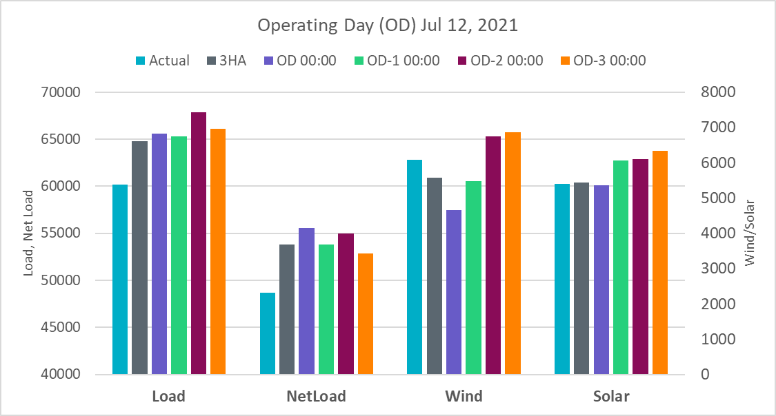
July 12, 2021 (assessment day July 9, 2021)
The week of Jul 12, 2021 presents a weather pattern much more typical of July.
Most days the week of Jul 12, 2021 show potential for the temperatures to come in two to four degrees hotter than the current forecast.
Also, there’s a couple days next week when the wind has potential to come in significantly lower than forecast – July 12 and July 13 in particular.
Note that the graph above focuses on the forecast performance for HE17 on Jul 12.

Slide 5
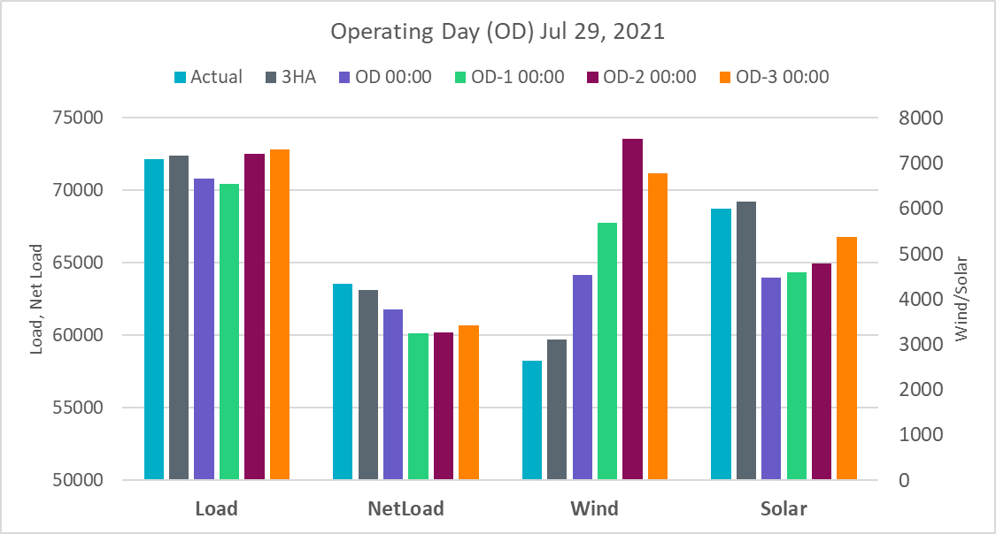
July 28 - July 29, 2021 (Assessment day July 25, July 26, respectively)
July 28, 2021 and July 29, 2021 show the highest potential variability from the current forecast. The forecasts are relying in cloud and rain impacts on temperatures – especially July 28. Then slow to rebound hotter on July 29. The other concern is rain and clouds could be more prevalent in West Texas during this time frame, resulting in lower wind and solar generation than is currently forecast. While not a high probability, there is a high potential variability during July 28 into July 29 time frame.
Additional Non-Spin was procured for July 29.
Note that the graph above focuses on the forecast performance for HE17 on Jul 29.

Slide 6
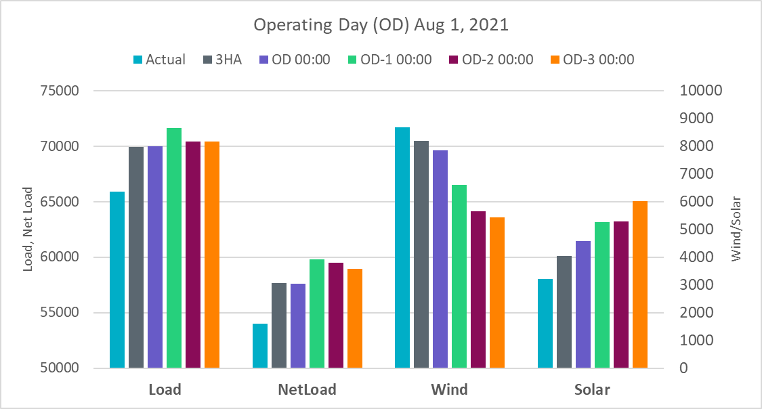
August 1, 2021 (assessment day July 29)
August 1, 2021 continues to show the greatest concern over the next seven days. The current load forecast is significantly lower than the level it was forecasted yesterday. There’s still potential temperatures come in just as hot as suggested with yesterday’s update. Also, it’s very likely rain and clouds will ramp up in West Texas by late-afternoon Sunday. This poses a significant risk to both wind and solar coming in below forecast.
Additional Non-Spin was procured for August 1.
Note that the graph above focuses on the forecast performance for HE17 on Jul 29.

Slide 7
August 2, 2021 (assessment day July 30)
On Monday morning (August 2, 2021), showers and thunderstorms are expected over much of West Texas and portions of North Texas. That area of precipitation is likely to continue over West Texas throughout the day, but with more focus on the southern half Monday afternoon into evening. There’s less certainty with the precipitation east of West Texas, as the activity is likely to be more scattered. Dallas-Fort Worth has its highest rain chance in the morning, then possibly dry by afternoon. As that area of precipitation shifts southward, it may become increasingly scattered. Austin, San Antonio, and Houston will all have rain chances on Monday, but there’s currently not enough evidence to rely on rain for the load forecast input. With minimal rain, temperatures would top out in the mid-to-upper-90s for the large cities on Monday. Among the large cities, Dallas-Fort Worth has the relatively greater chance of coming in a degree or two hotter than forecast.
Again, it’s much more likely West Texas will see rain and cloud impacts Monday afternoon leading up to peak. This creates a high variability potential for both wind and solar on Monday.
Additional Non-Spin was procured for August 2.

Slide 8
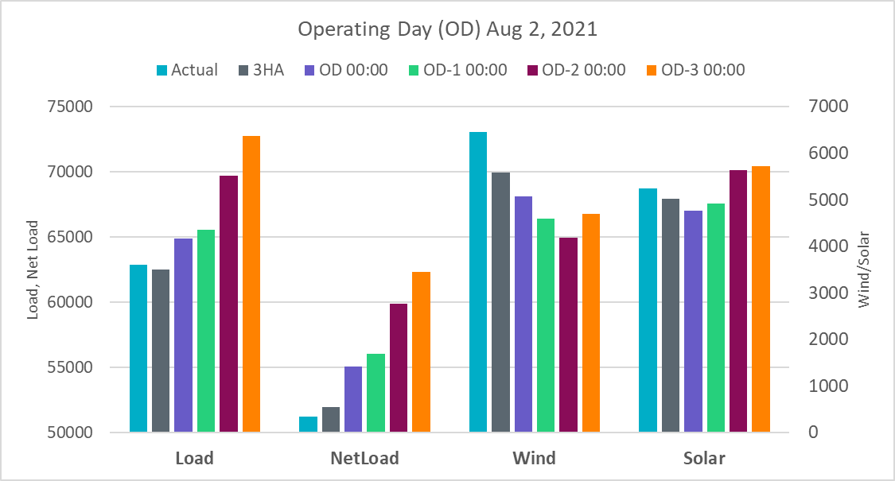
August 2, 2021
Note that the graph above focuses on the forecast performance for HE17 on Jul 12.

Slide 9
August 14, 2021 (assessment day August 11)
Saturday will serve as a transition day from what has been a very consistent weather pattern this week to the possibility of rain chances over a larger portion of the state and the temperature impacts that would coincide.
The current Dallas-Fort Worth temperature forecast for Saturday afternoon leading up to peak is in the low-90s. That would be relying on at least thick cloud cover and possibly rain in the area. D/FW has been in the upper-90s all week. If the timing of clouds and rain chances hold off a few hours, upper-90s on Saturday afternoon cannot be ruled out.
The other issue with Saturday is that renewable generation is likely to be quite low. Rain, clouds, and cooler temperatures are likely to impact much of West Texas on Saturday (higher chances than away from West Texas). Solar does have potential to come in significantly lower.
Additional Non-Spin was procured for August 14.

Slide 10
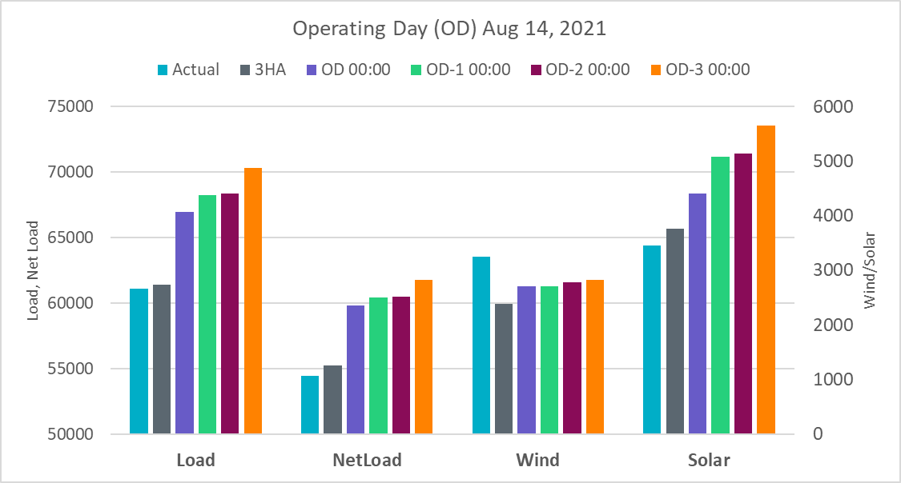
August 14, 2021
Note that the graph above focuses on the forecast performance for HE17 on Aug 14.

Slide 11
Summary
The weather in Texas could be very volatile, making it difficulty to produce a precise load and/or IRR forecast and to quantify their uncertainties.
Forecast variability assessment helps ERCOT to plan for the grid operations ahead of time and to mitigate the reliability risk foreseen
ERCOT can manage the reliability more efficiently by procuring different amount of Non-Spin reserve for non-high and high forecast variability days.

Slide 12
Questions?

