Slide 1
OWG: Preliminary May 9, 2021 System Event Update
ERCOT
August 19, 2021

Slide 2
Event Overview
At approximately 11:21:37 on 5/9/2021, several inverter-based resources tripped or temporarily reduced their MW output simultaneously from non-consequential interruption for loss of 1,244 MW of generation and 131 MW of generation partially tripped from a thermal resource totaling a generation loss of approximately 1,375 MW. Because of this, frequency dropped to 59.817 Hz and 859.13 MW of RRS was released and frequency took 2 min 52 sec to recover
Event: 1PH fault at Natural Gas unit 18/345-kV GSU and cleared in 3 cycles, unit was tripped accordingly
System Impact: 18 solar, 3 wind projects and one combined cycle train either tripped or temporary experienced active power reduction and restored within few seconds to few minutes.
  The affected combined cycle train was due to the fault and fault clearing that tripped one of the CTs of the train.
  IBRs were tripped or temporary experienced MW reduction due to the system voltage performance during and post the disturbance.

Slide 3
Overview of Impacted Solar Projects
Solar Unit (138)
Solar Unit (345)
Gas Unit 18/345 XFR 1PH Fault for 3 cycles at
Solar Unit (138)
Solar Unit (345)
Solar Unit (138)
Solar Unit (138)
Solar Unit (138)
Solar Unit (138)
3 Solar Units (138)
Solar Unit (138)
Solar Unit (138)
Solar Unit (345)
Solar Unit (138)
Solar Unit (138)
Solar Unit (69)
Solar Unit (345)
MW Restoration Time:
< 10s
10s~1min
1~5 mins
> 5 mins

Slide 4
Overview of Impacted Wind Projects
OECCS18/345 XFR 1PH Fault for 3 cycles at
Gas Unit 18/345 XFR 1PH Fault for 3 cycles at
Wind Unit (345)
Wind Unit(345)
Wind Unit (345)
MW Restoration Time:
< 10s
10s~1min
1~5 mins
> 5 mins

Slide 5
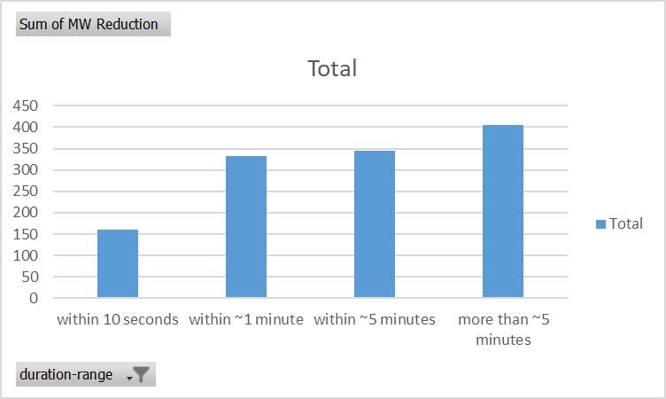
Preliminary Summary of Gen Tripped and Temporary MW Reduction
Units that restored MW within 10 seconds: could be part of low voltage ride through response with slow MW ramping back setting after voltage was recovered. In this event, voltage was back to acceptable range in less than 0.5s.
Units that restored MW within 1~5 minutes: were the inverters “blocked” by the control and returned after voltage was back to acceptable range or a pre-set blocked time like xx minutes? Also, were the inverters back to service automatically or by plant operator? If auto, what was the trigger or system condition to return the inverter back to service and what time delay may be artificially delaying restoration.
Units that restores power more than 5 minutes: were the inverters back to service automatically or by plant operator? If auto, what was the trigger or system condition to return the inverter back to service may be artificially delaying restoration?
?

Slide 6
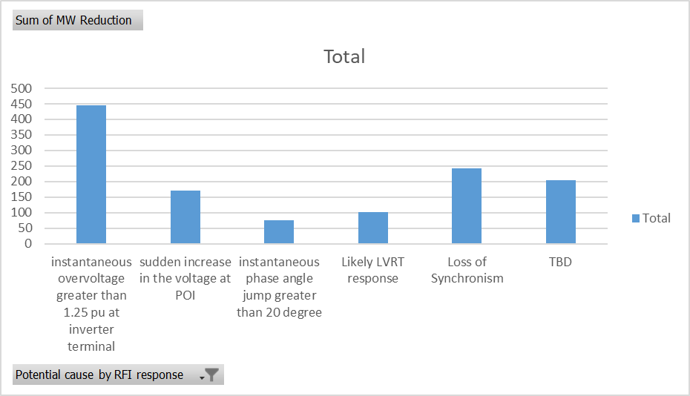
Preliminary Summary of Potential Causes
Based on the initial RFI responses, few potential momentary cessation during fault. Most projects injected more Q and may temporarily reduce P per the typical VRT designed performance
50% of MW tripped/reduction was caused by overvoltage (instantaneous/temporary) after fault was cleared
25% of MW tripped/reduction was caused by loss of synchronism or phase jump exceeded 20 degree
8% of MW tripped/reduction may be considered as slow VRT MW restoration
17% of MW tripped/reduction: unknow, limited initial RFI responses

Slide 7
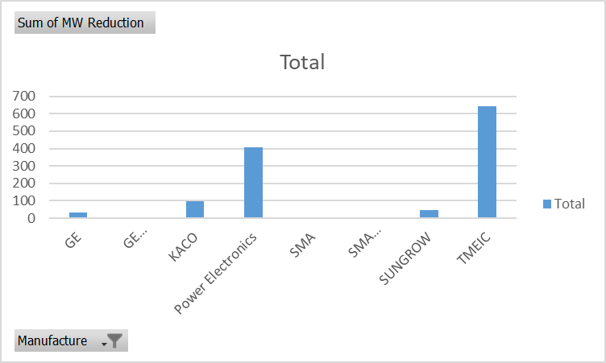
Preliminary Summary of Impacted Manufactures
52% of MW reduction was TMEIC inverter
33% of MW reduction was Power Electronics
15% of MW reduction was other vendors (KACO, GE, SUNGROW)

Slide 8
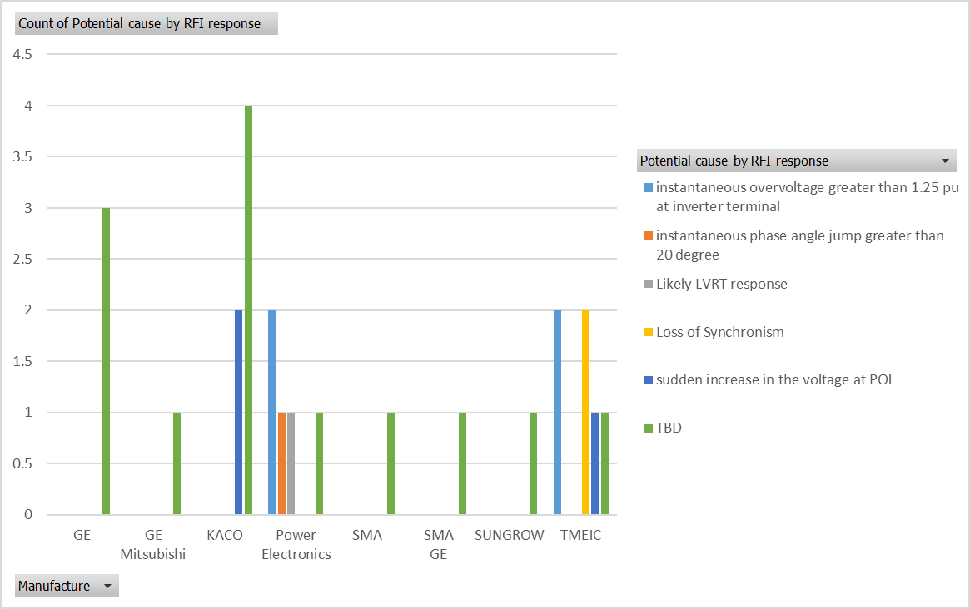
Preliminary Summary of Causes of Impacted Manufactures
* The potential causes were based on RFI responses and are subjected to be updated as needed.

Slide 9
Preliminary review of dynamic models
PSS/e dynamic models: a simplified model representation of an IBR project to assess the system stability in the frequency range from up to 5~10 Hz. Generally, this model is sufficient to assess the typical synchronous gen’s angle stability, oscillation, and system voltage stability.
PSCAD models: a fully detailed or less simplified model representation of an IBR project to assess the system stability that can be caused by high-speed control, such as inverter inner loop control (in µs). Typical issues include subsynchronous resonance, control interaction/instability due to improper coordination and/or weak grids.
IBRs | Generic Model | User-Defined Model (UDM)
Wind | 1 | 2
Solar | 16 | 2
IBRs | Available PSCAD Model* | No PSCAD Model
Wind | 2 | 1
Solar | 15 | 3
* Most available PSCAD models were provided prior to the newly implemented model requirements. May require model quality review and correction by REs/manufactures.

Slide 10
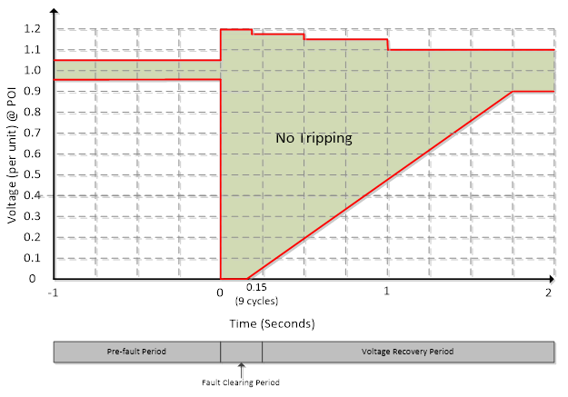
Preliminary review of actual data
6 initial RFI responses included recorded high-resolution data (PMU or fault recorder). All the provided measurements indicated that voltage performance at the recorded point (at or behind the POI) was within the required voltage ride through profile.
Operating Guide requirement
  During operating conditions listed in paragraph (1) above, each Generation Resource shall not, during and following a transient voltage disturbance, cease providing real or reactive power except to the extent needed to provide frequency support or aid in voltage recovery (=> momentary cessation is not allowed)
  VRT Profile

Slide 11
Preliminary Findings
Most projects injecting reactive power to assist voltage recovery during the fault. Some units upon closer review returned to initial MW very quickly.
Mainly solar projects were affected
  Could be due to the lack of understanding and experience of the transmission grid compared to wind developers.
Preliminary issues
  Some solar units set default settings with IEEE 1547 (Distribution System) settings
  One solar unit had an inaccurate Frequency measurement led to frequency trip – may not even need to have frequency protection enabled for IBR
  Some units had voltage ride through protection settings were set to match the PRC-024 curve instead of at their actual equipment limitations.
  Some inverters going into an idle mode with MW reduction with a timer that prevents returning MW to pre-disturbance output.
  Some ramp rate limitations prevent units that reduced MW’s from returning quickly.
  Loss of Synch erroneously tripped
  Some units potentially are driving voltage higher by going to a setpoint calculated at low voltage point after fault before the inverter went to an on hold mode.
  Ride through performance is at POI but settings are based at terminal

Slide 12
Additional Observations
Having DFR/PMU/relay data provided in a comtrade format was very helpful in troubleshooting. SCADA alone was often insufficient to identify the issues.
Some units had significant MW oscillations when frequency drifts just outside of deviation band (potentially too sensitive).
Some units were outside of their voltage tolerance band at the POI.
May be some potential handoff issues between the inverter controllers and the Power Plant Controller (PPC).
Most units were not switching in their shunt devices as their MW output increases (not maintaining reactive capability as losses increase).
One unit had high reactive loading because of lack of Voltage Set Point coordination between it and another unit next to it.
Most generators were very helpful and cooperative.
Having vendor support or subject matter expertise to answer questions or get into the level of detail needed to troubleshoot was also very valuable.
NERC and TRE SME participation has also been very helpful.

Slide 13
Next Steps
ERCOT, TRE, and NERC continuing to meet with the remaining affected units.
ERCOT will be presenting preliminary and or final event summaries with DWG, OWG, PDCWG, and ROS in next couple of months.
ERCOT will be submitting a final NERC Event Analysis report.
NERC is going to be submitting an Event Report with potential recommendations similar to those done in California.
Potential recommendations and or requests from ERCOT
  Follow up with individual units to take the appropriate corrective actions.
  Incorporating additional relevant NERC Alerts and Guidelines recommendations into the ERCOT Interconnection processes and or Protocols/Guides.
    https://www.nerc.com/pa/rrm/ea/1200_MW_Fault_Induced_Solar_Photovoltaic_Resource_/1200_MW_Fault_Induced_Solar_Photovoltaic_Resource_Interruption_Final.pdf
    https://www.nerc.com/pa/rrm/bpsa/Alerts%20DL/NERC_Alert_Loss_of_Solar_Resources_during_Transmission_Disturbance-II_2018.pdf
    https://www.nerc.com/comm/RSTC_Reliability_Guidelines/Inverter-Based_Resource_Performance_Guideline.pdf
    https://www.nerc.com/comm/PC/Pages/Inverter-Based-Resource-Performance-Task-Force.aspx
  Request additional DFR/PMUs or measurements be installed for units that do not currently have one and that have experienced repetitive issues or after major event (e.g. high side of GSU, low side of GSU, at terminal level).
  Clarification, if necessary, of the expectation for units to proactively switch shunts which allows reactive capability to be deliverable to the POI as losses increase.

