Slide 1
Workshop
NPRR1087 Prohibit Participation of Critical Loads and Generation Resource Support Loads as Load Resources or ERS Resources
Sandip Sharma
Mark Patterson
August 19, 2021 Workshop

Slide 2
Antitrust Admonition
To avoid raising concerns about antitrust liability, participants in ERCOT activities should refrain from proposing any action or measure that would exceed ERCOT’s authority under federal or state law. For additional information, stakeholders should consult the Statement of Position on Antitrust Issues for Members of ERCOT Committees, Subcommittees, and Working Groups, which is posted on the ERCOT website.
Disclaimer
All presentations and materials submitted by Market Participants or any other Entity to ERCOT staff for this meeting are received and posted with the acknowledgement that the information will be considered public in accordance with the ERCOT Websites Content Management Operating Procedure.

Slide 3
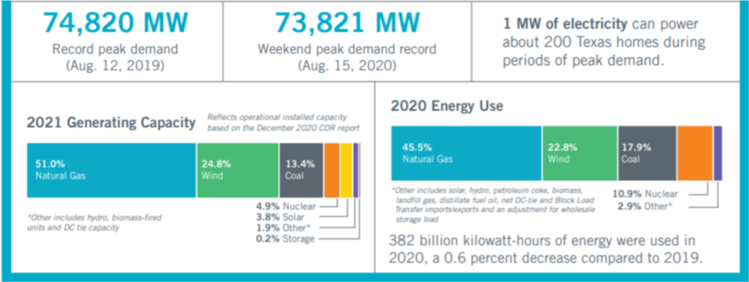
Generating Capacity by Fuel Type

Slide 4
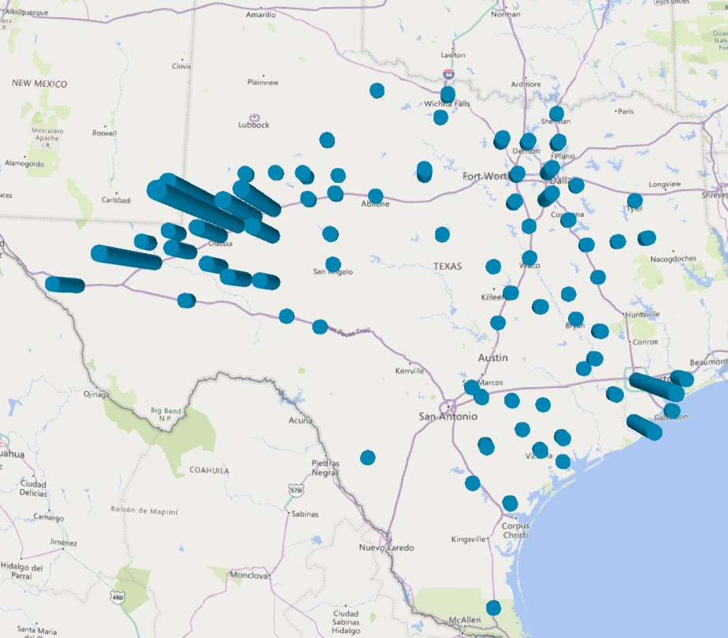
Geographical Distribution of Registered NCLRs by Count Summed by County

Slide 5
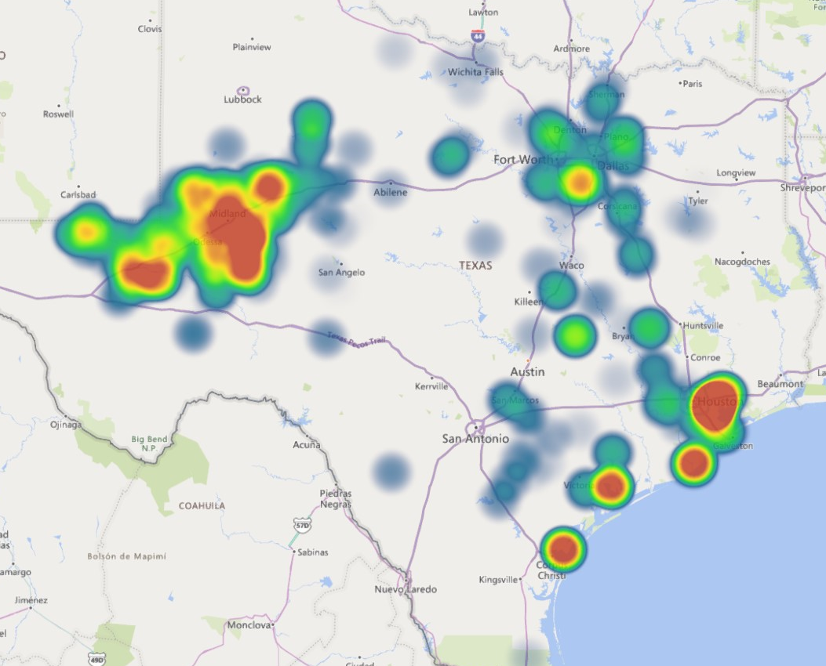
Geographical Distribution of Registered NCLRs by Max Interruptible Load MW Summed by Substation

Slide 6
NPRR 1087
Based on the importance of the natural gas fuel supply to the electric grid, ERCOT submitted NPRR-1087 to prohibit any load that is part of the natural gas supply chain to participate in paid voluntary load curtailment programs
The NPRR also extends the prohibition to other types of loads that are critical to public safety, like hospitals, fire station, water pumping, etc.
ERCOT’s intent with the NPRR was to prohibit critical load participation during the upcoming winter since the mapping of the natural gas supply chain required by SB3 is not expected to be complete before winter 2021/2022
Goal is to have ERCOT BOD and PUCT approval of NPRR 1087 before winter season (Oct. BOD so in place by beginning of the Dec.-Mar. ERS Standard Contract Term)

Slide 7
Observations during the February event
Under the current Protocols, ERCOT’s RRS and ERS procurement processes do not consider whether a Load Resource or ERS Resource may be registered with its utility as a critical load
ERCOT received calls from QSEs requesting permission to allow LRs that had been deployed to return to service.
    Requests applied to more than 100 LRs in the natural gas supply chain
    Other LRs served supporting critical functions (refinery, chemical industry)

Slide 8
ERS
ERS-30 Resources are deployed when ERCOT enters an EEA1 condition while ERS-10 Resources are deployed at EEA2
During the February event, ERS-30 was deployed at 00:18 and ERS-10 was deployed at 01:21.
Non-Weather Sensitive ERS has a maximum deployment time of 8 hours, but if the deployment is still in effect when the maximum deployment time is reached, they must remain deployed for up to an additional 4 hours.
During the February event, most Non-Weather Sensitive ERS Resources reached the 12-hour deployment limit on February 15 shortly after noon, although ERCOT did not recall ERS until the morning of February 19.
ERS Resources (Non-Weather Sensitive ERS)
3.14.3.3(2)&(3)(a)
….An ERS Resource shall be subject to a maximum of eight hours of cumulative deployment obligation time per ERS Contract Period….
….For a Non-Weather-Sensitive ERS Resource, if an ERS deployment is still in effect when the ERS Resource’s cumulative deployment obligation time equals or exceeds eight hours, the ERS Resource must continue to meet its event performance requirements for the next four hours or until ERCOT releases the ERS Resource, whichever comes first.

Slide 9
Load Resources
Non-Controllable Load Resources (NCLR) providing Responsive Reserve Service (RRS) are deployed when ERCOT enters EEA2
Protocols require the NCLRs, once deployed in an emergency condition, to remain deployed until recalled by ERCOT
During February Event:
  NCLRs were deployed at 01:09 on Feb. 15
  Recalled at 09:01 on Feb. 19
  Duration of deployment event: ~ 104 hours
Load Resources providing RRS
6.5.7.6.2.2 Deployment of Responsive Reserve (RRS)
(2)(8) Once RRS is deployed, the QSE’s obligation to deliver RRS remains in effect until specifically instructed by ERCOT to stop providing RRS. However, except in an Emergency Condition, the QSE’s obligation to deliver RRS may not exceed the period for which the service was committed.

Slide 10
Key Summary of February Event RFI
This information is based on responses to the RFIs following the February Event
Separate RFIs went out to each of the QSEs representing LRs or ERS Resources
RFI asked if any of the resources in their portfolios were in the supply chain for Generation Resources
RFI did not ask whether resources were critical loads

Slide 11
NCLRs – Key Summary of February Event RFI
Based on the LR RFI responses following the Winter event:
  Number of LRs in natural gas supply chain: 100
  Number of LRs in natural gas supply chain carrying RRS during event: 63
  Sum of registered capacity from active LRs: 875 MW
  Sum of max RRS responsibility: 206 MW

Slide 12
ERS – Key Summary of February Event RFI
Based on the ERS RFI responses following the Winter event
  Number of ERS Resources in natural gas supply chain: 29
  Number of sites: 78
    1 resource included 27 sites
  Total ERS responsibility for all ERS Resources in natural gas supply chain: 55 MW

Slide 13
ERS Generators/Back-up Generators
In days leading up to the event, ERCOT received notice from some ERS Generators and ERS Loads with backup generators that fuel supplies may be an issue
Post-event RFI responses confirmed there were fuel issues that prevented some from meeting their obligations to ERCOT.
  Issues associated with extreme temperatures preventing startup/operations
  TDSP outages impacting ability to operate/export
  Limited/restricted natural gas service
  Fuel re-supply issues (weather related)

Slide 14
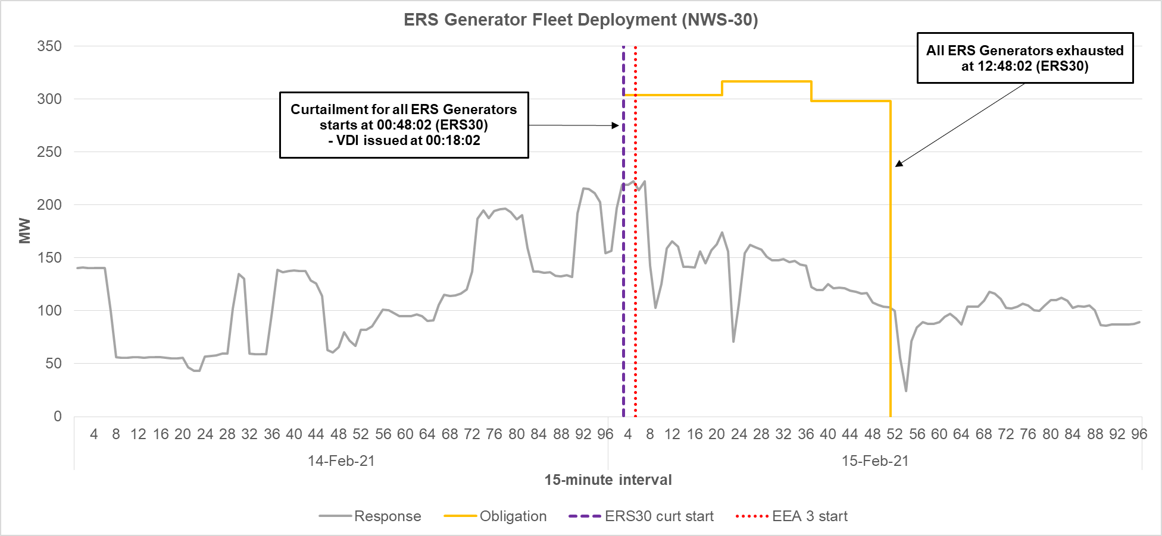
ERS Fleet Performance – Generator Only

Slide 15
ERS Fleet Performance – Generator Only
Activity on February 14, 2021 shows export from ERS Generators prior to the first ERS deployment
In aggregate, ERS Generators generally failed to meet their combined obligation during the Winter Event
  On average, fleet-level ERS Generator exports were 50%-55% below the combined fleet-level obligation during the first 12 hours after the first deployment (prior to exhaustion of the ERS Generator fleet)
  Based on responses to ERCOT RFIs, supply constraints, refueling issues, and forced outages were the primary factors affecting performance
Unlike ERS Loads, ERS Generators experiencing forced outages generally failed to perform relative to their obligations
  Generators are unable to perform (export) for ERS during forced outages
  Even prior to the forced outages, the ERS Generator fleet was only meeting 70%-75% of its combined obligation

Slide 16
Next Steps
PRS consideration at September 16 meeting
Goal is to have ERCOT BOD and PUCT approval of NPRR 1087 before winter season (Oct BOD, so in place by Dec. 1, beginning of the Dec.-Mar. ERS Standard Contract Term)

