Slide 1
Credit Exposure Update
Spoorthy Papudesi
Credit Work Group
ERCOT Public
Aug 18, 2021

Slide 2
Monthly Highlights June 2021 - July 2021
Market-wide average TPE increased from $ 610.6 million in June to $ 704.3 million in July
TPE increased mainly due to higher Forward Adjustment Factors in July compared to June
Discretionary Collateral is defined as Secured Collateral in excess of TPE,CRR Locked ACL and DAM Exposure
Average Discretionary Collateral increased from $1,791.3 million to $2,081.8 million
The increase in Discretionary Collateral is largely due to increase in Secured Collateral.
Short pay entities are excluded from the above calculations to remove data skew
No unusual collateral call activity

Slide 3
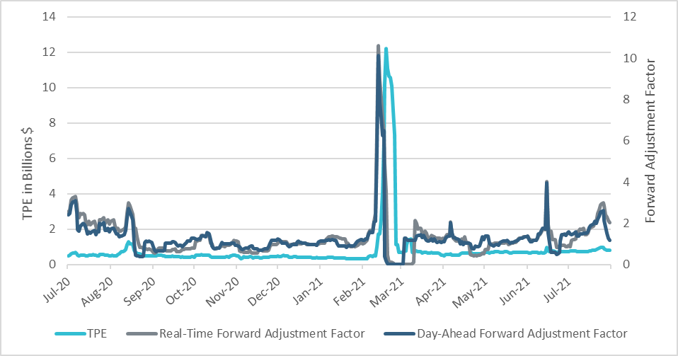
TPE and Forward Adjustment Factors July 2020 - July 2021
*Short pay entities are excluded from the above calculations to remove data skew

Slide 4
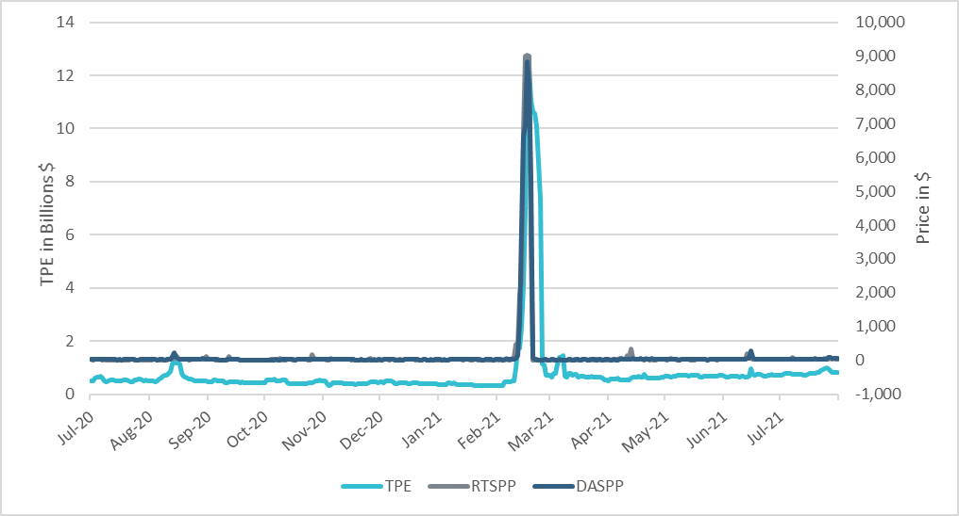
TPE/Real-Time & Day-Ahead Daily Average Settlement Point Prices for HB_NORTH July 2020 - July 2021
*Short pay entities are excluded from the above calculations to remove data skew

Slide 5
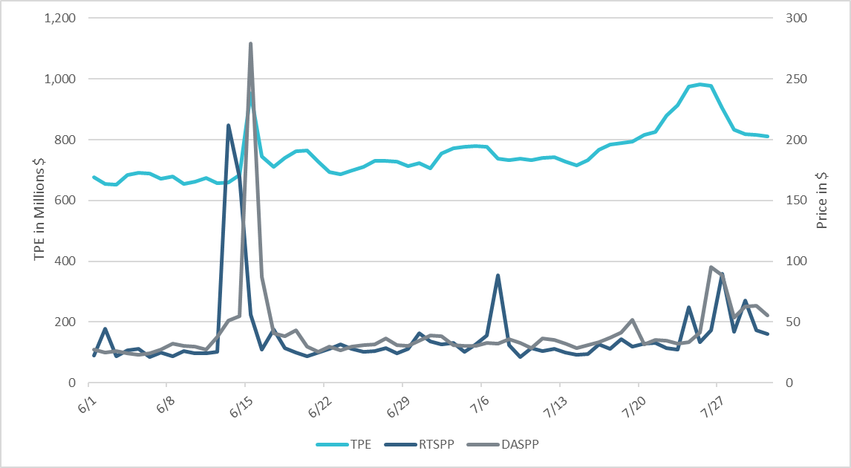
TPE/Real-Time & Day-Ahead Daily Average Settlement Point Prices for HB_NORTH June 2021- July 2021
*Short pay entities are excluded from the above calculations to remove data skew

Slide 6
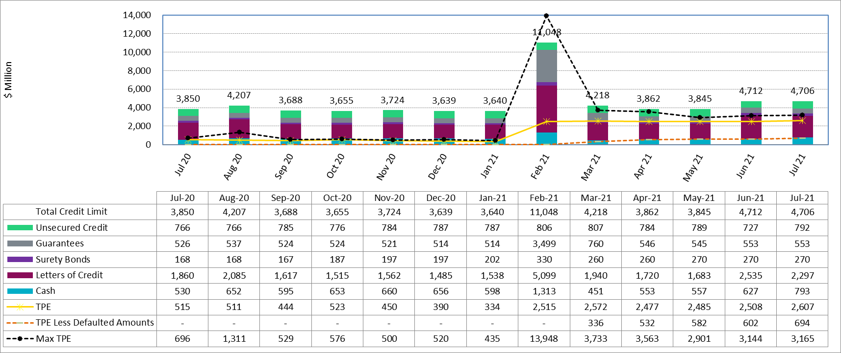
Available Credit by Type Compared to Total Potential Exposure (TPE) July 2020- July 2021
Numbers are as of month-end except for Max TPE
Max TPE is the highest TPE for the corresponding month
TPE less Defaulted Amounts: TPE – Short-Paid Invoices

Slide 7
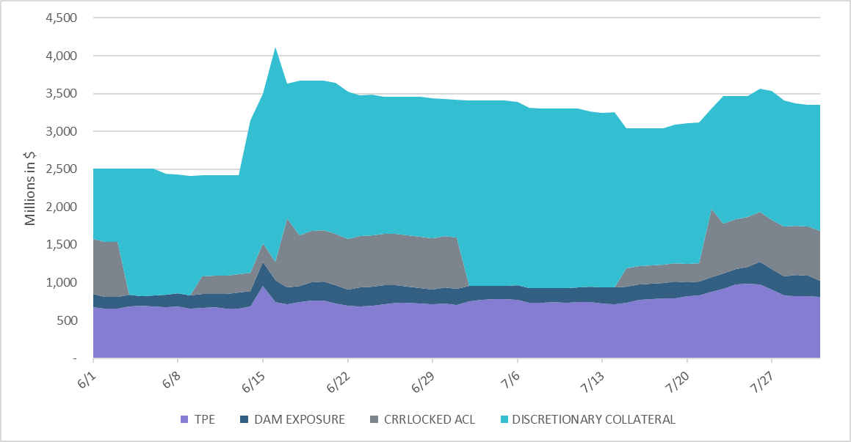
Discretionary Collateral June 2021 - July 2021
*Discretionary collateral doesn’t include Unsecured Credit Limit or parent guarantees
*Short pay entities are excluded from the above calculations to remove data skew

Slide 8
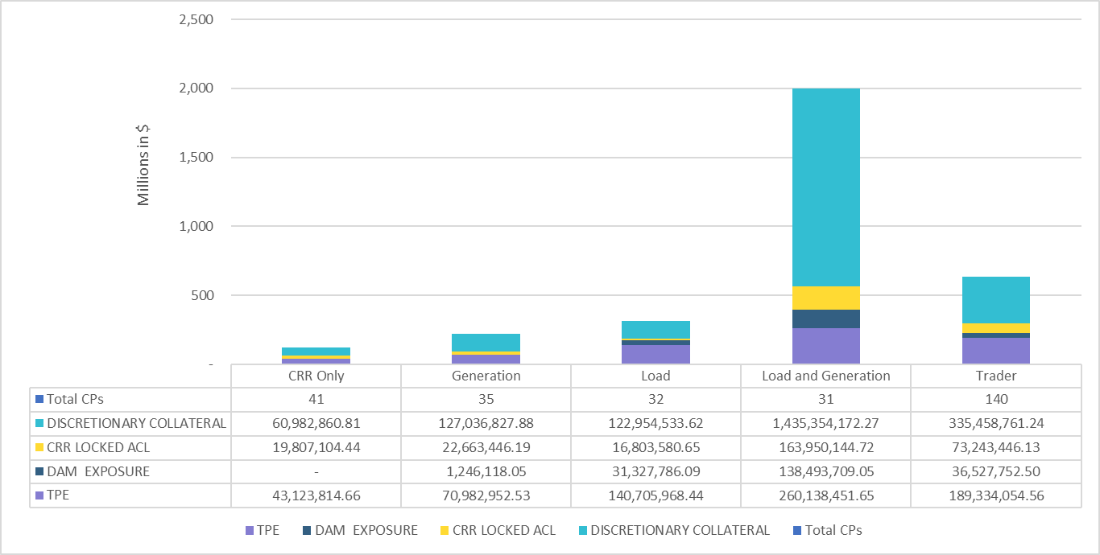
TPE and Discretionary Collateral by Market Segment- July 2021*
Load and Generation entities accounted for the largest portion of discretionary collateral
*Discretionary collateral doesn’t include Unsecured Credit Limit or parent guarantees
*Short pay entities are excluded from the above calculations to remove data skew

Slide 9
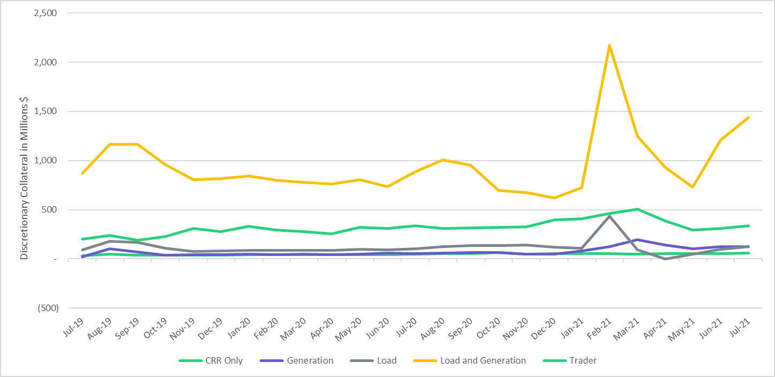
Discretionary Collateral by Market Segment July 2019- July 2021
*Short pay entities are excluded from the above calculations from March 2021 to remove data skew

Slide 10
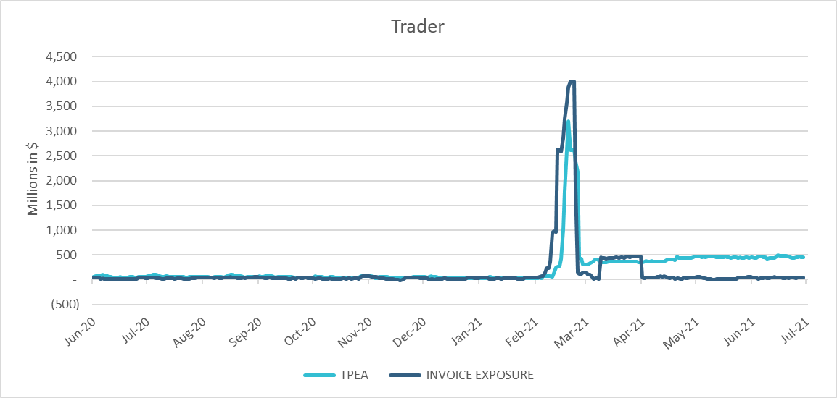
TPE Coverage of Settlements June 2020 – June 2021
*TPEA generally exceeds invoice exposure
*During the 2021 winter event, invoice exposure was slightly higher than TPEA

Slide 11
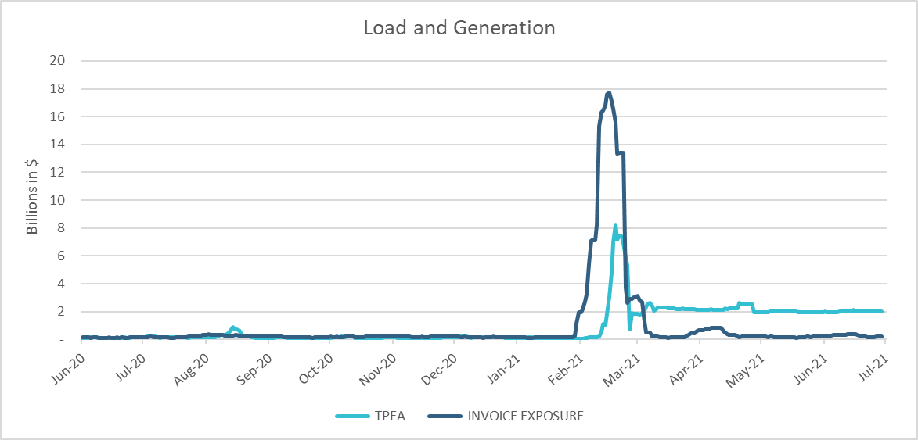
TPE Coverage of Settlements June 2020 – June 2021
*During the 2021 winter event, invoice exposure was higher than TPEA

Slide 12
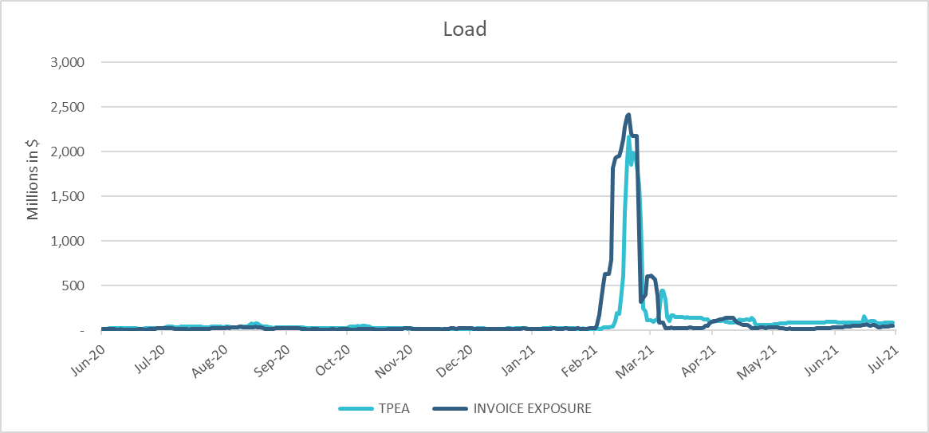
TPE Coverage of Settlements June 2020 – June 2021
*TPEA closely approximates invoice exposure except during the winter 2021 event

Slide 13
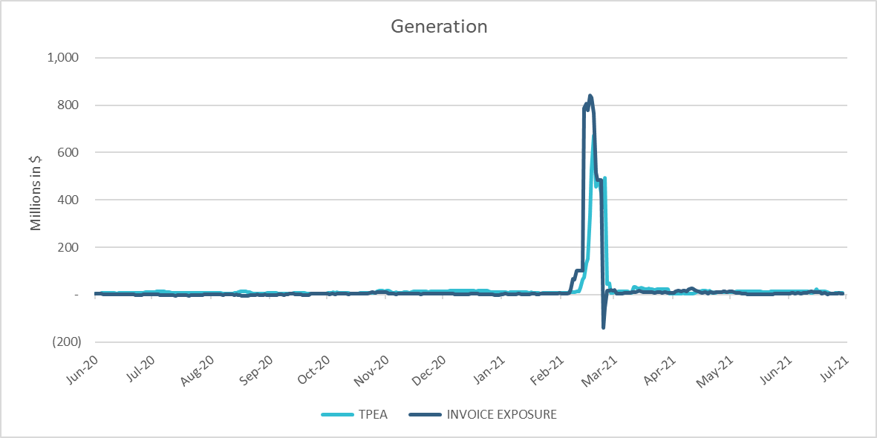
TPE Coverage of Settlements June 2020 – June 2021
*TPEA generally exceeds invoice exposure except during the 2021 winter event

Slide 14
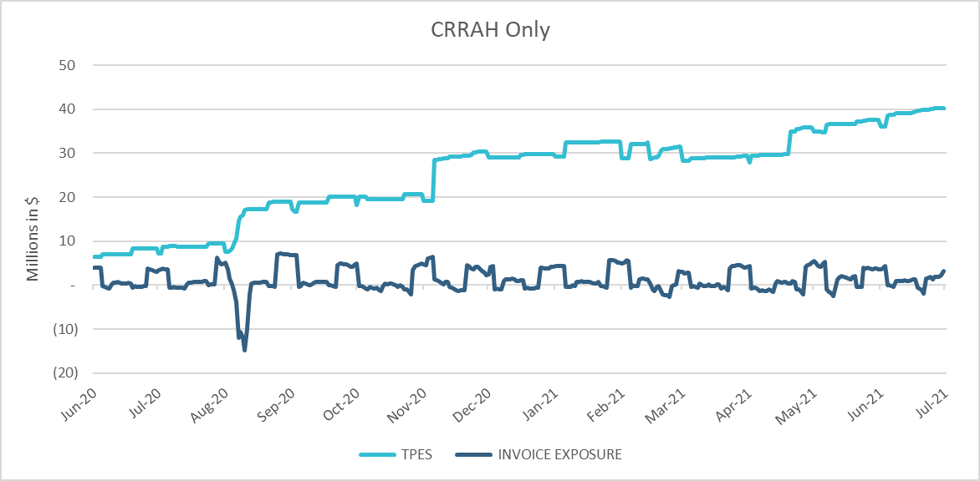
TPE Coverage of Settlements June 2020 – June 2021
*TPES mostly exceeds actual/invoice exposure

Slide 15
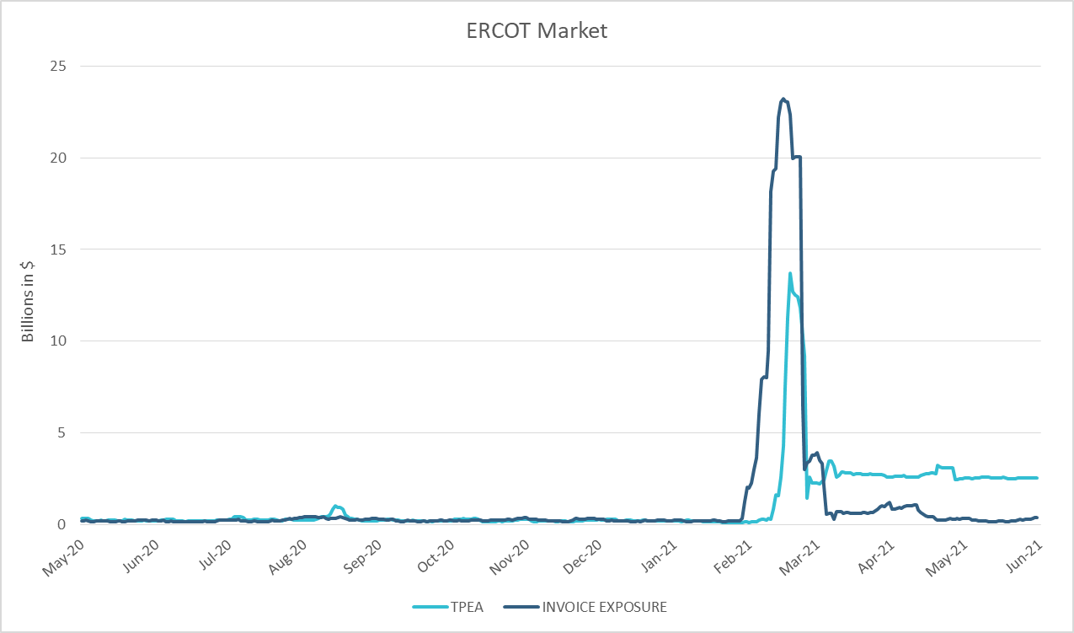
TPE Coverage of Settlements June 2020 – June 2021
*TPEA closely approximates actual/invoice exposure except during the 2021 winter event

Slide 16
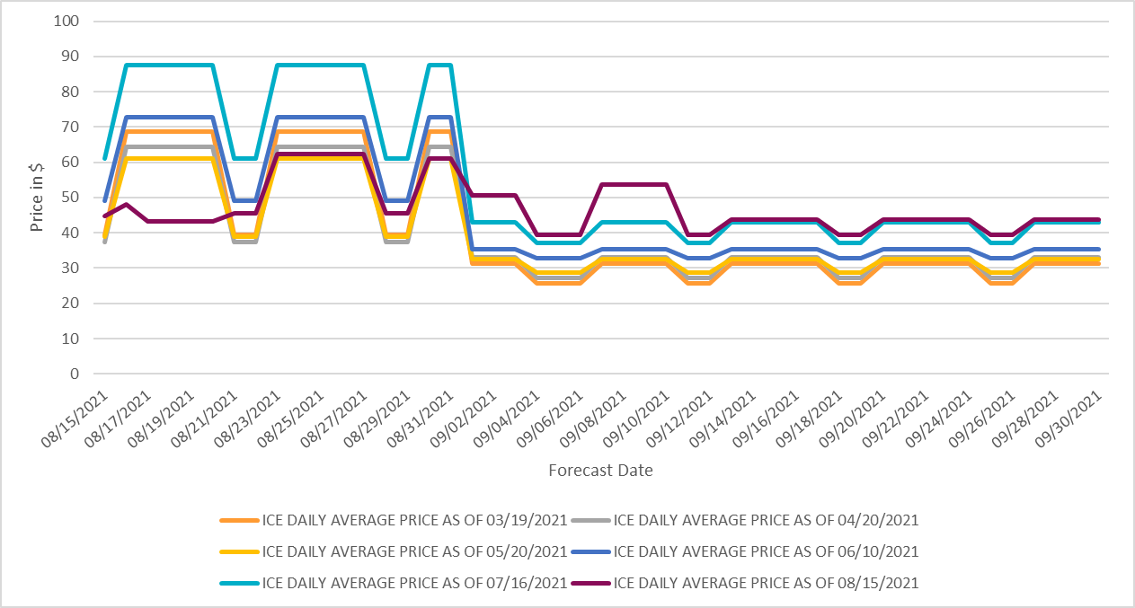
ICE Daily Average Future Prices Aug 2021 - Sep 2021

Slide 17
Appendix

Slide 18
Summary of Distribution by Market Segment*
*Excess collateral doesn’t include Unsecured Credit Limit and is defined as Collateral in excess of TPE
*Short pay entities are excluded from the above calculations to remove data skew

Slide 19
Summary of Distribution by Rating Group*
*Short pay entities are excluded from the above calculations to remove data skew

Slide 20
Distribution of TPE by Rating and Category*
*Short pay entities are excluded from the above calculations to remove data skew

Slide 21
Distribution of Excess Collateral by Rating and Category*
*Excess collateral doesn’t include Unsecured Credit Limit
*Short pay entities are excluded from the above calculations to remove data skew

Slide 22
TPE Coverage of Settlements
TPEA covers Settlement/Invoice exposure and estimated Real-Time and Day- Ahead completed but not settled activity (RTLCNS and UDAA)
The analysis was performed for the period, Jun 2020 - Jun 2021
Only Settlement invoices due to ERCOT are considered in the calculation
M1 values as of May 28th, 2020, were used for the period Feb 2020- May 2020 and M1 values effective as of each day were used since Jun 2020
Example
For business date 2/1/2020, if a Counter-Party has M1 value of 20, then all the charge invoices till 2/21/2020 including RTLCNS and UDAA as of 2/1/2020 is summed up to arrive at “Invoice Exposure”

Slide 23
Questions

