Slide 1
August 2021 NDSWG

Slide 2
ICCP Handbook Review

Slide 3
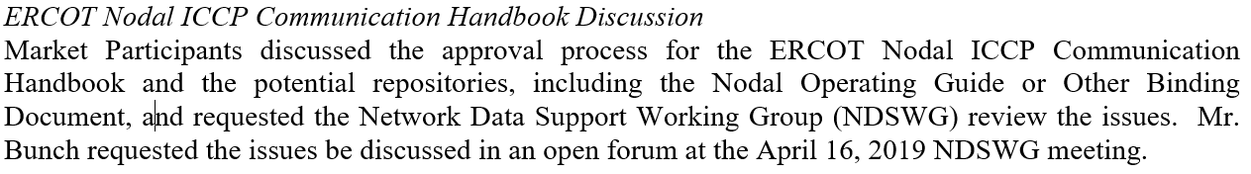
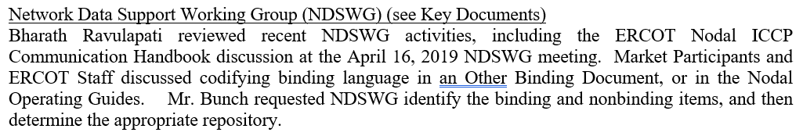
ICCP Handbook Review - Background
At the April and May 2019 ROS meetings, it was requested that NDSWG review the the ICCP Handbook
  Determine what is binding/non-binding
  Determine the proper repository for the binding language
  Update references to ICCP Handbook to new repository
April Notes
May Notes

Slide 4
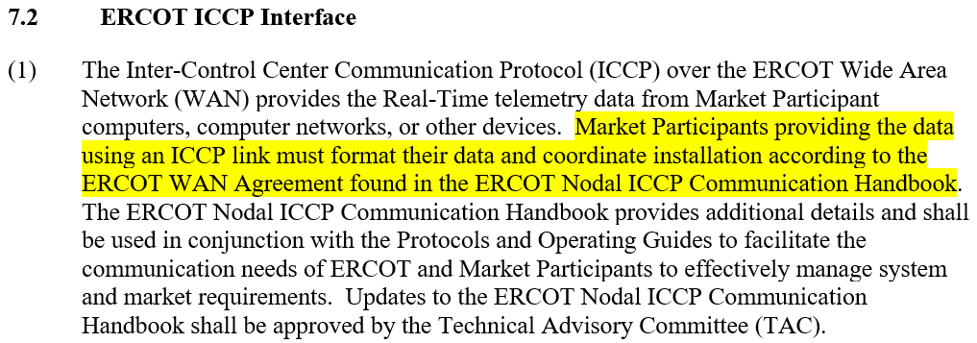
ICCP Handbook Review - Main Issues
ERCOT Nodal ICCP Communication Handbook may have language that should be binding
At least one binding document, the Nodal Operating Guides, refers to the non-binding Handbook in a “binding fashion” (e.g. “must”)
Nodal Operating Guides

Slide 5
Current Attempt – Identify Binding Language in ICCP Handbook
Update references to Handbook to properly reflect that is should be use as a guide
Review Handbook to identify candidate language to add to a new binding document.
Binding
Non-Binding
Binding

Slide 6
ICCP Handbook Review - Schedule
ERCOT proposes a phased review of the ICCP Handbook
Sections 1 and 2 (discuss findings during August NDSWG meeting)
  Equipment, equipment interconnections, connection procedures and physical layer protocols necessary to physically connect a Market Participant’s systems to ERCOT’s systems.
Sections 3 and 4 (discuss in September meeting)
  ICCP parameters, standards, and conventions required for every Market Participant to successfully communicate with ERCOT.
Sections 5, 6, and Appendix (discuss in October meeting)
  ICCP parameters and data exchange requirements for each type of Market Participant (QSE or TSP) to reliably exchange operational data with ERCOT on a day to day basis.
Goal is to identify any language that should become binding/required for ERCOT or MPs.

Slide 7
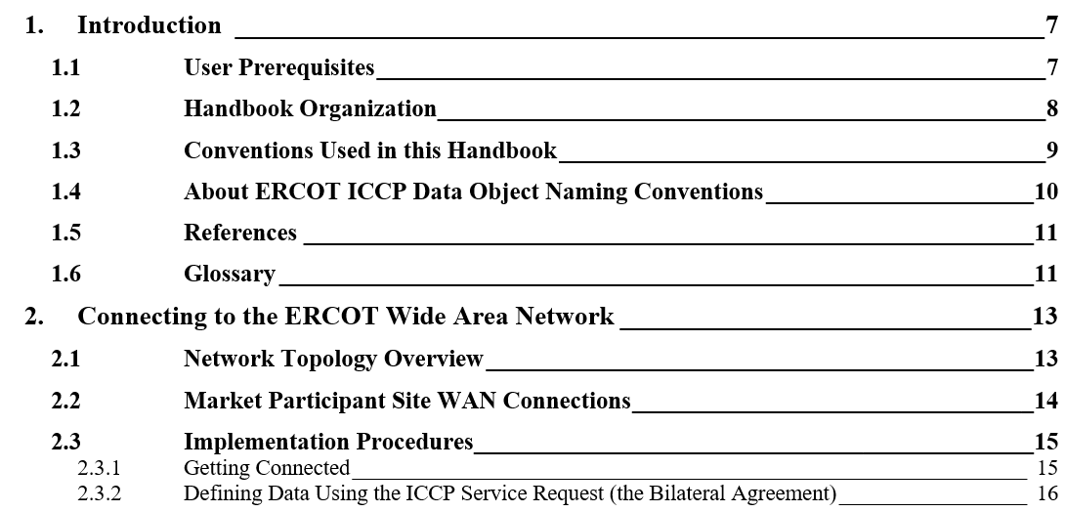
ICCP Handbook Review – ToC Section 1 and 2

Slide 8
ICCP Handbook Review – Next Meeting
ERCOT proposes a phased review of the ICCP Handbook
Sections 1 and 2 (discuss findings during August NDSWG meeting)
  Equipment, equipment interconnections, connection procedures and physical layer protocols necessary to physically connect a Market Participant’s systems to ERCOT’s systems.
Sections 3 and 4 (discuss in September meeting)
  ICCP parameters, standards, and conventions required for every Market Participant to successfully communicate with ERCOT.
Sections 5, 6, and Appendix (discuss in October meeting)
  ICCP parameters and data exchange requirements for each type of Market Participant (QSE or TSP) to reliably exchange operational data with ERCOT on a day to day basis.
Goal is to identify any language that should become binding/required for ERCOT or MPs.

Slide 9
ICCP Handbook Review – ToC Section 1 and 2

Slide 10
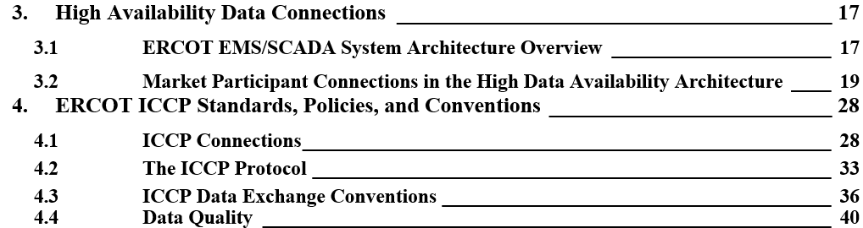
ICCP Handbook Review – ToC Section 3 and 4

Slide 11
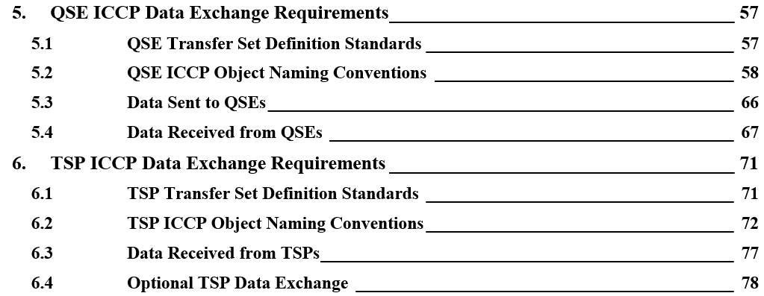
ICCP Handbook Review – ToC Section 5 and 6

Slide 12
Appendix

Slide 13
Attempt #1 – Pull NOG-Referenced Language Into New* Doc
ERCOT’s initial attempt was to pull all sections of the ICCP Handbook referenced by the Nodal Operating Guides into a new binding document.
Binding
Non-Binding
Binding

Slide 14
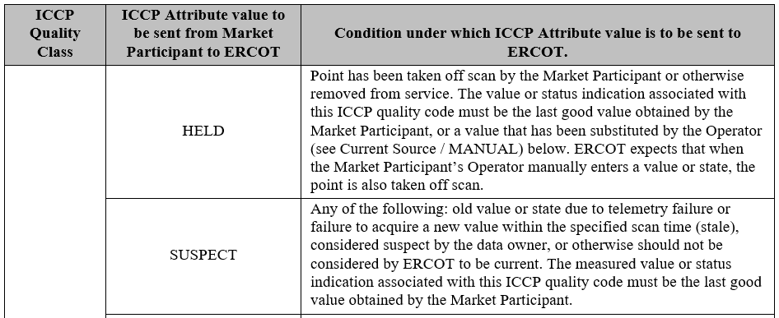
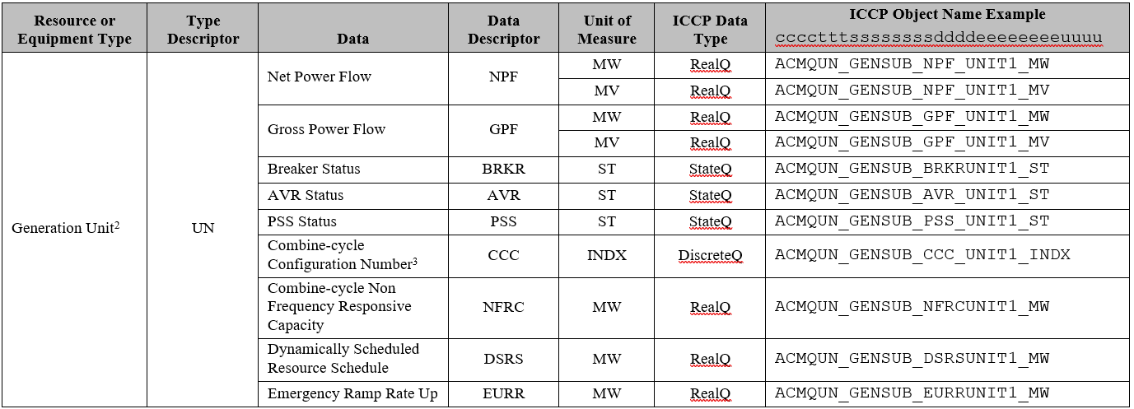
Attempt #1 – Sample ICCP Sections Referenced by NOG
Quality Codes
Not all systems send every quality code
Object name syntax is a suggestion and not a rule
Data Exchange Tables

Slide 15
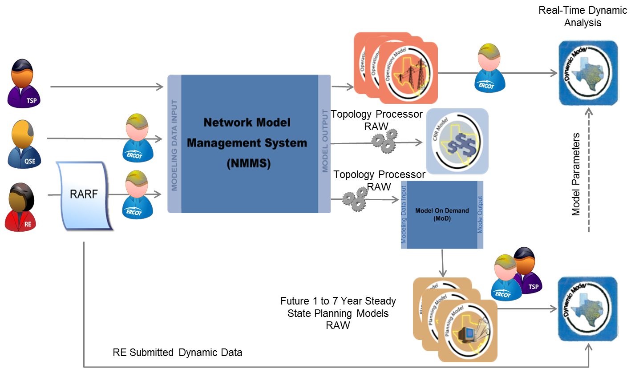
ERCOT Modeling Applications and Processes

