Slide 1
PLWG Extreme Case Group
PLWG Meeting 8/17/2021

Slide 2
Reasons for Extreme Cold Case Development
Non-deliverability is a resource adequacy and transmission planning problem that is not directly addressed by current modeling efforts.
Can we identify generation and transmission facilities that are critical to the operation of the ERCOT System during extreme load and weather events?
We know from transmission system studies that certain generators and transmission lines are more important to maintaining adequate voltage profiles and line flows.
This new planning case or process would help identify load or generation pockets susceptible to correlated generation or transmission failures.
Critical generation facilities could have more stringent winterization requirements and resiliency measures (e.g., on-site fuel supplies).
Generation facilities include all units in a single physical location, or all units served by the same fuel supply (e.g., gas pipeline).
Critical transmission facilities could have requirements that they be hardened against higher wind speeds, more extreme temperatures, or greater ice loadings (for example).

Slide 3
Proposed New Cases / Extreme Events
New Case | Case Description
Extreme cold | Statewide less than 20 degrees Fahrenheit
Extreme heat | Statewide greater than 105 degrees Fahrenheit
Extreme drought | Statewide extended lack of rainfall
Extreme heat and drought | Combination of extreme heat and drought scenarios
Tornadoes | More likely standalone in the North portion of the system
Hurricanes/Tropical Storms | More likely on the coastal side of the system (e.g. Ike, Harvey)

Slide 4
Example of Extreme Cold Case Development
Case could use assumptions that proposed for a very cold winter morning with 0% solar and 10% wind and all available thermal generators dispatched to their maximum.
Load would be not scaled down to match generation.
Do we allow load shed as an option?
Do we assume that new load products are part of the solution?
Study would be a G1N1 or GXN1 analysis, where the GX is a group of generation facilities in the same physical area or with a common failure mode (e.g., gas pipeline).
Houston and Valley Import (e.g., Hurricane Hanna) constraints may be of particular interest in this analysis.

Slide 5
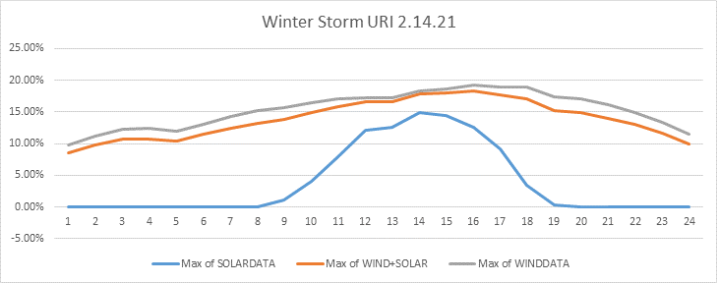
Renewables on 2/14/2021

Slide 6
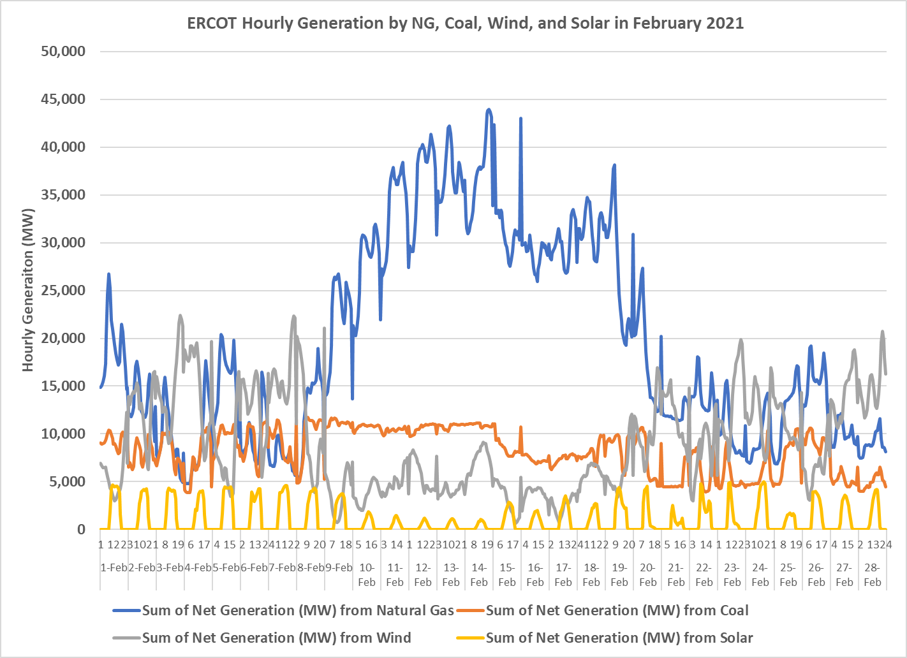
NG, Coal, Wind, and Solar Gen in ERCOT in Feb 2021
Source: EIA 930

Slide 7
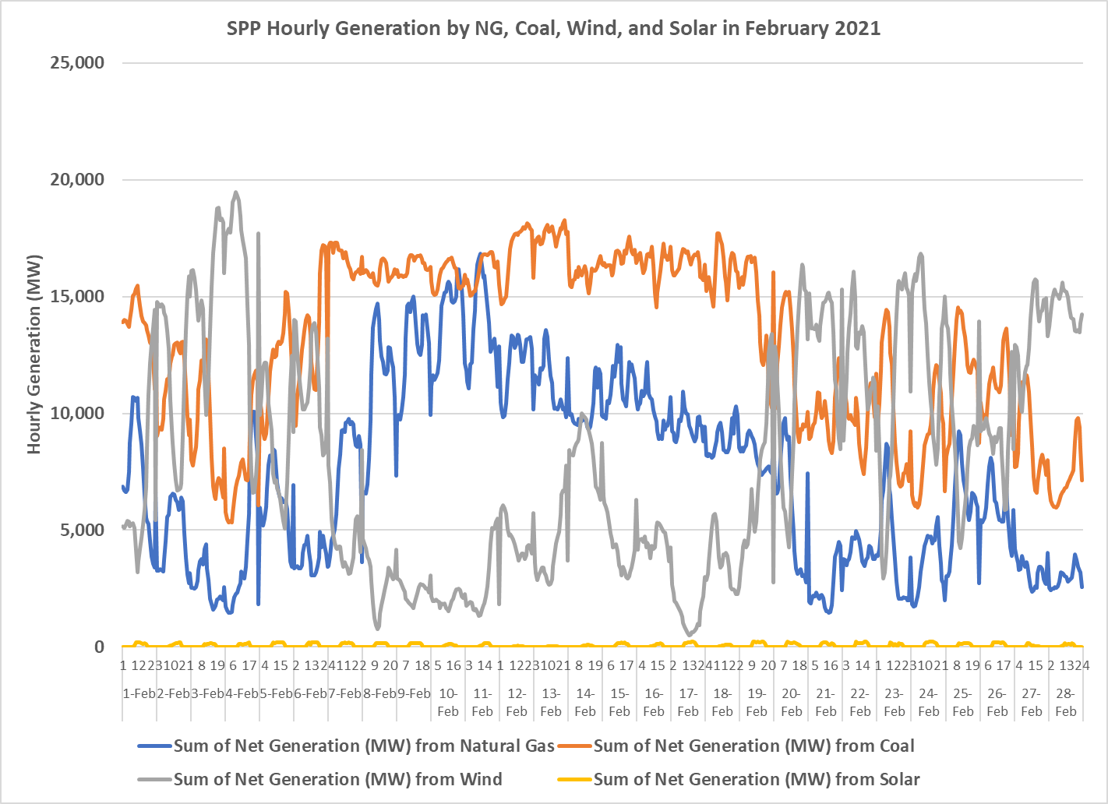
NG, Coal, Wind, and Solar Gen in SPP in Feb 2021
Source: EIA 930

Slide 8
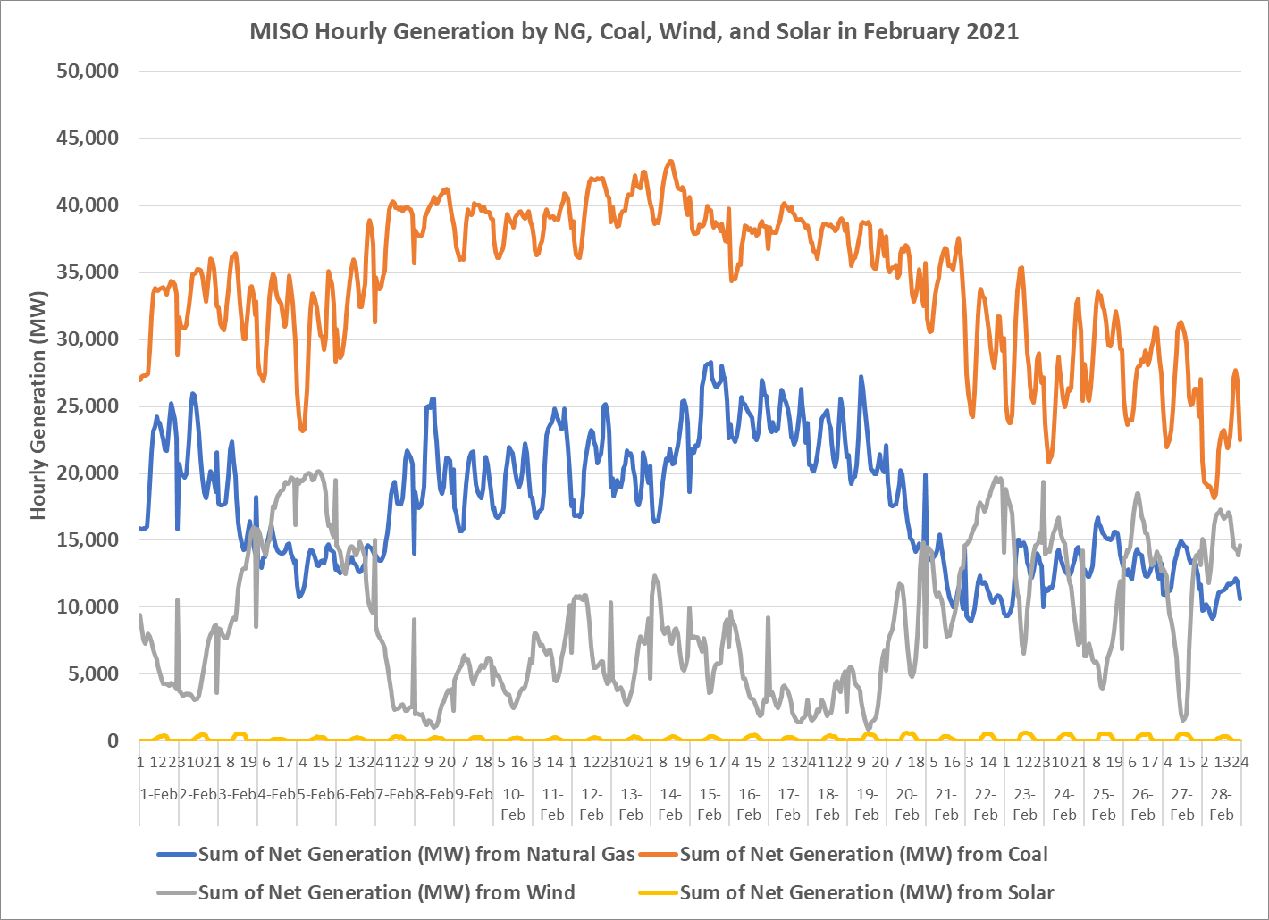
NG, Coal, Wind, and Solar Gen in MISO in Feb 2021
Source: EIA 930

Slide 9
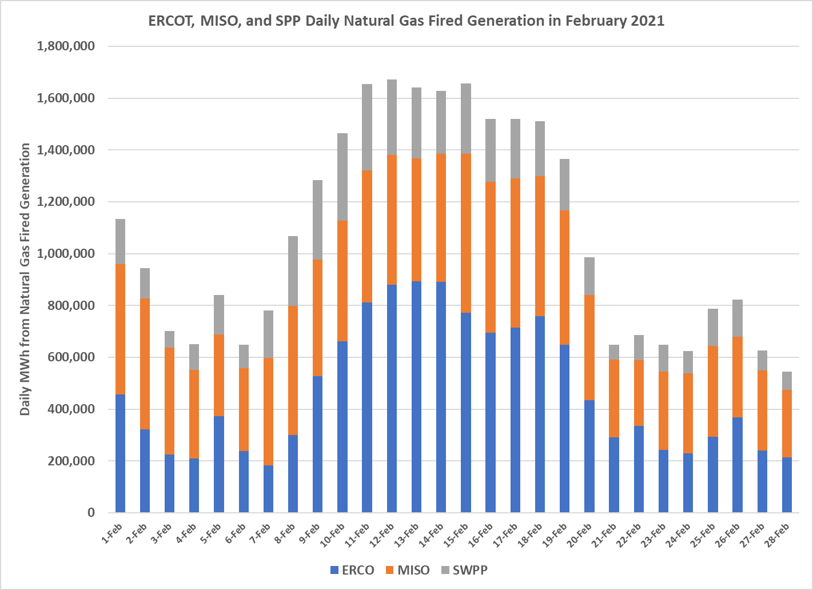
Daily NG Gen in ERCOT, SPP and MISO in Feb 2021
Source: EIA 930

Slide 10
Extreme Winter Case
6 am time period
February 15, 2021 Weather Assumptions
Load would be not scaled down to match generation
Solar generation at 0%
Wind generation at 10%
One study would be a G1N1 or GXN1 analysis, where the GX is a group of generation facilities in the same physical area or with a common failure mode (e.g., gas pipeline)
Another study would be systemwide natural gas fired deration of XX% to be reflective of natural gas system not pressurized appropriately

Slide 11
Other items discussed the group
What duration of events should we be planning?
Identify evidence whether the existing ERCOT market structure is working to handle “extreme” weather scenarios
Does ERCOT have the tools they need?
Additional educational ideas
Many customers and market participants have renewables / zero carbon goals that shouldn’t necessarily be ignored as technology is available for more reliable renewable energy sources, e.g. hydrogen fired generation.

Slide 12
What duration of events should we be planning?
Do we have a “normal” expected duration that we are planning?
Storm Uri in February 2021 could be described as a 96 hour event.
Most events are locational specific (e.g. Harvey) but could also occur over a longer duration.
Most summer time events will occur for less than 4 hours. But could occur longer due to major pipelines being shutdown or extended weather lulls (e.g. low wind, fires could created cloud cover for solar generation).
Is it a small or large event? Can the outages be rotated?

Slide 13
Identify evidence whether the existing ERCOT market structure is working to handle “extreme” weather scenarios
Not a topic of PLWG
Being discussed at PUC Texas currently

Slide 14
Does ERCOT have the tools they need?
Natural gas issues
ERCOT does not currently have natural gas analysis tools from operational to planning to model and understand the natural gas markets
Does ERCOT need these tools?
Building a single ERCOT planning model (not segmented out)
Can such a model be built out and solved?
The answer may include coordinated load shed as the ultimate solution.
Can ERCOT work with the REPs, municipals, cooperatives, and industrials to identify “orderly” load shed?
Not a PLWG issue, but needs to be addressed by some ERCOT group
If not, can we prepare a document identifying how load shed would be accomplished?

Slide 15
Additional education ideas
Invite MISO Gas Electric Coordinator to speak to PLWG
Invite Dr. Sinnott Murphy to present the work that he is doing with NREL regarding temperature-dependent models for generator failures and recoveries.
He wrote a paper that shows that all generator types perform worse in very cold and very hot weather than recognized under current modeling practice.

Slide 16
Next Steps and Outstanding Questions
Develop assumptions for other “Extreme” cases beyond winter
How do these assumptions differ from TPL1-004?
What venues should some of the other topics we discussed?

Slide 17
Appendix

Slide 18
Items from the “Roadmap”
#9 – Improve the assessment and communication of extreme low-probability, high-impact weather scenarios, including temperatures, durations, precipitation, humidity, and wind. Propose updated methodologies for the Seasonal Assessment of Resource Adequacy (SARA) for the ERCOT Region and other resource adequacy studies. This will improve public awareness about the potential high impacts of low-probability severe situations.
#16 – Improve and expand toolsets to manage short-supply situations. This includes facilitating additional voluntary load reductions and procuring additional ancillary or reliability services from resources with unique capabilities to operate during extreme weather conditions.
#18 – Initiate a process, both at ERCOT and the PUC, to address the Lower Rio Grande Valley transmission limitations, up to and including the construction of new transmission capacity. This will provide increased market access for resources in the Valley, improving reliability for customers during both normal conditions and high-risk winter events.
#53 – Improve system planning, including localized and regional significant growth patterns. This will improve the range of conditions considered in planning studies.
#57 – Consider on-site fuel supply including contracts with remote secured supplies.

Slide 19
Members
John Bernecker (ERCOT)
Doug Evans (STEC)
Andrew Hamann (LCRA)
Kevin Hanson (National Grid)
Brian Hithersay (BEPC)
Lori Simpson (Exelon)
Mina Turner (AEP)
Monica Walker (GM)

