Slide 1
Feb 2021 Winter Event
TAC #30 Under Frequency Protection Data RARF Survey
TAC #44 Ancillary Service Deployments Feb 14 evening
TAC #91 Role of FFR
ERCOT Staff
August 11, 2021
PDCWG

Slide 2
TAC #30
Under frequency Protection Data for Generation Resources

Slide 3
Nodal Operating Guide 2.6.2 – Under Frequency Relays for Generators
If under-frequency relays are installed and activated to trip the unit, these relays shall be set such that the automatic removal of individual Generation Resources from the ERCOT System meets the following requirements:
Aligned with NERC PRC-024-2 Standard.
Frequency Range | Delay to Trip
Above 59.4 Hz | No automatic tripping (Continuous operation)
Above 58.4 Hz up to And including 59.4 Hz | Not less than 9 minutes
Above 58.0 Hz up to And including 58.4 Hz | Not less than 30 seconds
Above 57.5 Hz up to And including 58.0 Hz | Not less than 2 seconds
57.5 Hz or below | No time delay required

Slide 4
Capacity breakdown between conventional resources and IBR’s that have under frequency relay set between 58.4 Hz to 59.4 Hz for 9 minutes
 | Conventional Resources |  | IBR’s |  | Total
Frequency (Hz) | Capacity (MW) | Unit Count | Capacity (MW) | Unit Count | Capacity (MW) | Unit Count
59.4 | 18198 | 76 | 5812 | 52 | 24010 | 128
59.3 | 398 | 2 | 35 | 2 | 433 | 4
59.2 | 0 | 0 | 372 | 3 | 372 | 3
59.1 | 400 | 1 | 0 | 0 | 400 | 1
59 | 102 | 1 | 1430 | 10 | 1532 | 11
58.8 | 0 | 0 | 16 | 2 | 16 | 2
58.5 | 608 | 2 | 1040 | 28 | 1648 | 30
58.4 | 150 | 2 | 0 | 0 | 150 | 2
Total | 19856 | 84 | 8705 | 97 | 28561 | 181
Total capacity and unit count in different buckets of unit capacity for conventional resources with UF relay setting 59.4 Hz for 9 minutes
Unit Capacity Range (MW) | Total Capacity in this range(MW) | Unit Count
0 to 300 | 6735 | 56
300 to 500 | 4230 | 11
500 to 800 | 1798 | 3
800 to 1000 | 5435 | 6

Slide 5
Capacity breakdown between conventional resources and IBR’s that were online on 2/15/21 when frequency fell below 59.4 Hz and have under frequency relay set at 59.4 Hz for 9 minutes
 | Conventional Resources | IBR’s | Total
Capacity | 15442 | 1560 | 17002
Unit Count | 54 | 12 | 66
Total capacity & unit count in different buckets of unit capacity AND breakdown by resource category for conventional resources with UF relay setting 59.4 Hz for 9 minutes
Unit Capacity Range (MW) | Total Capacity in this range(MW) | Unit Count
0 to 300 | 5160 | 37
300 to 500 | 3050 | 8
500 to 800 | 1798 | 3
800 to 1000 | 5434 | 6
Resource Category | Capacity (MW) | Unit Count
Coal and Lignite | 7904 | 12
Gas Steam | 2209 | 10
Combined Cycle GT | 2768 | 17
Combined Cycle ST | 2038 | 9
Simple Cycle <= 90 MW | 331 | 5
Simple Cycle > 90 MW | 192 | 1

Slide 6
Capacity breakdown between conventional resources and IBR’s that were online on 2/15/21 when frequency fell below 59.4 Hz and have under frequency relay set between 58.4 Hz and 59.4 Hz for 9 minutes
 | Conventional Resources | IBR’s | Total
Capacity | 16900 | 1630 | 18530
Unit Count | 61 | 19 | 80

Slide 7
TAC #44
AS Deployment Prior to 2/15 Low Frequency event

Slide 8
Cold Weather 2/14-2/15 Midnight

Slide 9
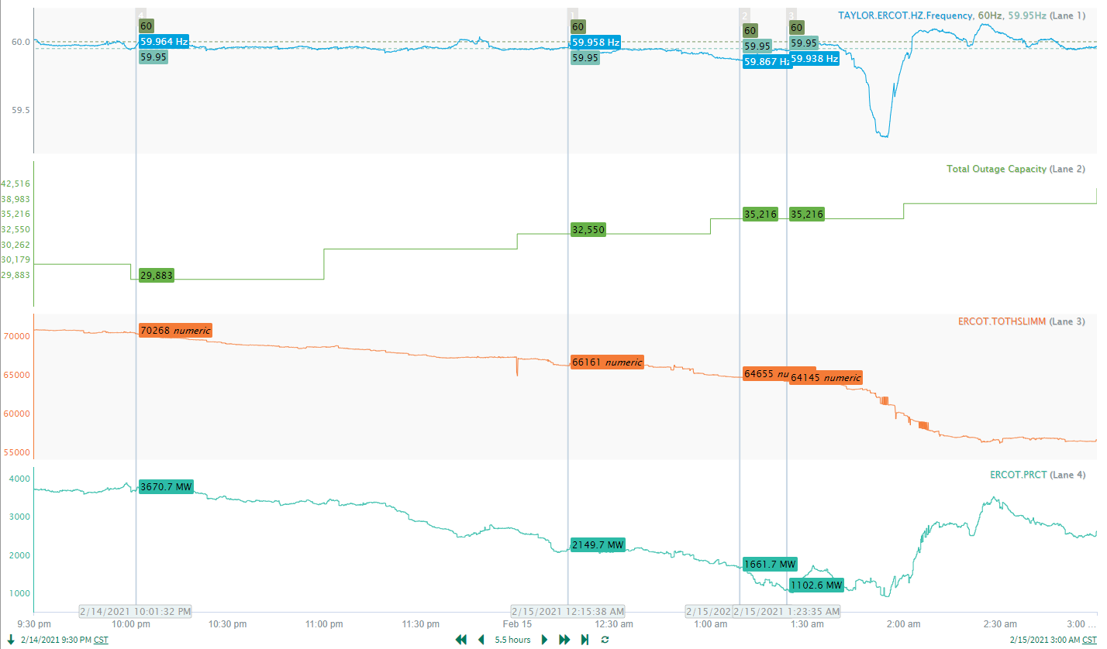
Pre-Event System Condition
Frequency
EEA1
EEA2
EEA3
Total Outage Capacity
Total HSL
Total PRC

Slide 10
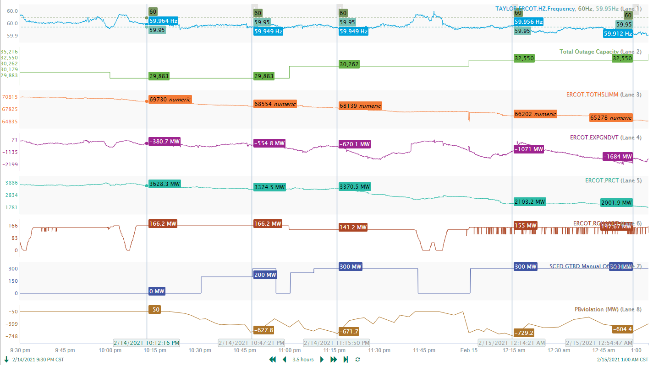
Regulation and SCED Manual Offset
Frequency
Total Outage Capacity
Total HSL
Total Expected Gen Dev
Total PRC
Reg-Up exhausted
Reg-Up Deployment
SCED Offset to try and recover reg-up
SCED Offset
SCED Power Balance Violation

Slide 11
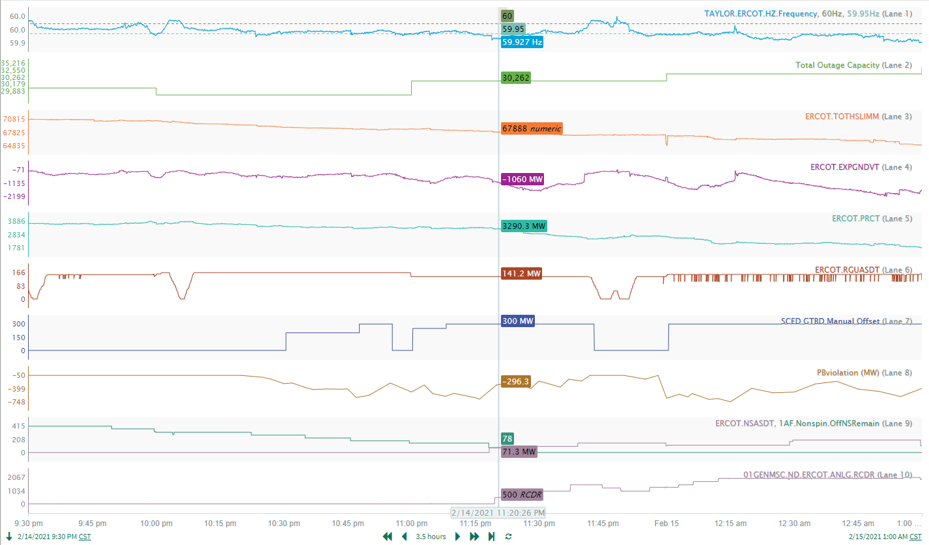
RRS and Non-Spin
Frequency
Total Outage Capacity
Total HSL
Total Expected Gen Dev
Total PRC
Reg-Up Deployment
SCED Offset
SCED Power Balance Violation
Non-spin Deployment
Offline Non-Spin Deployed
RRS Deployment
RRS Deployed

Slide 12
TAC #91
Role of Fast Frequency Response

Slide 13
TAC Item 91 - Could fast frequency response play a bigger role?
Excerpts from the Draft Recommendation
The February storm was an issue of total sustained generation not being able to meet the load requirements. To that point, ANY additional generation, generation provided AS, or load provided AS could have played a bigger role. However, FFR would’ve likely provided some benefit even for the relatively slow drop in frequency on 2/15/21 at around 01:45. FFR product is designed to arrest frequency during drastic drop in frequency and thus provide critical reliability support. Current FFR market design, where FFR is prorated with LR-RRS, makes the provision of FFR financially unattractive compared with PFR-RRS. ESRs providing FFR has the added benefit of lowering Critical Inertia. With ERCOT now procuring additional RRS, now is the time to ensure that disincentives to providing the critically important FFR service are removed. This goal can be very easily achieved by the following:
Set offer floor for all RRS offers, except FFR offers, at $0.01/MW/hr. This can be immediately implemented as a behavioral rule and thus have no system impact. The implication of this simple change is to fully award FFR offered at $0/MW/hr up to 450MW while paying the same RRS MCPC for awarded FFR. When FFR offers exceed 450MW, then FFR awards would again be prorated.
Trigger FFR deployment on RoCoF trigger rather than the current frequency trigger. Since this change would make FFR even more valuable to grid reliability, item 1 needs to be pursued urgently to make FFR a financially viable alternative for ESRs to provide.
Examine whether the 59.98Hz restriction on recharging needs modification.
PDCWG’s question - does ERCOT recommend displacing RRS-LR/UFR with RRS-FFR? If so, what is the limit?

Slide 14
Discussion Outline
FFR vs. UFR
Benefits of having FFR
Limit on FFR
Inertia Trends

Slide 15
Introduction to Responsive Reserve Service
RRS is an Ancillary Service that provides operating reserves that is intended to:
Arrest frequency decay within the first few seconds of a significant frequency deviation on the ERCOT Transmission Grid using Primary Frequency Response and interruptible Load;
After the first few seconds of a significant frequency deviation, help restore frequency to its scheduled value to return the system to normal;
Provide energy or continued Load interruption during the implementation of the Energy Emergency Alert (EEA); and
Provide backup regulation.
RRS may be provided by,
Resources providing Primary Frequency Response (RRS-PFR) (ex. Gen Resources, Energy Storage Resources, Controllable Load Resources, Generation Resources operating in synchronous condenser fast-response mode)
Resource providing Fast Frequency Response (RRS-FFR)
Load Resources controlled by high-set under-frequency relays (RRS-UFR)

Slide 16
What is Fast Frequency Response (FFR)?
Fast Frequency Response (FFR)
The automatic self-deployment and provision by a Resource of their obligated response within 15 cycles after frequency meets or drops below a preset threshold, or a deployment in response to an ERCOT Verbal Dispatch Instruction (VDI) within 10 minutes. Resources capable of automatically self-deploying and providing their full Ancillary Service Resource Responsibility within 15 cycles after frequency meets or drops below a preset threshold and sustaining that full response for at least 15 minutes may provide Responsive Reserve (RRS).
Notes:
Verify against current Section 2.1 FFR- done

Slide 17
RRS-FFR vs RRS-PFR – Trigger Frequency
Resource providing FFR
Load Resource providing RRS
support frequency at 59.85 Hz.
support frequency at 59.7 Hz.
Notes:
Update from spreadsheet.- done

Slide 18
RRS-FFR vs RRS-PFR – Response Time
Resource providing FFR
Load Resource providing RRS
provide full response within 15 cycles after frequency is at/below frequency threshold.
15 cycles includes delay time of under-frequency relay and breaker operation time.
respond within 30 cycles after frequency is at/below frequency threshold.
30 cycles includes delay time of under-frequency relay and breaker operation time.

Slide 19
RRS-FFR vs RRS-PFR – Max Response Duration
Resource providing FFR
Load Resource providing RRS
sustain full response for 15 minutes or till ERCOT recalls deployment, whichever occurs first.
sustain response till deployment is recalled.
Notes:
Update from spreadsheet -done

Slide 20
RRS-FFR vs RRS-PFR – RRS Restoration Time
Resource providing FFR
Load Resource providing RRS
will restore and become available for next event within 15 minutes after deployment ends.
after deployment ends, are only be allowed to withdraw energy from the grid when Physical Responsive Capability (PRC) is above 2,500 MW and frequency has recovered to 60 Hz, unless ordered to do so by ERCOT.
may take up to 3 hours to reset after deployment ends.

Slide 21
RRS-FFR vs RRS-PFR – Manual Deployment
Resource providing FFR
Load Resource providing RRS
can be deployed via Verbal Dispatch instructions during EEAs.
upon such deployment, are obligated to sustain response for 15 minutes or till ERCOT recalls deployment, whichever occurs first.
after deployment ends, will only be allowed to withdraw energy from the grid when Physical Responsive Capability (PRC) is above 2,500 MW and frequency has recovered to 60 Hz, unless ordered to do so by ERCOT.
can be deployed similarly during EEAs as well.
upon such deployment, are obligated to sustain response till the deployment is recalled.
Notes:
Go into the Op Guide (protocol) and check this.
A Resource providing FFR may withdraw energy from the grid only after the frequency has recovered to 60 Hz and Physical Responsive Capability (PRC) is above 2,500 MW, unless ordered to do so by ERCOT. – Operating guide : 2.3.1.2 (10)
The amount of RRS provided from a Resource capable of providing Fast Frequency Response (FFR) must be less than or equal to its 15-minute rated capacity. The initiation setting of the automatic self-deployment of the Resource providing RRS as FFR must be no lower than 59.85 Hz. A Resource providing RRS as FFR that is deployed shall not recall its capacity until system frequency is greater than 59.98 Hz. – Protocol 3.18 (3)

Slide 22
What are the benefits of having FFR?
Early response from FFR aids in preserving Load Resource providing RRS for more severe events.
With 59.85 Hz or higher frequency trigger, FFR will deploy more often than Load Resources in response to frequency events;
With Resources providing FFR, most frequency events will not trigger Load Resources deployment.
Thus preserving frequency response capabilities from Load Resources to be available for (the next) severe event.
Short restoration time for resources providing FFR will limit ERCOT’s exposure (i.e. inability to respond) to next event of similar magnitude.
Upon recall of deployment, Resources providing FFR will reset and become available to respond to another event within 15 minutes.
If a frequency event triggers deployment of RRS from Load Resources, for a 3 hour duration following such an event, ERCOT may not have adequate frequency responsive resources to respond to a large trip (~2700 MW trip).
This is because Load Resources providing RRS after a deployment have 3 hours to reset and become available to respond to another event.
Notes:
Now let’s switch gears and talk about the benefits of having FFR.
First. With early response from FFR at 59.85 Hz, most frequency events will not trigger Load Resource deployment and thus aid in preserving these for a more severe event.
Second. The short restoration time of 15 minutes for Resources providing FFR will limit ERCOT’s exposure to next event of similar magnitude. Load Resource providing RRS have 3 hours to reset. If a frequency event triggers deployment of RRS from Load Resources, for a 3 hour duration following such an event, ERCOT’s ability to respond to a large frequency event may be limited.

Slide 23
What are the benefits of having FFR?
FFR can help mitigate Critical Inertia and facilitate further increased penetration levels of Inverter Based Resources in ERCOT.
PFR minimum:1150 MW 1420 MW
RCC : 2750 MW 2805 MW
FFR’s Impact

Slide 24
What are the benefits of having FFR?
FFR can help improve system frequency response and may reduce overall RRS quantities.
By replacing 460 MW of LR with FFR, frequency nadir is improved by 26 mHz (dark blue trend).
Total RRS requirement for 130 GWs inertia condition is reduced by 140 MW with 460 MW FFR available in the system (green trend).
Notes:
Update this.

Slide 25
FFR Limit Determination
370 MW Generation Loss
Notes:
Update this.

Slide 26
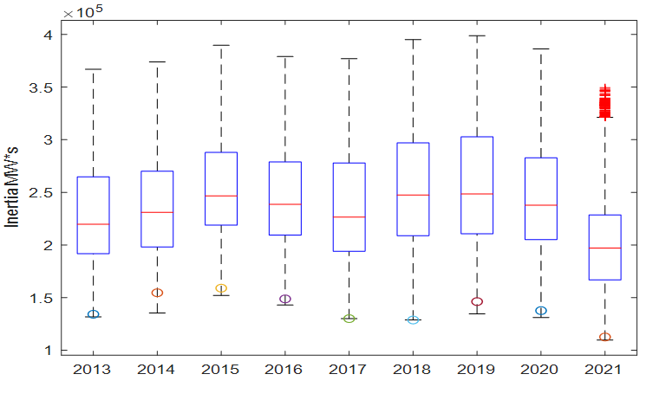
Declining System Inertia
On March 22, 2021 ERCOT inertia was at its lowest of 109 GW.s.
Note that, in ERCOT’s validation of the cases from this time, certain inconsistencies were identified in inertia value between DWG cases and ERCOT’s Network Model. These inconsistencies are primarily due to an ongoing effort to improve DWG models since 2019. As a result of these changes, inertia from at the time of the lowest value would have been around 116 GW.s.

Slide 27
Number of hours with low inertia in March
In March 2021 overall inertia on the system was lower than at same time in years prior. This was largely due to a lower net load (driven by milder temperatures, more wind and thermal resource outages) during the month in comparison to same time in years prior.
Note that given the inconsistencies in inertia data, the number of hours for 2021 in the table above is potentially lower than the value computed using raw inertia data.
 | March
 | 2018 | 2019 | 2020 | 2021
Number of hours with <120 GWs | 0 | 0 | 0 | 15
Number of hours with <128 GWs | 0 | 0 | 0 | 71

Slide 28
Total Inertia in March 2018-2021

Slide 29
Net-Load in March 2018 - 2021

Slide 30
Load in March 2018 - 2021

Slide 31
Wind in March 2018 - 2021

Slide 32
Conventional Resource Outage Capacity Mar-May

Slide 33
Summary & Conclusion
There are benefits to having FFR. There continues to be a need to enforce a limit on the total amount of RRS that can come from FFR.
To date less than 125 MW of ESRs are qualified to provide FFR, no FFR has been provided in Real Time.
FFR Advancement project will bring about system changes that will make it easier for ESRs to provide FFR. ESRs will be able to qualify to provide higher quantities of FFR.
There is a decline in the minimum inertia levels that the grid has operated at. With increases in installed IRR capacity and the right weather conditions, it is possible for ERCOT’s minimum inertia to decline further.
Market designs that incent more FFR to be available in Real Time may help widen ERCOT’s Critical Inertia if more Resources qualify to provide FFR and carry it consistently in Real Time. Approaches that aid this need the further Stakeholder discussion.

