Slide 1
Improving Efficient Control of IRRs to Manage GTC Stability Limits
ERCOT
August 16, 2021

Slide 2
Agenda
Introduction
  Generic Transmission Constraint (GTC) Overview
  Current Method of Managing GTC Flow
Proposed Solution: Not-To-Exceed Method
  Benefits
  Implementation
  Other Considerations
Summary and Next Steps

Slide 3
GTC Background
Generic Transmission Constraints (GTCs): A transmission constraint made up of one or more grouped Transmission Elements that is used to constrain flow between geographic areas of ERCOT for the purpose of managing stability, voltage, and other constraints that cannot otherwise be modeled directly in ERCOT’s powerflow and contingency analysis applications.
Each GTC is designed so that the appropriate Resources are controlled (as a result of the GTC) to protect against the stability phenomenon
  Some GTCs have a closed interface (where all Resources behind the interface have a similar affect on the stability phenomenon) while others are an open interface (where different Resources have a different impact on the stability phenomenon）
From GTC limit management perspective, a margin is desirable to be maintained so as to accommodate unaccounted factors when determining GTC limit, which include, but not limited to deviations from base points
  For those GTCs designated as IROLs (Interconnection Reliability Operating Limits), a tighter control is needed to avoid IROL Exceedances in order to comply with NERC Requirement (New ERCOT SOL Methodology - IROL Assessment)
Workshop on GTC was held on August 21st
  Slides: http://www.ercot.com/calendar/2020/8/21/209816

Slide 4
Current GTC/IROLs (as of 8/16/21)
A list of all GTC’s can be found on the MIS posting: Generic Transmission Constraints Methodology
GTC’s and the posted documentation is considered ERCOT Critical Energy Infrastructure Information (ECEII)
There are 16 GTC’s
  4 Interconnection Reliability Operating Limit’s (IROL)
  12 System Operating Limit’s (SOL)
*Transmission and Security Operating Procedure

Slide 5
Management of GTC Limits
SCED dispatches units in the most optimal manner in order not to exceed the GTC limit by considering offer and shift factor from Resources
  If all units have same SF (Shift Factor) on GTC elements (closed interface) then units with highest offers are curtailed down to where interface flow is within limit. It does this by setting SBBH (SCED Base Point Below HDL) flag for the marginal units and requiring them to not exceed (or follow) their UDBP (Updated Desired Base Point)
  Other infra-marginal units not required to follow UDBP since their SBBH flag is not set (those IRR units without SBBH flag to be set can increase output above UDBP, sometimes very quickly, if wind speed or irradiance allows them to do so).
**The effective GTC limit used by SCED is the GTC limit times discount factor

Slide 6
Problem: Ramp-up for Un-curtailed IRRs Causes GTC Limit to be Exceeded
Rapid changes in power production from IRRs without SBBH flag set may result in GTC exceedance. (Add discount factor during this period)

Slide 7
Current Approach
Current approach: to bind and dispatch GTC flow to a certain lower limit (percentage of actual limit) due to potential for IRR units that do not have SBBH flag to ramp up.
  This percentage is lower for GTCs that are IROLs due to increased reliability implications of exceeding the limit
Selecting the appropriate percentage:
  Controlling to a higher percentage of the limit will not be sufficient to avoid exceedances in the case when IRRs ramp up (reliability risk)
  Controlling to a lower percentage of the limit may lead to excessive curtailment of IRRs (efficiency loss) and more binding intervals for all units behind the GTC
    If assessed as IROL, a lower percentage may be needed per Operating Procedure to avoid NERC reporting

Slide 8
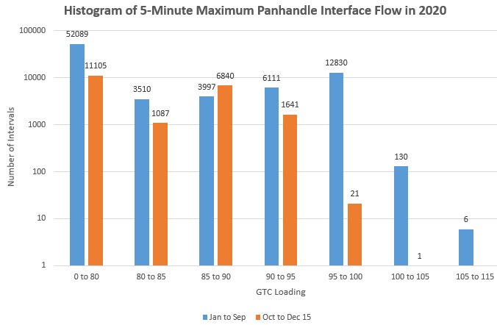
Panhandle GTC Limit Exceedance
From January to September 2020, ERCOT controlled to 90-95% of the actual limit for the vast majority of intervals, there were a total of 136 instances of exceedance of Panhandle GTC limit between Jan. and Sep. 2020
Now that the Panhandle GTC is an IROL, ERCOT has controlled to 85-90% of the limit, in order to prevent any exceedances which in turn results in more binding intervals and curtailment

Slide 9
Proposed Concept: Not-to-Exceed (NTE) Method
General description
  IRR units behind a binding GTC with a considerable impact over the GTC flow (which units) should NOT exceed their SCED BP (how) when NTE is activated (when).
NTE Method parameters:
  Triggering condition: To be determined. Trigger conditions being considered are:
    When GTC loading is above a threshold
    When GTC constraint is activated/ binding in SCED
  Discount factor: Reliability limit will be discounted in a less-conservative manner, closer to 1.0.
  Unit Impacts: IRR units with shift factor greater than 2% on a GTC cannot exceed their SCED BP.

Slide 10
Benefits of NTE Concept
Should allow ERCOT to bind at a higher limit, resulting in more MW production from IRRs behind IROL when binding
  Allows for fewer time intervals of low prices behind the constraints
Keeps ERCOT from exceeding SOLs and IROLs
More efficient way of meeting reliability requirements, especially when GTC limit constraints are binding
Additional advantages to real-time operations
  Requires less operator attention
  Provides greater certainty in managing flow

Slide 11
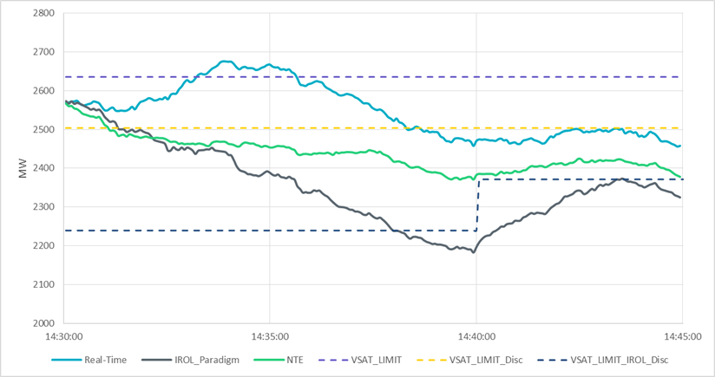
NTE Concept Example

Slide 12
Implementation of NTE Concept
Post-processing is needed to override SBBH signal when NTE is triggered
SCED in MMS will remain unchanged

Slide 13
Following BP once NTE is Implemented
Current SBBH is issued to Resources in cases where the Nodal LMP is aligned with the BP MW on the Resource EOC, and that the expansion of SBBH to the NTE approach will also include issuing an SBBH to Resources in cases where the Nodal LMP is not aligned with the BP MW on the Resource EOC
According to Protocol 6.5.7.4 and 6.6.5.4, ERCOT expects IRR Generation Resource to follow Base Point once NTE is implemented.
  The benefits of NTE can be maximized only when each individual IRR resource behind the GTC follows its BP.
  Operators may have to reduce the discount factor to accomodate the expected over-generation above BP.
  A large over-generation above the BP for an IRR behind the GTC when SBBH flag is set may threaten the grid reliability, and could run into a risk of being instructed to be disconnected from the grid.

Slide 14
Transmission and Security Desk OPERATING PROCEDURE
Situation
IF: BASECASE PNHNDL is approaching 92%; | THEN: Tighten constraint to at least 85%, Rerun SCED, Call QSEs beginning with those which have the largest IRR base point deviations and issue Operating Instruction as appropriate.
IF: BASECASE PNHNDL is approaching 95%; | THEN: Instruct QSEs, beginning with those which continue to have the largest IRR base point deviation, to zero immediately (violate ramp rate), as long as exceedance exists Issue electronic VDI as time permits, Confirm with Market Participant electronic VDI received.
When there is a risk for IROL exceedance, Operators may instruct QSEs with large IRR base point deviation to zero immediately

Slide 15
Summary and Next Steps
The NTE method will require all IRR units with shift factors greater than 0.02, behind a GTC to not exceed their SCED BP.
  Benefits
    Keeps ERCOT from exceeding GTC SOLs and IROLs
    More efficient dispatch
    GTC constraints will bind at higher limit, resulting in fewer time intervals of low prices behind the constraints
    Advantages to real-time operations
      Requires less operator attention
      Provides greater certainty in managing flow by restricting feasible region of IRR’s output
  Implementation will need to fit into project portfolio
ERCOT is seeking comments and feedback from Stakeholders for the implementation of NTE and next steps
Following this feedback, ERCOT will propose the SCR and Protocol Revisions necessary to implement the preferred solution, which can then be discussed further through the approval process

