Slide 1
2022 Ancillary Service Methodology
Preliminary Discussion
ERCOT Staff
August 11, 2021
PDCWG

Slide 2
Tentative Stakeholder Discussion Timeline
August 11, 2021 – PDCWG (Current Methodology)
August 23, 2021 – WMWG (Current Methodology)
September 08, 2021 – PDCWG (Proposed Methodology)
September 22, 2021 – WMWG (Proposed Methodology)
October 13, 2021 – PDCWG (Proposed Methodology)
October 21, 2020 – OWG (Proposed Methodology)
October 25, 2021 – WMWG (Proposed Methodology)
November 03, 2021 - WMS
November 04, 2021 - ROS
November 17, 2021 - TAC
December 14, 2021 - BoD

Slide 3
Scope
The values of Ancillary Services (AS) quantities for 2022 contained in this presentation are based on the current methodology that was approved in December 2020.
  The quantities for 2022 simply reflects moving forward the historic data on which quantities are based, unless otherwise noted.
ERCOT is seeking feedback, based on this analysis, on any changes that should be considered to the Methodology used to compute AS in 2022.

Slide 4
Regulation Service
The preliminary Regulation quantities in subsequent slides for January through July of 2022 are based on historical (2021 and 2020) five-minute net load variability data using the current methodology.
  These Regulation quantities for 2022 have been computed using updated Wind and Solar Adjustment tables for 2022.

Slide 5
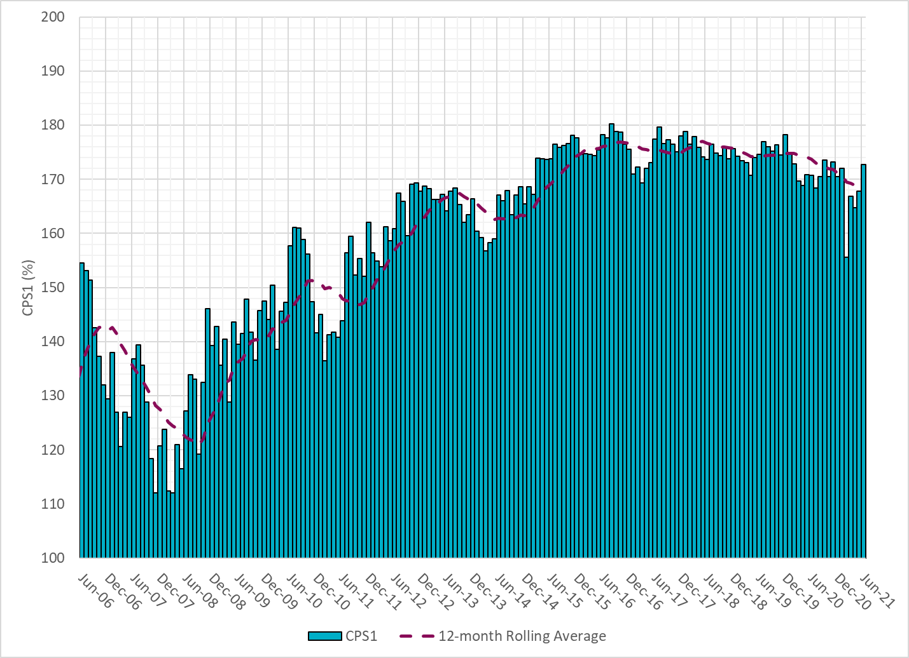
ERCOT CPS1 Monthly Trend

Slide 6
ERCOT CPS1 Hourly Trend

Slide 7
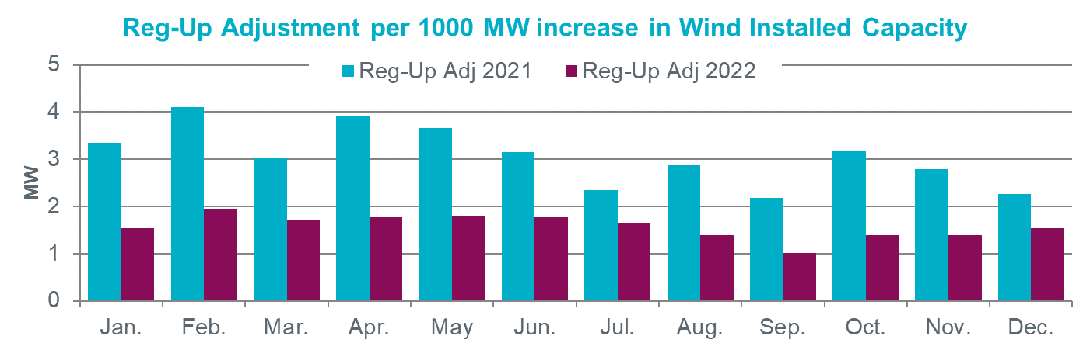
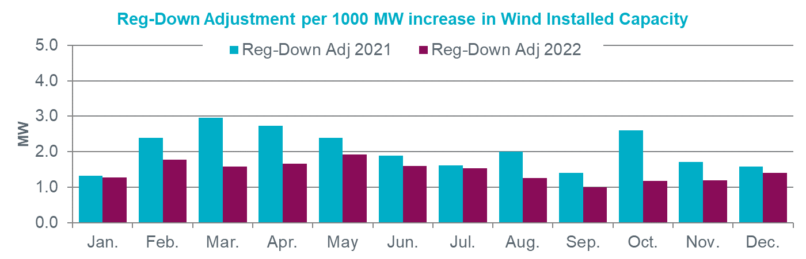
Wind Adjustment Tables - 2022
Wind Adjustment Tables track incremental MWs of Regulation needed to account for additional variability per 1000 MW increase in installed wind capacity.

Slide 8
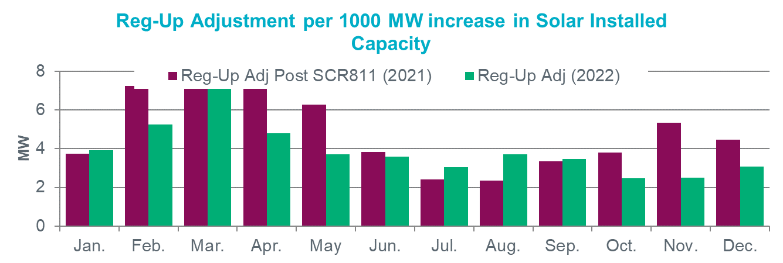
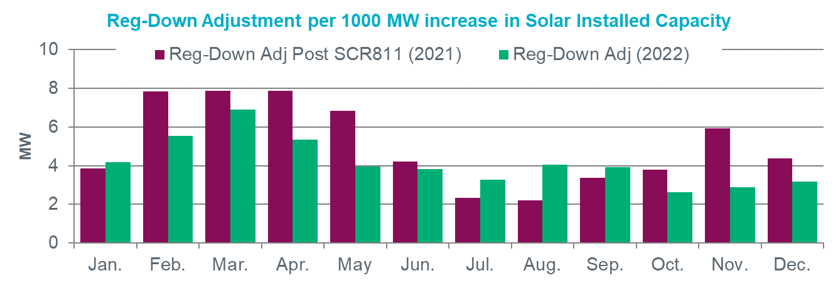
Solar Adjustment Tables - 2022
Solar Adjustment Tables track incremental MWs of Regulation needed to account for additional variability per 1000 MW increase in installed solar capacity.

Slide 9
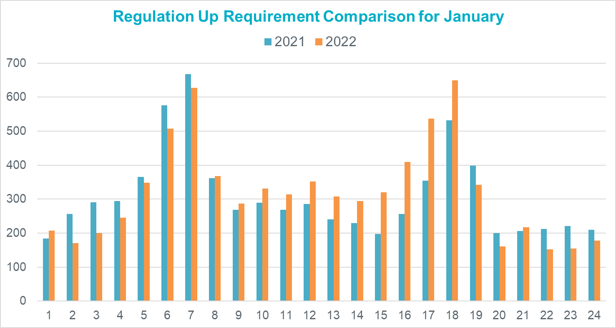
January

Slide 10
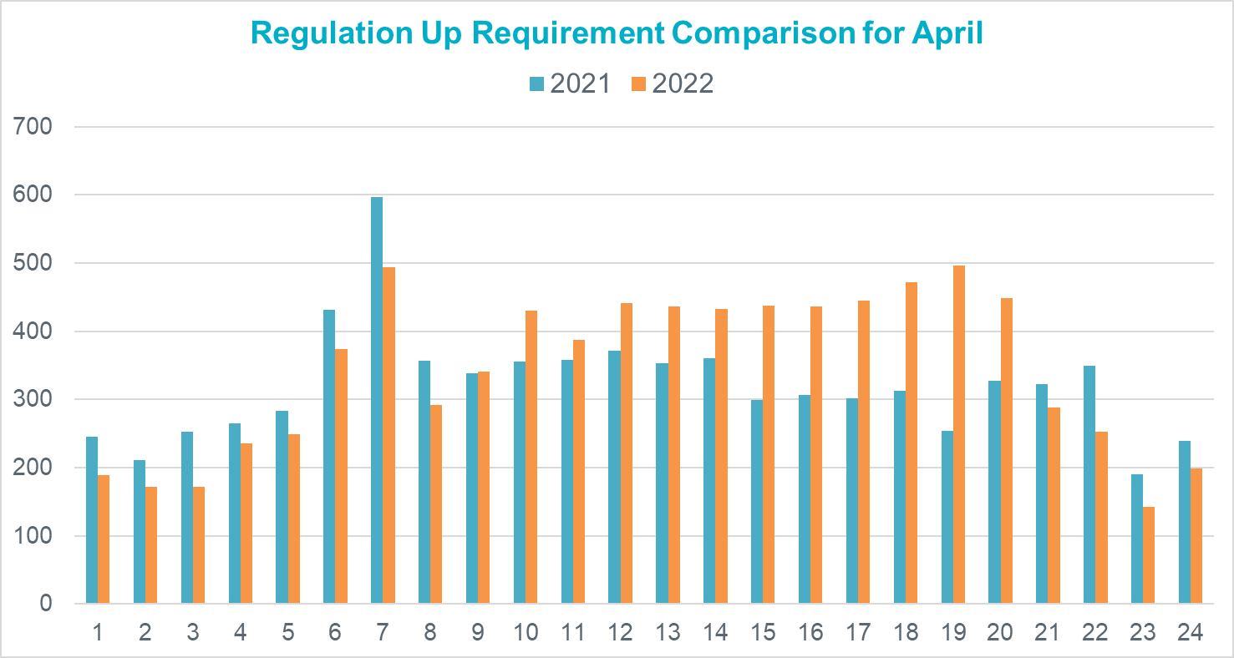
April

Slide 11
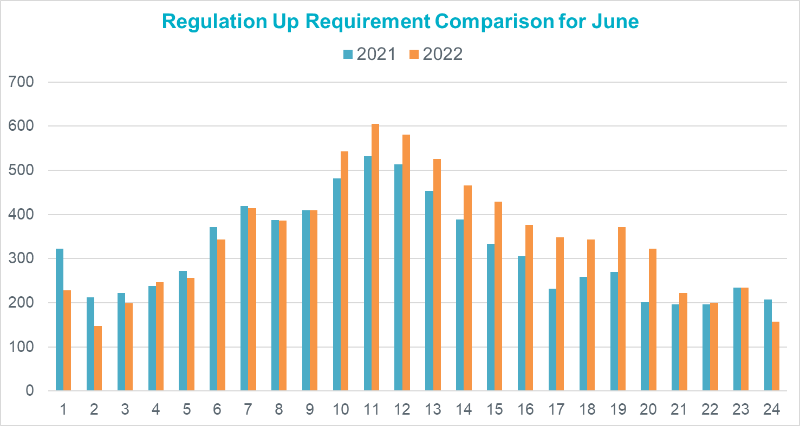
June

Slide 12
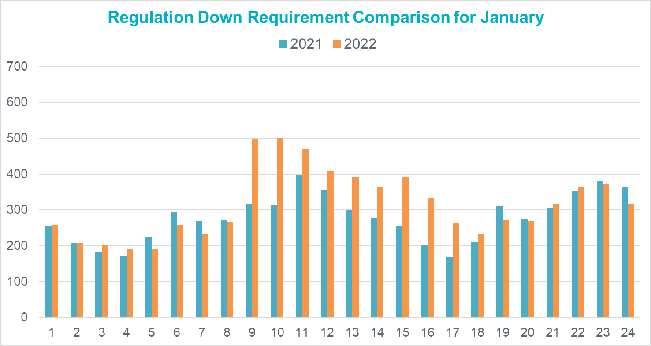
January

Slide 13
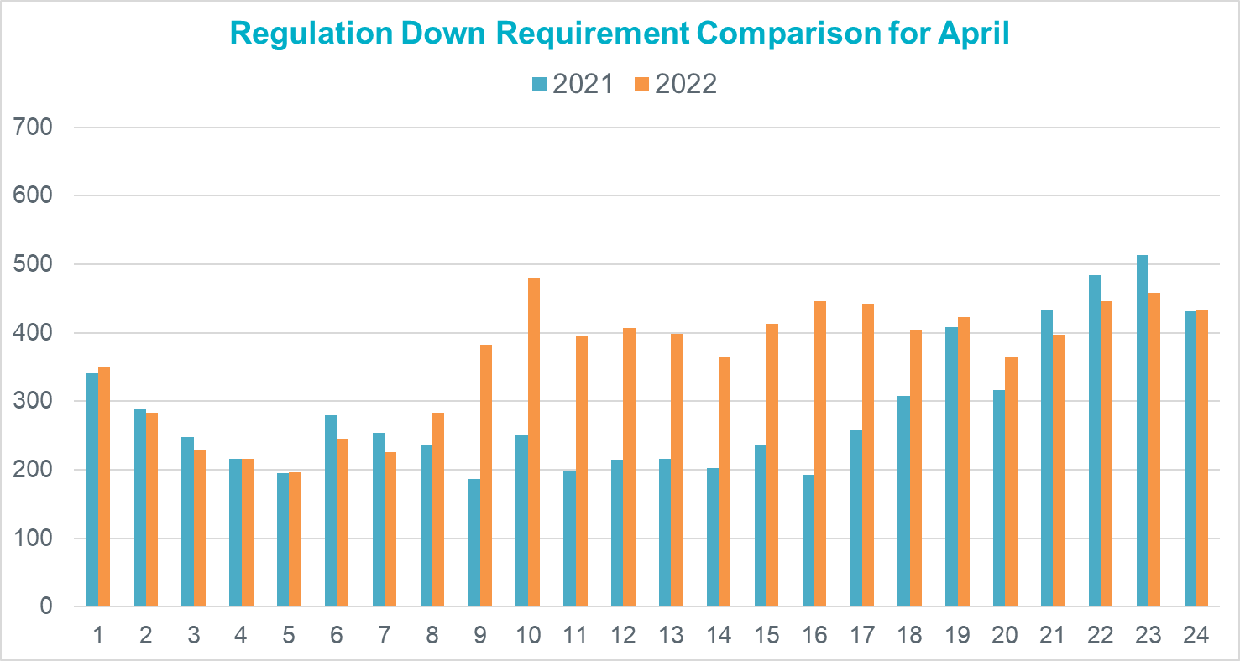
April

Slide 14
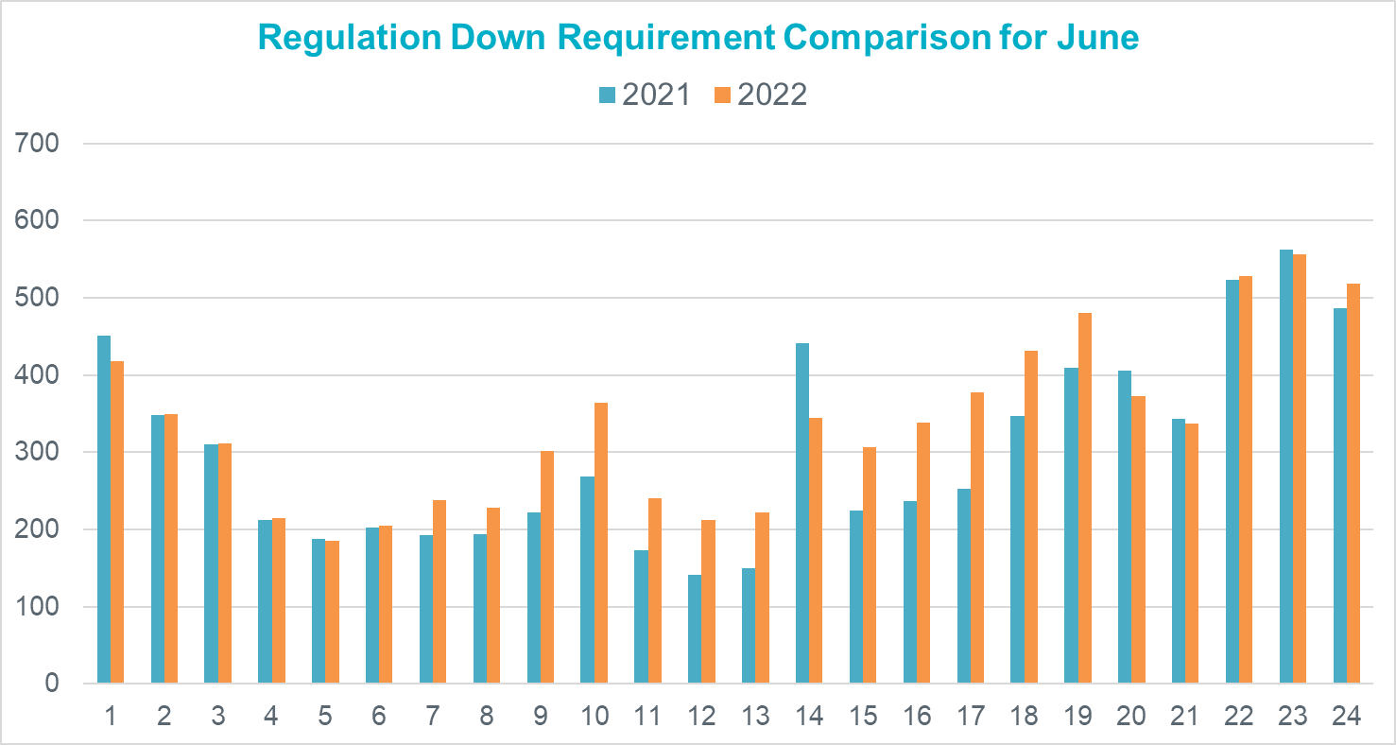
June

Slide 15
Regulation Methodology Changes
ERCOT does not plan to change current methodology used to calculate the minimum Regulation requirement.
ERCOT will continue to monitor ERCOT’s frequency control performance and use existing tools as necessary to meet established performance criteria.

Slide 16
Responsive Reserve Service (RRS)
The preliminary RRS quantities for January 2022 through July 2022 in subsequent slides have been computed using current methodology and are based on 2020 and 2021 system inertia conditions and RRS table updated in 2020.
  Note that beginning July 12, 2021, RRS quantities were increased from 2300 MW to 2800 MW during peak load hours on all days between July 12 and Aug. 31, 2021.

Slide 17
RRS Table
 | Scenario 1 | Scenario 2 | Scenario 3 | Scenario 4 | Scenario 5 | Scenario 6 | Scenario 7 | Scenario 8 | Scenario 9 | Scenario 10 | Scenario 11 | Scenario 12
LR/PFR | 2.35:1 | 2.2:1 | 2.06:1 | 1.94:1 | 1.83:1 | 1.74:1 | 1.65:1 | 1.58:1 | 1.51:1 | 1.44:1 | 1.39:1 | 1.33:1
Inertia (GW∙s) | 130 | 140 | 150 | 160 | 170 | 180 | 190 | 200 | 210 | 220 | 230 | 240
PFR Req. (no LR) (MW) | 5960 | 5563 | 5200 | 4892 | 4622 | 4329 | 4114 | 3920 | 3744 | 3522 | 3314 | 3139
**RRS Upd IFRO (MW) | 3352 | 3303 | 3255 | 3210 | 3170 | 3092 | 3053 | 3002 | 2959 | 2880 | 2783 | 2712
 | Scenario 13 | Scenario 14 | Scenario 15 | Scenario 16 | Scenario 17 | Scenario 18 | Scenario 19 | Scenario 20 | Scenario 21 | Scenario 22 | Scenario 23 | Scenario 24 | Scenario 25
LR/PFR | 1.28:1 | 1.24:1 | 1.19:1 | 1.15:1 | 1.12:1 | 1.08:1 | 1.04:1 | 1.01:1 | 1:1 | 1:1 | 1:1 | 1:1 | 1:1
Inertia (GW∙s) | 250 | 260 | 270 | 280 | 290 | 300 | 310 | 320 | 330 | 340 | 350 | 360 | 370
PFR Req. (no LR) (MW) | 3004 | 2890 | 2784 | 2686 | 2595 | 2510 | 2421 | 2353 | 2290 | 2230 | 2173 | 2119 | 2068
**RRS Upd IFRO (MW) | 2658 | 2605 | 2566 | 2521 | 2469 | 2429 | 2383 | 2344 | 2290 | 2230 | 2173 | 2119 | 2068
**RRS quantity is calculated for RCC of 2805 with limit of 60% limit on LRs and min RRS-PFR limit of 1420 MW.
***Red font in table above identifies study scenario where RRS needed < 2300 MW. 2300 MW floor will be used in RRS requirement determination.
****Generation mix (CCs, Gas, SC, Coal, Steam) providing 1150 MW of PFR has been aligned with actual historic system operations.
Inertia < 250 GW·s: 30% Coal + 70% Rest. Inertia ≥ 250 GW·s: 15% Coal + 85% Rest

Slide 18
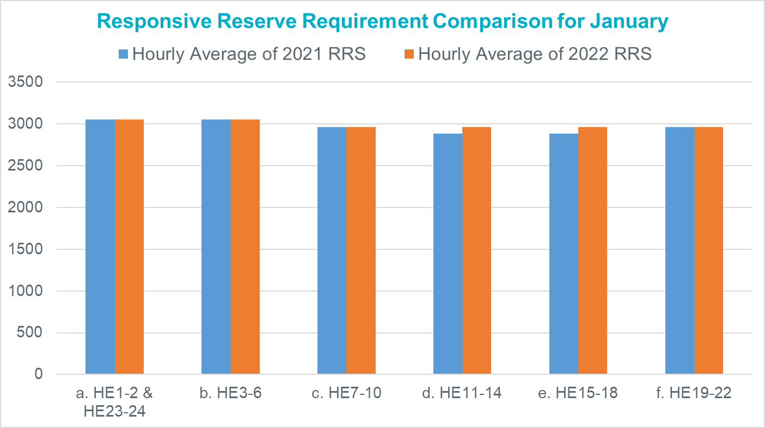
January

Slide 19
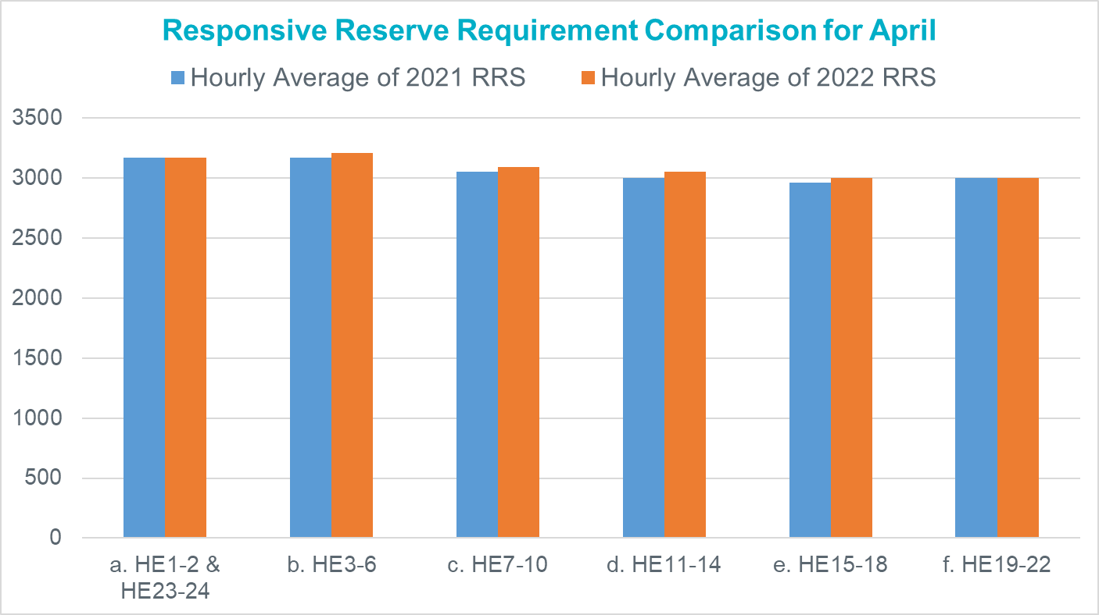
April

Slide 20
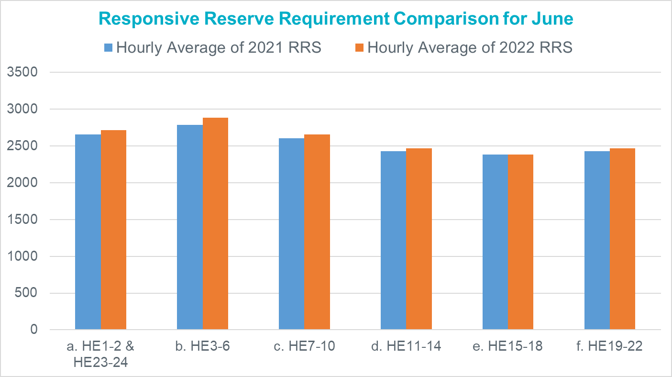
June

Slide 21
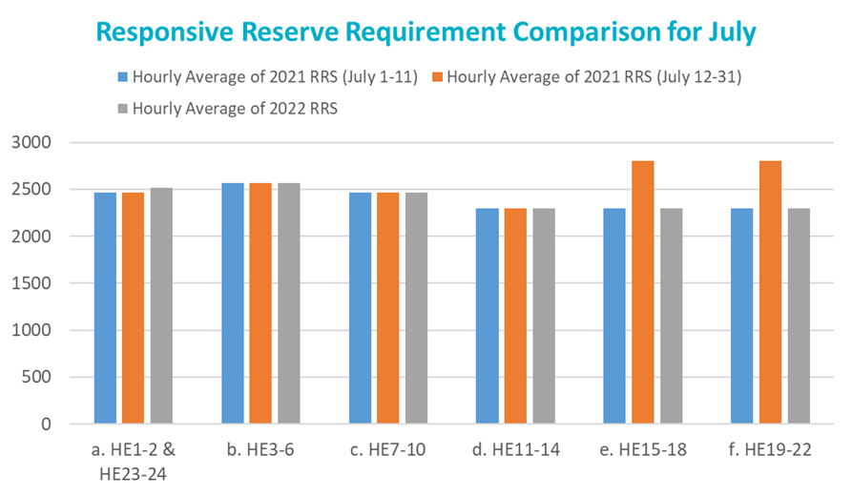
July

Slide 22
RRS Methodology Changes
ERCOT is assessing if additional RRS quantities are needed during peak hours to help respond to larger frequency events.
With projected increases in renewable capacity and continued decline in ERCOT’s minimum inertia, ERCOT is also assessing if the 70% coverage of historic inertia is appropriate for all hours.

Slide 23
Non-Spin Reserve Service (Non-Spin)
The preliminary Non-Spin quantities in subsequent slides for January through July of 2022 are based on historical (2019, 2020 and 2021) 3-hour-ahead net forecast error data using the current methodology.
  These NSRS quantities for 2022 have been computed using updated Wind and Solar Over-Forecast Adjustment tables for 2022.

Slide 24
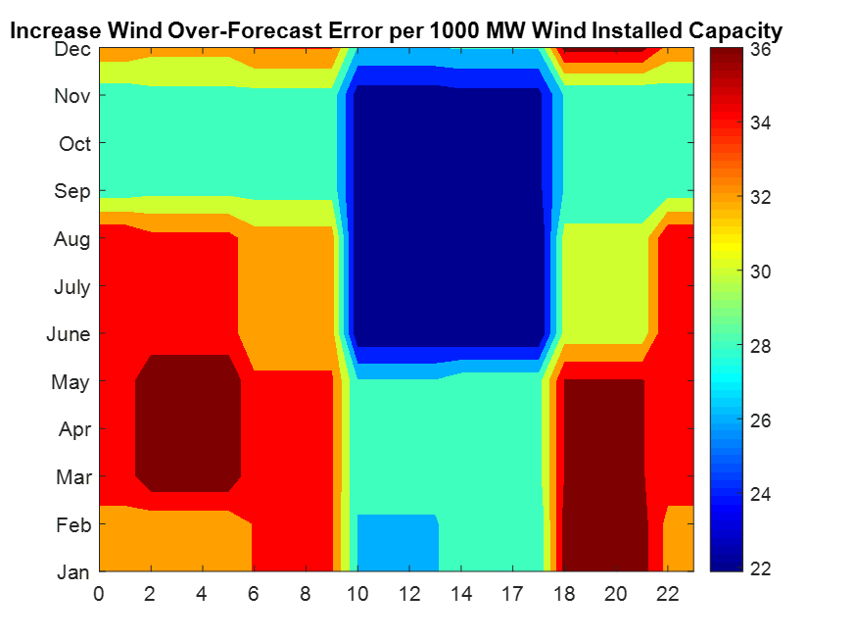
Wind Over-Forecast Error Adjustment Table - 2022
Wind Over-Forecast Error Adjustment Table track estimated increase in wind over forecast error per 1000 MW increase in installed wind capacity.
Max: 39 MW per 1000 MW additional Wind capacity
Mean: 31 MW per 1000 MW additional Wind capacity

Slide 25
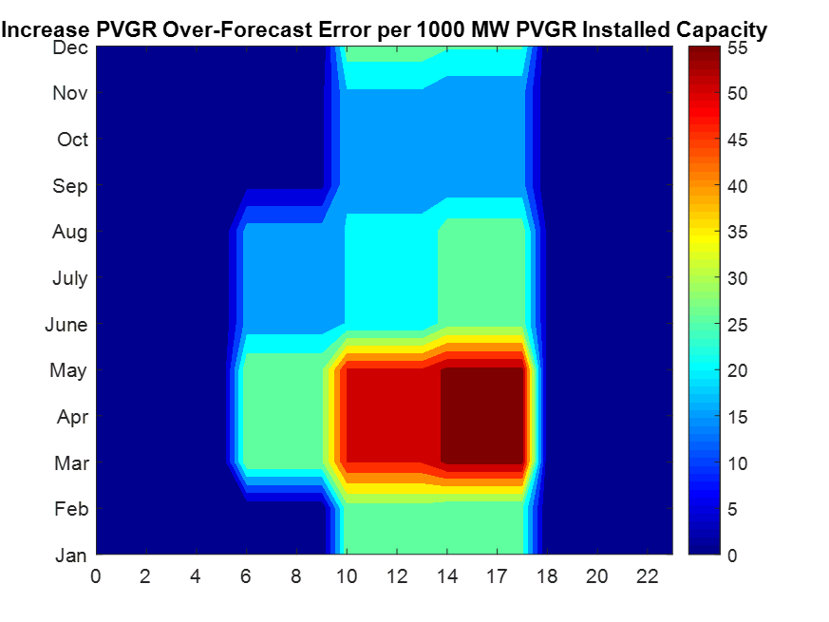
Solar Over-Forecast Error Adjustment Table - 2022
Solar Over-Forecast Error Adjustment Table track estimated increase in solar over forecast error per 1000 MW increase in installed solar capacity.
Max: 56 MW per 1000 MW additional solar capacity
Mean: 13 MW per 1000 MW additional solar capacity

Slide 26
Non-Spin Reserve Changes in 2020
In 2021, there have been days where the total net load forecast error and intra-day forced outage rate was greater than the Non-Spin quantities being procured. As a result,
  ERCOT has been using RUC to maintain sufficient online headroom to help respond to these uncertainties.
  Non-Spin quantities were changed beginning July 12, 2021. Specifically,
    Between Jul 12 and Aug 31, Non-Spin quantities were increased such that sum of Regulation Up, Non-Spin and RRS is equal to 6500 MW for all hours on all days.
    Between Sep 1 and Dec 31, Non-Spin quantities will be increased such that sum of Regulation Up, Non-Spin and RRS less RRS expected to be provided by Load Resources (CLR and NCLR) is equal to 6500 MW for all hours on all days.
  On days that are identified as having a higher potential of weather forecast uncertainty that may result in having a higher net load, ERCOT may increase Non-Spin quantities further by up to 1000 MW.

Slide 27
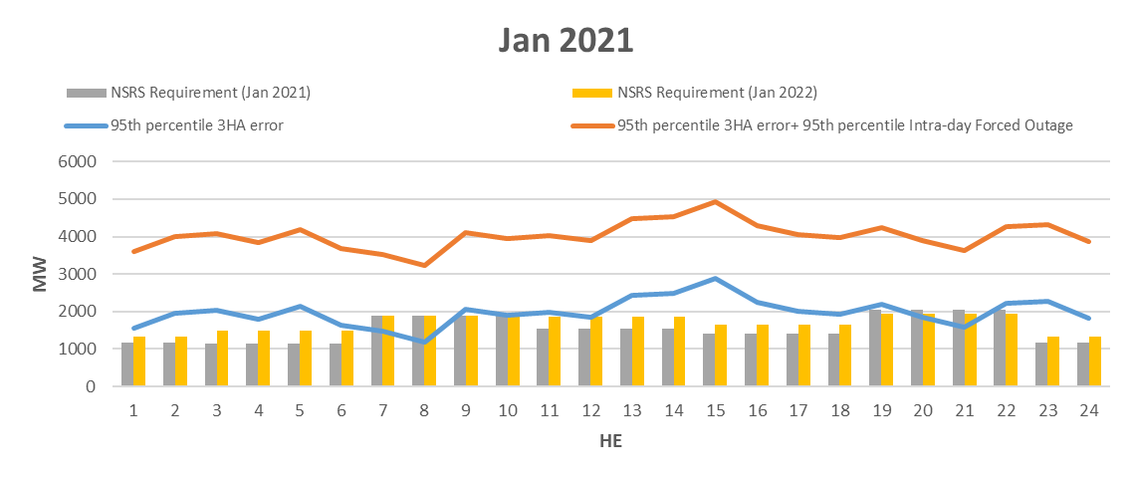
January
Graph below shows
  Jan 2021 Non-Spin requirements (gray),
  preliminary Jan 2022 Non-Spin requirements computed using current methodology (yellow),
  95th percentile of 3 Hour Ahead (HA) Net Load Forecast Error (NLFE) for Jan 2021 (blue) and
  sum of 95th percentile of 3 HA of NLFE for Jan 2021 and 95th percentile of Intra-day forced outages in Jan 2021 (orange).

Slide 28
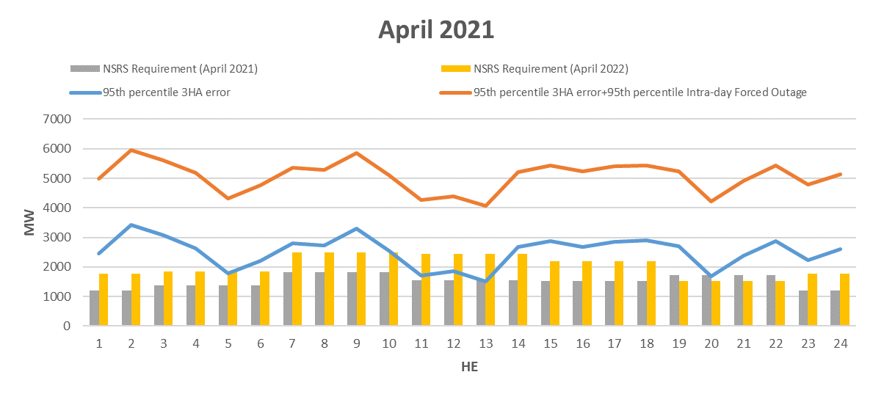
April
Graph below shows
  Apr 2021 Non-Spin requirements (gray),
  preliminary Apr 2022 Non-Spin requirements computed using current methodology (yellow),
  95th percentile of 3 Hour Ahead (HA) Net Load Forecast Error (NLFE) for Apr 2021 (blue) and
  sum of 95th percentile of 3 HA of NLFE for Apr 2021 and 95th percentile of Intra-day forced outages in Apr 2021 (orange).

Slide 29
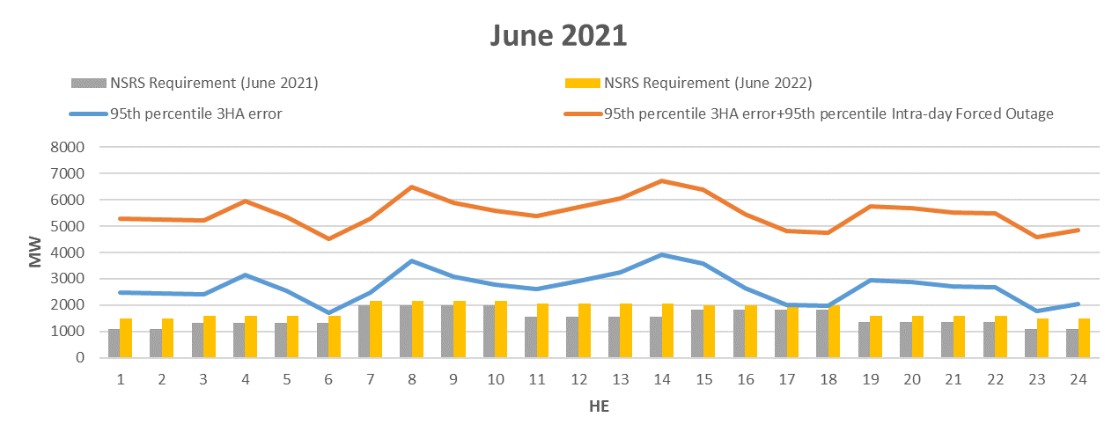
June
Graph below shows
  Jun 2021 Non-Spin requirements (gray),
  preliminary Jun 2022 Non-Spin requirements computed using current methodology (yellow),
  95th percentile of 3 Hour Ahead (HA) Net Load Forecast Error (NLFE) for Jun 2021 (blue) and
  sum of 95th percentile of 3 HA of NLFE for Jun 2021 and 95th percentile of Intra-day forced outages in Jun 2021 (orange).

Slide 30
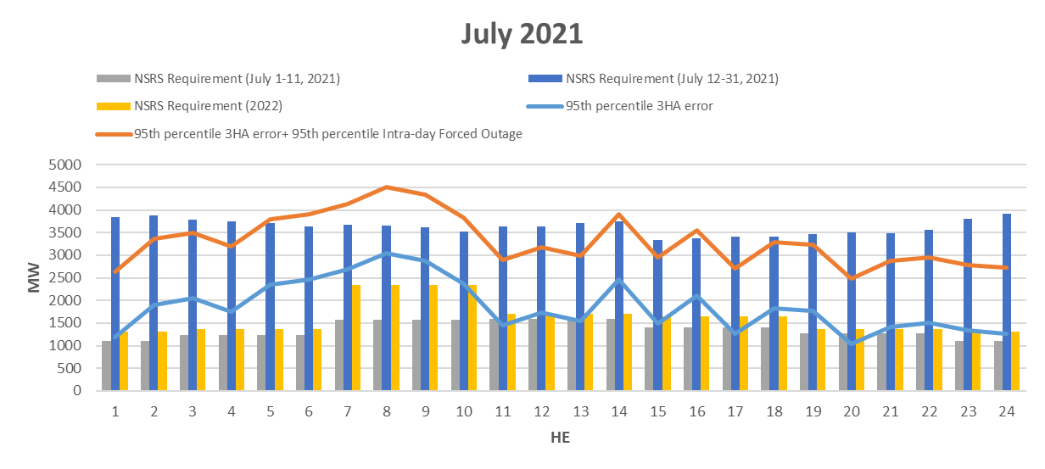
July
Graph below shows
  Jul 1-11, 2021 Non-Spin requirements (gray),
  Jul 12-31, 2021 Non-Spin requirements (dark blue),
  preliminary Jul 2022 Non-Spin requirements computed using current methodology (yellow),
  95th percentile of 3 Hour Ahead (HA) Net Load Forecast Error (NLFE) for Jul 2021 (blue) and
  sum of 95th percentile of 3 HA of NLFE for Jul 2021 and 95th percentile of Intra-day forced outages in Jun 2021 (orange).

Slide 31
Non-Spin Methodology Changes
ERCOT is considering if intra-day forced outage rate may need to be incorporated into the calculation for Non-Spin quantities.
Similarly, since ERCOT has been seeing the need to RUC resources earlier, ERCOT is assessing if the Net Load Forecast Error used in the methodology may need to be based upon a look-ahead time point earlier than 3 hours ahead.

Slide 32
Discussion

Slide 33
Forecast Variability Considerations
Factors that ERCOT will consider when assessing whether or not a day has the potential for having high variability in the forecast include, but are not limited to:
  Timing of a weather front, that if accelerated or delayed, could impact the load, wind, and/or solar forecasts,
  Variation of temperatures in weather forecasts and ERCOT is not selecting the most conservative (hottest/coldest) for the load forecast,
  ERCOT believes that the temperature forecasts from ERCOT’s weather vendors are not hot or cold enough,
  Rain is forecast over a significant portion of ERCOT load, but ERCOT believes there is a chance the rain doesn’t happen,
  There is a significant variation between the wind forecasts ERCOT receives from different models,
  There is a significant variation between the 50th percentile (STWPF) and 80th percentile (WGRPP) wind forecasts,
  The forecast for areas with high amounts of solar resources shows clear skies, but ERCOT believes there is a chance for cloudy conditions, and
  There is a potential for extreme weather conditions such as snow, icing, dust storm, hail, or an eclipse.

Slide 34
Updates to Forecast Variability Assessment
The assessment is posted at
  http://www.ercot.com/about/weather/forecastvariability
As Of August 1, 2021, recognizing that the sole purpose of this assessment is to aid in determining if additional Non-Spin quantities are needed for Current Day + 3, ERCOT has updated its approach to limit the net load variability assessment for Current-Day+3 only. The Forecast Variability Assessment will continue to be updated 7 days per week.

