Slide 1
Project Update and Summary of
Project Priority List (PPL) Activity
August 12, 2021
Troy Anderson
Sr. Mgr. Portfolio Managment

Slide 2
Project Update Agenda
Project Portfolio Update
Recent / Upcoming Project Highlights
2021 Release Targets
ESR and DGR Pre-Passport Projects
DGR/DESR Moratorium Market Notice
Priority/Rank Options for Revision Requests with Impacts
Location of Project Priority List (PPL): http://www.ercot.com/services/projects/index

Slide 3
Recent / Upcoming Project Highlights
2021 July Release – 7/14/2021 Complete
SCR789 – Update NMMS Topology Processor to PSSE 34 Capability
2021 July Release Off-Cycle – 7/23/2021 Complete
NPRR1062 – Modify IDR Meter Requirement and Eliminate IDR Meter Requirement Report
RMGRR164 – Related to NPRR1062
2021 July Release – R4 – 7/27/2021 – 7/29/2021 Complete
NPRR902(b) – ERCOT Critical Energy Infrastructure Information
NPRR905 – CRR Balancing Account Resettlement (8/1/2021 effective date)
2021 July Release Off-Cycle – 7/29/2021 Complete
ListServ redundancy implemented
2021 August Release Off-Cycle – 8/1/2021 Complete
NPRR1031 – Notices for Curtailment of Load
2021 September Release Off-Cycle – 9/10/2021 In Flight
NPRR867 – Revisions to CRR Auction Credit Lock Amount to Reduce Excess Collateral
Note: Projected Go-Live dates are subject to change. Please watch for market notices as the effective dates approach.

Slide 4
2021 Release Targets – Board Approved NPRRs / SCRs / xGRRs
R1
R3
R5
February 2/2 – 2/4 | April 3/30 – 4/1 | May 5/25 – 5/27 | July 7/27 – 7/29 | October 10/5 – 10/7 | December 12/7 – 12/9
NPRR902(a) NOGRR195 NPRR1055 OBDRR023(a) NPRR1020 SCR804 | NPRR971 NPRR986 NPRR998 NPRR1024 NPRR1043 NOGRR213 VCMRR027 PGRR070 NPRR1060 | NPRR974 NPRR978(c) NPRR1048 NPRR1051 SCR811 ECMS ECMS NPRR1080 OBDRR030 NPRR1081 | NPRR902(b) NPRR905 SCR789 SCR789 NPRR1062 RMGRR164 NPRR1031 NPRR867 | OBDRR023(b) SCR781(b) | FFR Advancement (NPRR863 FFR) NPRR1015 DGR/DESR (See next slide)
R2
R4
R6
ü
ü
ü
ü
ü
ü
ü
ü
ü
ü
ü
ü
ü
ü
ü
ü
ü
ü
E
E
E
E
E
E
E
E
ü
1/1
10/1
ü
7/14
2/1
Replace NoticeBuilder
ü
7/23
ECMS – Nov.
Infrastructure replace
New navigation
2022 R1 (Feb.)
6/25
3/15
5/1
ü
ü
New public version of ERCOT.com homepage
8/1
7/1
RIOO – Q4 2021
RARF Add Functionality Go-Live
4/22
6/1
E
ü
ü
9/10
E
E
TBD Items | NPRRs: 484, 825(b), 826, 829, 841, 857, 879, 885, 904, 918, 930, 935(b), 936, 939, 941, 945, 962, 965, 1004, 1006, 1019, 1023, 1030, 1032, 1034, 1040, 1057 SCRs: 799, 800, 805, 809, 812 Market Guides: PGRR066, PGRR076 Other Binding Docs: OBDRR009
Go-live dates can differ from Protocol effective dates – Please refer to market notices for more details
APPENDIX
Red Text: New additions and target release changes
Strike-Through Text: Previous target release
(a), (b), etc.: Multiple phase release
Project Status Codes
NS = Not Started
I = Initiation
P = Planning
E = Execution
H = On Hold
NPRR902(a) – ECEII Market Participant MPIM role
NPRR902(b) – MIS links updated for ECEII reports
NPRR978(c) – Forecast Zone scope
SCR781(b) – “Add” capability
OBDRR023(a) – ERS Expenditure Limit
OBDRR023(b) – 4 Standard Contract Terms/Year
Release targets are subject to change

Slide 5
In-Flight Pre-Passport Projects
ESR: Energy Storage Resource
DGR: Distributed Generation Resource
BES: Battery Energy Storage
PR325-01 Fast-Frequency Response (FFR) Advancement (Gated to Execution on 6/22/2021)
Planned go-live for 2021-R6 (December 2021)
NPRR863, NPRR1015, NOGRR187
PR354-01 DGR/DESR Implementation (Gated to Execution phase on 7/30/2021)
Target go-live 2022-R1 (February 2022)
NPRR917 – Nodal Pricing for SODGs and SOTGs
NPRR1016 – Clarify Requirements for DGRs and Distribution Energy Storage Resources
NPRR1052 – Load Zone Pricing for Settlement Only Storage Prior to NPRR995
NPRR1065 – Implementation Adjustment for NPRR917
PGRR082 – Revise Section 5 and Establish Small Generation Interconnection Process
Related RRs – NOGRR212, RRGRR026
PR353-01 BES Combo Model Implementation – potential for multiple go-lives
Target go-live TBD (core project On Hold until resources are available after FFR and DGR)
NPRR963 – Base Point Deviation Settlement & Deployment Performance Metrics for ESRs (Combo Model)
NPRR987 – BESTF-3 ESR Contribution to Physical Responsive Capability and RT On-Line Reserve Capacity Calcs
NPRR989 – BESTF-1 ESR Technical Requirements
NPRR1002 – BESTF-5 ESR Single Model Registration and Charging Restrictions in Emergency Conditions
NPRR1026 – BESTF-7 Self-Limiting Facilities and Self-Limiting Resources
NPRR1038 – BESTF-8 Limited Exemption from Reactive Power Requirements for Certain ESRs
NPRR1069 – Align Ancillary Service Responsibility for ESRs with NPRR987
Related RRs – NOGRR204, NOGRR208, OBDRR017, PGRR081, RRGRR023
Blue text: ERCOT considering removing from project for earlier delivery

Slide 6
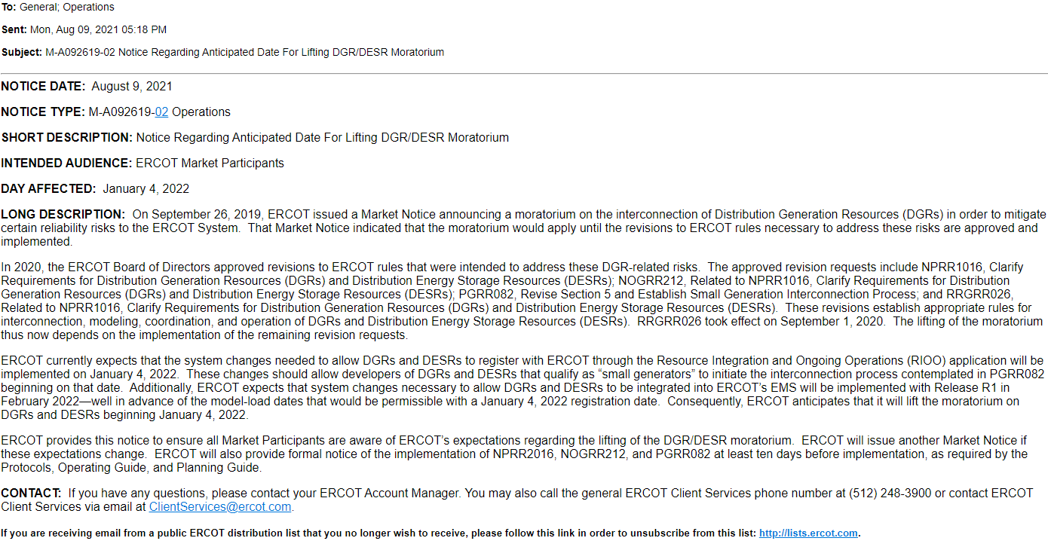
DGR/DESR Moratorium Market Notice – 8/9/2021

Slide 7
Priority / Rank Options for Revision Requests with Impacts
Options for…
Revision Request | Description | Priority | Rank | Comments
SCR813 | NMMS Jointly-Rated Equipment Coordination Confirmation | 2022 | 3510 | $100k-$150k, 5-7 months Impacted Systems: NMMS 2022 project start
SCR814 | Point-to-Point (PTP) Obligation Bid Interval Limit | 2021 | 3350 | $10k-$25k, 3-5 months Impacted Systems: MMS Candidate for 2021 start but must be assessed for resource availability with other Not Started projects
PPL Rank Information
Next available 2021 Rank in Business Strategy = 3350
Next available Rank in Regulatory = 320

