Slide 1
ERCOT Frequency Control Report
July 2021
ERCOT
Operations Planning
PDCWG | August 11th, 2021

Slide 2
Summary of July 2021
CPS1: 171.81%
Current CPS1 12-Month Rolling Average: 168.87%
0 BAAL Exceedance(s)
2 hourly CPS1 score below 100%
BAAL-003 Events have updated through 2020
2020 BAAL-003 FRM Performance: -789.34
2021 RMS1 Statistics
  Mean: 16.75 mHz
  Min: 12.01 mHz
  Max: 60.6 mHz
Energy Statistics
  Total Energy: 39,555,014 MWh
  Wind Energy: 5,369,386 MWh
  Percent Energy from Wind: 18.66%
  Solar Energy: 1,826,325 MWh
  Percent Energy from Solar: 4.62%
Minimum System Inertia
  Mean: 270,728 MW*s
  Max: 307,668 MW*s on Jul 27th
  Min: 229,166 MW*s on Jul 10th
Notes:
2018 BAAL-003 FRM Performance: -843.17

Slide 3
Frequency Control
CPS1, BAAL, & RMS1

Slide 4
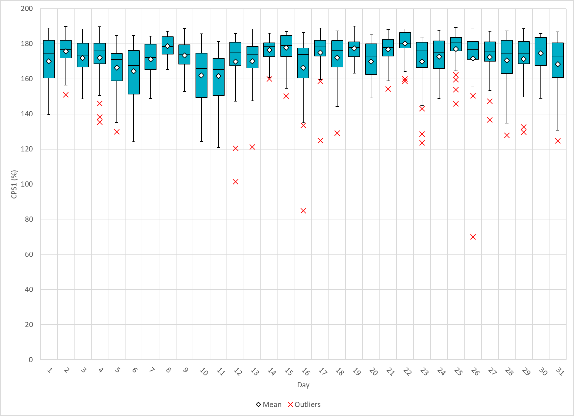
Hourly CPS1 by Day
Jul-21 CPS1 (%): 171.81
Notes:
1. 87.93% @ 07/16/2021 HE 20:00
Expected Generation Deviation
Expected gen dev remained negative for the most part of the hour. The largest expected gen dev was -1645MW @ 19:40 with significant contribution from solar
IRR Ramps
Solar generation ramped down by 2850 MW during this hour.
Regulation: Regulation up was exhausted for most part of the hour
Other
SCED was run manually multiple times and Manual offset of 250 MW @ 19:38
2. 70.02% @ 07/26/2021 HE 20:00
Expected Generation Deviation
Expected gen dev remained negative for the most part of the hour. The largest expected gen dev was -1690MW @ 19:43 with significant contribution from solar
IRR Ramps
Solar generation ramped down by 3300 MW during this hour.
Regulation: Regulation up was exhausted for most part of the hour
Other
SCED was run manually multiple times and Manual offset of 200 MW @ 19:39

Slide 5
BAAL Exceedances & Violations
There were 0 BAAL exceedance(s) in July

Slide 6
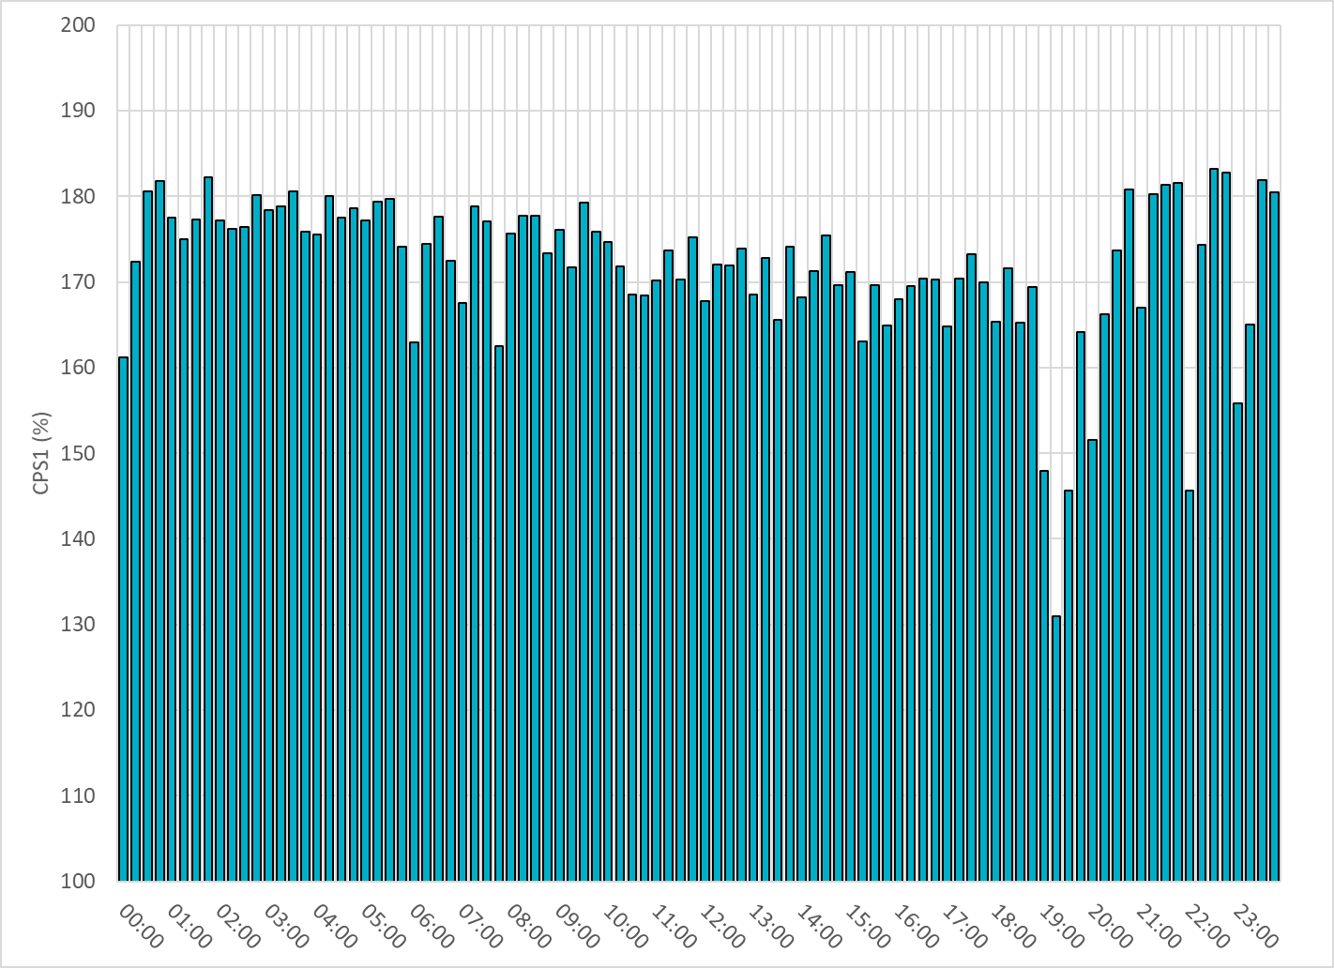
15-Minute Average CPS1%
Jul-21 CPS1 (%): 171.81

Slide 7
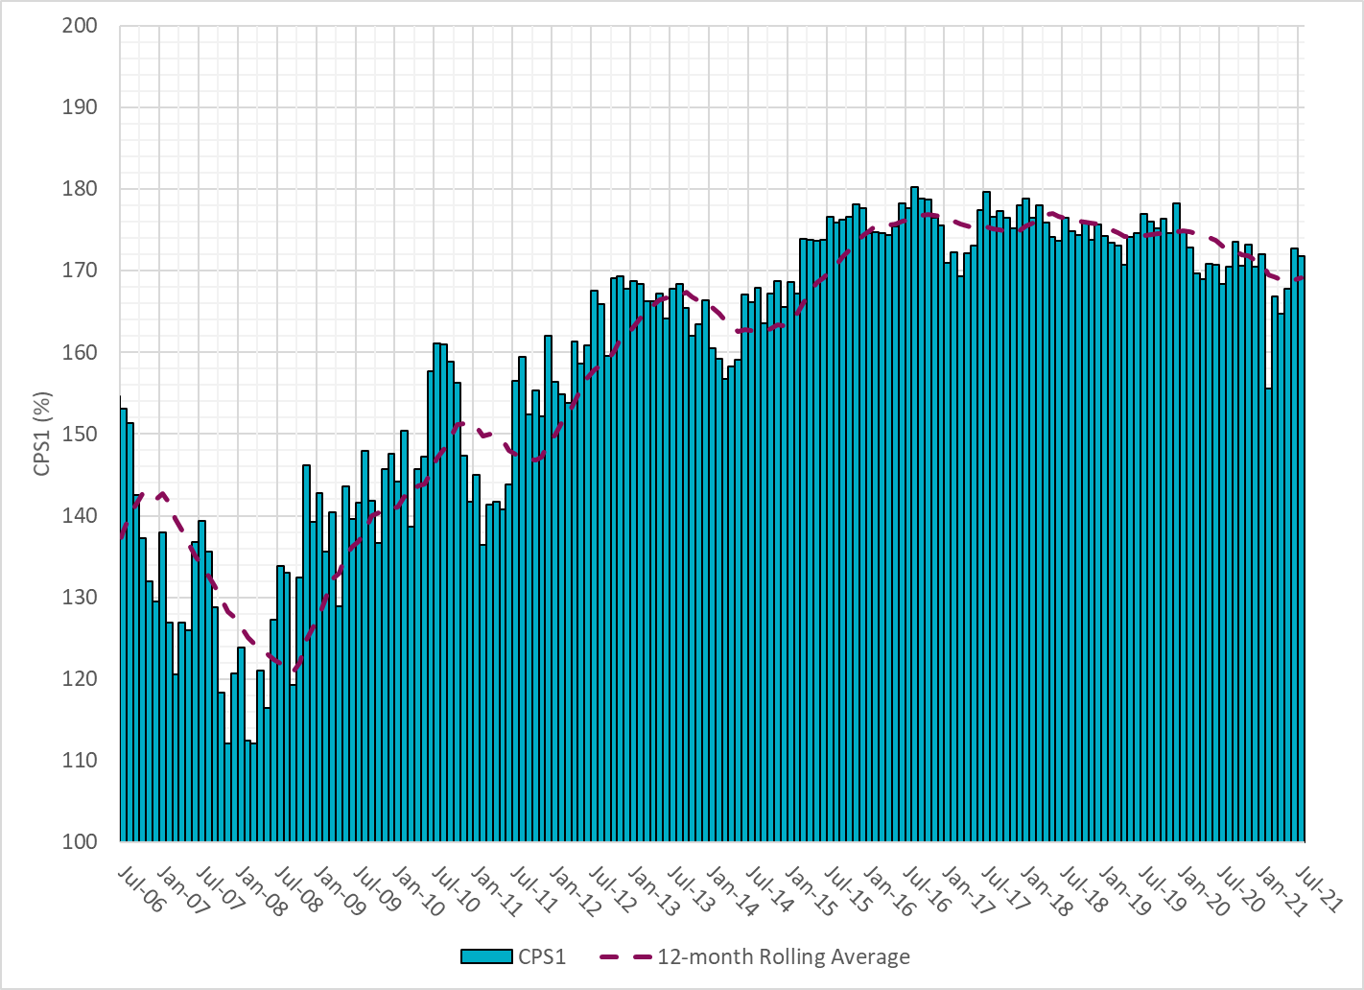
12-Month Rolling Average CPS1
Current 12-Month Rolling Average: 169.16%

Slide 8
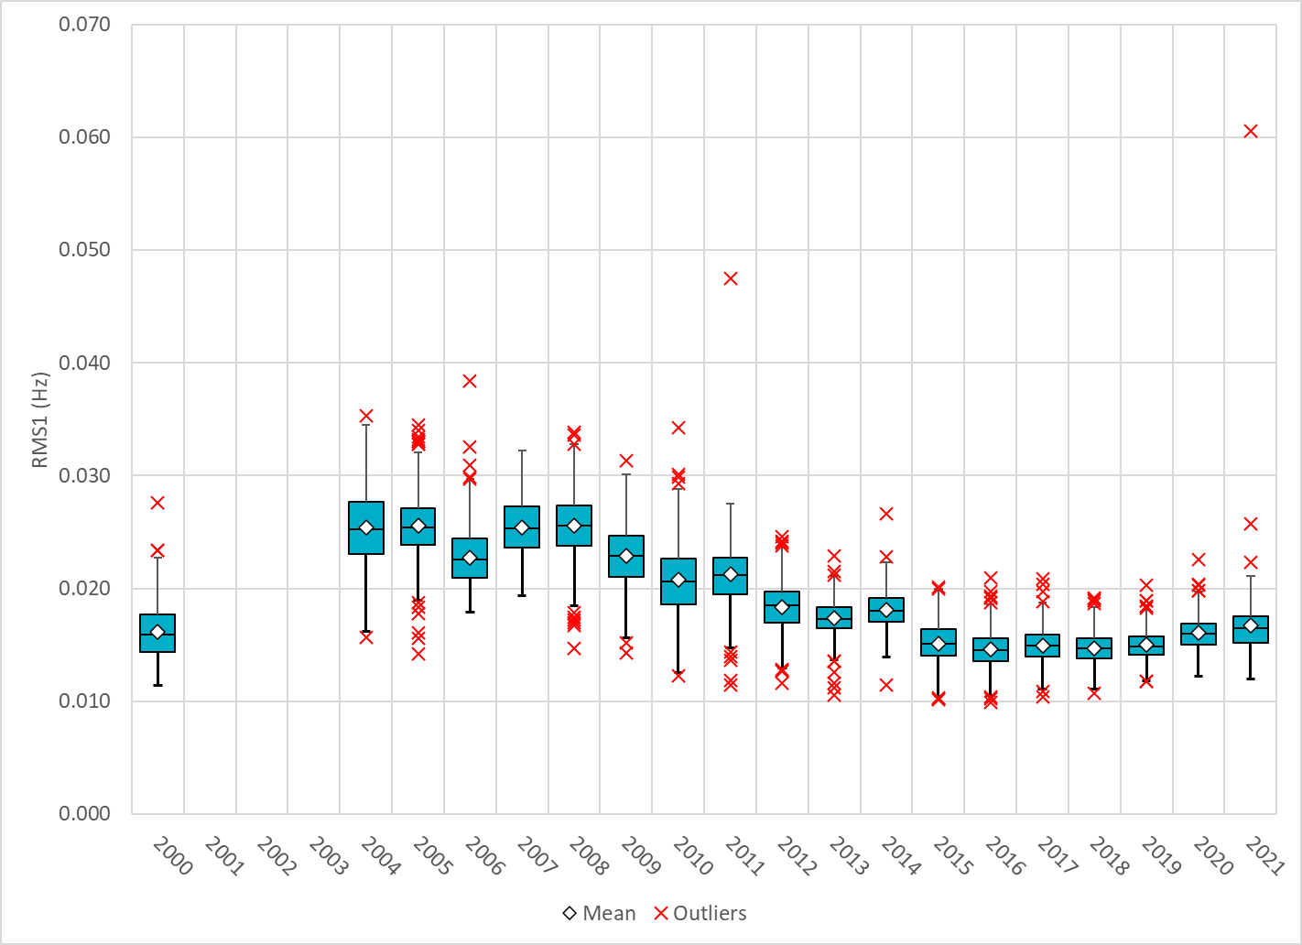
Daily RMS1 of ERCOT Frequency by Year
Notes:
Mean: 16.75 mHz
Min: 12.01 mHz
Max: 60.6 mHz

Slide 9
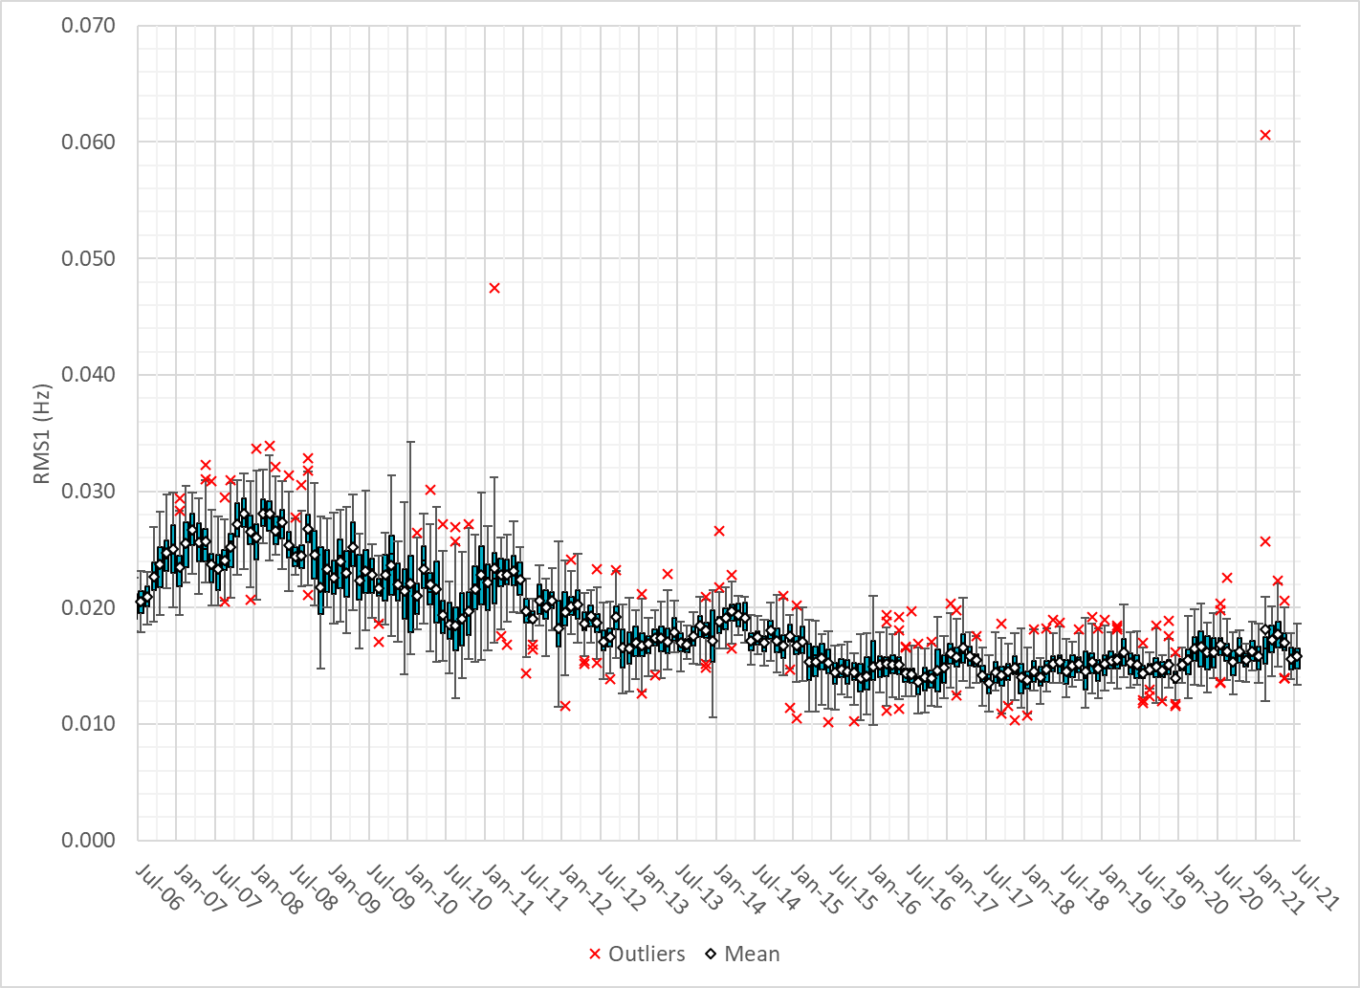
Daily RMS1 of ERCOT Frequency by Month

Slide 10
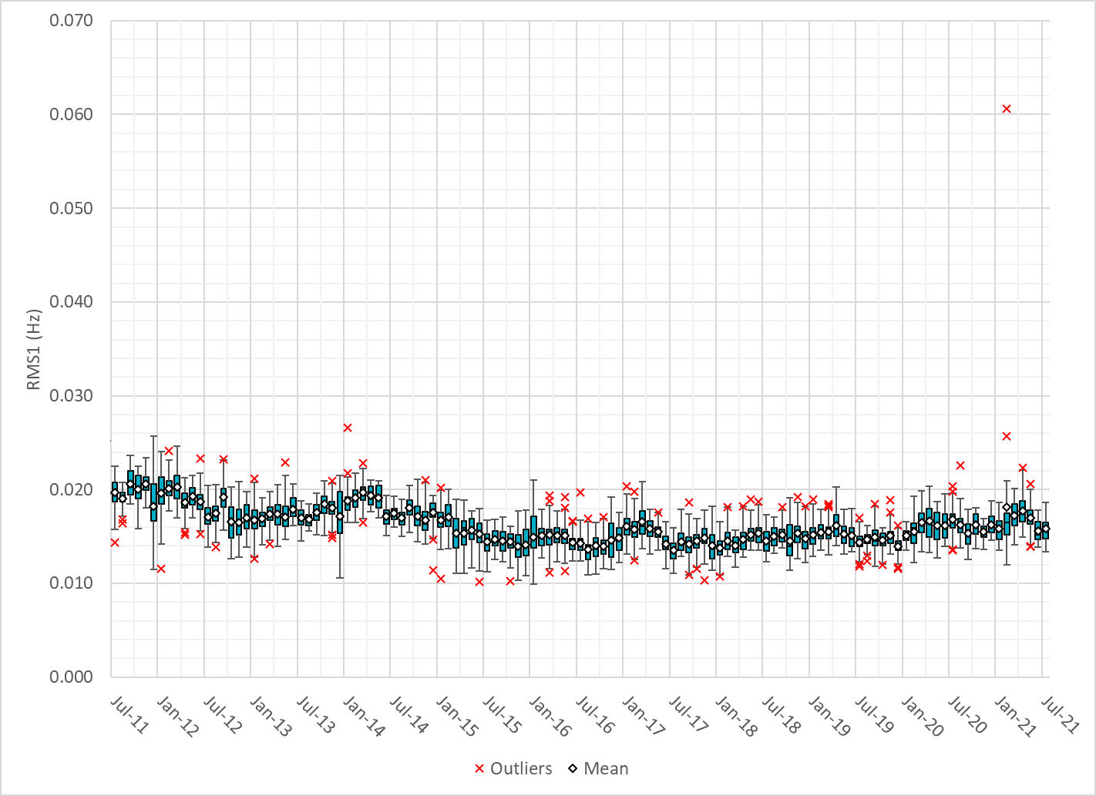
Daily RMS1 of ERCOT Frequency by Month

Slide 11
Frequency Profile Comparison

Slide 12
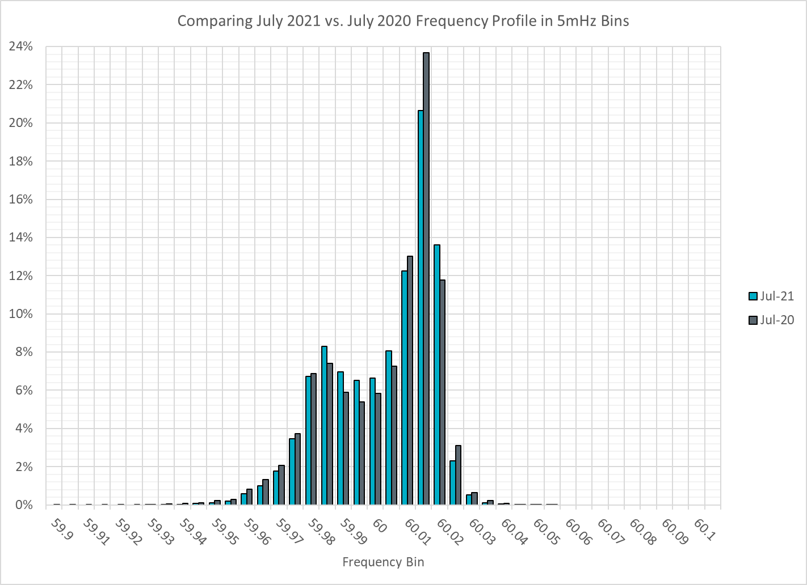
Frequency Profile Comparison

Slide 13
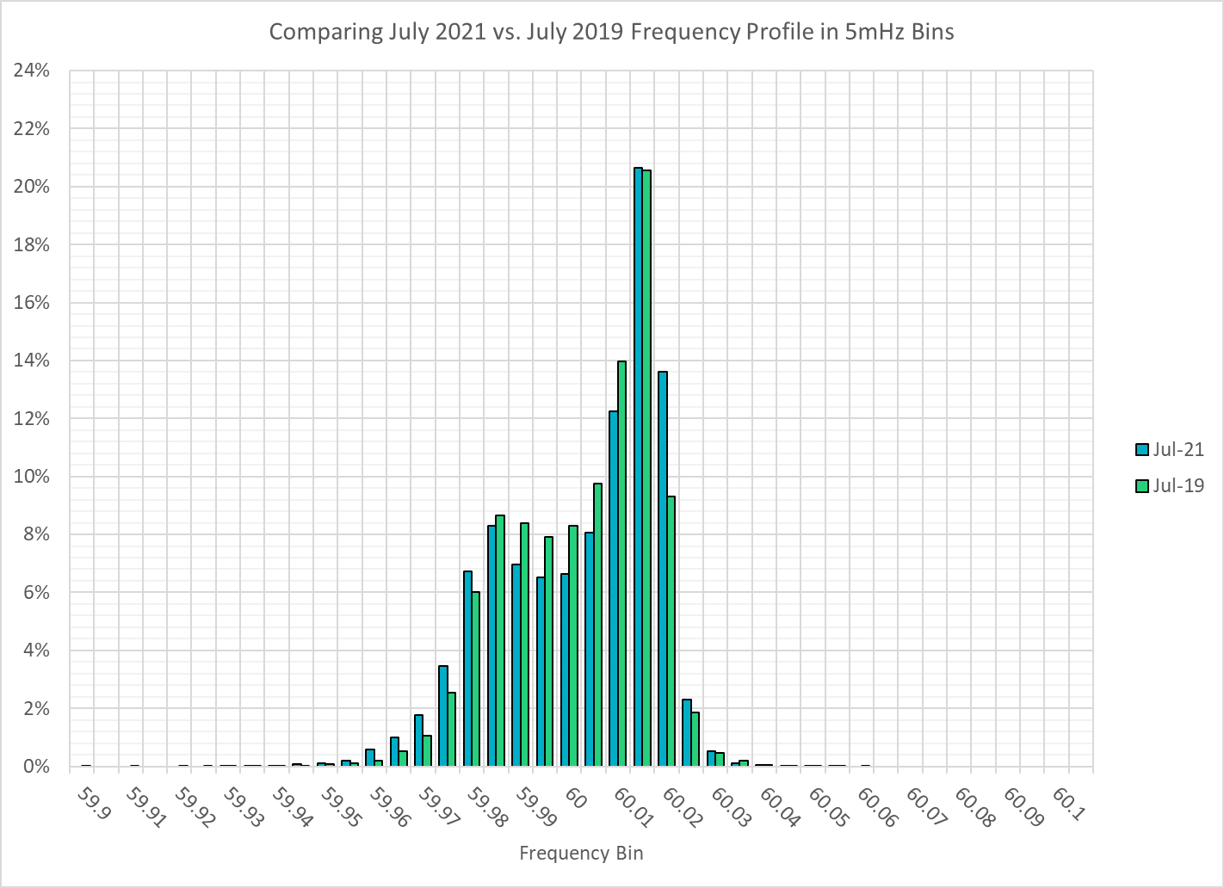
Frequency Profile Comparison

Slide 14
Time Error Correction

Slide 15
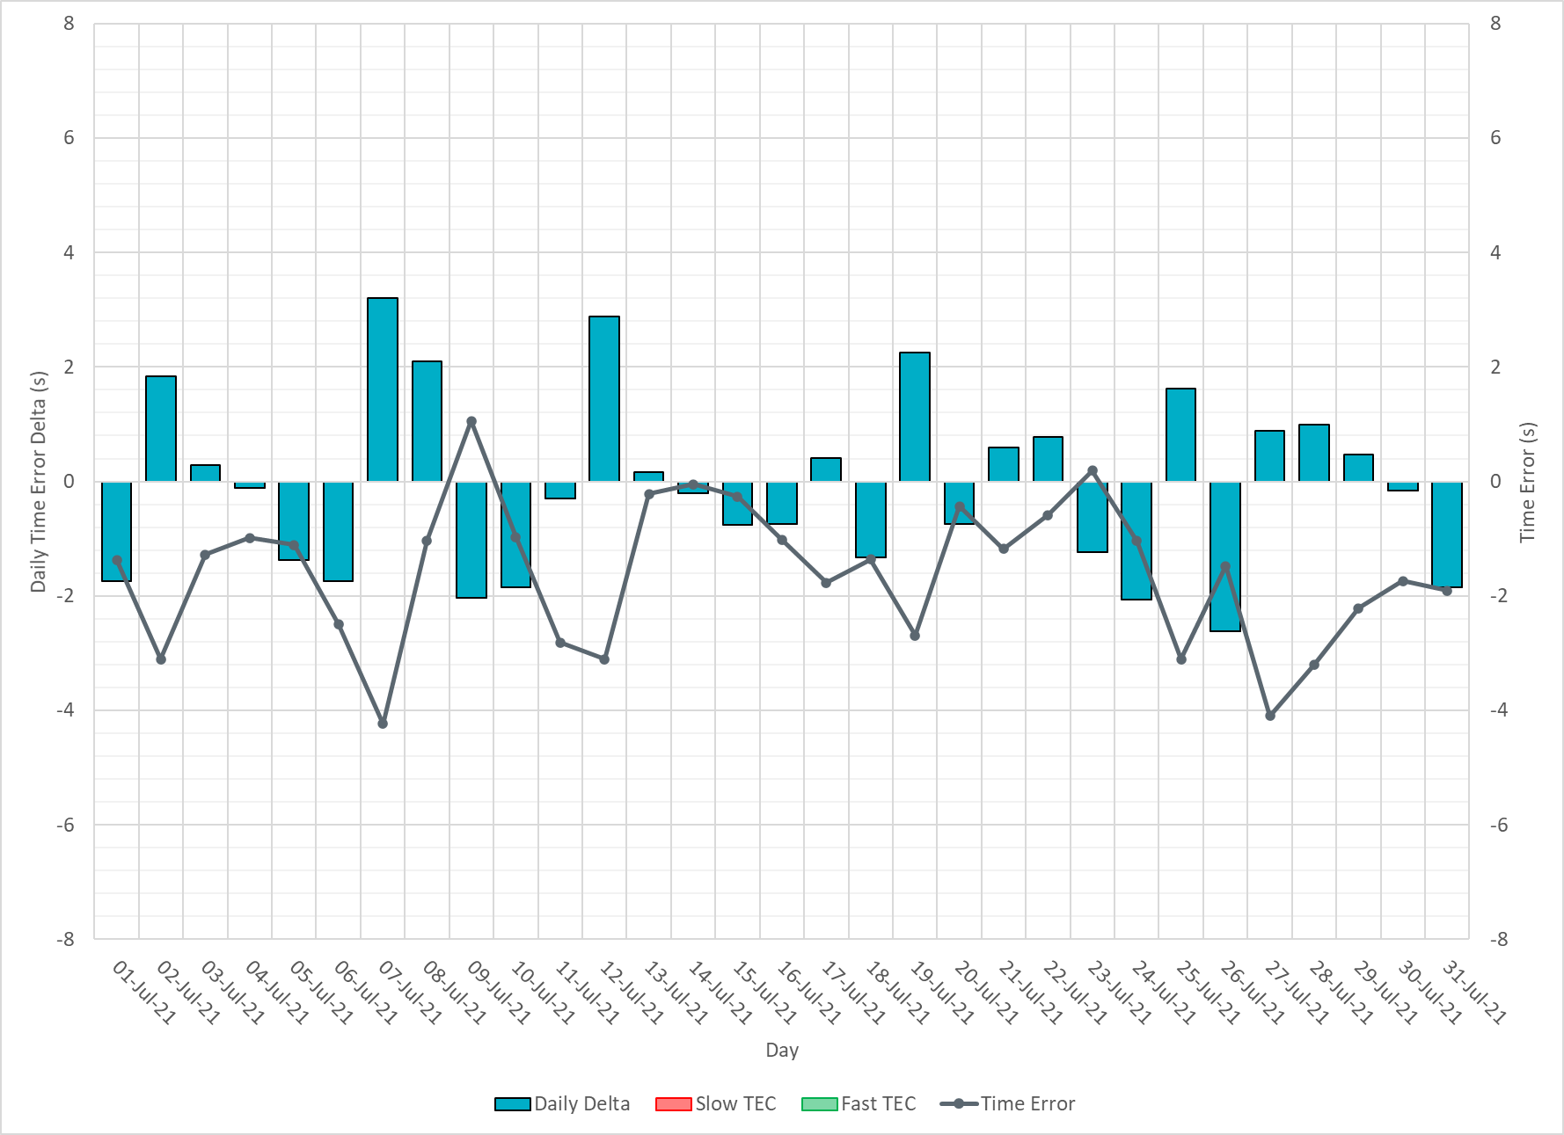
ERCOT Daily Time Error

Slide 16
Time Error Corrections Log Summary
There have been no time error corrections since December 2016

Slide 17
BAL-003 Performance

Slide 18
Op. Year 2020 BAL-003 Selected Events – Update
Notes:
BAL-003

Slide 19
Op. Year 2020 BAL-003 FRM Performance - Update
Notes:
OP2018: FRO = -381.0, FRM_median = -843.17, FRM_average = -959.7
OP2019: FRO = -381.0, FRM_median = -811.14, FRM_average = -892.5
OP2020: FRO = -425.0, FRM median = -789.34, FRM average = -879.0
OP2021: FRO =

Slide 20
ERCOT Energy Statistics

Slide 21
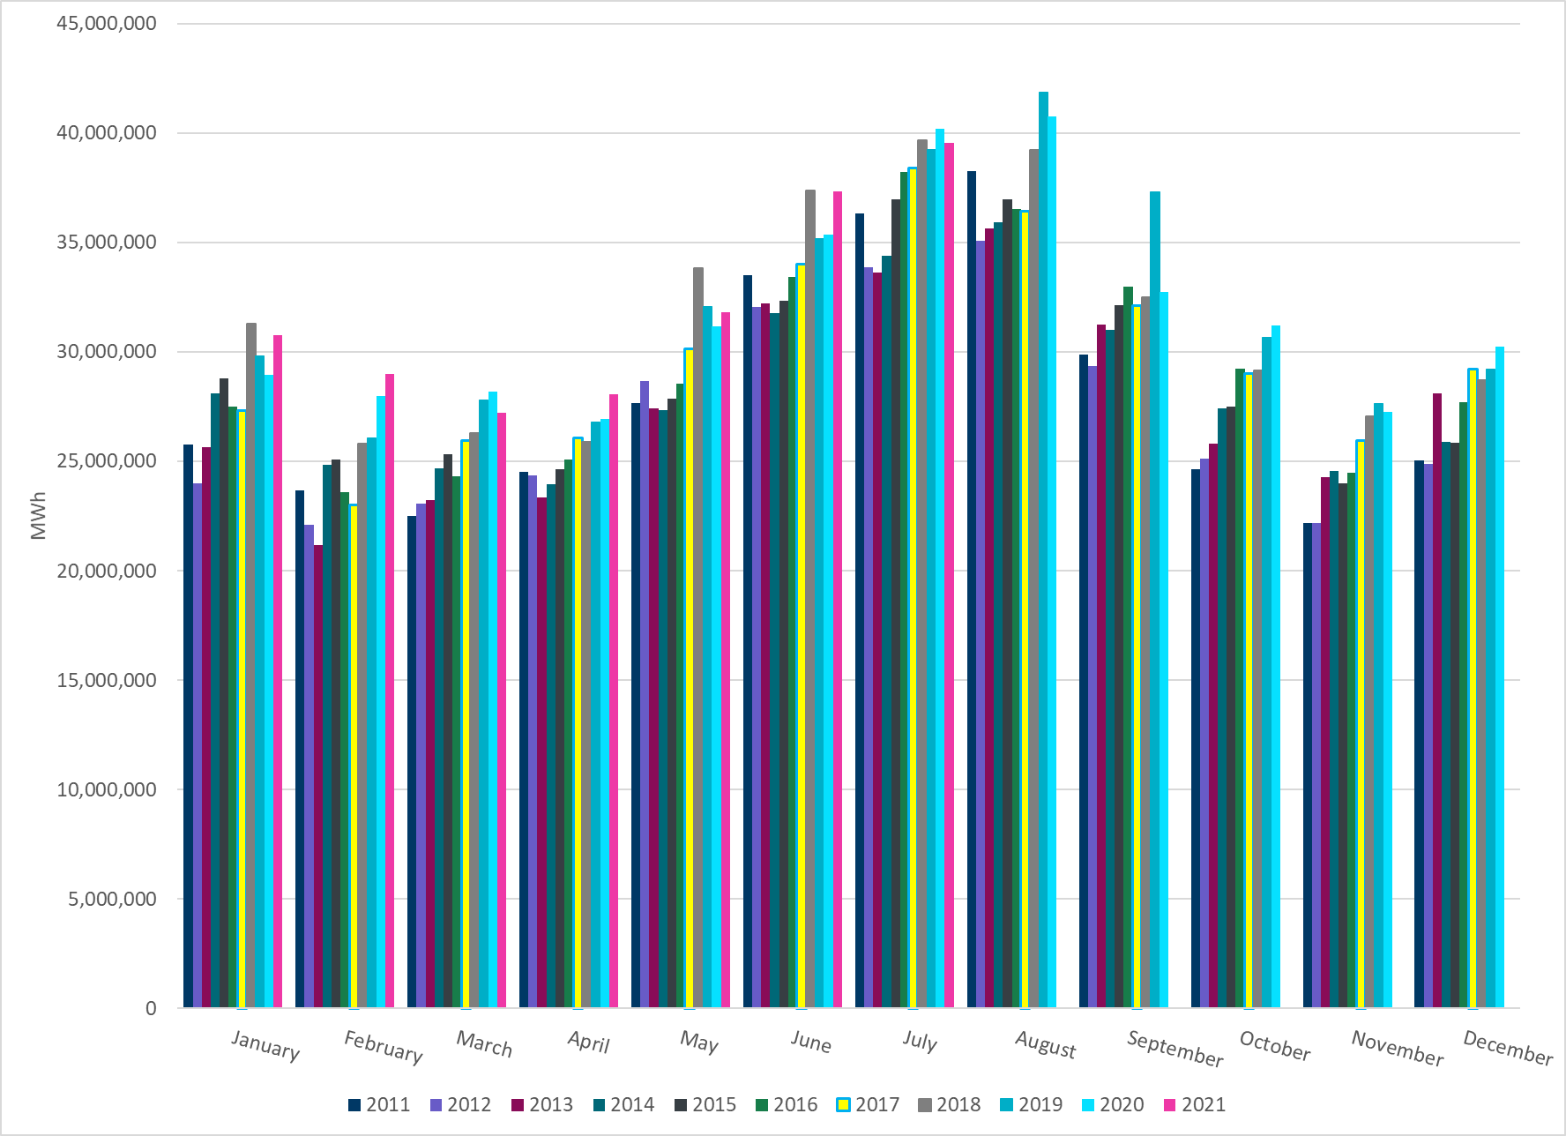
Total Energy
Notes:
39,555,014 MWh

Slide 22
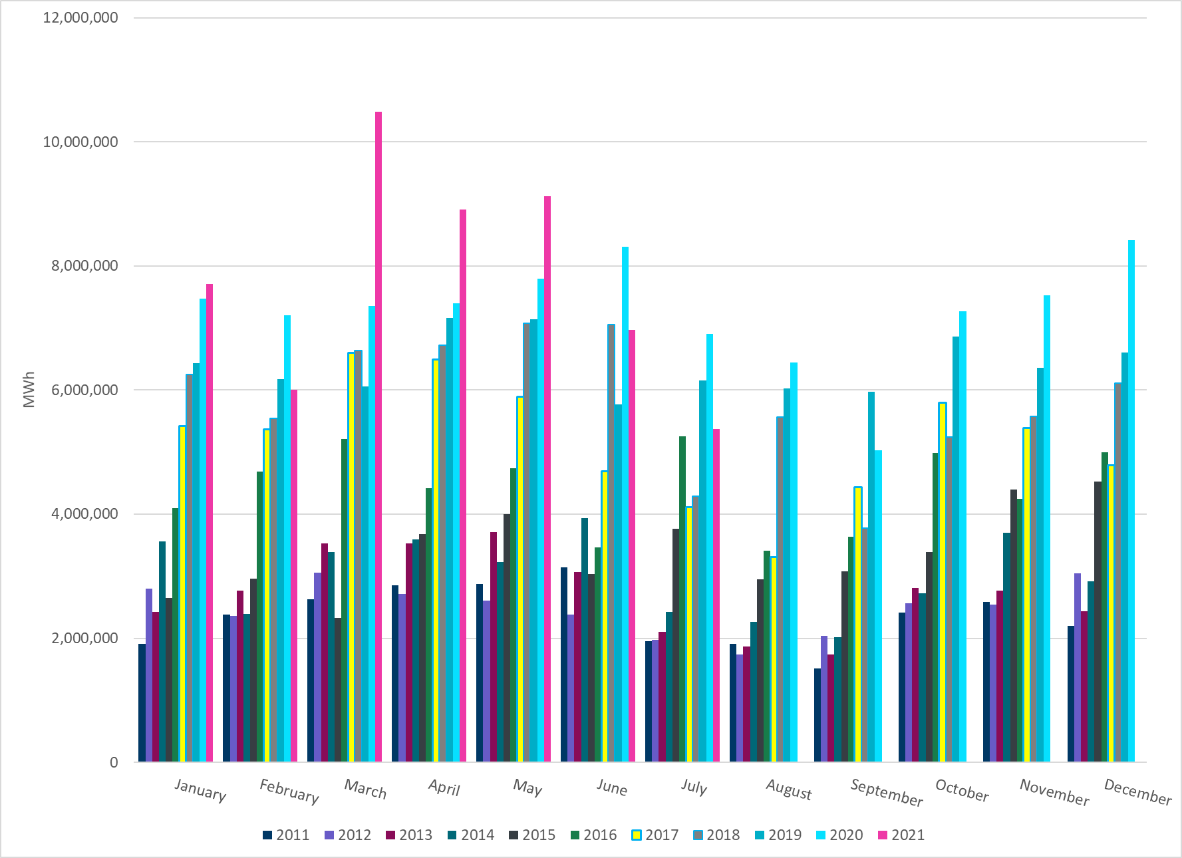
Total Energy from Wind Generation
Notes:
5,369,386 MWh

Slide 23
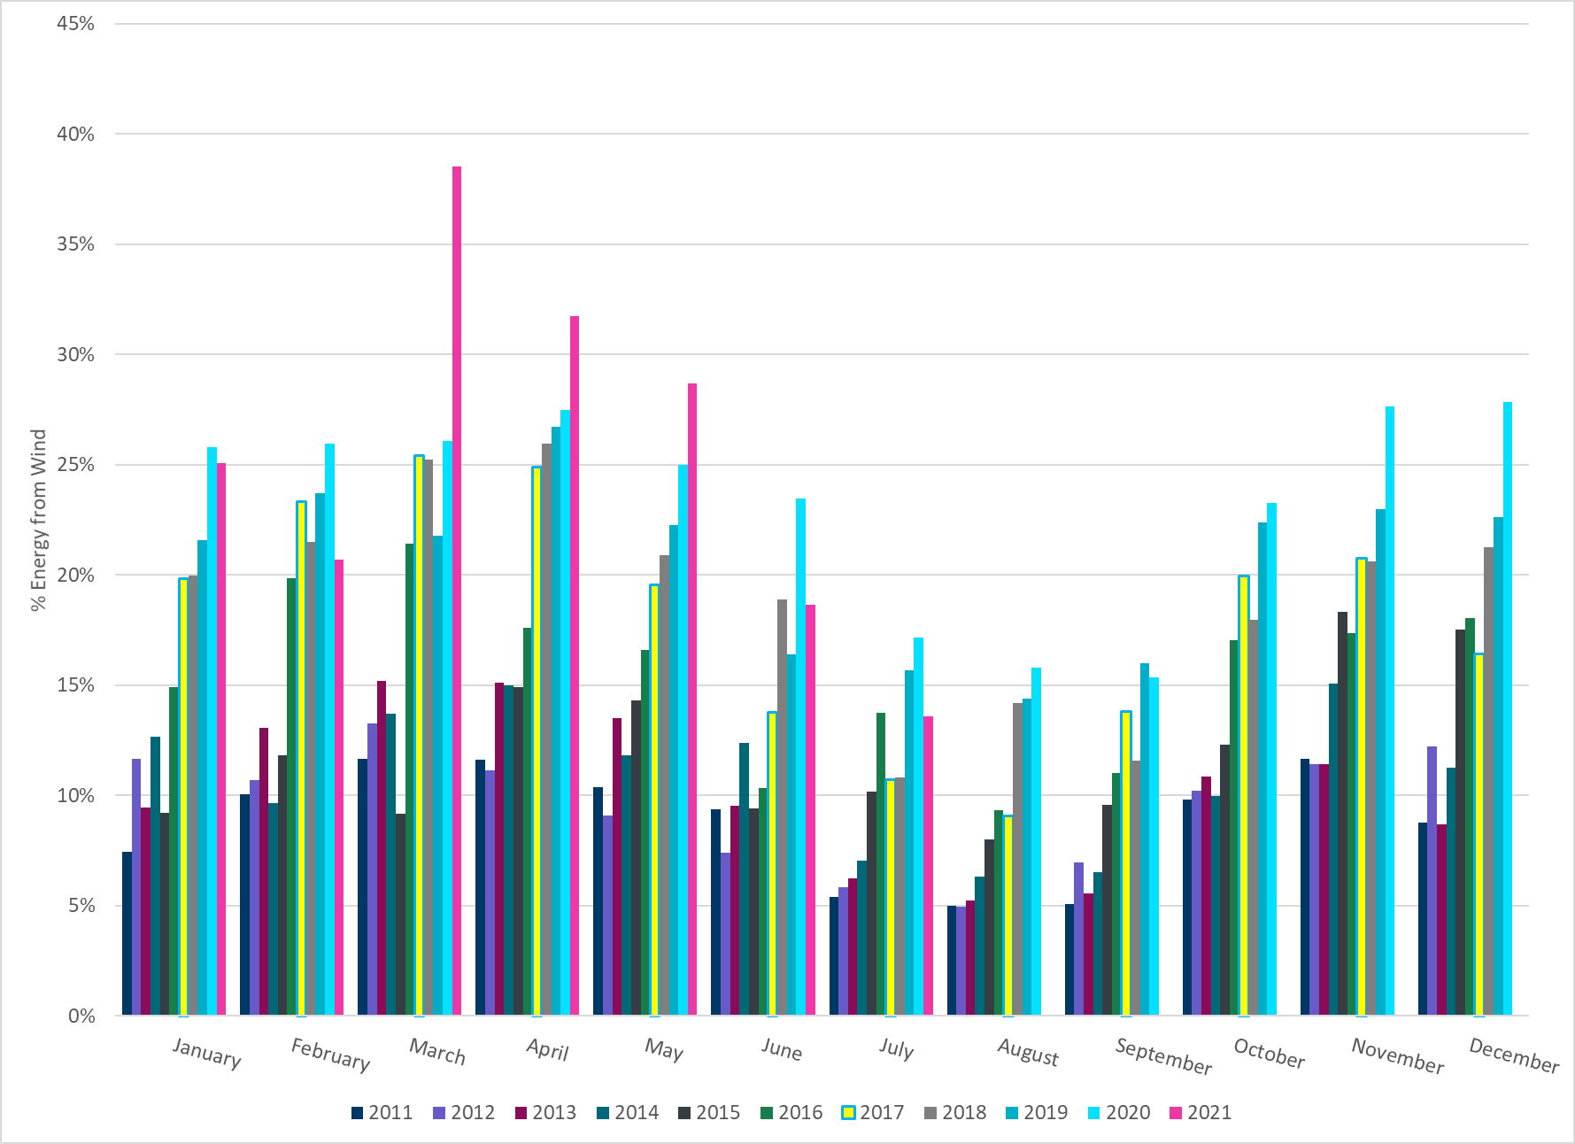
% Energy from Wind Generation
Notes:
13.57%

Slide 24
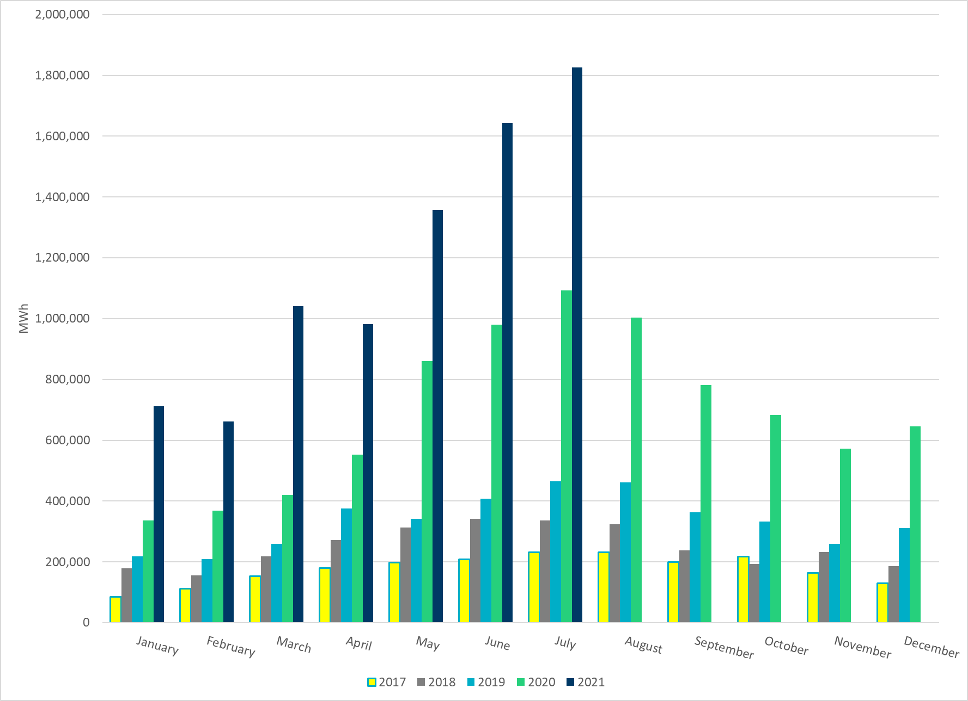
Total Energy From Solar Generation
Notes:
1,826,325 MWh

Slide 25
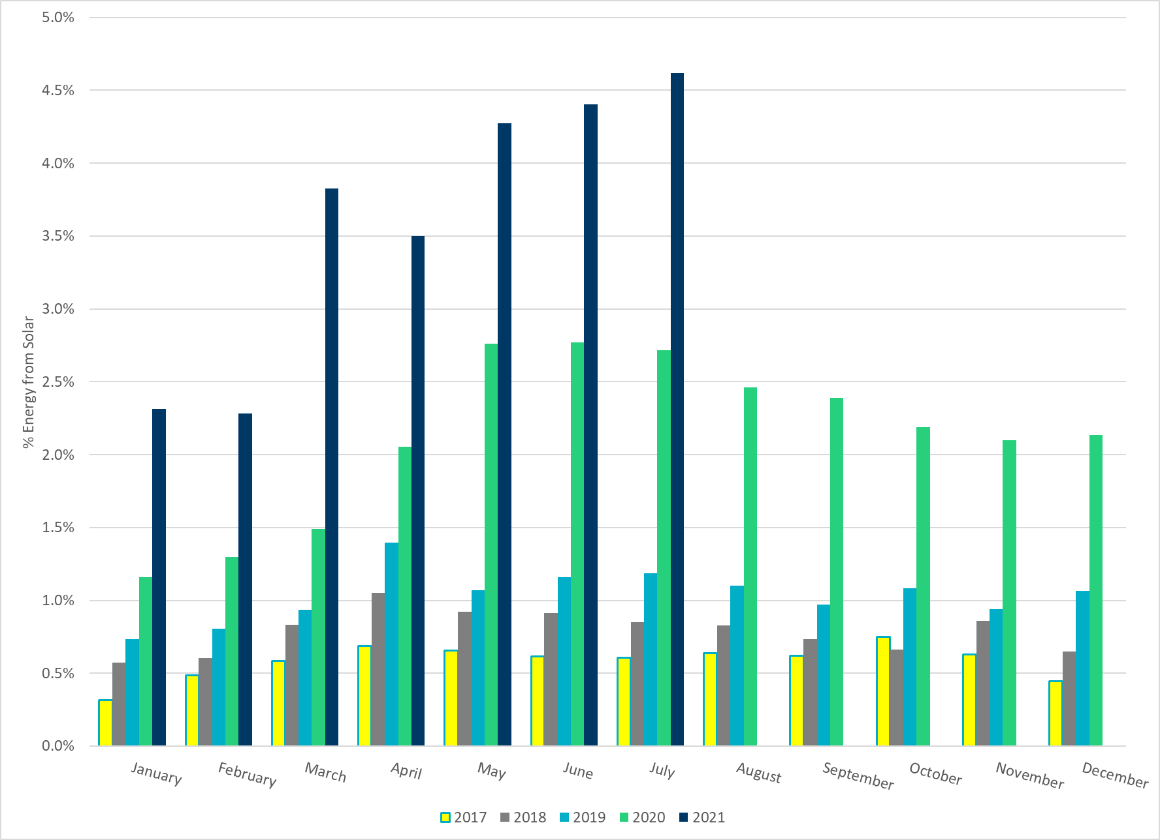
% Energy from Solar Generation
Notes:
4.62%

Slide 26
ERCOT System Inertia

Slide 27
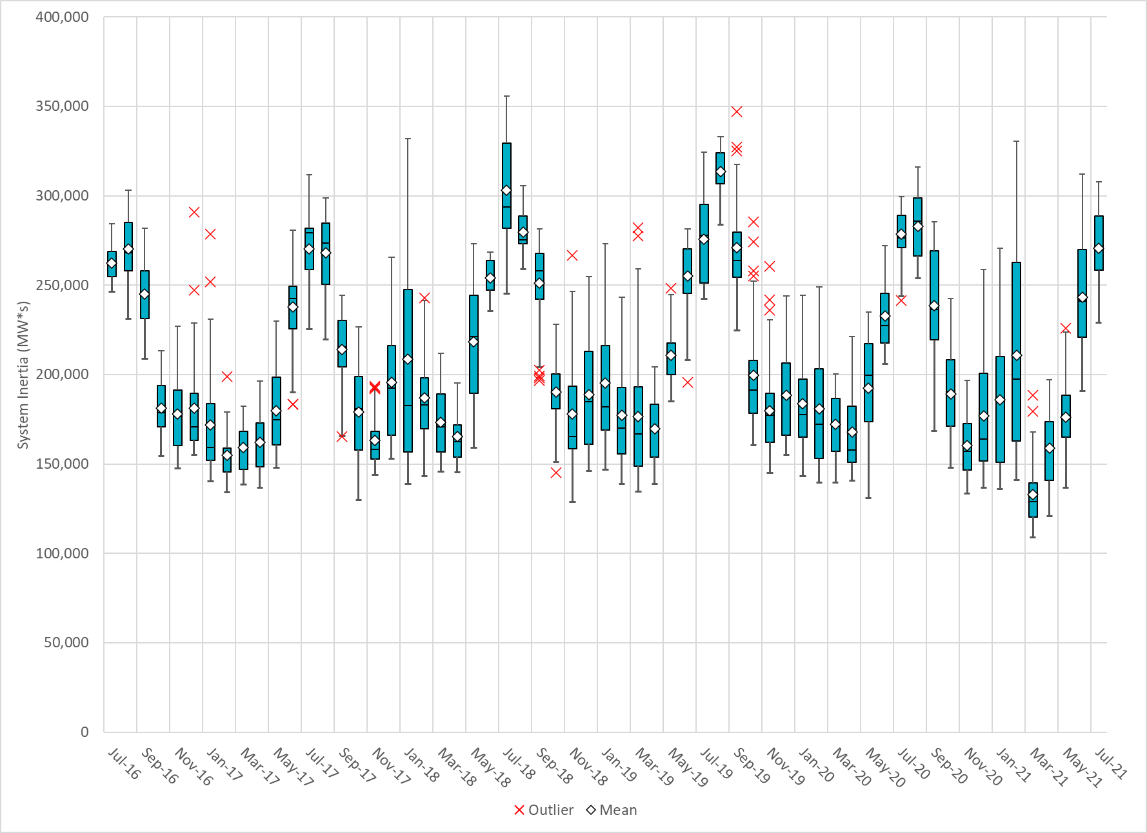
Daily Minimum System Inertia
Notes:
Minimum Inertia = 229,116 MW*s on 7/10/2021
Previous Minimum was 109,029 MW*s on 3/22/2021
Data:
Mean: 270,728 MW*s
Max: 307,668 MW*s on Jul 27th
Min: 229,166 MW*s on Jul 10th

Slide 28
Questions?
Thank you!

