Slide 1
ERCOT Frequency Events
July 2021
ERCOT
Operations Planning
PDCWG | August 11th, 2021

Slide 2
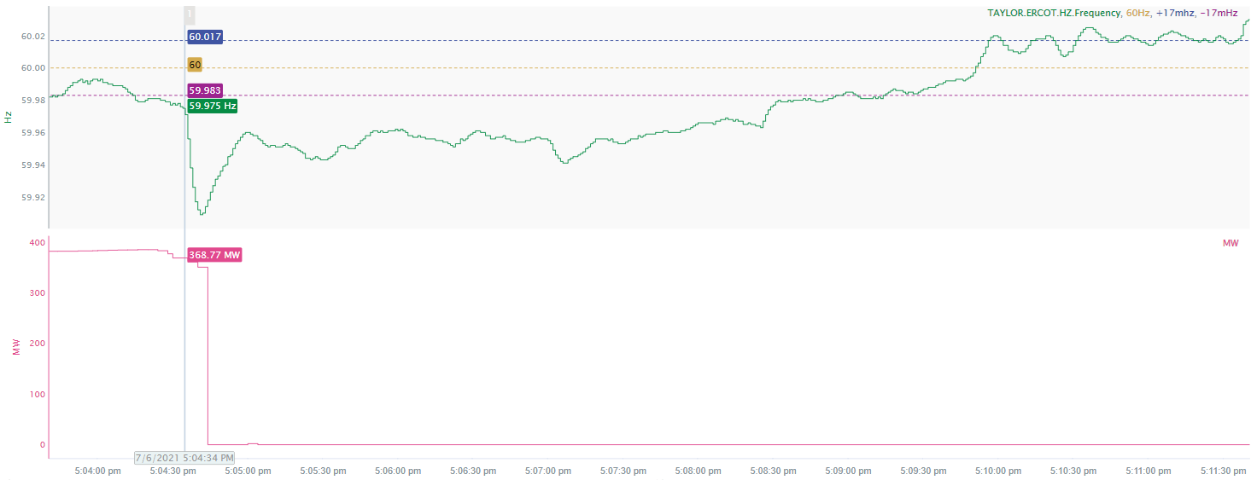
7/6/2021 17:04:34 (NON FME)
Notes:
Unit experienced run back while carrying 385 MW and tripped offline while carrying 351 MW.
Starting Frequency: 59.975 Hz
Minimum Frequency: 59.909 Hz
A-C Time: 7 seconds
Recovery Time (back to deadband): 4 minutes and 15 seconds
RRS Deployed: 0 MW
Trip Reason: Boiler circulating pump differential
Contextual Information: A total of 220 MW of regulation up was deployed during the event.
No Selection Reason: The starting frequency was outside low deadband and MW loss is small

Slide 3
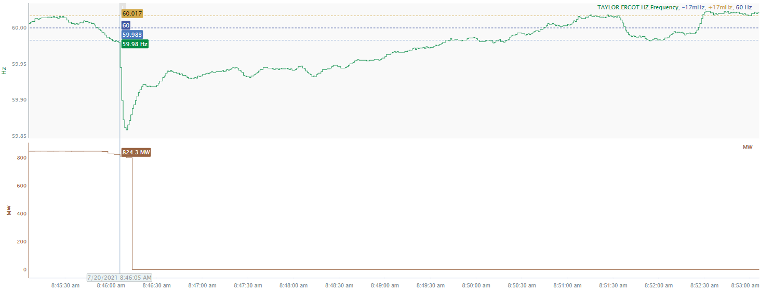
7/20/2021 8:46:05 (FME)
Notes:
Unit experienced run back while carrying 848 MW and tripped offline while carrying 801 MW.
Starting Frequency: 59.98
Minimum Frequency: 59.858 Hz
A-C Time: 5 seconds
Recovery Time(back to deadband): 3 minutes and 29 seconds
RRS Deployed: 696.05 MW
Trip Reason: loss of vacuum to the condenser
Contextual Information: A total of 369 MW of regulation up was deployed and manual offset of 300 MW was applied during the event.

Slide 4
Questions?
Thank you!

