Slide 1
Credit Exposure Update
Spoorthy Papudesi
Credit Work Group
ERCOT Public
April 21, 2021

Slide 2
Monthly Highlights Feb 2021- Mar 2021
Market-wide average TPE decreased from $ 4,521.1 million in February to $ 716.6 million in March
TPE decreased mainly due to lower Real-Time and Day-Ahead Settlement Point prices and lower Forward adjustment Factors in March compared to February
Due to the winter event, adjustments were made to the TPE calculation in February
TPE ranged from $ 317.01 million to $13.95 billion in February
Discretionary Collateral is defined as Secured Collateral in excess of TPE,CRR Locked ACL and DAM Exposure
Average Discretionary Collateral decreased from $3,251.2 million to $2,091.7 million
The decrease in Discretionary Collateral is largely due to decrease in Secured Collateral.
Short pay entities are excluded from the above calculations to remove data skew

Slide 3
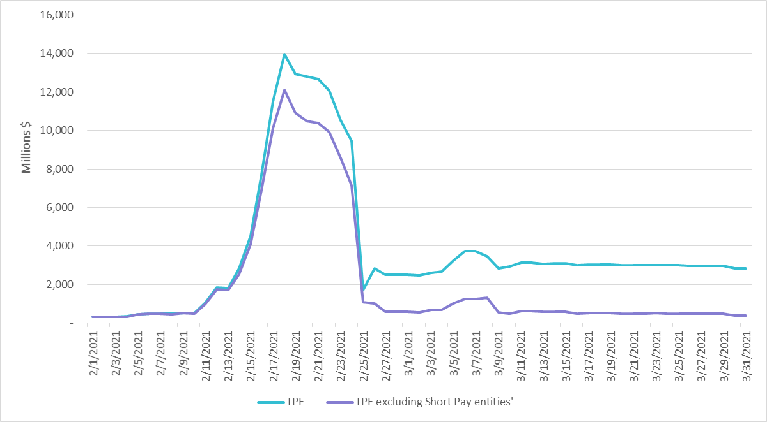
TPE with /without Short Pay Entities Feb 2021- Mar 2021

Slide 4
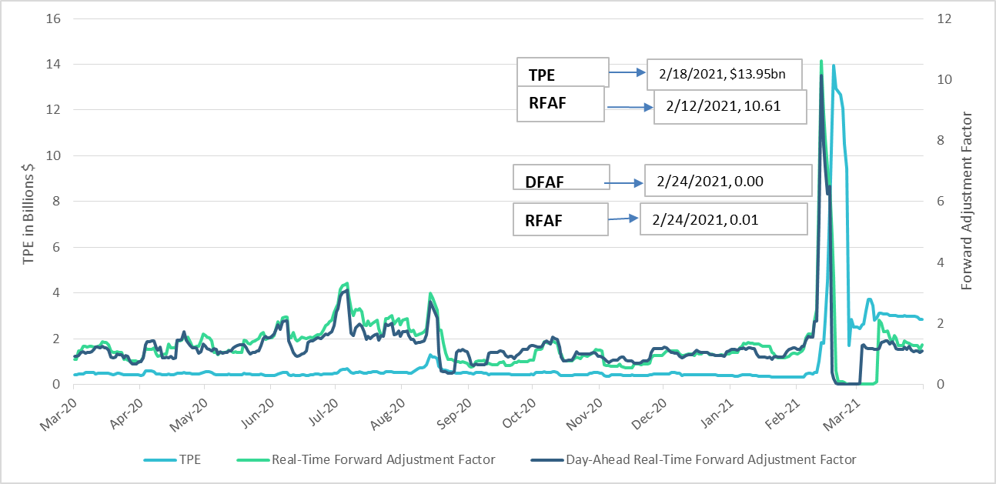
TPE and Forward Adjustment Factors Mar 2020- Mar 2021

Slide 5
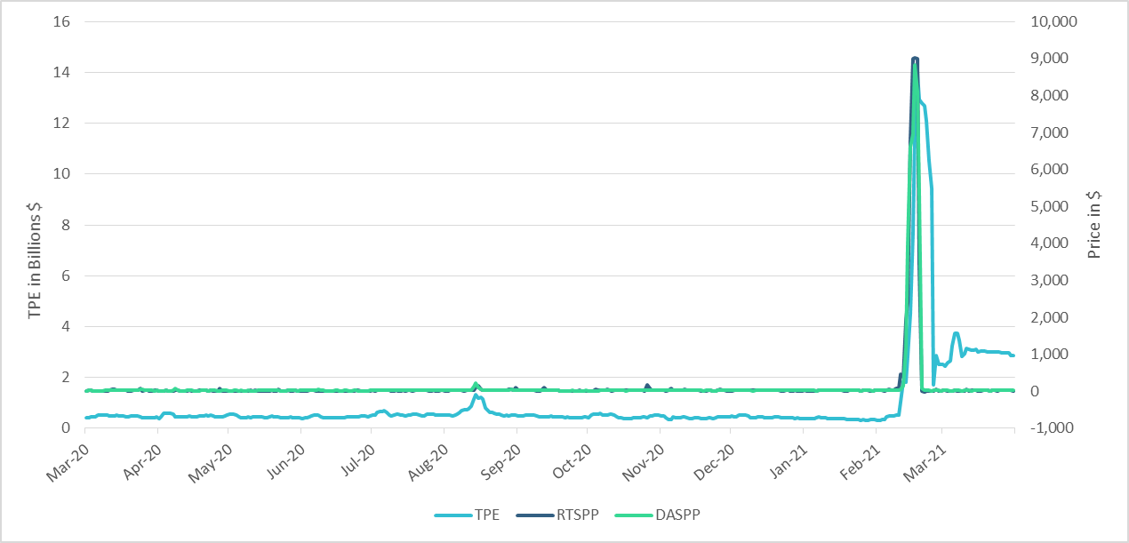
TPE/Real-Time & Day-Ahead Daily Average Settlement Point Prices for HB_NORTH Mar 2020- Mar 2021
RTSPP
2/17/2021, $9,025.97
DASPP
2/17/2021, $8,833.66

Slide 6
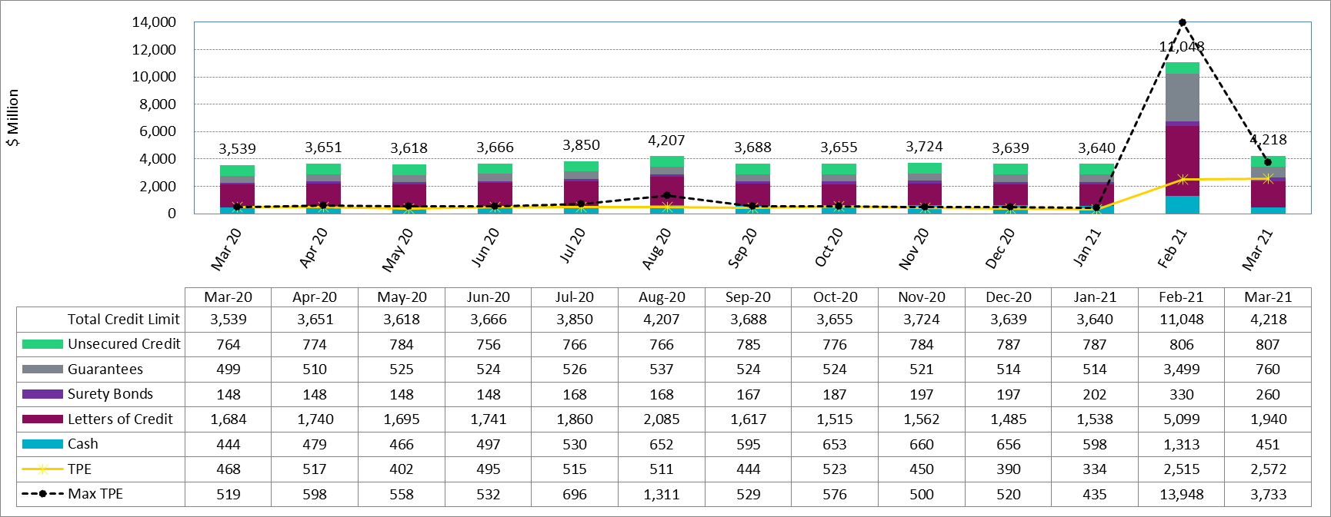
Available Credit by Type Compared to Total Potential Exposure (TPE) Mar 2020- Mar 2021
* Numbers are as of month-end except for Max TPE

Slide 7
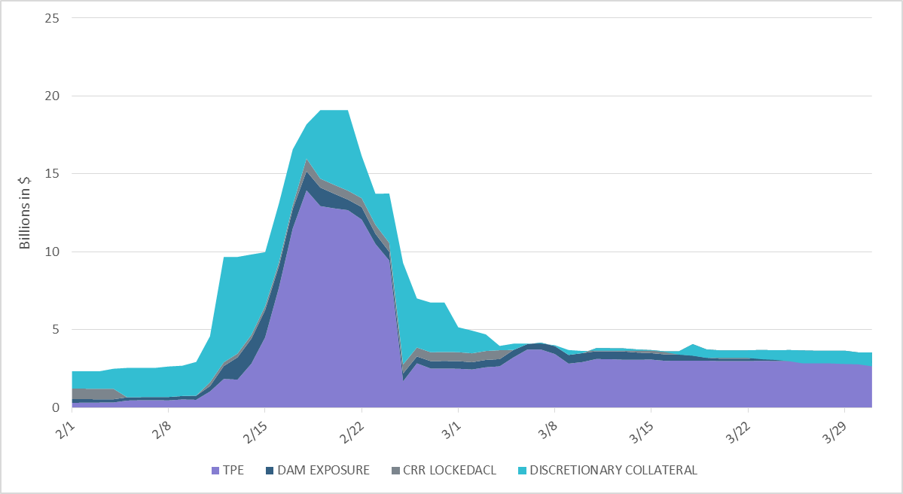
Discretionary Collateral Feb 2021 - Mar 2021
Average Discretionary Collateral increased to $3.2 bn in February
Note: Discretionary collateral doesn’t include Unsecured Credit Limit or parent guarantees

Slide 8
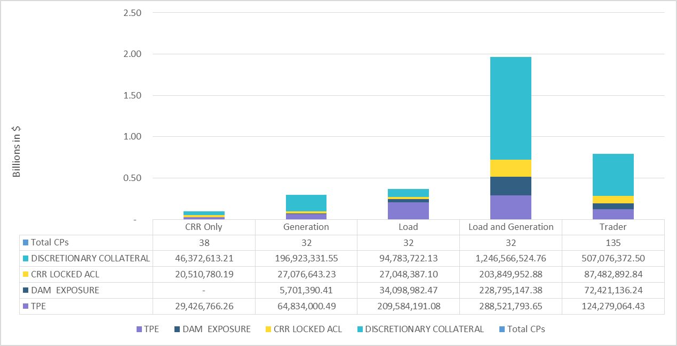
TPE and Discretionary Collateral by Market Segment- Mar 2021*
Load and Generation entities accounted for the largest portion of discretionary collateral
*Short pay entities are excluded from the above calculations to remove data skew

Slide 9
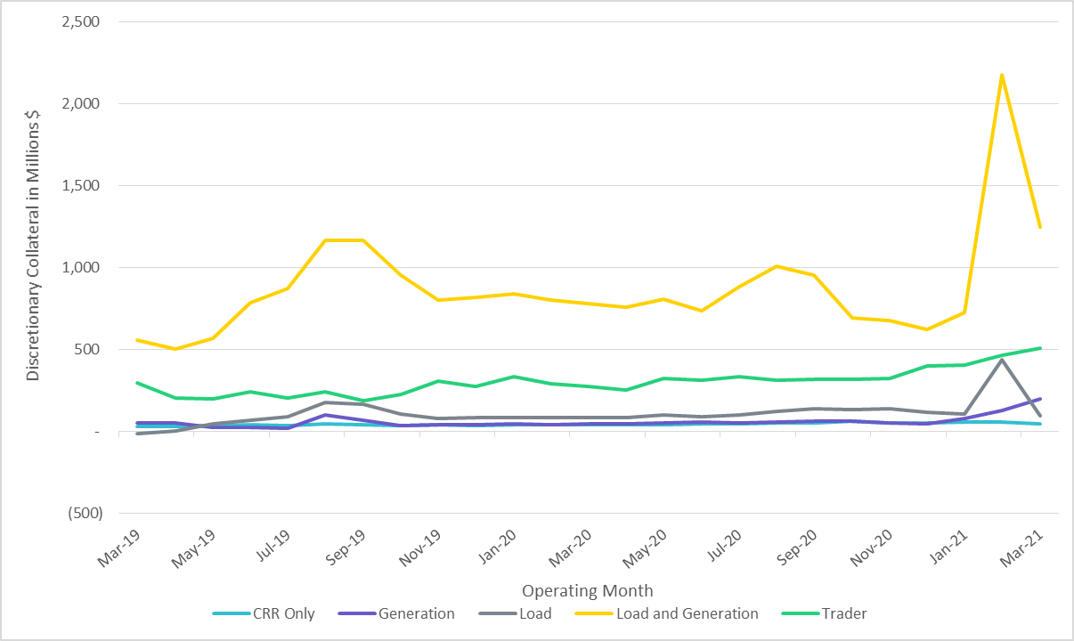
Discretionary Collateral by Market Segment Mar 2019- Mar 2021
*Short pay entities are excluded from the above calculations for March 2021 to remove data skew

Slide 10
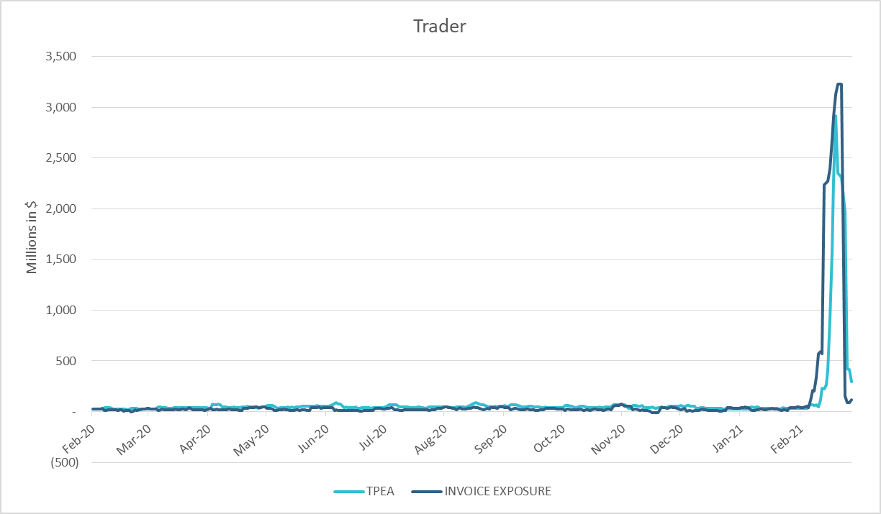
TPE Coverage of Settlements Feb 2020 - Feb 2021
TPEA generally exceeds actual/invoice exposure
During the 2021 winter event, Invoice Exposure was slightly higher than TPEA

Slide 11
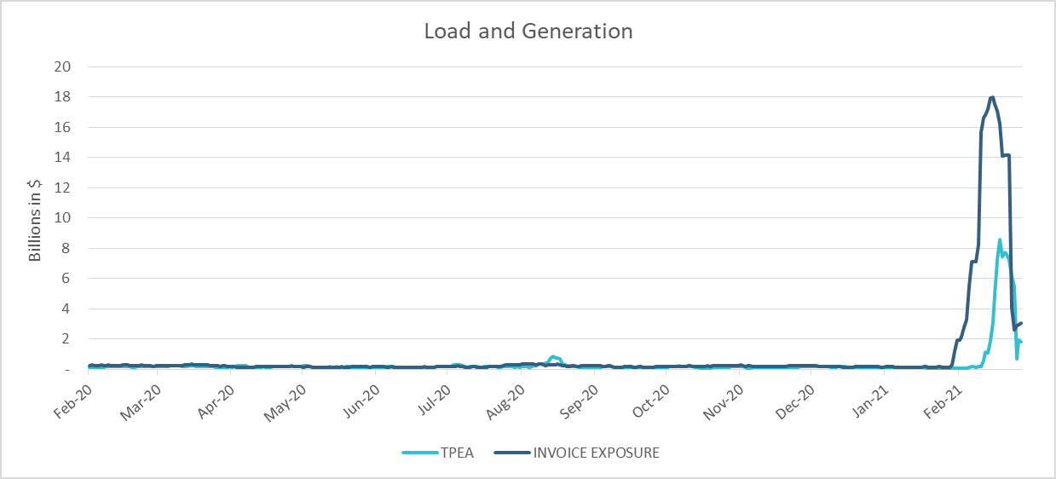
TPE Coverage of Settlements Feb 2020 - Feb 2021
During the 2021 winter event, Invoice Exposure was higher than TPEA

Slide 12
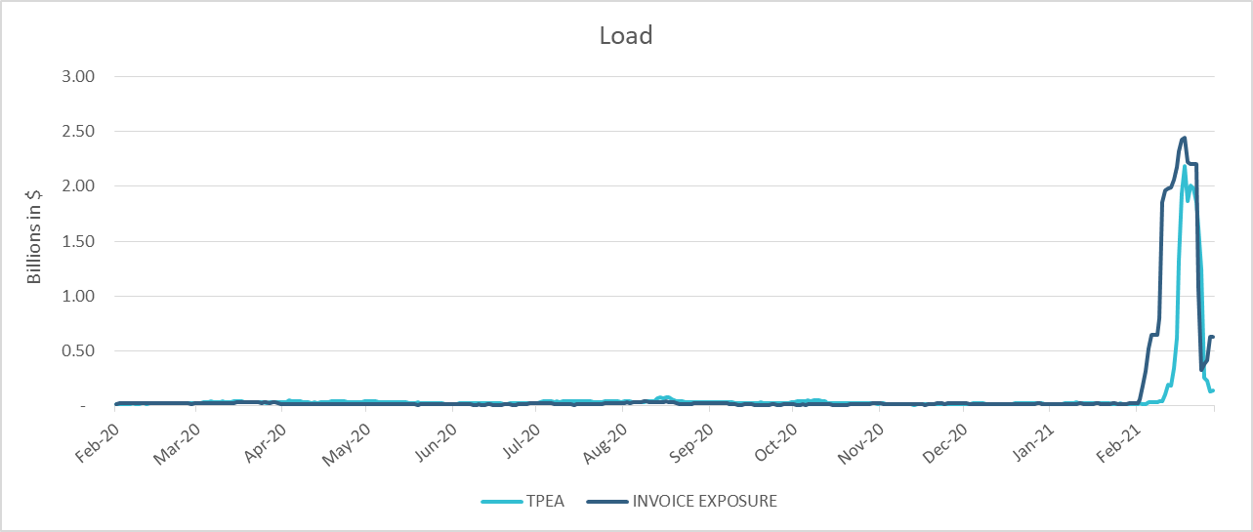
TPE Coverage of Settlements Feb 2020 - Feb 2021
TPEA closely approximates actual/invoice exposure except during the Winter 2021 event

Slide 13
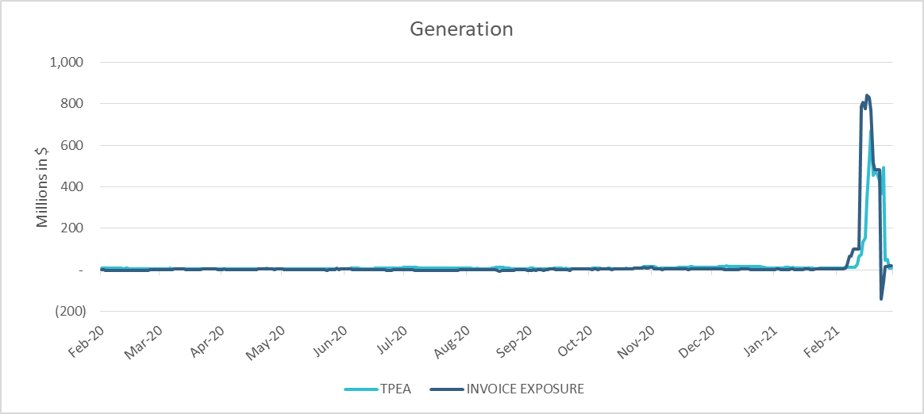
TPE Coverage of Settlements Feb 2020 - Feb 2021
TPEA generally exceeds actual/invoice exposure except during the Winter 2021 event

Slide 14
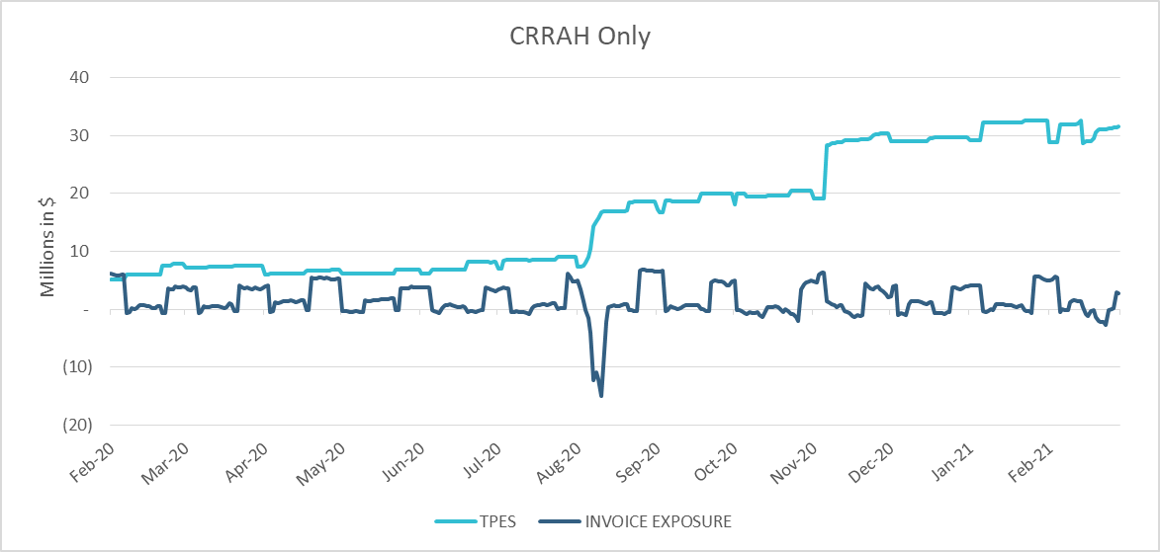
TPE Coverage of Settlements Feb 2020 - Feb 2021
TPES mostly exceeds actual/invoice exposure

Slide 15
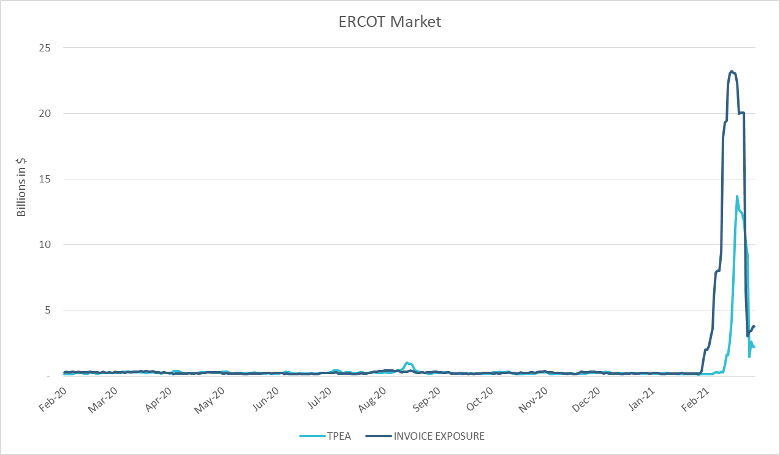
TPE Coverage of Settlements Feb 2020 - Feb 2021
TPEA closely approximates actual/invoice exposure except during weather event

Slide 16
Appendix

Slide 17
Summary of Distribution by Market Segment*
Note: Excess collateral doesn’t include Unsecured Credit Limit and is defined as Collateral in excess of TPE
*Short pay entities are excluded from the above calculations to remove data skew

Slide 18
Summary of Distribution by Rating Group*
*Short pay entities are excluded from the above calculations to remove data skew

Slide 19
Distribution of TPE by Rating and Category*
*Short pay entities are excluded from the above calculations to remove data skew

Slide 20
Distribution of Excess Collateral by Rating and Category*
Note: Excess collateral doesn’t include Unsecured Credit Limit
*Short pay entities are excluded from the above calculations to remove data skew

Slide 21
TPE Coverage of Settlements
TPEA covers Settlement/Invoice exposure and estimated Real-Time and Day- Ahead completed but not settled activity (RTLCNS and UDAA)
The analysis was performed for the period, Feb 2020 - Feb 2021
Only Settlement invoices due to ERCOT are considered in the calculation
M1 values as of May 28, 2020 were used for the period Feb 2020- May 2020 and M1 values effective as of each day were used since Jun 2020
Example
For business date 2/1/2020, if a Counter-Party has M1 value of 20, then all the charge invoices till 2/21/2020 including RTLCNS and UDAA as of 2/1/2020 is summed up to arrive at “Invoice Exposure”

Slide 22
Questions

