Slide 1
Comparison of Renewable Capacity Contribution Methods
Supply Analysis Working Group
Pete Warnken
Resource Adequacy
August 6, 2021
Notes:
Welcome to

Slide 2
Methods Evaluated – Summer Season Examples
Current Protocol approach: Average telemetered High Sustained Limits for the highest 20 seasonal peak load hours, averaged over the past seven seasons. Values calculated as a percentage of the weighted-average installed wind capacities.
Seven-season history for wind; three seasons for solar
Current Protocols approach using Net Peak Loads: Average telemetered High Sustained Limits for the highest 20 net peak load hours (load minus wind output), averaged over the past seven seasons. Values calculated as a percentage of the weighted-average installed wind capacities.
Seven-season history for wind regions; three seasons for solar

Slide 3
Methods Evaluated – Summer Season Examples
Effective Load Carrying Capability: A measure of the incremental load that the system can meet with renewable capacity, with no net change in reliability
Values determined using a probabilistic loss-of-load model (SERVM)
Values come from Appendix 2 of the 2020 Reserve Margin study report: http://www.ercot.com/content/wcm/lists/219844/2020_ERCOT_Reserve_Margin_Study_Report_FINAL_1-15-2021.pdf
Median (P50) Value of the Profile Distributions for HE 13-20: The median of all values of the UL Renewables profile distributions for summer 2021 SARA operation/planned resources (covering HE 13-20), as a percentage of the nameplate capacity
Profile distributions represent the summer hourly MW output values over the last 40 years (1980-2020) based on the corresponding historical weather patterns

Slide 4
Methods Evaluated – Summer Season Examples
Current Protocol Approach, but calculated for individual hours, HE 16-18
Current Protocols approach using Net Peak Loads, but calculated for individual hours, HE 16-18
Median (P50) Value of the Profile Distributions for individual hours, HE 16-18

Slide 5
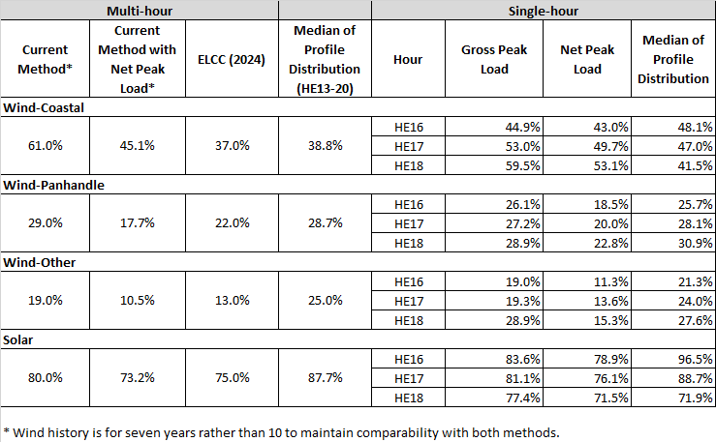
Method Comparison

