Slide 1
NERC 2021 LTRA Status
Pete Warnken
Manager, Resource Adequacy
August 6, 2021

Slide 2
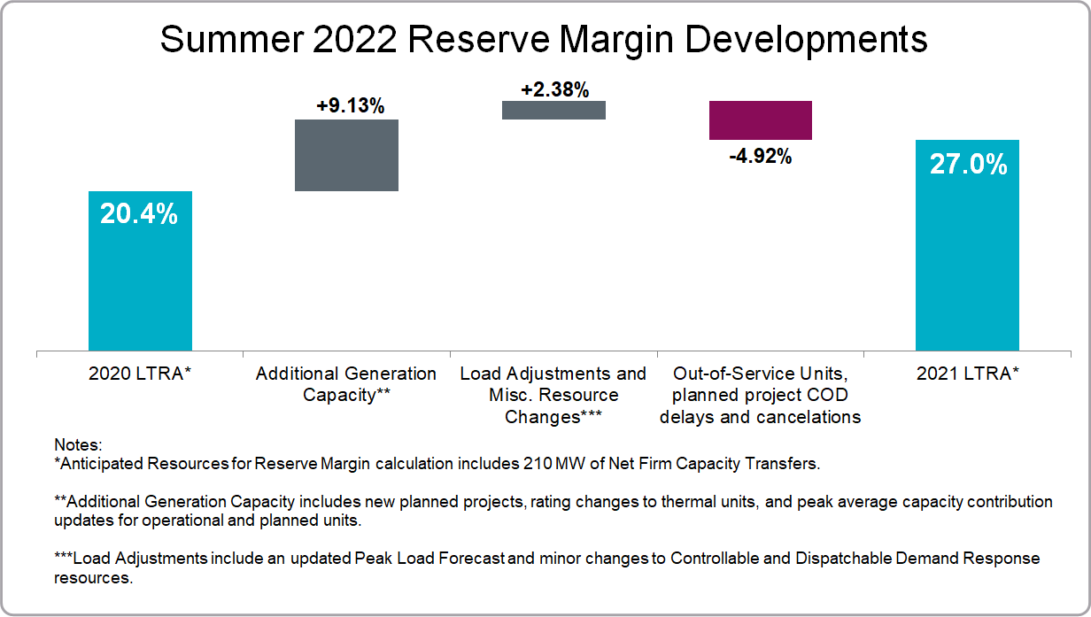
2022 Summer Anticipated Reserve Margin
Changes since 2020 LTRA

Slide 3
Tier 1, 2 and 3 Resource Categorization
Operational – Includes units undergoing commissioning that have been approved by ERCOT for grid synchronization (Change from 2020 LTRA)
Tier 1 – Same as CDR criteria
Tier 2 – All projects for which an ERCOT steady-state Security Screening Study was completed and a Full Interconnection Study has been requested
Tier 3 – Projects for which an interconnection application has been completed, and that do not meet Tier 1 or Tier 2 criteria
July 15 remains the summer cut-off date for including resources

Slide 4
Remaining LTRA Preparation Schedule
RAS – Reliability Assessment Subcommittee
RSTC – Reliability and Security Technical Committee

