Slide 1
Impact of Additional Procurement on Day-Ahead Market Ancillary Service Prices and Costs for July ‘21
August 6, 2021

Slide 2
Summary of Information
The following information is provided in these slides:
Graphs of changes in the Ancillary Service Plan amounts for Responsive Reserve Service (RRS) and Non-Spinning Reserve (Non-Spin) in July
Comparison of recent Market Clearing Prices for Capacity (MCPCs) looking at the various Ancillary Service types: Regulation Down Service (Reg-Down), Regulation Up Service (Reg-Up), RRS, and Non-Spin
Comparison of recent total Day-Ahead Market (DAM) Ancillary Service costs looking at the various Ancillary Service types: Reg-Down, Reg-Up, RRS, and Non-Spin

Slide 3
Change in Ancillary Service Plan Amounts for July – Non-Spin

Slide 4
Change in Ancillary Service Plan Amounts for July – RRS
Lighter color reflects the incremental change for the latter part of the month

Slide 5
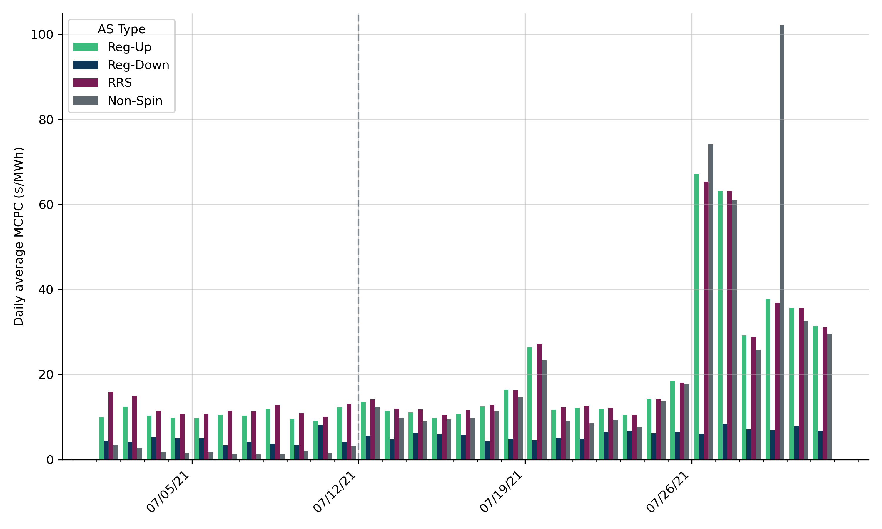
Average DAM MCPCs for July ‘21
Comparison of Monthly Avg. DAM MCPCs ($/MWh)
 | July ‘20 | June ‘21 | July ‘21
Reg-Up | 9.52 | 25.24 | 18.44
Reg-Down | 5.11 | 9.18 | 5.56
RRS | 9.80 | 30.86 | 19.08
Non-Spin | 4.27 | 16.97 | 16.55
Dotted line indicates when the changes in procurement amounts took effect

Slide 6
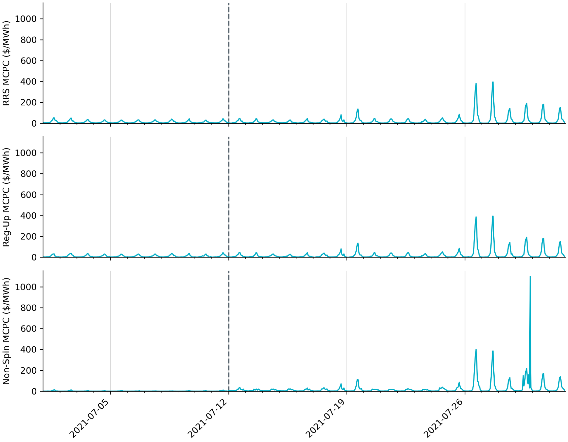
Hourly DAM MCPCs across July ‘21
Dotted line indicates when the changes in procurement amounts took effect

Slide 7
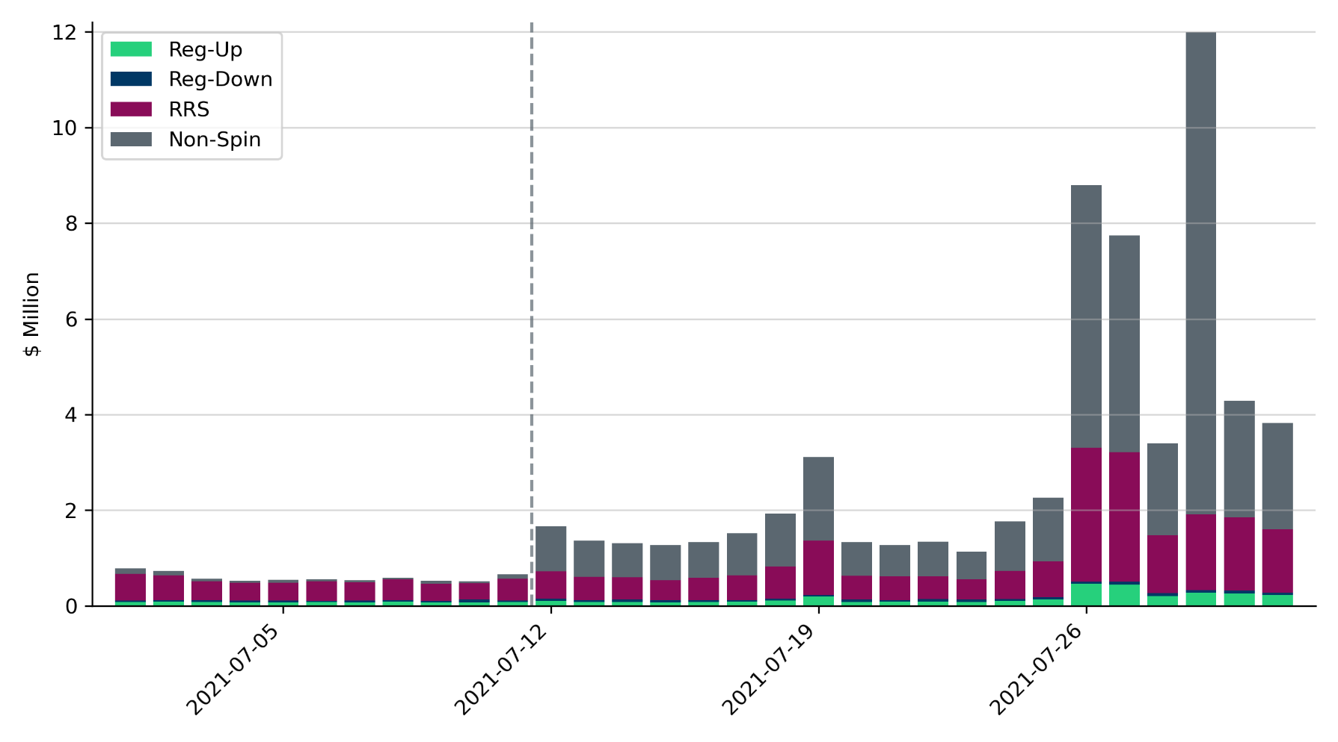
DAM Ancillary Service Costs
Comparison of Monthly Total DAM Ancillary Service Costs ($ Million)
 | July ‘20 | June ‘21 | July ‘21
Reg-Up | 2.2 | 5.9 | 4.1
Reg-Down | 1.4 | 2.4 | 1.3
RRS | 10.2 | 33.2 | 23.7
Non-Spin | 3.9 | 19.7 | 40.0
Dotted line indicates when the changes in procurement amounts took effect

