Slide 1
PDCWG Report to ROS
Chair: Chad Mulholland, NRG
Vice Chair: Jimmy Jackson, CPS
ROS
August 05, 2021

Slide 2
Report Overview & Notes
Report Overview
Meeting Minutes
BAL-001-TRE-2 FMEs & IMFR
4 FMEs in the month of June
Frequency Control Report

Slide 3
Meeting Minutes
PDCWG Meeting 07/16/2021
Review of emergency conditions list from ROS
February cold weather event follow up discussion
ROS Action item – Ancillary Service questions
ERCOT reports

Slide 4
Frequency Measurable Events Performance

Slide 5
Frequency Measurable Events
There were 4 FMEs in June
6/7/2021 15:26:43
Loss of 1324 MW generation
Interconnection Frequency Response: 1151 MW/0.1 Hz
11 of 56 Evaluated Generation Resources had less than 75% of their expected Initial Primary Frequency Response.
11 of 56 Evaluated Generation Resources had less than 75% of their expected Sustained Primary Frequency Response.
6/12/2021 13:23:56
Loss of 503 MW generation
Interconnection Frequency Response: 1324 MW/0.1 Hz
13 of 57 Evaluated Generation Resources had less than 75% of their expected Initial Primary Frequency Response.
13 of 57 Evaluated Generation Resources had less than 75% of their expected Sustained Primary Frequency Response.

Slide 6
Frequency Measurable Events
6/14/2021 9:55:52
Loss of 566 MW of load (lots of evaluations; lots of failures)
Interconnection Frequency Response: 1230 MW/0.1 Hz
118 of 262 Evaluated Generation Resources had less than 75% of their expected Initial Primary Frequency Response.
99 of 262 Evaluated Generation Resources had less than 75% of their expected Sustained Primary Frequency Response.
6/20/2021 22:53:33
Loss of 556 MW of generation
Interconnection Frequency Response: 830 MW/0.1 Hz
9 of 44 Evaluated Generation Resources had less than 75% of their expected Initial Primary Frequency Response.
6 of 44 Evaluated Generation Resources had less than 75% of their expected Sustained Primary Frequency Response.

Slide 7
High Frequency FME on 6/14
Some additional metrics for FME on 6/14/2021 9:55:52
Of the 118 units that failed Initial Primary Frequency Response, 38 were Wind units (32% of failures), 31 were Combined Cycles (26% of failures), and 26 were Solar units (22% of failures)
Frequency response of other unit types (non-CC thermals and hydro units) was generally good
The 38 Wind unit failures represents 30% of the online Wind units
The 31 Combined Cycle unit failures represents 50% of the online CC units
The 26 Solar unit failures represents 49% of the online Solar units

Slide 8
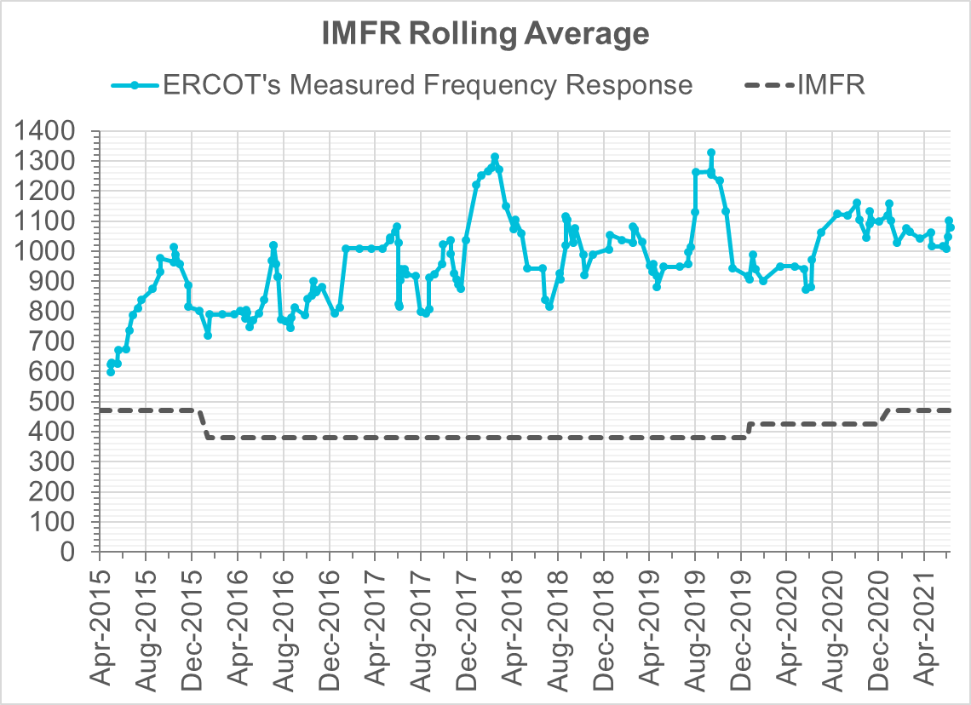
Interconnection Minimum Frequency Response (IMFR) Performance
IMFF Performance currently
1080.34 MW/0.1HZ
Frequency Response Obligation (FRO): 471 MW/0.1 Hz

Slide 9
Questions?

Slide 10
Frequency Control Report
June 2021

Slide 11
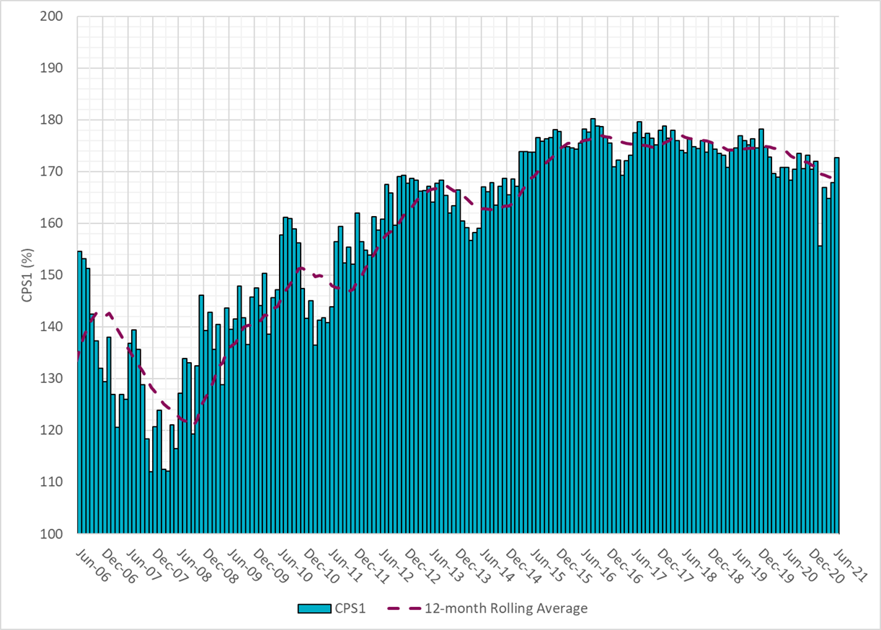
CPS1 Performance
Current 12-Month Rolling Average: 168.87%

Slide 12
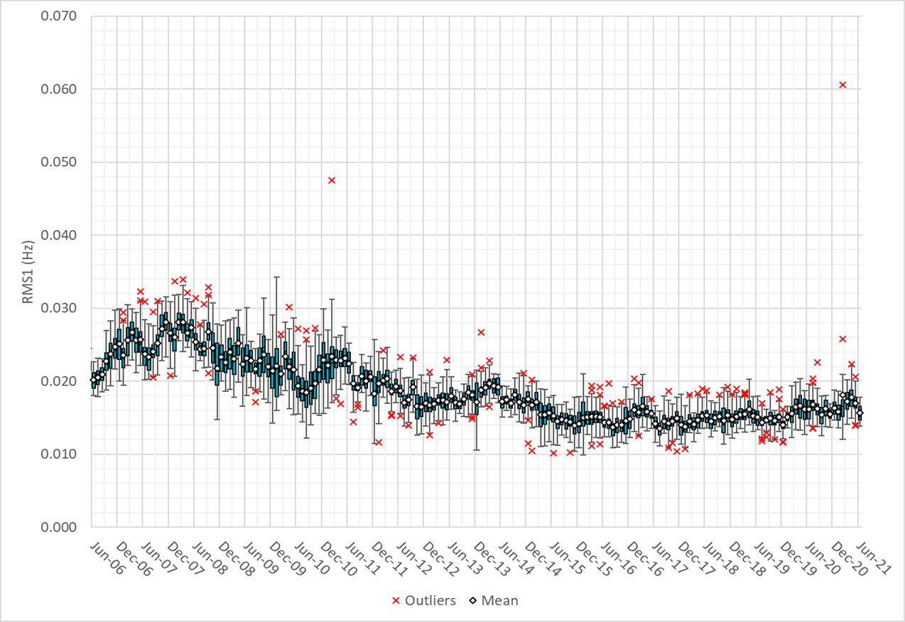
RMS1 Performance of ERCOT Frequency

Slide 13
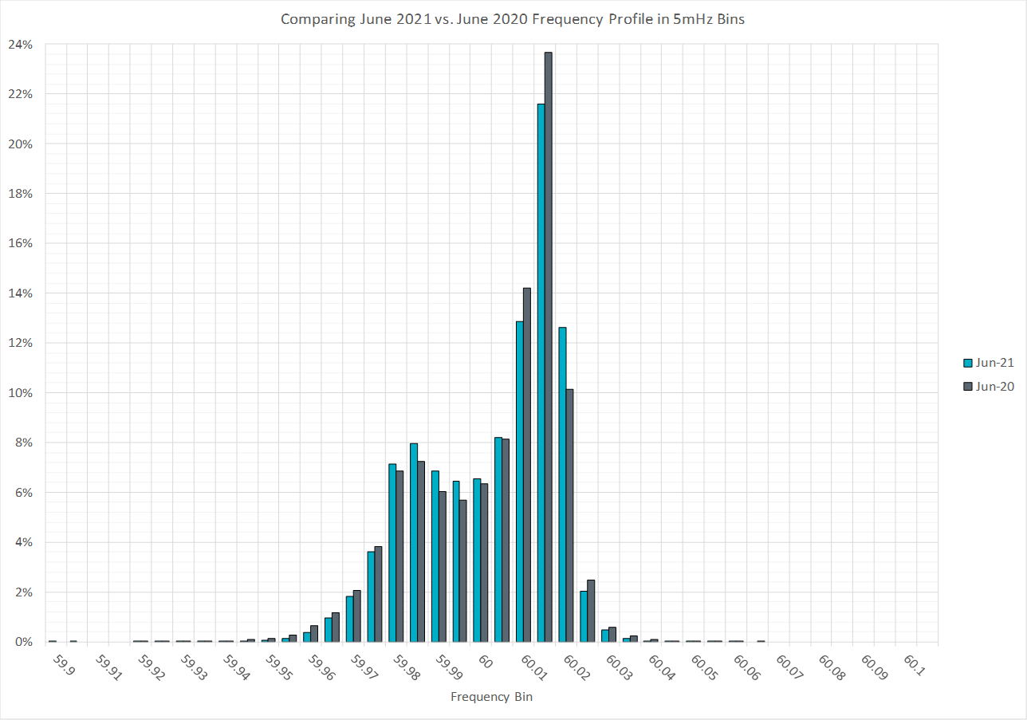
Frequency Profile Analysis

Slide 14
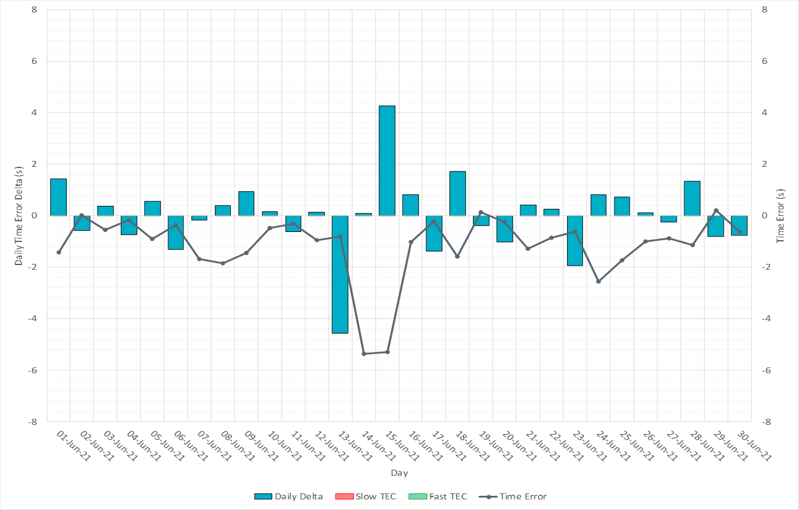
Time Error Corrections

Slide 15
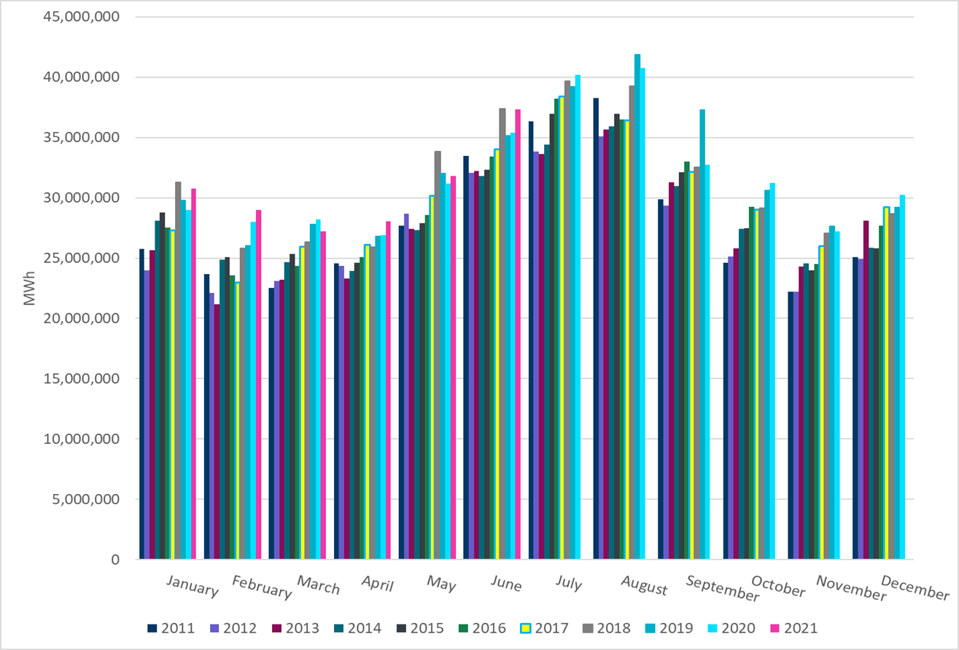
ERCOT Total Energy
Notes:
37,331,144 MWh

Slide 16
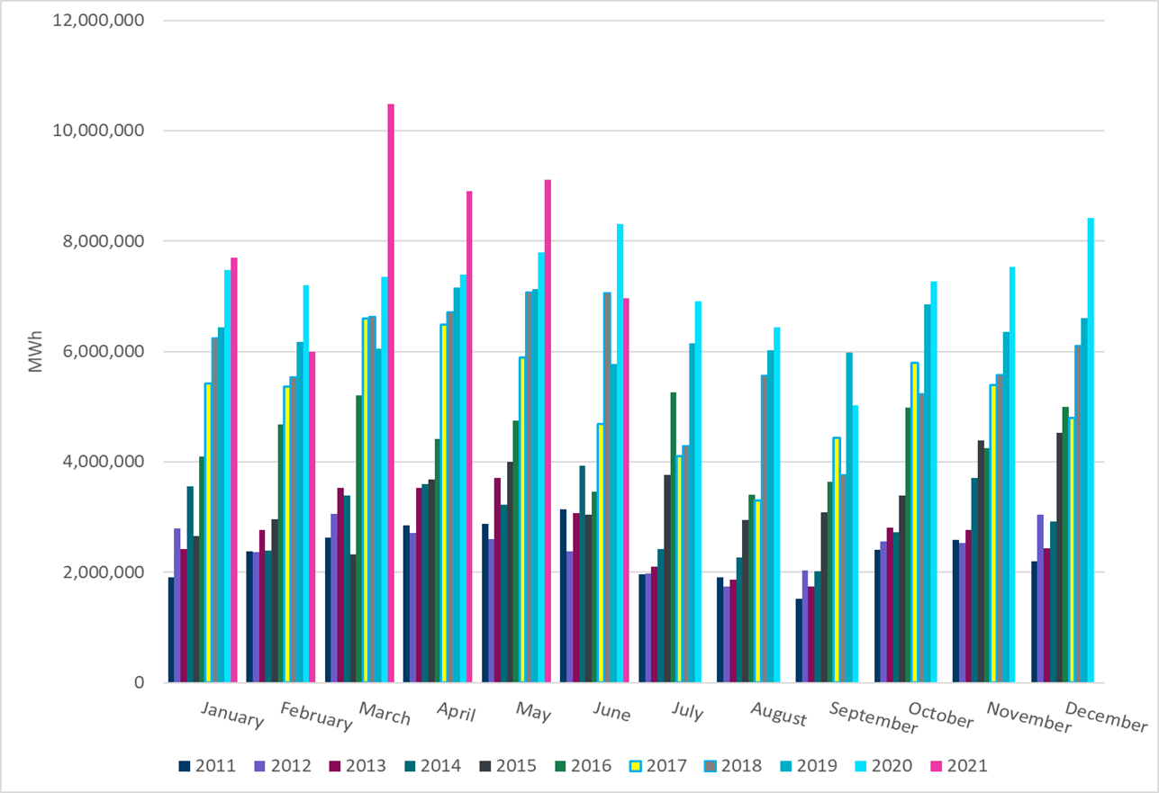
ERCOT Total Energy from Wind Generation
Notes:
6,965,821 MWh

Slide 17
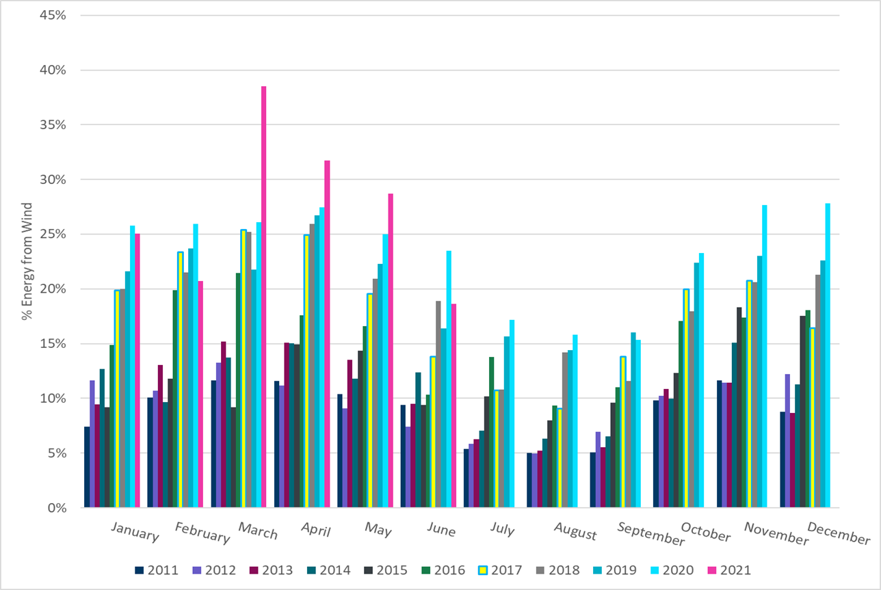
ERCOT % Energy from Wind Generation
Notes:
18.66%

Slide 18
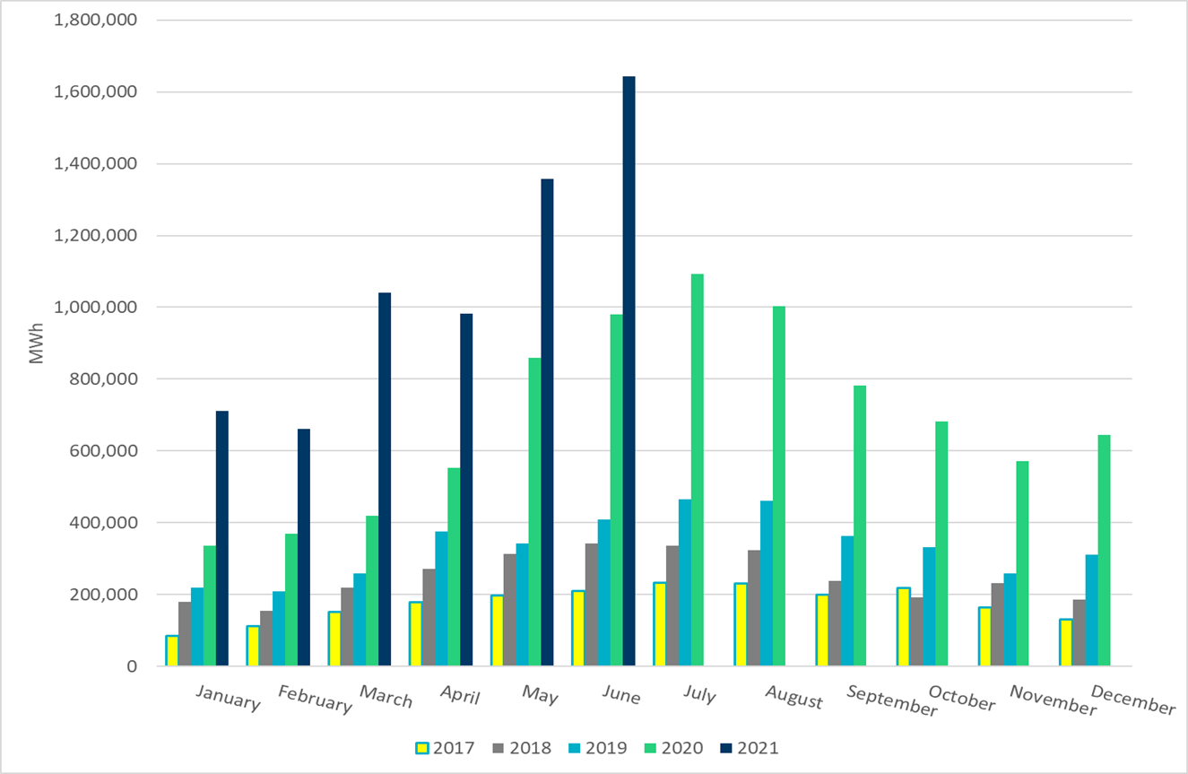
ERCOT Total Energy from Solar Generation
Notes:
1,643,972 MWh

Slide 19
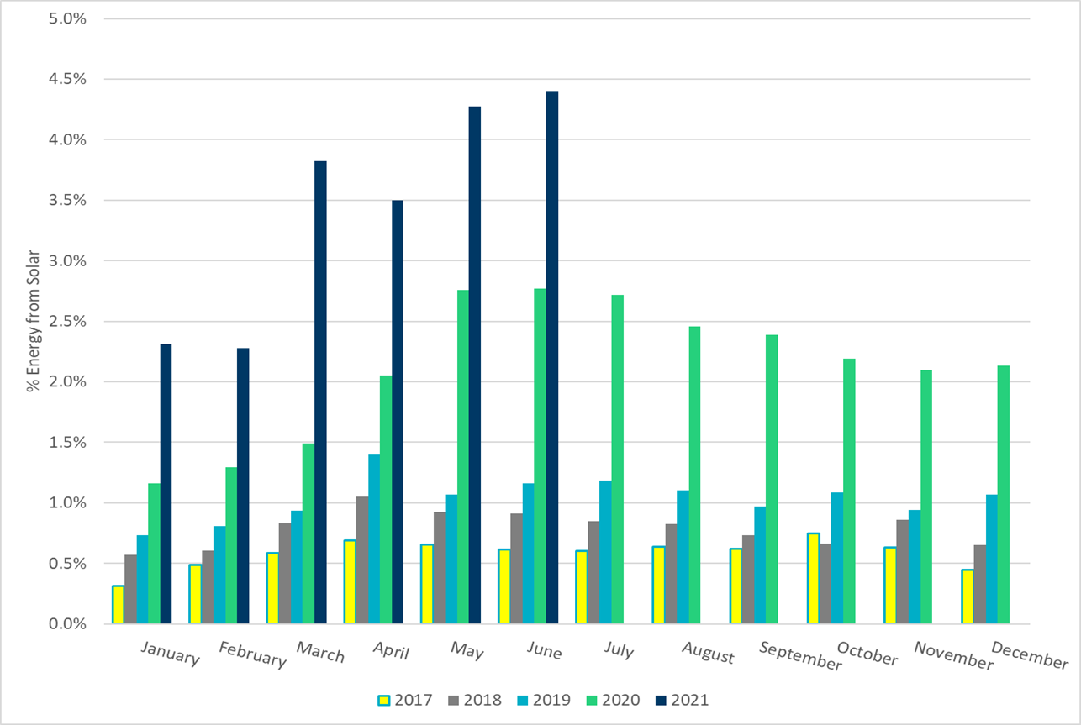
ERCOT % Energy from Solar Generation
Notes:
4.40%

