Slide 1
SARA Probabilistic Model, Summer 2021
Supply Analysis Working Group
Pete Warnken
Resource Adequacy
August 6, 2021
Notes:
Welcome to

Slide 2
Model Updates

Slide 3
Major Model Changes
New 1980-2020 hourly wind and solar profiles from UL Renewables
  Improved estimation of early morning and evening solar ramps
Widened the probability distributions for demand and thermal forced outages to encompasses the Extreme Scenarios in the 2021 Final Summer SARA
Incorporated the Summer 2021 SARA peak demand forecast and resource updates
  Includes planned resources with ERCOT synchronization approvals as of June 1 regardless of the summer projected commercial operations dates
Updated resource quantities available to respond to Energy Emergency Alerts (down by 350 MW overall)

Slide 4
Major Model Changes, continued
Modified price-responsive demand (PRD) uncertainty modeling
  Amount of PRD capacity selected for each trial increases as the sampled load forecast amount increases
  A fixed amount of PRD is assigned to deciles 5 through 10 of the load forecast distribution per the following table:
  For example, if the sampled load forecast amount for trial 1 is 78,110 MW, the selected PRD amount is 829 MW. If the sampled load amount is 77,000 MW, the amount selected is zero MW

Slide 5
Major Model Changes, continued
Model now determines a distribution for each hour’s “pre-EEA” reserve margin:
  This is not the same as the CDR’s Planning Reserve Margin; it is more akin to an operating reserve margin
Reserve Margin % = ((Total Resources – Outages) - Net Demand) / Net Demand

Slide 6
Simulation Results

Slide 7
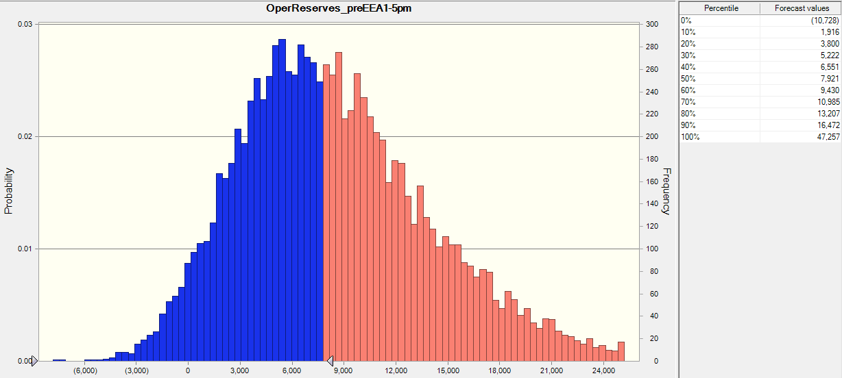
“Capacity for Operating Reserves” Outcome Distribution, HE 5:00 PM – 10,000 Trial Simulation
Simulation Outcome Range: 47,257 MW to -10,728 MW
Most extreme scenario for 2021 Summer SARA: -16,672 MW

Slide 8
Hourly Risk Profiles, Summer 2021 vs. 2020

Slide 9
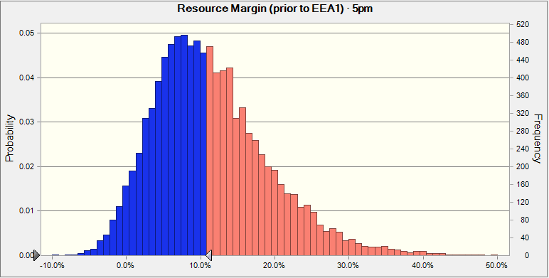
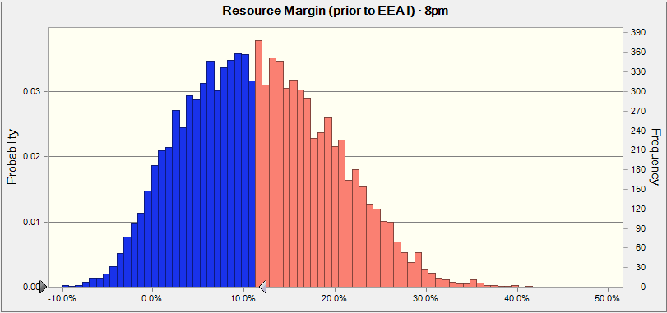
Reserve Margin Comparison, HE 5:00 PM vs. 8:00 PM
Reserve Margin % = ((Total Resources – Outages) - Net Demand) / Net Demand

Slide 10
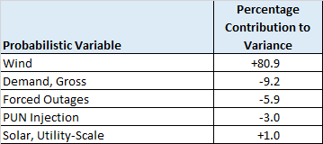
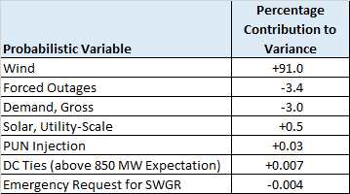
Probabilistic Variable Sensitivities
The tables below provide, for the key probabilistic variables, the percentage contributions to the overall variance in simulated “Capacity for Operating Reserves” for HE 5:00 PM
Wind dominates the variance in a positive direction, but less than for the summer 2020 simulation
Demand and forced outage variables have significant negative variance contributions that are larger than for the summer 2020 simulation, due to expansion of the probability distribution tails to encompass more extreme adverse outcomes
Summer 2021 Simulation
Summer 2020 Simulation

Slide 11
Simulation-based Probabilities for the Summer SARA Scenarios

Slide 12
Recap
Additions of new renewable resources, particularly solar, reduces the risk of EEA events for all hours relative to summer 2020 model results, except for HE 8:00 PM
Drop-off of solar to zero MW during HE 5:00 PM now causes higher EEA risk than for all other hours; the effect of this drop-off is amplified by the doubling of installed solar capacity relative to what was reported in the summer 2020 SARA

Slide 13
Unplanned Outages: SARA vs. Operations Reporting Differences
Compared to Unplanned Outage reports released by the ERCOT Operations Department, the SARA:
  Excludes wind, solar and hydro outages since they are already accounted for in other SARA resource availability line items, and therefore reflected in SARA available resource capacity
  Excludes battery storage outages since battery capacity is currently given no on-peak contribution credit in the SARA
  Excludes PUN generator outages since outages and impacts of self-supply are accounted for in the SARA aggregate PUN capacity contribution line item and thus reflected in available resource capacity
  Excludes Unavoidable Extension (UE) outages classified as "Planned”: these outages are treated as Planned outages in the SARA while Operations treats them as Forced: the sum of all UEs are nevertheless equal for both SARA and Operations reporting

Slide 14
Thermal Unplanned Outages: SARA vs. Operations Reporting Differences, continued
Compared to Unplanned Outage reports released by the ERCOT Operations Department, the SARA:
  Excludes outages for Switchable Generation Resources (SWGRs) unavailable to the ERCOT grid (currently Elk Units 1 and 2) since the unit capacities are already excluded as available operational capacity
  Excludes outages classified as Extended Outages (>180 days per "Notification of Suspension of Operations" submissions); these outages are accounted for in another SARA capacity line item in the Capacities tabs
  Operations reporting may reflect more recent seasonal HSLs in the Outage Scheduler than what are reflected in the SARA (minimal impact).

