Slide 1
DSWG Report
Christian powell
WMS Meeting – august 2021

Slide 2
Overview
Previous meeting – July 30
NPRR1082 - Emergency Response Service (ERS) Test Exception for Co-located ERS Loads
NPRR1087 - Prohibit Participation of Critical Loads and Generation Resource Support Loads as Load Resources or ERS Resources (Emergency Conditions Item 62)
Review of Transmission Connected ERS Loads (Emergency Conditions Item 103)
NPRR1090 – ERS Winter Storm Uri Lessons Learned and Other ERS Items (Emergency Conditions Items 48 and 102)
SODG RFI Summary for Winter Storm Uri (Emergency Conditions Item 98)

Slide 3
NPRR1082 - Emergency Response Service (ERS) Test Exception for Co-located ERS Loads
Posted by Enerwise Global Technologies LLC on June 22.
Enerwise reviewed the NPRR with discussion of the particular issues with co-located ERS generation and load.
This NPRR is limited to testing requirements and would not change deployment performance requirements.
ERCOT supports the language in the NPRR including the 100kw threshold that limits this to co-located situations where the load is not the driver of ERS performance.
DSWG moving forward for vote at WMS.

Slide 4
NPRR1087 - Prohibit Participation of Critical Loads and Generation Resource Support Loads as Load Resources or ERS Resources (Emergency Conditions Item 62)
ERCOT posted with request for Urgency on July 19.
Defines “Critical Load” and “Generation Resource Support Load” and adds language in Section 3.6.1 to prohibit the registration and participation of such Loads as Load Resources or ERS Resources.
Requires any Resource Entity that owns or controls a currently registered Load Resource to submit an attestation that the Load Resource is not, and does not include, a Critical Load or Generation Resource Support Load.
Requires a QSE representing an ERS Resource to attest that the ERS Resource is not, and does not include, a Critical Load or a Generation Resource Support Load, and does not support a Critical Load or a Generation Resource Support Load.
ERCOT believes this is consistent with subsection (g)(3) of P.U.C. Subst. R. 25.503, Oversight of Wholesale Market Participants, which mandates that a “market participant must not offer reliability products to the market that cannot or will not be provided if selected.”

Slide 5
NPRR1087 (continued)
Stakeholders questioned:
The new definitions and the need to include specific language that may not match PUC definitions now, or in the near future.
The attestation and implementation process including any validation of resource status as critical and/or gas resource supporting
The timing of request for such statuses, designations by TDSPs, and participation
The difference between a facility, load, premise, account, meter, POI, etc. and which is more appropriate
The difference between competitive area and NOIE area processes and data
In general, many stakeholders commented on the need to move forward with ERS and LR improvements, but many stated this seemed overly broad and complicated to implement.
At the time of DSWG meeting, comments had been filed by TIEC and Enchanted Rock. Both were also reviewed and ERCOT communicated that they would appreciate others to file comments that they could consider and discuss with PUC Staff moving forward. No consensus was reached on this NPRR.

Slide 6
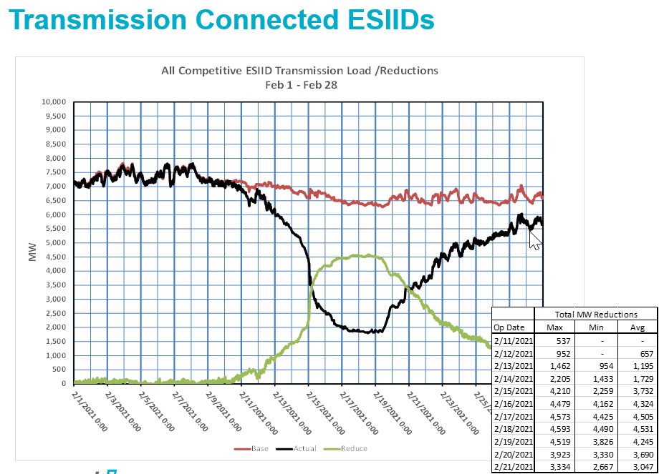
Review of Transmission Connected ERS Loads (Emergency Conditions Item 103)
ERCOT Presentation: Analysis population is Business ESI IDs in competitive areas of ERCOT.

Slide 7
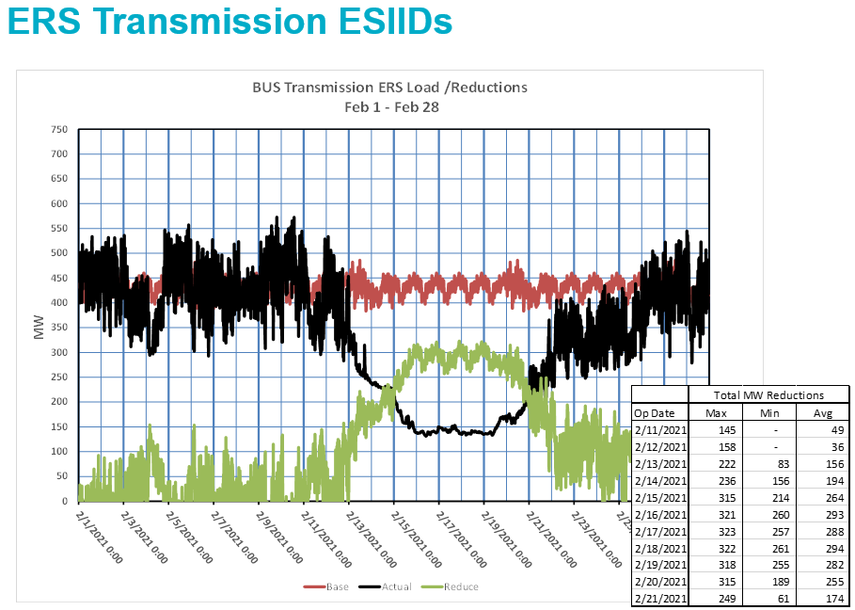
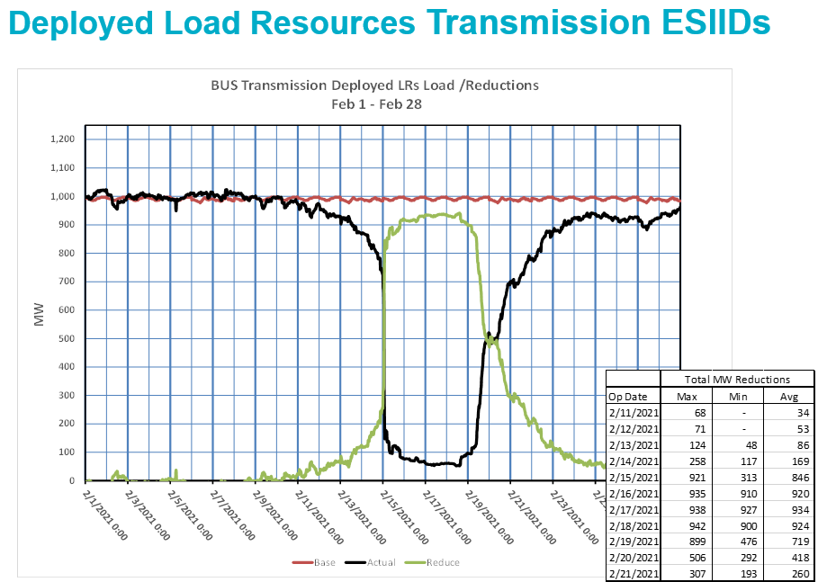
Transmission Connected ERS and LR ESIIDs

Slide 8
NPRR1090 – ERS Winter Storm Uri Lessons Learned and Other ERS Items (Emergency Conditions Items 48 and 102)
ERCOT posted on July 29.
Summary presentation of NPRR given by ERCOT.
The majority of this NPRR is intended for implementation December 1, 2021, so that the changes will be effective starting with the December-March 2022 ERS Standard Contract Term. Changes to Section 3.14.3.3 are intended to become effective upon system implementation.
Stakeholders commented that more time was needed to review the specifics of the NPRR and make comments.

Slide 9
NPRR1090 (continued)
Proposed Changes:
Modifying the requirement of issuing an Extensible Markup Language (XML) message followed by a Verbal Dispatch Instruction (VDI) for ERS deployments by using only the XML message and eliminating the VDI from the requirement;
Modifying and clarifying language related to the beginning and end of ERS Contract Periods for ERS renewals;
Removing the limit on the maximum number of deployments per ERS Contract Period, the three-hour maximum limit per single deployment event, and modifying language related to the cumulative deployment obligation time requirement for Weather-Sensitive ERS Resources;
Eliminating the options for ERS Resources to be excluded from an ERS deployment event or to exclude intervals from event and availability performance with properly noticed scheduled unavailability and planned maintenance for up to 2% of their obligated intervals without payment reductions;
Modifying language related to short ERS Contract Period availability calculations for ERS Resources to account for short Contract Periods in which no exhaustion occurs and modifying the formula for the ratio of Availability Factor Hours to the total awarded hours in the ERS Standard Contract Term to include all awarded hours in the Standard Contract Term;
Removing the requirement to reduce the time-weighting factor for intervals by 25% after eight hours for Qualified Scheduling Entity (QSE)-level event performance;
Removing language related to the first full interval of an ERS deployment event from the ERS Resource-level event performance criteria and modifying language related to successful performance during ERS deployment events to satisfy annual testing requirements;
Removing language related to testing ERS Generators for failing self-tests; and
Modifying QSE-level event performance to be both time and capacity weighted.

Slide 10
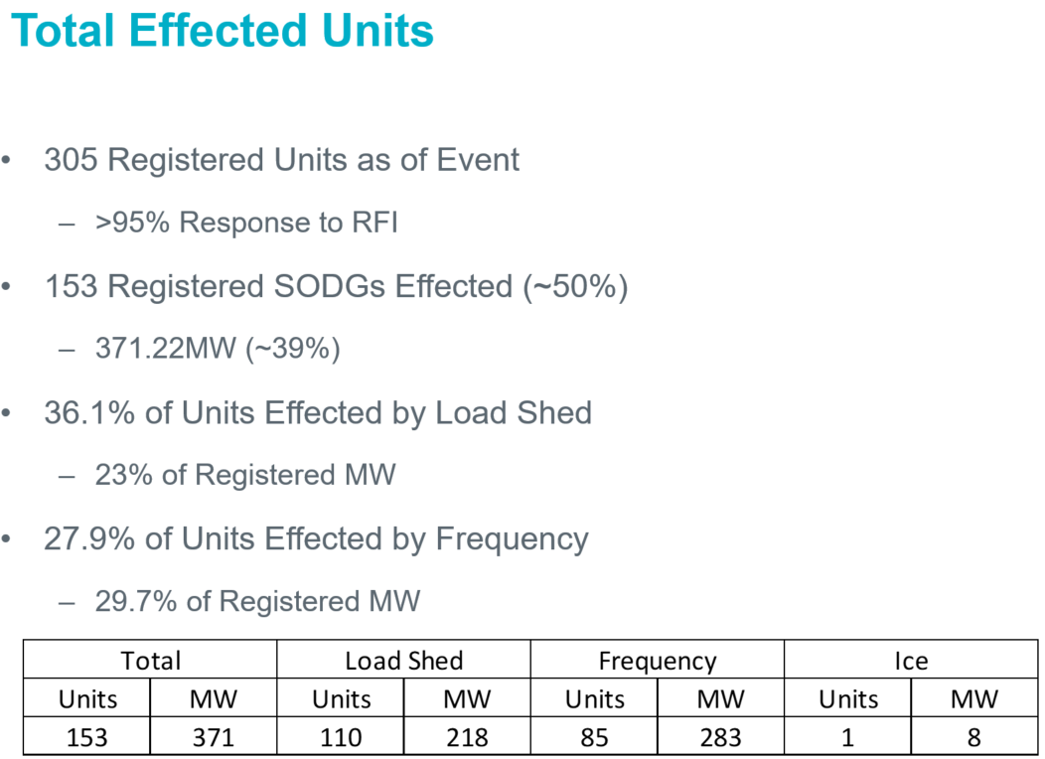
SODG RFI Summary for Winter Storm Uri (Emergency Conditions Item 98)
ERCOT gave presentation on SODG RFI responses received.
ERCOT does not believe that more needs to be done on the SODG (DER-light) side of DR.
ERCOT is reviewing the needs on the DGR (DER-heavy) side of DR.

Slide 11
Emergency Conditions List
Item 48 - ERCOT presented data at 4/16 and 5/28 meetings for deployment results for ERS and LR. ERCOT has established a lessons learned list and submitted NPRR1090 on these items. Participants requesting additional time to review.
Item 50 - ERCOT presented data at 4/16 and 5/28 meetings for DR results (including REP and NOIE) during February event. LR providing RRS program education session will be provided at later DSWG meeting for how program actually works, is dispatched, and is settled.
Item 62 - Load Resources: ERCOT submitted NPRR1087 related to a prohibition on load essential for the generation fuel supply chain and Critical Loads from LR and ERS. Point person from DSWG is Ian Haley (Luminant). Participants filing comments and many questions around implementation.
Item 64 - Awaiting further direction from WMS or the PUC.
Item 74 - Investigating adding this as a June DSWG Agenda Item.
Item 96 - DR performance has been presented. AS imbalance charge issue to be worked on with in conjunction with WMWG and SAWG. Point persons from DSWG are Mike Hourihan (CPOWER) and Holly O'Neill (MP2).
Item 97 - See item 62.
Item 98 - Generally believe more DER would help. SODG RFI summary provided by ERCOT. DGR to be future topic with expected completion by Q1-2022.
Item 101 - Completed and presented to May WMS.
Item 102 - Completed and presented to May WMS.
Item 103 – Completed and presented to August WMS.
Item 104 - Generally believe more response, including ERS, would have helped, but so would more generation. This question beyond DSWG, but as data tells the story will report back to WMS.
Other - Is predeployment acceptable for LR, similar to ERS? Bill Barnes (NRG)

Slide 12
Next Meeting – August 27

