Slide 1
Synchronized Planned Projects Analysis
August 2021 SAWG
Dan Mantena
Resource Adequacy

Slide 2
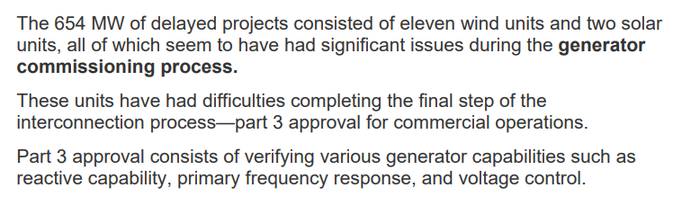
Background
In the February SAWG meeting, ERCOT presented some retrospective analysis on the planned project forecast used in the Summer 2020 Final SARA report.
One notable observation was that planned projects synchronized to the grid and waiting for commercial operations approval frequently experienced delays to their in-service dates (projected COD).
Notes:
February 2021 SAWG meeting: http://www.ercot.com/calendar/2021/2/5/220195-SAWG

Slide 3
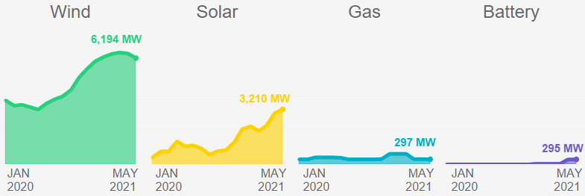
Follow-up to questions from Feb. analysis
Additional information regarding synchronized planned units
  Are synchronized projects allowed to generate their maximum capability?
  How long do planned projects stay in synchronization mode?
  Operational behavior during recent peak periods (including summer 2020).
The large rise in synchronized capacity in the queue makes this a relevant and timely topic worth discussing.
from May 2021 Resource Capacity Trend Charts
Notes:
http://www.ercot.com/content/wcm/lists/219848/Capacity_Changes_by_Fuel_Type_Charts_May_2021.xlsx

Slide 4
Generator Resource Interconnection Process Flow
Notes:
Resource Integration Resources:
http://www.ercot.com/content/wcm/lists/168284/Resource_Interconnection_Handbook_v1.91_01082021.docx
http://www.ercot.com/content/wcm/lists/168312/ERCOT_New_Generator_Commissioning_Checklist_06032020.docx
http://www.ercot.com/services/rq/integration

Slide 5
Main takeaways (1)
Initial Synchronization Approval – Output limited to 20 MVA
  The project has met requirements to Energize Equipment (Part 1): provided latest model data, verified Voltage Ride-Through capability and communication capabilities specified by ERCOT Operating Guides are in place.
Initial Synchronization Approval – Output is not limited
  The project has passed a curtailment test.
  The project owner has submitted an attestation for the following plant controls: Automatic Voltage Regulator (AVR), Primary Frequency Response (PFR), Voltage Support Service (VSS), and Power System Stabilizer (PSS).
On average, planned projects are limited to 20 MVA for the first month after initial synchronization approval by ERCOT.
Notes:
More information on the Generator Commissioning Phase can be found in the Resource Interconnection Handbook pages 24 – 33.
http://www.ercot.com/content/wcm/lists/168284/Resource_Interconnection_Handbook_v1.91_01082021.docx

Slide 6
Main takeaways (2)
Retrospective analysis shows synchronized solar and wind planned projects have generated significant amounts of generation during peak load conditions.
If we consider the contribution of capacity from synchronized projects, the accuracy of planned project forecasts in the CDR/SARA reports is much higher than the previous SAWG analysis showed.
Notes:
http://www.ercot.com/content/wcm/lists/168284/Resource_Interconnection_Handbook_v1.91_01082021.docx

Slide 7
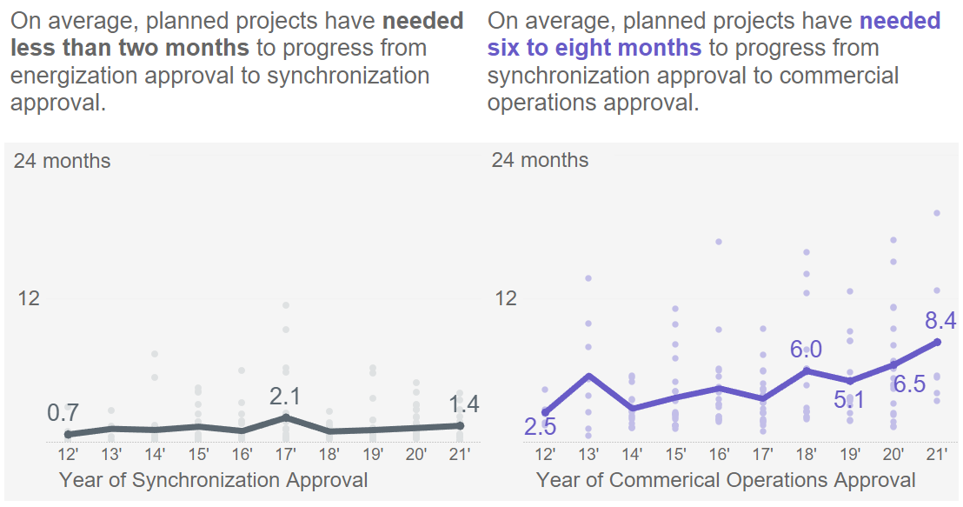
New Generator Commissioning Milestone Trends
Notes:
RIOO-IS data snapshot from 5/24/21.
Excludes planned repower and upgrade projects.

Slide 8
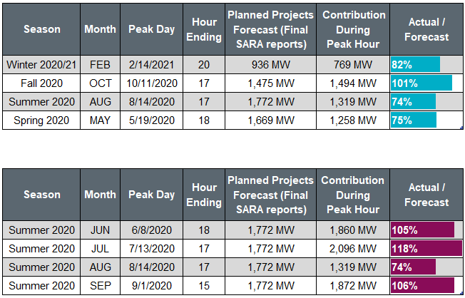
Planned Projects SARA Forecast vs. Actual Output
Recent seasons
Summer 2020 months

Slide 9
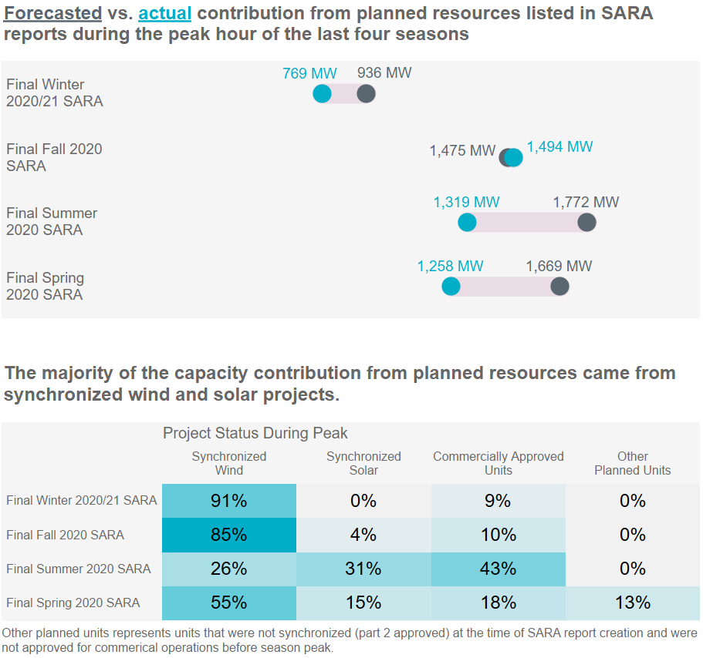
Generation from SARA planned projects during season peaks

Slide 10
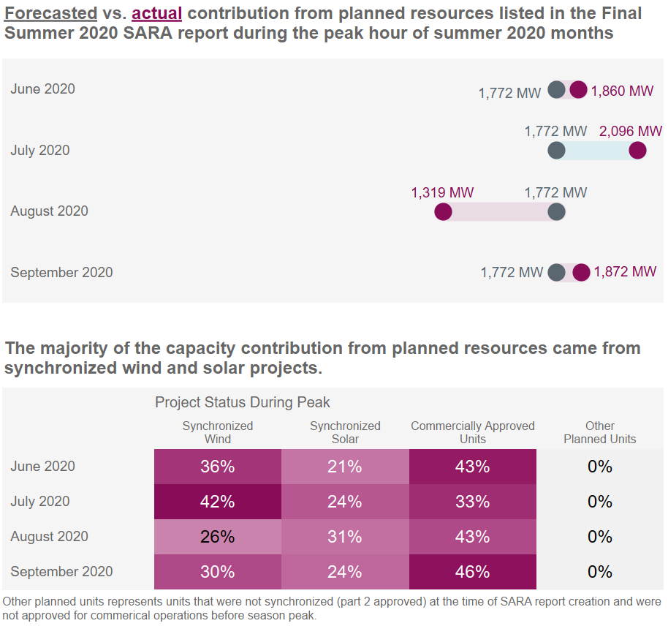
Generation from SARA planned projects during summer 2020

Slide 11
Detailed breakdown for recent season peaks
 | Winter 2020/21 |  | Fall 2020 |  | Summer 2020 |  | Spring 2020
Fuel Type Project Status During Peak | SARA Forecast | Actual | SARA Forecast | Actual | SARA Forecast | Actual | SARA Forecast | Actual
Wind | 928 MW | 766 MW | 1,090 MW | 1,276 MW | 586 MW | 399 MW | 1,238 MW | 1,043 MW
Commerically Operational | N/A | 65 MW | N/A | - | N/A | 59 MW | N/A | 195 MW
Synchronized | N/A | 701 MW | N/A | 1,276 MW | N/A | 340 MW | N/A | 690 MW
Other | N/A | - | N/A | - | N/A | - | N/A | 158 MW
Solar | 35 MW | 0 MW | 386 MW | 218 MW | 1,096 MW | 918 MW | 335 MW | 215 MW
Commerically Operational | N/A | - | N/A | 148 MW | N/A | 508 MW | N/A | 27 MW
Synchronized | N/A | - | N/A | 67 MW | N/A | 410 MW | N/A | 188 MW
Other | N/A | - | N/A | 3 MW | N/A | - | N/A | -
Gas | 0 MW | 0 MW | 0 MW | 0 MW | 90 MW | 0 MW | 96 MW | 0 MW
Commerically Operational | N/A | - | N/A | - | N/A | - | N/A | -
Synchronized | N/A | - | N/A | - | N/A | - | N/A | -
Other | N/A | - | N/A | - | N/A | - | N/A | -
Storage | 0 MW | 3 MW | 0 MW | 0 MW | 0 MW | 2 MW | 0 MW | 0 MW
Commerically Operational | N/A | 3 MW | N/A | - | N/A | - | N/A | -
Synchronized | N/A | - | N/A | - | N/A | 2 MW | N/A | -
Other | N/A | - | N/A | - | N/A | - | N/A | -

Slide 12
Detailed breakdown for summer 2020
 | June 2020 |  | July 2020 |  | August 2020 |  | September 2020
Fuel Type Project Status During Peak | SARA Forecast | Actual | SARA Forecast | Actual | SARA Forecast | Actual | SARA Forecast | Actual
Wind | 586 MW | 902 MW | 586 MW | 1,039 MW | 586 MW | 399 MW | 586 MW | 832 MW
Commerically Operational | N/A | 238 MW | N/A | 150 MW | N/A | 59 MW | N/A | 262 MW
Synchronized | N/A | 664 MW | N/A | 889 MW | N/A | 340 MW | N/A | 570 MW
Other | N/A | - | N/A | - | N/A | - | N/A | -
Solar | 1,096 MW | 957 MW | 1,096 MW | 1,057 MW | 1,096 MW | 918 MW | 1,096 MW | 1,039 MW
Commerically Operational | N/A | 566 MW | N/A | 550 MW | N/A | 508 MW | N/A | 596 MW
Synchronized | N/A | 391 MW | N/A | 507 MW | N/A | 410 MW | N/A | 443 MW
Other | N/A | - | N/A | - | N/A | - | N/A | -
Gas | 90 MW | 0 MW | 90 MW | 0 MW | 90 MW | 0 MW | 90 MW | 0 MW
Commerically Operational | N/A | - | N/A | - | N/A | - | N/A | -
Synchronized | N/A | - | N/A | - | N/A | - | N/A | -
Other | N/A | - | N/A | - | N/A | - | N/A | -
Storage | 0 MW | 0 MW | 0 MW | 0 MW | 0 MW | 2 MW | 0 MW | 0 MW
Commerically Operational | N/A | - | N/A | - | N/A | - | N/A | -
Synchronized | N/A | - | N/A | - | N/A | 2 MW | N/A | -
Other | N/A | - | N/A | - | N/A | - | N/A | -

Slide 13
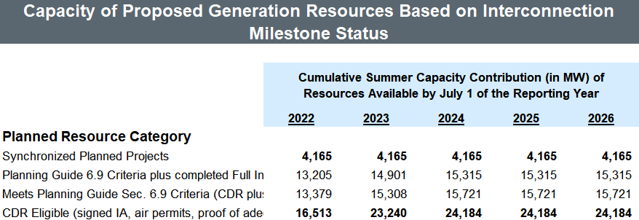
Current reporting of synchronized projects in RA reports
SARA - All synchronized planned projects are forecasted as available for upcoming seasons regardless of their projected in-service date. (first implemented in the Preliminary Summer 2021 SARA report)
CDR - Generation Resource Scenarios tab provides the synchronized capacity that makes up the planned resources for the Planning Reserve Margin calculation.
More detailed information on synchronized projects can be found in the monthly GIS and Resource Capacity Trends Charts.
http://www.ercot.com/gridinfo/resource

Slide 14
Conclusion of Analysis
Synchronized planned projects can generate to their maximum capability after providing an attestation of full plant controls and passing a curtailment test by ERCOT.
Synchronized wind and solar units have generated large amounts of generation during recent peak load conditions.
The accuracy of planned project forecasts in the CDR/SARA reports is much higher than reported in the previous SAWG analysis if we consider the capacity contribution from synchronized units.

