Slide 1
RMS Emergency Conditions Issues List Update to RMS
August 3, 2021
Jim Lee – RECTF Co-Chair

Slide 2
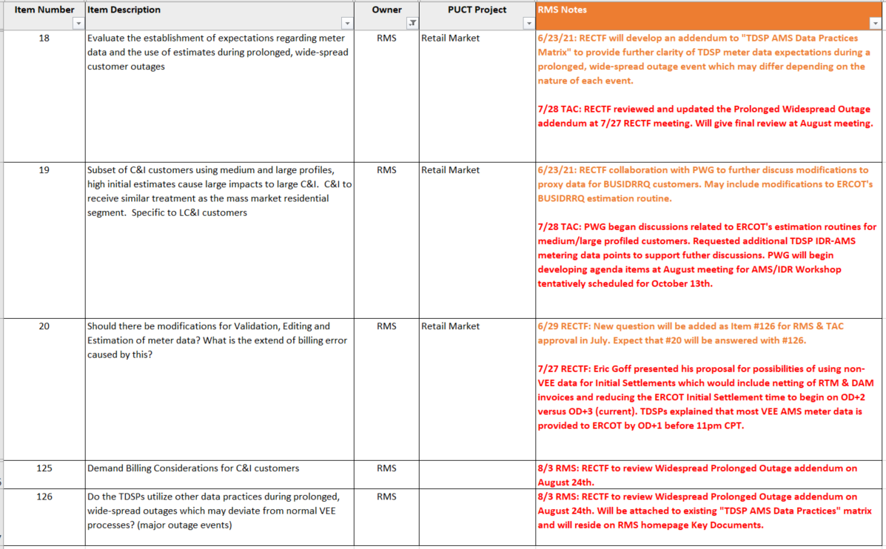
Meter Data Expectations

Slide 3
Discussion re: Pre-Vee Data for Settlement (Item #20: Should there be modifications to VEE data?)
TAC member, Eric Goff, wanted to explore methods to mitigate the risk of short pay default uplift.
Introduced a conceptual solution of netting the Day-Ahead Market (DAM) Invoice with the Real-Time Market (RTM) Invoice from ERCOT.
While it conceptually reduces the uplift risk, this solution would likely require changes to ERCOT’s Initial Settlement timeline to begin earlier than the current OD+5 and consider accelerating the TDSP AMS interval data delivery timelines. Age old question: “Is the juice worth the squeeze?”
TDSPs were asked if VEE timelines could be shortened; and if AMS data can be delivered any earlier?
TDSPs explained that VEE data is “settlement quality” data and TDSPs cannot circumvent the VEE process. Wide-scale system changes would be required to support eliminating/modifying VEE.
REPs confirmed their needs and importance of VEE data – products developed with confidence in “settlement quality” data.
Timeline perspective -- Currently, all AMS interval data undergoes the VEE process and the LSE file is sent to both ERCOT and SMT by mid-afternoon the next day (OD+1). Further reductions to the TDSP delivery timelines appear unattainable.
Additional efforts currently underway to transition IDR profiled ESIIDs to AMI profiles, which would reduce data delivery from monthly 867_03 to daily LSE files.
Agreed that this topic is a collaborative effort between RMS and WMS.
RMS (PWG) will continue with the IDR/AMI Workshop schedule for Oct 13th.
WMS/ERCOT to explore accelerating the Settlement timeline and combination of DAM/RTM Invoices.
Pre-VEE Data for Settlements

Slide 4
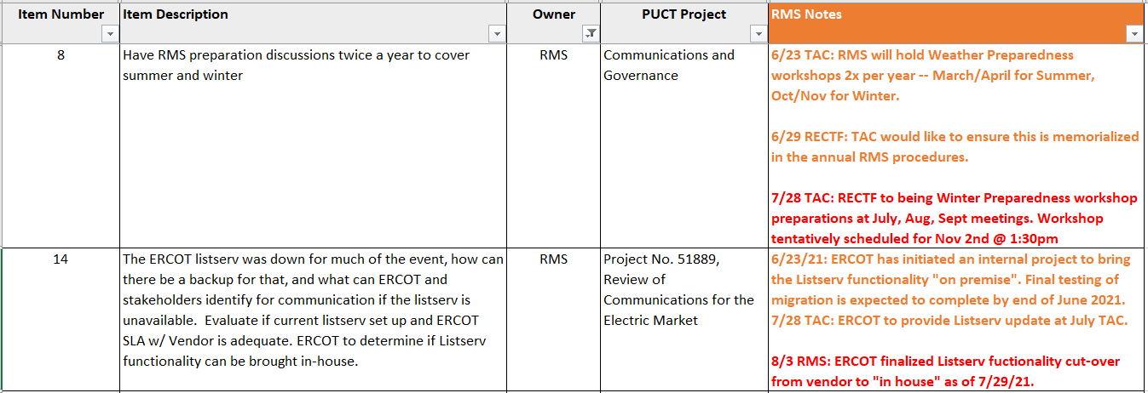
Communications

Slide 5
Mass Transition/ Acquisition

Slide 6
Awaiting Regulatory/Legislative

