Slide 1
System Protection Working Group
(SPWG)
Update to ROS
AUGUST 5TH, 2021
Chair: Vincent Roberts, P.E.
Vice-Chair: Glenn Callaghan, P.E.

Slide 2
SPWG Meeting Overview
2nd SPWG Meeting of 2021 was held on July 21st, 2021
Topics Discussed:
  2021 Q1 Misoperation Data
  Annual Report on Misoperations Caused by Relay Failures
  Misoperations During February Cold Weather Event
  New Aspen OneLiner V15 Software Release
  Emergency Condition List Item: Frequency Relay Points
Next Meeting Scheduled for November 10th-11th, 2021

Slide 3
Protection System Misoperations
2021 Q1

Slide 4
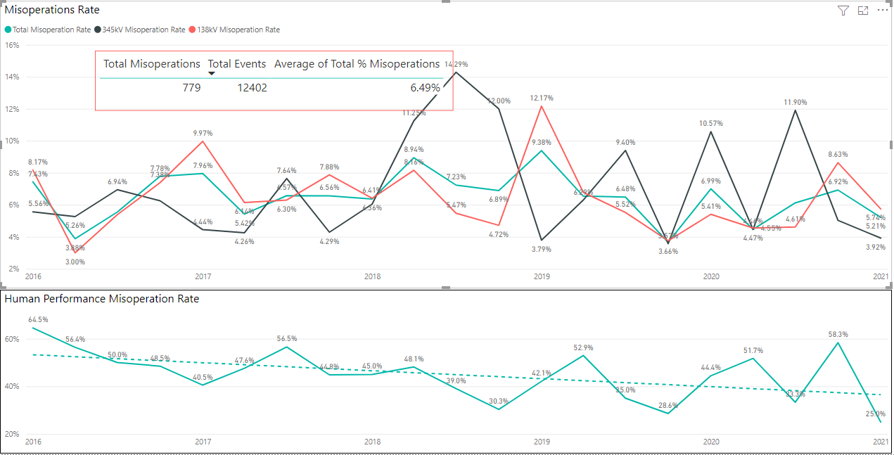
Protection System Misoperations: 2016-2021 Q1

Slide 5
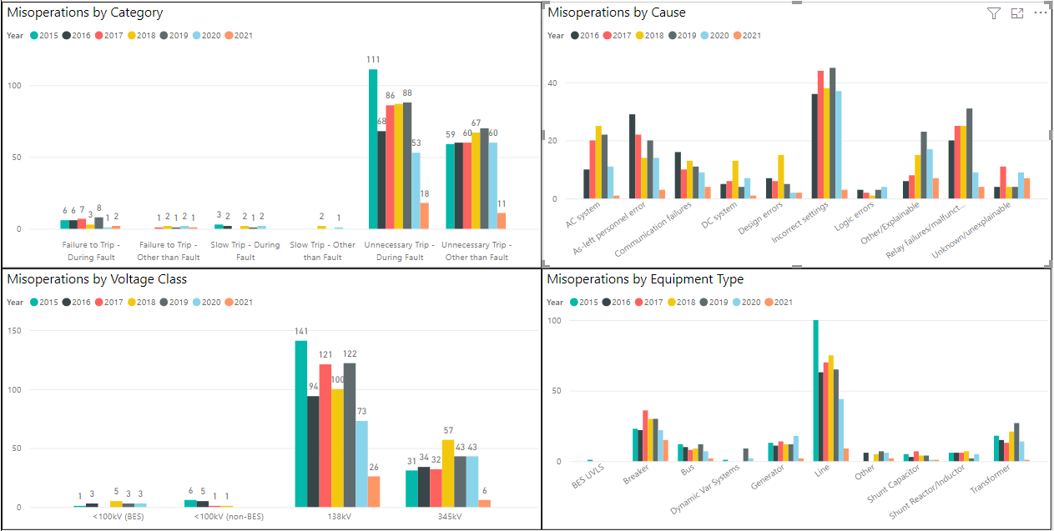
Protection System Misoperations: 2016-2021 Q1

Slide 6
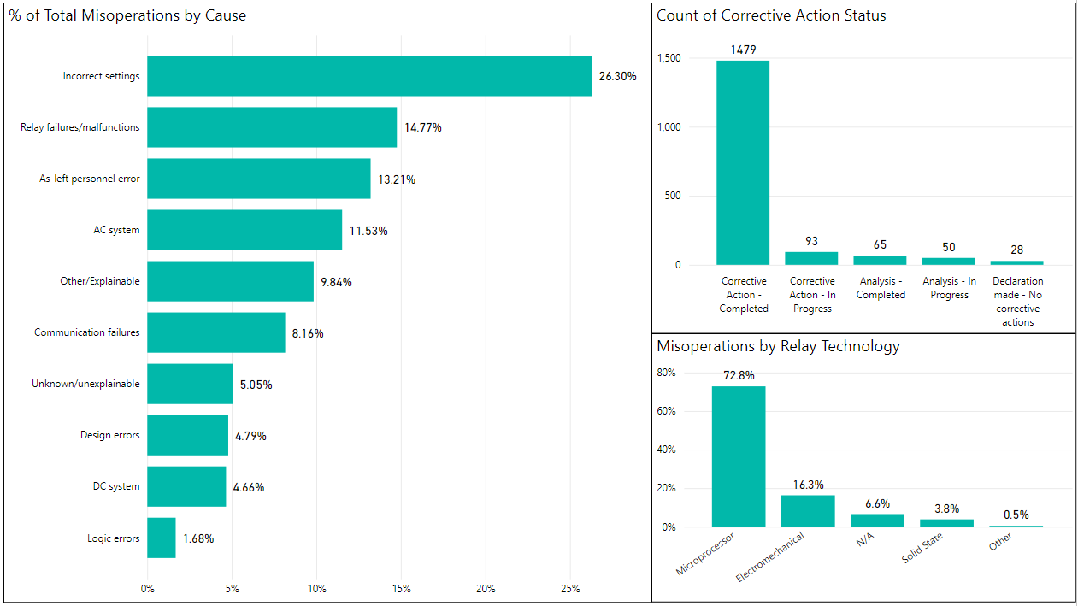
Protection System Misoperations: 2016-2021 Q1

Slide 7
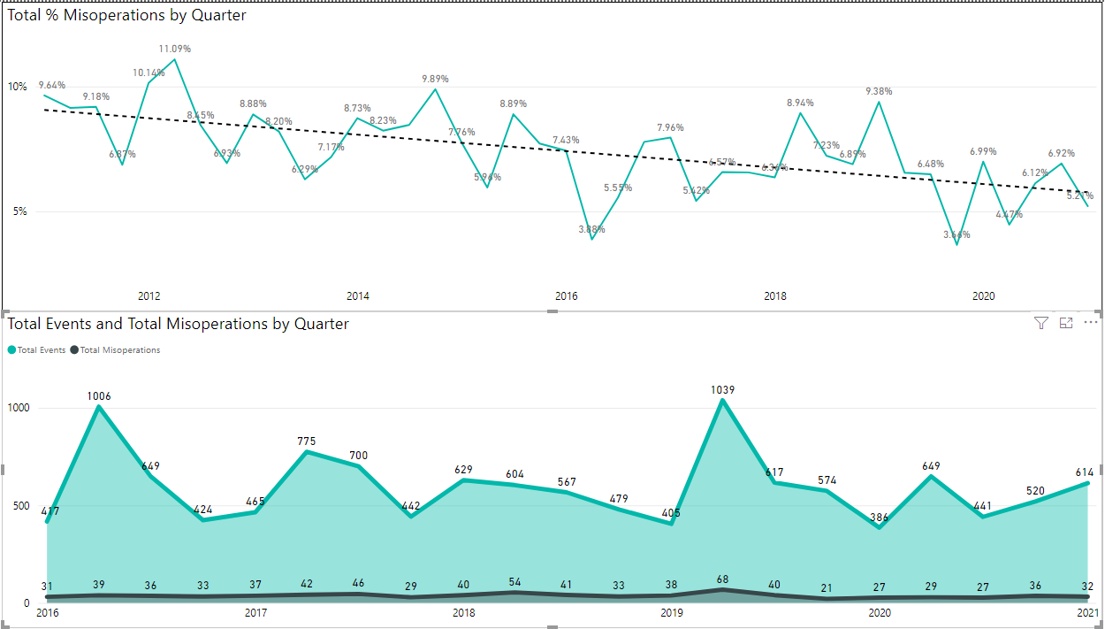
Protection System Misoperations: 2016-2021 Q1

Slide 8
Protection System Misoperations – 2021 Q1
 |  | Q1 | 2021 YTD
# of Misoperations | Total | 32 | 32
 | 345 kV | 6 | 6
 | 138 kV | 26 | 26
 | < 100 kV | 0 | 0
By Category | Failure to Trip | 3 | 3
 | Slow Trip | 0 | 0
 | Unnecessary Trip during Fault | 18 | 18
 | Unnecessary Trip – Non Fault | 11 | 11
 | SPS | 0 | 0
By Relay System Type | Electromechanical | 5 | 5
 | Solid State | 0 | 0
 | Microprocessor | 20 | 20
 | Other/ N/A | 7 | 7
By Equipment Protected | Line | 9 | 9
 | Transformer | 1 | 1
 | Generator | 2 | 2
 | Shunt/Series Capacitor | 1 | 1
 | Shunt/Series Reactor | 0 | 0
 | Dynamic VAR system | 0 | 0
 | Bus | 2 | 2
 | Breaker | 15 | 15
 | Other | 2 | 2

Slide 10
Protection System Misoperations 2021 Q1
Summary of Human Performance Issues noted for 2021 Q1:
138kV line breaker tripped due to incorrect CCVT field wiring in the voltage polarizing circuit of the ground directional relays
138kV breaker tripped due to incorrect DC wiring. Wire was not removed as shown on prints
345kV breaker tripped and reclosed twice for a fault and relay declared a breaker failure condition due to and incorrect design in the breaker close circuit and anti-pump relay scheme
138kV breaker tripped due to incorrect ground time overcurrent torque control settings
Failure to Trip/Slow Trip Misoperations in 2021 Q1:
One 138kV breaker of a double-bus-double breaker scheme was off-line due to scheduled maintenance. Due to design, DC control power to overcurrent relays was fed from breaker trip power. Fault occurred on circuit and overcurrent relays failed to operate.
Generator breaker failed to trip due to failed G60 relay with an active system failure alarm

Slide 11
Cold Weather Event
Relay Misoperations
February 2021

Slide 12
Protection System Misoperations Feb 2021
Summary of Misoperations Occurring Feb 11-18, 2021:
138kV breaker tripped due to incorrect DC wiring. Wire was not removed as shown on prints
138kV line misoperated due to directional detection elements not adequate for a weak source
138kV line misoperated due to loss/chatter on power line carrier signal (3 separate events)
Generator tripped due to a failed negative sequence relay
Solar plant tripped due to corrosion on 35kV PT wiring and fuses causing incorrect voltage signal
Generator tripped due to blown fuses on 4160V aux equipment breaker
138kV bus tripped due to burned CT wiring feeding the bus differential relays
345kV breaker tripped and reclosed twice for a fault and relay declared a breaker failure condition due to and incorrect design in the breaker close circuit and anti-pump relay scheme
138kV bus tripped due to failed lockout relay faceplate circuit board

Slide 13
Annual Report
Misoperations Caused by Relay Failure

Slide 14
Notes:
This data should not be used as an indicator of relay failure rates
Relay Failures Resulting in a Misoperation
Period: 2018-2020
Relay Failures by Scheme | 3-Year (2018-2020)
Step Distance | 6
DCB | 8
POR/POTT | 0
DUTT | 0
Phase Comparison | 1
Line Current Differential | 7
Differential | 18
DTT | 0
Breaker Failure | 4
Other | 4
No data | 17
Manufacturer | Relay Type | 3-Year (2018-2020
ABB | AR | 1
ABB | HCB-1 | 2
ABB | HU-1
ABB | IRD-9
ABB | IRP | 1
ABB | ITH | 1
ABB | KA-4
ABB | KC
ABB | KD | 1
ABB | KF
ABB | KLF
ABB | KRP
ABB | LCB-II | 6
ABB | MDAR | 1
ABB | REL-512
ABB | TD
Manufacturer | Relay Type | 3-Year (2018-2020
GE | B30 | 2
GE | B90 | 2
GE | BDD
GE | CFD | 1
GE | D60 | 4
GE | DBF | 1
GE | F35
GE | FANUC PLC
GE | G60
GE | GCX
GE | ICW
GE | L90 | 1
GE | SAM
GE | SBC
GE | SLY
GE | SPD11
GE | T60 | 1
Relay Failures by Failure Mode | 3-Year (2018-2020)
Relay - Power Supply Failure/Malfunction | 3
Relay - AC I/O Module Failure/Malfunction | 5
Relay - Digital I/O Module Failure/Malfunction | 3
Relay - Communication Module Failure/Malfunction | 1
Relay - Self-Diagnostic Failure/Malfunction | 2
Relay - CPU Processor Failure/Malfunction | 5
Relay - Incorrect Manufacturer Programming ('Bug') | 1
Relay - Incorrect Manufacturer Design | 2
Relay - Unknown | 6
Relay - Other | 11
No data | 26
Manufacturer | Relay Type | 3-Year(2018-2020
SEL | 311 | 2
SEL | 321 | 2
SEL | 351 | 2
SEL | 411 | 1
SEL | 421 | 4
SEL | 451 | 1
SEL | 387/487 | 2
SEL | 551 | 1
Manufacturer | Relay Type | 3-Year (2018-2020
Basler | BE1-50BF
Beckwith | M3425 | 1
Beckwith | M3430
Electroswitch | Lockout relay | 3
Qualitrol | SPR or Pressure Relief | 1
RFL | RFL9300 | 1

Slide 16
Aspen OneLiner V15 Release
ASPEN OneLiner™ V15.3 was released in early July
ERCOT and SPWG discussed new features, challenges, potential issues, and questions related to V15.3
SPWG members will continue to evaluate between now and the November 2021 SPWG meeting for potential adoption in the November 10th meeting.
If adopted, SPWG will work with ERCOT to revise the ERCOT Short Circuit Case Building Procedure Manual to reflect the new version for the 2022 case building process.

Slide 17
Emergency Condition List: Underfrequency Relay Setpoints
SPWG discussed the TAC Emergency Conditions List Item #30 request:
  Frequency Relay Points: Analyze load shed responsibilities related to frequencies for generation and load and ensure alignment
SPWG created an action item to review this request and continue to monitor for updates related to ongoing NOGRRs and other requests.

Slide 18
End of SPWG Presentation
Next Meeting Scheduled for November 10th & 11th, 2021
ERCOT ROS Update will be Provided on December 2nd, 2021
Thank You
Any Questions?

