Slide 1
Unregistered Distributed Generation Report:
2021 Q2 Update
Dan Mantena
Resource Adequacy
8/4/2021

Slide 2
2021 Q2 Unregistered Distributed Generation Report
Load Zone | 2021 Q2 Distributed Generation Installed Capacity in MW (AC)
 | SOLAR |  | WIND |  | OTHER RENEWABLE |  | OTHER NON-RENEWABLE |  | TOTAL
 | < 50 kW | ≥ 50 kW | < 50 kW | ≥ 50 kW | < 50 kW | ≥ 50 kW | < 50 kW | ≥ 50 kW | < 50 kW | ≥ 50 kW | Combined
LZ_AEN | 67 | 27 | - | - | - | - | - | - | 67 | 27 | 94
LZ_CPS | 179 | 40 | - | - | 2 | - | - | 20 | 181 | 60 | 241
LZ_HOUSTON | 110 | 3 | - | - | - | - | - | 5 | 110 | 8 | 118
LZ_LCRA | 64 | 18 | - | - | - | 1 | 1 | - | 65 | 19 | 84
LZ_NORTH | 314 | 30 | 2 | 1 | - | - | 2 | 5 | 317 | 36 | 353
LZ_RAYBN | 20 | 3 | - | - | - | - | - | - | 21 | 3 | 24
LZ_SOUTH | 126 | 23 | 1 | - | - | - | 1 | - | 127 | 23 | 151
LZ_WEST | 48 | 6 | 1 | - | - | - | - | 1 | 49 | 7 | 56
TOTAL | 929 | 150 | 4 | 2 | 2 | 1 | 3 | 30 | 938 | 182 | 1,120
Notes:
- NOIE data is submitted through surveys. Competitive TDSP data is submitted through load profile codes.

Slide 3
2021 Q1 → Q2 Change
Load Zone | 2021 Q1 → Q2 Change in Distributed Generation Installed Capacity in MW (AC)
 | SOLAR |  | WIND |  | OTHER RENEWABLE |  | OTHER NON-RENEWABLE |  | TOTAL
 | < 50 kW | ≥ 50 kW | < 50 kW | ≥ 50 kW | < 50 kW | ≥ 50 kW | < 50 kW | ≥ 50 kW | < 50 kW | ≥ 50 kW | Combined
LZ_AEN | +2.64 | +1.21 | - | - | - | - | - | - | +2.64 | +1.21 | +3.85
LZ_CPS | +10.05 | +1.37 | - | - | +0.14 | - | - | - | +10.2 | +1.37 | +11.57
LZ_HOUSTON | +20.14 | +0.24 | - | - | - | - | +0.01 | +1.25 | +20.16 | +1.48 | +21.64
LZ_LCRA | +3.96 | +0.69 | - | - | - | - | +0.1 | - | +4.06 | +0.69 | +4.76
LZ_NORTH | +27.47 | +0.47 | -0.01 | - | +0.01 | - | +1.21 | +0.06 | +28.67 | +0.53 | +29.2
LZ_RAYBN | +2.49 | - | +0.02 | - | - | - | - | - | +2.51 | - | +2.51
LZ_SOUTH | +34.45 | +2.51 | +0.01 | - | - | - | +0.5 | -0.63 | +34.67 | +1.89 | +36.56
LZ_WEST | +7.02 | - | - | - | - | - | - | +0.33 | +7.02 | +0.33 | +7.35
TOTAL | +108.23 | +6.5 | +0.03 | - | +0.15 | - | +1.82 | +1.01 | +110.23 | +7.51 | +117.74

Slide 4
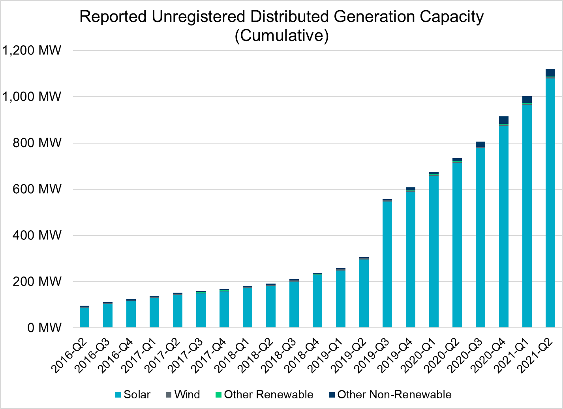
Unregistered DG Growth: 2016-Q2* to 2021-Q2
Large increase due to reporting requirement change**
* 2016-Q2 was the first report published after implementation of report changes per NPRR794/COPMGR044
** 2019-Q3 was the first report published after implementation of report changes per NPRR891

