Slide 1
Renewable Energy Credit Project Update
Don Tucker
Manager Settlements Metering
August 2021 RMS & WMS

Slide 2
Market Facing I-test
Thanks for Participating

Slide 3
Market Facing I-test - what we learned
Auth0 error message “email could not be verified”
Occurred during the email verification step
Multiple tickets opened with the Auth0 vender, pending resolution
Users still received the reset password email and were able to successfully login to the REC application
Auth0 error message “password expired”
Link expires after 5 days
Confusion on username
Username is the registered email address
Confusion on test system versus production system
Systems are separate
Changes in one does not impact the other

Slide 4
Market Facing I-test - what we learned
Confusion on using a cell phone to register the Auth0 account
MFA requires use of a cell phone for sending code
REC Accounts not available in I-test for Testing
REC Accounts pending approval
Were not included in the user mapping exercise.
Will be handled as one offs after go live.
Admins and user accounts not migrated to I-test
Accounts activated after the user mapping files were generated
There will be another round of spreadsheets going out for accounts that have been approved since the last spreadsheets were generated and those that have not yet responded
Quick turnaround by the account admin will be required for these updates to be included in the user migration process for go live
Look for these emails in early August

Slide 5
Market Facing I-test - what we learned
Initiated a retirement and the message said that the retirement will be confirmed by the REC system in 30 days
Error in accurately setting the parameter between I-test loads
Should have been set to 5
Step has been added to include setting and verifying this database parameter for migrations
Formatting recommendations on the REC Summary; such as adding commas to numbers and removing the decimals
Comma separation for numbers added
Decimals removed in the total row

Slide 6
Market Facing I-test - what we learned
Error when I try to:
Withdraw a retirement – error – will not allow to withdraw
Withdraw a transfer – error – will not allow to transfer
Reject a transfer – error – will not allow to reject
Accept a transfer – even with error will allow the RECs to Pending Transfer
Retire RECs – even with error will allow the RECs to move to retirement pending
Change made to code for improved error handling inadvertently created these issues
Updated error code handling to correct this issue
Code will be migrated for final regression testing prior to go live

Slide 7
Market Facing I-test - what we learned
When the “We’ve sent an sms message” screen pops up in the login process, there is a broken image icon displayed.
This is related to ercot.com not being served via https
In order to get the logo to display, you have to modify your internet browser settings to allow mixed content.
Here is a helpful link that includes steps and screenshots: https://experienceleague.adobe.com/docs/target/using/experiences/vec/troubleshoot-composer/mixed-content.html?lang=en
Or see the appendix for instructions

Slide 8
Production Go Live Scheduled for Aug 19th
REC System disabled morning of August 19th
No access to the system till the new system is brought up around noontime
Updates to REC Program URL on the ERCOT website
Migration of code, data and users to the new application
Accounts where mapping has been provided and migrated
Emails initiated for users to gain access to Auth0
Users to follow email instructions to establish an Auth0 account & access their REC Account(s)
Links have a shelf life of 5 days
Must use the email that the link was sent to for resetting password
Cell phone number for receiving text message required

Slide 9
Production Go Live Scheduled for Aug 19th
Accounts where link expires prior to user accessing Auth0
Initiate the login process from the REC site homepage login link
REC application link is on the ERCOT web site
Use the ‘Don't remember your password?’ link from the Auth0 login screen to reset your password.
Users to follow email instructions to establish an Auth0 account & access their REC Account(s)
Must use the email that the link was sent to for resetting password
Cell phone number for receiving text message required

Slide 10
Production Go Live Scheduled for Aug 19th
Account administrators with no mapping provided
Account admin must send request to recadmin@ercot.com with a request to be added to an account
Recadmin will verify applicability and add the account admin to the REC account
Email will be generated once the admin is added to the account
Users to follow email instructions to establish an Auth0 account & access their REC Account(s)
Must use the email that the link was sent to for resetting password
Cell phone number for receiving text message required
Account admin must be available to add users to the account

Slide 11
Changing REC Account Admin Prior to Go Live
The spreadsheet mapping is being used to modify users in the production system.
The current admin is included in the spreadsheet and the admin in the spreadsheet is a protected cell.
If the change in admin and migration to the new system is not imperative for your current operations, the account admin should remain the same and be updated after production go live.
If the change in admin and migration to the system is imperative for your current operations, we can work with you to generate and accept an updated mapping spreadsheet and replace the prior information provided.
The process to change the admin for migration would be as follows:
admin is changed in the existing production system
the new admin will request generation of a new spreadsheet
the new admin will return the spreadsheet with updated mapping
the new spreadsheet would replace the existing spreadsheet for loading users in the system.

Slide 12
Adding New Users Prior to Go Live
The spreadsheet mapping is being used to modify users in the production system.
The preference is that the account admin add new users into the production system after go live.
If the addition of new users is not imperative for your current operations, the account admin should add the new users after production go live.
If the addition of these new users is imperative for your current operations and the users must be in place when we move to the new system, we can work with you to generate and accept an updated mapping spreadsheet and replace the prior information provided.
The process to change the admin would be as follows:
account admin adds users in the production system
admin will request generation of a new spreadsheet
admin will return the spreadsheet with updated mapping
spreadsheet would replace the existing spreadsheet for loading users in the system

Slide 13
Questions or Discussion

Slide 14
Appendix

Slide 15
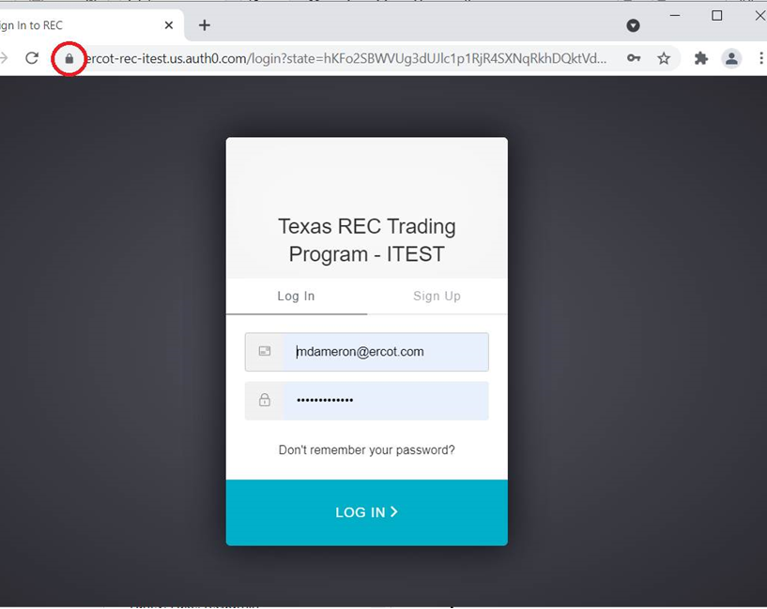
Allow insecure content for image loading
1. Click the lock (caution) icon, then click Site settings.

Slide 16
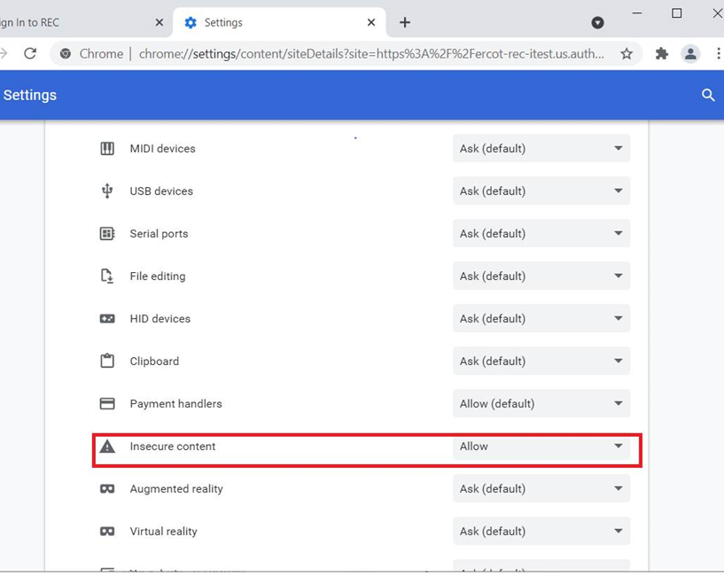
Allow insecure content for image loading
2. Scroll to Insecure content, then use the drop-down list to change “Block (default)” to “Allow.”
3. Reload the page and proceed with the login process or reload the REC site and try logging in again.

