Slide 1
NPRR 1077 Distributed Generation Review
Includes Registered and Unregistered DG
July 22, 2021

Slide 2
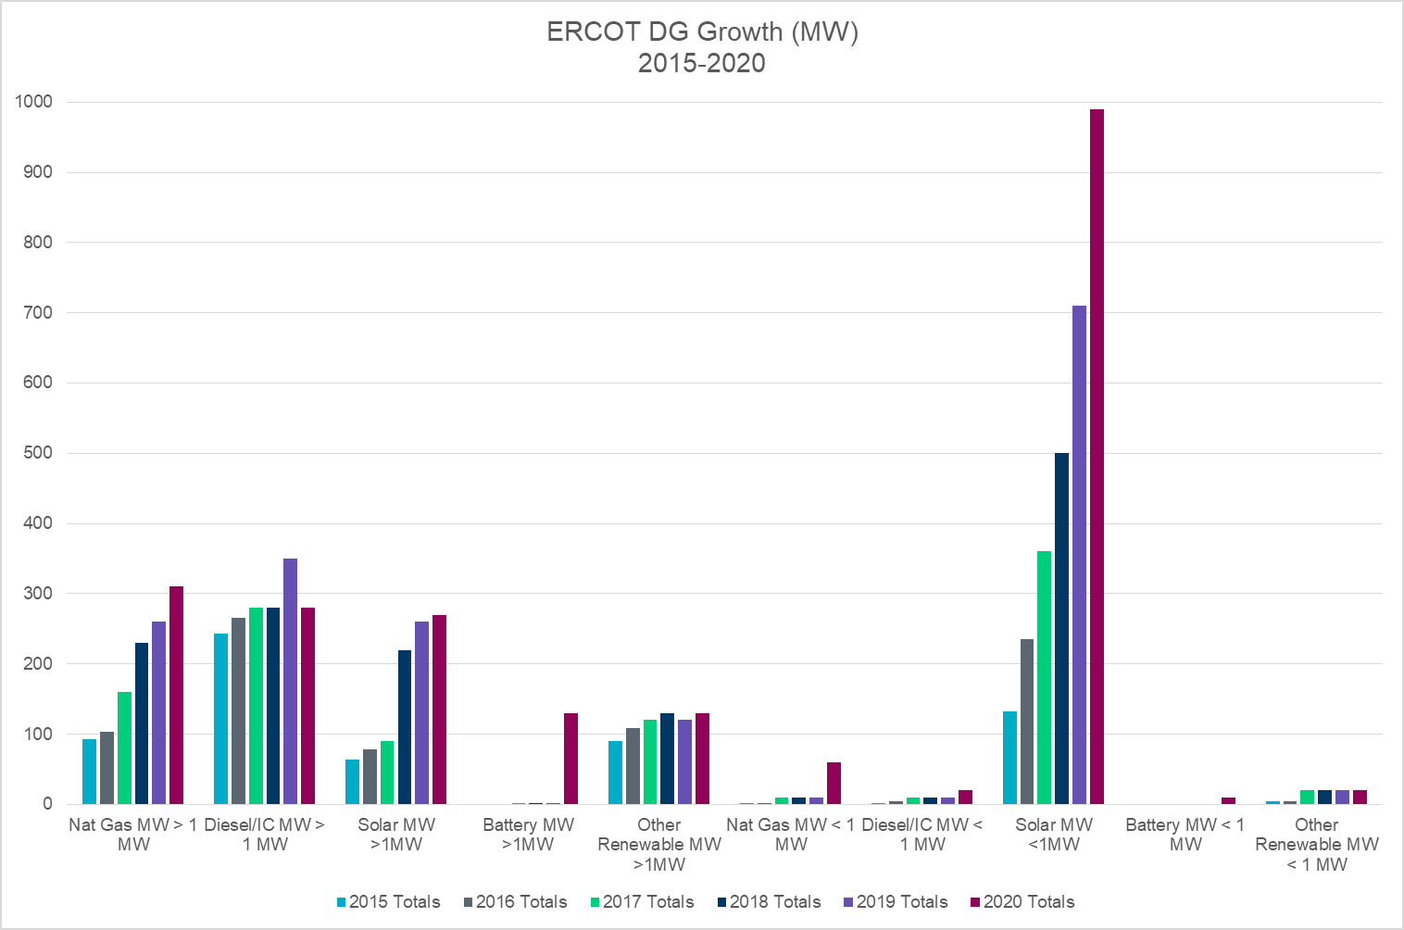
ERCOT Estimated Total DG Growth 2015-2020 (MW)
181%
*
31%
**
Note: The 2020 estimate includes NOIE data from their Annual Report to ERCOT, and TDSP data from their PUC reports excluding generation data informally reported by investor-owned utilities for generation that would typically be considered backup or emergency generation.
*2019 Transmission-connected generation incorrectly registered as SODG with ERCOT
** Other Renewable category includes: Wind, Landfill Gas and Hydro which were previously reported separately.

Slide 3
Settlement-Only Distributed Generation in ERCOT 2010-2020
SODGs are:
<10 MW
If >1 MW and inject to grid, must register with ERCOT
If <1 MW, registration optional
Accumulated Count
Non-renewables
Renewables

Slide 4
Observations and Trends
Major areas of DG growth in ERCOT
Solar PV <1 MW
Natural gas > 1 MW (co-located with load)
DGR Energy Storage> 1 MW
Detail for Systems > 1 MW
New applications for Energy Storage
Continuation of upward trend for Nat Gas
Decreased growth for solar > 1 MW
Little Diesel growth
Declining Landfill Gas, Hydro, Wind
Detail for Systems < 1 MW
Accelerating Solar PV trend (even during Covid!)
Increased small energy storage and Nat Gas (some registered as SODG)
Note that there seems to be a significant increase in interest for systems providing resiliency since Winter Event.
Nat gas
Batteries
181%
31%

Slide 5
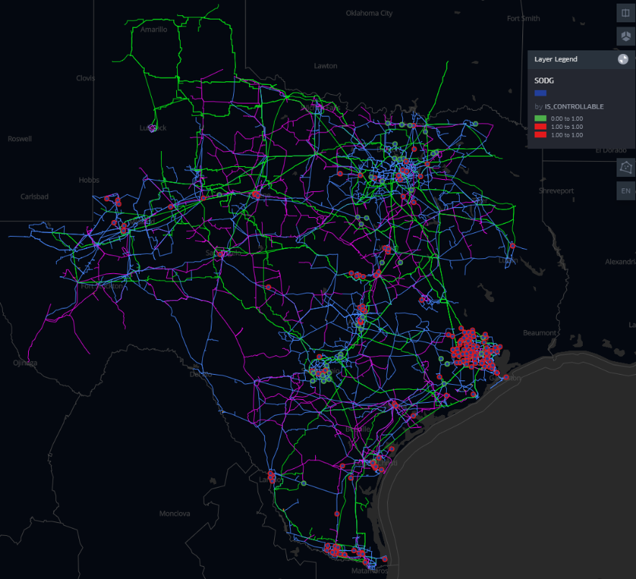
SODG growth

