Slide 1
Incorporating GIC data into existing ERCOT Modeling Processes
07/20/2021

Slide 2
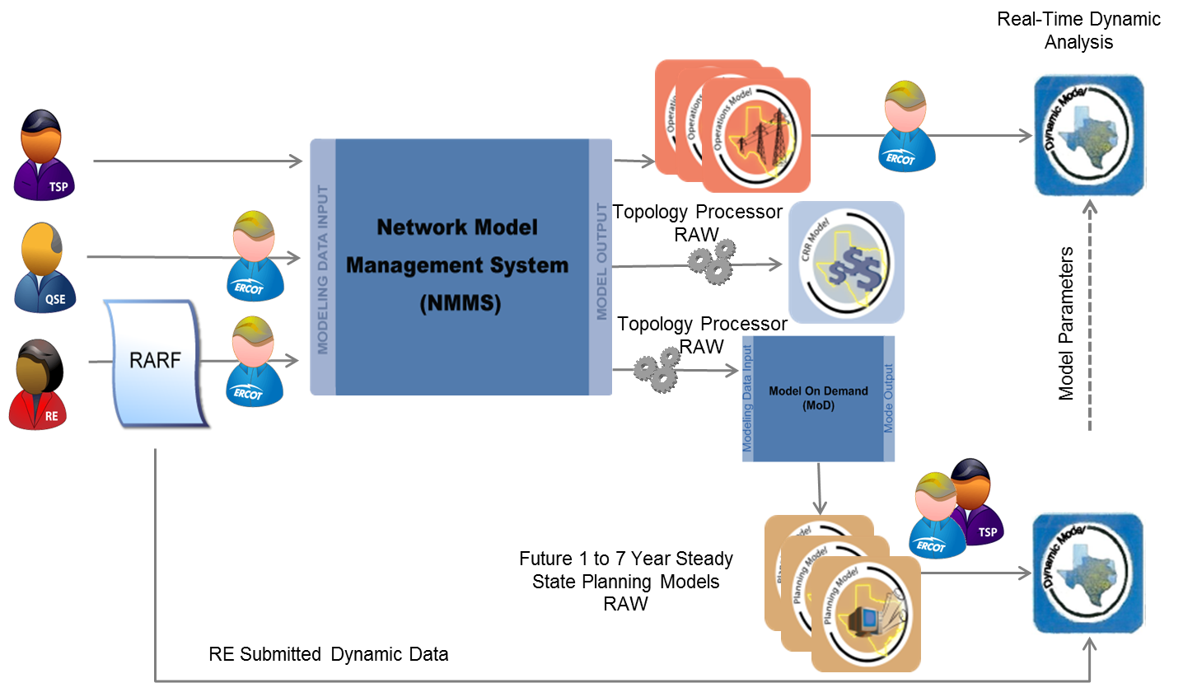
ERCOT Modeling Applications and Processes
A System Change Request(SCR) is need to integrate GIC modeling data into the existing modeling applications, http://www.ercot.com/mktrules/syschangereq.

Slide 3
GIC Modeling Data – Initial Assessment
Element | Attribute | Value | Description | Example of a Value
Substation | Grounding Resistance | RG: Numeric in Ohms | Substation dc grounding resistance (ohms) | 0.1
Line | DC Resistance | RBRN: Numeric in Ohms/Phase | Branch dc resistance in ohms/phase | 0
Transformer Winding | DC Winding Resistance | RDC: Numeric in Ohms/Phase | dc resistance of Winding in ohms/phase at nominal tap and adjusted to 75°C | 0
Transformer Winding | GIC Blocker on Winding | True – GIC Blocker is Present False – No GIC Blocker on the winding | GIC blocking device in neutral of Winding | False
Power Transformer | Vector Group | VecGrp - Alphanumeric | Alphanumeric identifier specifying vector group based on transformer winding connections and phase angles | YNynd0
Power Transformer | Core | Core: Alphanumeric | Number of cores in transformer core design | 3 = three phase 3-legged core form
Power Transformer | K-Factor | K-Factor: Numeric (no units) | A factor to calculate transformer reactive power loss from GIC flowing in its winding (Mvar/Ampere) | 0.00
Transformer Winding | Winding Grounding DC Resistance | RGDC: Numeric in Ohms | Winding grounding dc resistance in ohms | 0
Transformer | Transformer Model | T-Model: Alphanumeric | Transformer Model in GIC dc Network = 0, two and three winding and autotransformer model as defined by its vector group = 1, Transformer as T model in dc network | 0 = two and three winding and autotransformer model
Shunt | Coil DC Resistance | R: Coil DC Resistance | DC resistance in ohms/phase adjusted to 75°C | 99999
Shunt | Grounding DC Resistance | RG: Numeric in Ohms | Grounding dc resistance in ohms | 99999

Slide 4
GIC Modeling Data
Identify GIC data that could possibly be maintained within current ERCOT modeling processes. Engage those WGs to discuss possible adjustments to current process to improve the GIC model building.
Network Data Support Working Group (NDSWG) - NMMS
SSWG – Topology Processer and MOD
Others?

