Slide 1
Exelon comments on 1086
Lori.Simpson@constellation.com
Constellation (An Exelon Company)

Slide 2
Changes on top of ERCOT’s 7/20 comments
6.8.1 (2): Addresses when a generator is eligible for make whole.
6.8.3.1 (1): The balance between allocation to shorts and uplift LRS.

Slide 3
Changes on top of ERCOT’s 7/20 comments
6.8.1 (2): The calculation of operating losses under Section 6.8.2 applies only when the Real-Time Settlement Point Price for the Resource is equal to or exceeds the LCAP or when the Resource’s Energy Offer Curve is at the LCAP and the Resource receives a Dispatch Instruction or a Basepoint above its LSL. {Yellow highlight is added language.}
Why is this needed?
ERCOT can ask units to move up when uneconomic.
This could be exasperated when many units are offered at the cap (either LCAP or HCAP).
51871: (7) Reimbursement for Operating Losses when the LCAP is in Effect. When the system-wide offer cap is set to the LCAP, ERCOT must reimburse resource entities for any actual marginal costs in excess of the larger of the LCAP or the real-time energy price for the resource. ERCOT must utilize existing settlement processes to the extent possible to verify the resource entity's costs for reimbursement.

Slide 4
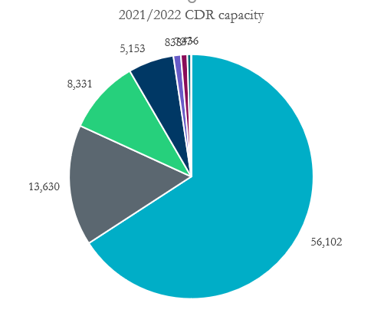
Winter CDR capacity
Nuc
2/3 of winter CDR capacity is gas.
If gas prices go above ~$300, then most gas units will be priced above the LCAP of $2,000.
Wind
Coal
Gas

Slide 5
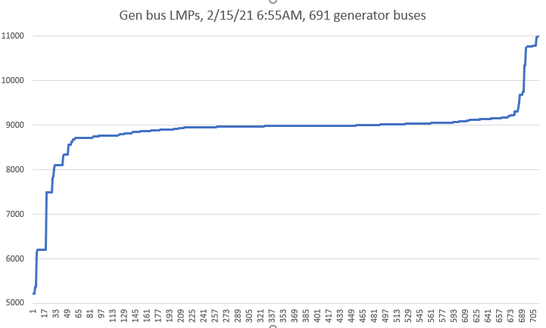
Significant generation can be priced below system lambda due to congestion
This is an example from the February event.
67% of generator buses (483/713) were priced below system lambda ($9,001).
CAVEAT: I do not know what this congestion pattern would look like if 66% of generation was offered at the cap.
I assume that some generation would be trapped behind congestion and would still need manual instructions to dispatch. ERCOT has said that they will investigate and report to CMWG.
477 buses below sys lambda
230 buses >= sys lambda

Slide 6
We did observe during the event that there were ESRs offered at the cap who had bus prices slightly below the cap (due to congestion) and couldn’t always be dispatched. Does the fact that the offer cap matches the price cap make it effectively impossible to dispatch some generation offered at the cap?
OWG discussed a problem accessing generation during the Feb event:
De minimus congestion near the cap
EOCs at the cap 2/15
Bus prices under the cap 2/15
RESOURCE_TYPE | SCED1_CURVE_MW2 | SCED1_CURVE_PRICE2 | SCED1_CURVE_MW3 | SCED1_CURVE_PRICE3 | SCED1_CURVE_MW4 | SCED1_CURVE_PRICE4 | SCED1_CURVE_MW5 | SCED1_CURVE_PRICE5
PWRSTR | 1 | 9,000 | 30 | 9,000
PWRSTR | 1 | 9,000 | 10 | 9,000
PWRSTR | - | 9,000 | 33 | 9,000
PWRSTR | - | 8,999 | 1 | 9,000 | 1 | 9,000
PWRSTR | 1 | 9,000 | 10 | 9,000
PWRSTR | - | 9,000
PWRSTR | - | 6,500 | 10 | 6,500 | 10 | 9,000 | 10 | 9,000
PWRSTR | - | 8,999 | 10 | 9,000 | 10 | 9,000
PWRSTR | - | 8,999 | 10 | 9,000 | 10 | 9,000
PWRSTR | - | 8,999 | 10 | 9,000 | 10 | 9,000
PWRSTR | - | 8,999 | 10 | 9,000 | 10 | 9,000
PWRSTR | - | 8,999 | 10 | 9,000 | 10 | 9,000
PWRSTR | - | 8,999 | 10 | 9,000 | 10 | 9,000
PWRSTR | 1 | (250) | 2 | 9,000 | 2 | 9,000
PWRSTR | - | 8,999 | 10 | 9,000 | 10 | 9,000
PWRSTR | 1 | 9,000 | 2 | 9,000
LMPsc | System_ lambda | Hb_north | ESR 1 | ESR 2
2/15/21 1:00 | 9,001 | 8,905 | 8,970 | 8,968
2/15/21 1:05 | 9,001 | 8,924 | 9,023 | 9,001
2/15/21 1:10 | 9,001 | 8,924 | 9,017 | 9,003
2/15/21 1:15 | 9,001 | 8,923 | 9,016 | 9,003
2/15/21 1:20 | 9,001 | 8,714 | 8,764 | 8,737
2/15/21 1:25 | 9,001 | 8,720 | 8,828 | 8,810
2/15/21 1:30 | 4,500 | 4,182 | 4,177 | 4,139
2/15/21 1:35 | 3,249 | 2,924 | 2,919 | 2,881
2/15/21 1:40 | 4,358 | 4,087 | 4,216 | 4,189
2/15/21 1:45 | 7,500 | 5,987 | 7,228 | 7,182
2/15/21 1:46 | 6,061 |  | 5,806 | 5,780
2/15/21 1:50 | 8,657 | 8,407 | 8,533 | 8,507

Slide 7
Changes on top of ERCOT’s 7/20 comments
51871: (7) Reimbursement for Operating Losses when the LCAP is in Effect. When the system-wide offer cap is set to the LCAP, ERCOT must reimburse resource entities for any actual marginal costs in excess of the larger of the LCAP or the real-time energy price for the resource. ERCOT must utilize existing settlement processes to the extent possible to verify the resource entity's costs for reimbursement.
6.8.1 (2): The calculation of operating losses under Section 6.8.2 applies only when the Real-Time Settlement Point Price for the Resource is equal to or exceeds the LCAP or when the Resource’s Energy Offer Curve is at the LCAP and the Resource receives a Dispatch Instruction or a Basepoint above its LSL. {Yellow highlight is added language.}
PUCT order 51871 language comments: “The addition of (g)(7) is meant to make a resource entity whole when the LCAP prevents it from being able to make offers that are sufficient to cover its costs. As such, (g)(7) only applies when the real-time energy price is at or exceeds the LCAP but is not limited to specific events.”
The addition of the yellow language fits within the PUCT order because the entity is not able to be priced on its correct cost curve when ERCOT asks it to move up even if its price is below the cap.

Slide 8
Cost allocations: comparison to RUC
RUC:
RUCCSAMT _{ruc, i, q} = (-1) * Max [(RUCSFRS _{ruc, i, q} * RUCMWAMTRUCTOT _{ruc, h}), (2 * RUCSF _{ruc, i, q} * RUCMWAMTRUCTOT _{ruc, h} / RUCCAPTOT _{ruc, h})] / 4
LCAP:
LCAPCSAMT _{i, q} = (-1) * Max [(LCAPSFRS _{i, q} * OPLPAMTTOT _{i}), (0.1 * LCAPSF _{i, q} * OPLPAMTTOT _{i} / OPLCAPTOT _{i}) / 4 ]
6.8.3.1 (1): To create a better balance between providing incentives to hedge and cost causation principals. Added a 10% coefficient so that each MWh of short would be required to buy up to 0.1MWh of LCAP gen. Allocating primarily to LRS would be consistent with cost causation principals as this charge is driven by high fuel costs, unlike RUC, while directly allocating a share of costs to entities that are short creates an incentive to hedge energy.

Slide 9
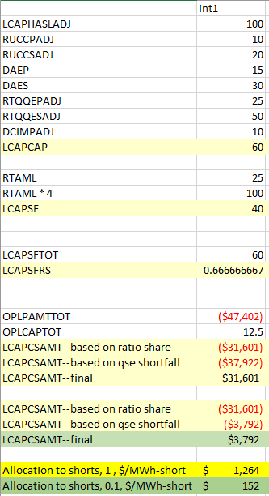
How does this change impact the ERCOT example in the xls file
This decreases the short-allocated payment from $1,264 to $152.
~20% of the make-whole would be paid by shorts and 80% by uplift LRS

Slide 10
Holistic winter, high-fuel-cost solution is needed
This is a different topic and not within the scope of 1086
This may be included in the SB3 discussions at the PUCT on the emergency pricing programs
Hopefully this process is never needed as we don’t see extreme cold temperatures again, but important to have a contingency plan.
Why is this needed?
Not clear to generators what to do when their cost is above the cap. How long do they wait for a RUC instruction? Can the RUC process handle committing 55,000MW of generation?
2/3 of generation possibly not participating in the DAM—could it lead to DAM not being able to clear? Is there a solution to pro-rationing and does it lead to all bidders drastically increasing their bid quantities?
RUC may not give correct incentives to generators to maximize reliability (see next slide)
At extreme gas costs, the RUC make whole for gas costs becomes untenable (could be $50bn if 45GW of gas generators paid $2,000 for gas over a 3-day period with the LCAP in place). Do we need a permanent securitization vehicle or rainy-day fund to allocate those costs to?
RUC instructions should be given before the gas trading window when gas liquidity is highest. This can occur up to 4 days before the operating day (physical gas trades on Friday morning for Saturday morning through Tuesday morning).

Slide 11
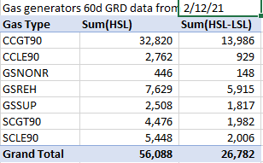
Incentive problems with RUC (& 1086) during extreme cold (high-NG cost) events
Approximately half of gas generation MW comes from LSL to HSL range.
RUC guarantees a generator is made whole to gas burn. The only portion of gas that is certain to be burned is the LSL.
This may incentivize generators to only buy gas to their LSL due to the uncertainty of recovering gas costs to their HSL.
This puts up to ~27GW of generation at risk (assuming no outages), with most of the risk on the marginal steam units combined HSL-LSL of 8GW.

