Slide 1
NPRR1086: Recovery, Charges, and Settlement for Operating Losses During an LCAP Effective Period
ERCOT Public
PRS Meeting
July 21, 2021

Slide 2
PUCT Order in Project 51871
NPRR1086, Recovery, Charges, and Settlement for Operating Losses During an LCAP Effective Period, was filed by ERCOT in order to comply with the changes to substantive rule 25.505, Scarcity Pricing Mechanism, in Project 51871

Slide 3
NPRR1086 ERCOT Comments (July 20, 2021)
Following some additional discussion and review, ERCOT is recommending the following changes to NPRR1086:
Added a missing sum function to OPLCAPTOT, in paragraph (1) of Section 6.8.3.1, Charges for Capacity Shortfalls During an LCAP Effective Period.
Clarify under Section 6.8.1, Determination of Operating Losses During an LCAP Effective Period, the following:
  Fuel prices may include all variable costs associated with the purchase, transportation, and storage of fuel.
  The payment for operating losses applies only when the Real-Time Settlement Point Price for the Resource is equal to or exceeds the Low System-Wide Offer Cap (LCAP) – per PUCT order in Project 51871.

Slide 4
PUCT Order in Project 51871: Review of the ERCOT Scarcity pricing Mechanism
(g)(7) Reimbursement for Operating Losses when the LCAP is in Effect
When the system-wide offer cap is set to the LCAP, ERCOT must reimburse resource entities for any actual marginal costs in excess of the larger of the LCAP or the real-time energy price for the resource. ERCOT must utilize existing settlement processes to the extent possible to verify the resource entity’s costs for reimbursement.

Slide 5
Calculations of Reimbursement for Operating Losses when the LCAP is in Effect
Payment for operating losses during an LCAP Effective Period is calculated as follows:
OPLPAMT _{i} = (-1) * (OPL + ADJOPL)
For the Generation Resource
OPL _{i} = Max(0, (AMC - Max(LCAP, RTSPP)) * Min(RTMG, MEP))
AMC = AHR * WAFP + ROM
MEP = AMF / AHR
OPLAMT = operating losses payment ($)
OPL = operating losses ($)
ADJOPL = operating losses adjustment ($)
i = 15-minute Settlement Interval
AMC = actual marginal cost ($/MWh)
AHR = average heat rate (MMBtu/MWh)
WAFP = weighted average fuel price ($/MMBtu)
ROM = variable O&M ($/MWh)
MEP = marginal energy production (MWh)
AMF = actual marginal fuel (MMBtu)
RTMG = Real-Time metered generation (MWh)

Slide 6
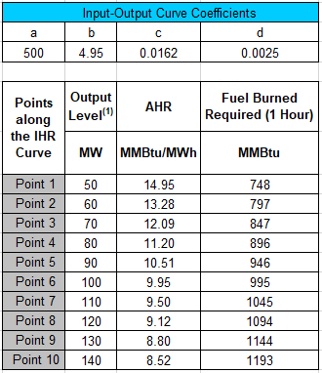
Example 1: Fuel purchased to operate Resource at HSL and dispatched to HSL
Input/Output (I/O) data required for calculation of the operating losses (OPL):
I/O = (a + bx + cx^2 + dx^3)
AHR = (I/O) / x
x = output level (MW)
OPL _{i} = Max[0 , (AMC - Max(LCAP , RTSPP )) * Min(RTMG , MEP )]
For the calculation of the actual marginal cost (AMC) and the marginal energy production (MEP), ERCOT will use the appropriate average heat rate (AHR).

Slide 7
Example 1: Fuel purchased to operate Resource at HSL and dispatched to HSL (cont’d)
Resource recovers fuel costs in both scenarios:
Prior to LCAP PUCT order through clearing prices
After LCAP PUCT order through a mix of clearing prices and operating losses (OPLAMT)

Slide 8
Example 2: Fuel purchased to operate Resource at HSL but SCED keeps the unit at LSL

Slide 9
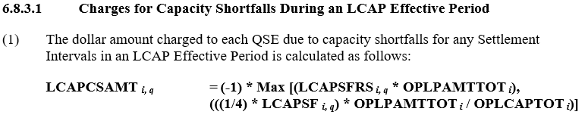
Capacity Short Uplift examples
LCAPSFRS (%) = LCAP Shortfall Ratio Share
OPLPAMTTOT ($) = Total Operating Losses Payment
LCAPSF (MW) = LCAP Shortfall
OPLCAPTOT (MWh) = Operating Loss Capacity Total (sum of RTMGs)
OPLPAMTTOT is a negative number (payment from ERCOT) so a “max” is used in the formula to allocate the lesser of the two possible uplift amounts to the QSE.

Slide 10
Allocation for Example 1
Operating Loss Payment Amount $45,554
Operating Loss Capacity Total 35 MWh (sum of RTMGs paid for losses)
LCAP Shortfall amount 40 MW (10MWh for the 15-minute interval)
LCAP Shortfall Ratio Share 6.67%
Max(cap short ratio share * loss payments, cap short MWh * loss payments / sum of RTMGs)
Max( 6.67% * -$45,554, 10MWh * -$45,554 / 35 MWh)
Max (-$30,369 -$13,015)
$13,015 is uplifted to cap short QSE

Slide 11
Allocation for Example 2
Operating Loss Payment Amount $47,402
Operating Loss Capacity Total 12.5 MWh (sum of RTMGs paid for losses)
LCAP Shortfall amount 40 MW (10MWh for the 15-minute interval)
LCAP Shortfall Ratio Share 6.67%
Max(cap short ratio share * loss payments, cap short MWh * loss payments / sum of RTMGs)
Max( 6.67% * -$47,402, 10 MWh * -$47,402 / 12.5 MWh)
Max(-$31,601, -$37,922)
$31,601 is uplifted to cap short QSE.

