Slide 1
July 2021 NDSWG

Slide 2
NMMS User Audit

Slide 3
Biannual External User Audit
ERCOT has initiated the required review of NMMS active users. If no response is received, you will lose write permission to NMMS
Process:
  Emails sent to each company’s USA to verify their active users
    Initial emails sent on 7/13
  If no response is received after 2 weeks a follow up email will be sent
  If no further response is received the NMMS user(s) will be set to read-only permissions

Slide 4
Validation Rules in Modeling Guidelines

Slide 5
Validation Rules in Modeling Guidelines
ERCOT proposes removing validation rules from the Modeling Guidelines document
Validation rules/concepts can currently be found in the appendix sections
Maintenance of these sections is cumbersome and trails the actual implementation of the rule by weeks
The format is not easy to consume
Does anyone use this section?

Slide 6
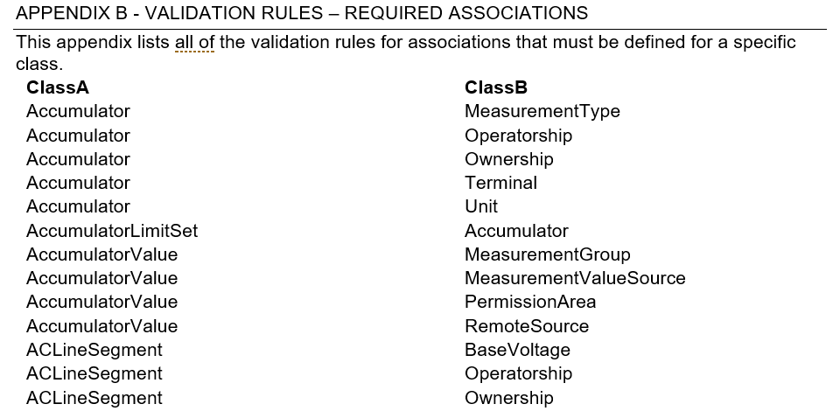
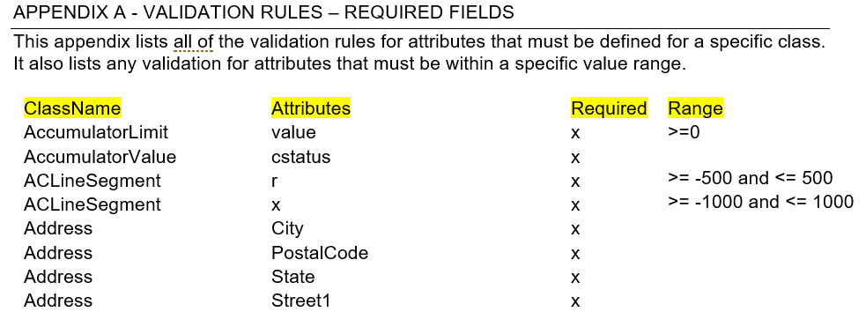
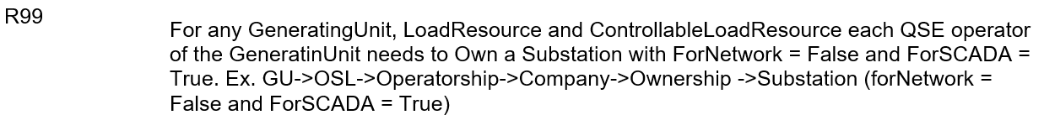
Validation Rules in Modeling Guidelines - Examples

Slide 7
Contact List

Slide 8
Modeling Contact List
Request for updated contacts sent to NDSWG exploder list on 6/23
Substantial response
TSPs have been reached out to directly if not on the list
How do we want to share this list?

Slide 9
Chronic Congestion Updates

Slide 10
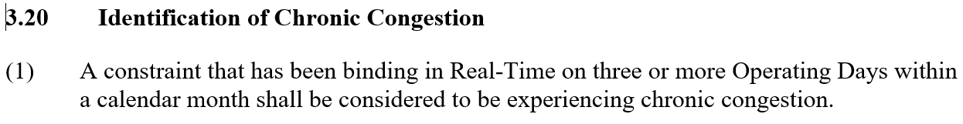
Update to Chronic Congestion File – NPRR1064
NPRR1064 was Board-approved in June which changed the definition of Chronic Congestion (3.20) from “active or binding” to just “binding”.
  “Binding”, for the most part, means that generation was moved to resolve the base case or post-contingency overload
  This change can (likely will) reduce the number of elements needing ratings and impedance verifications

Slide 11
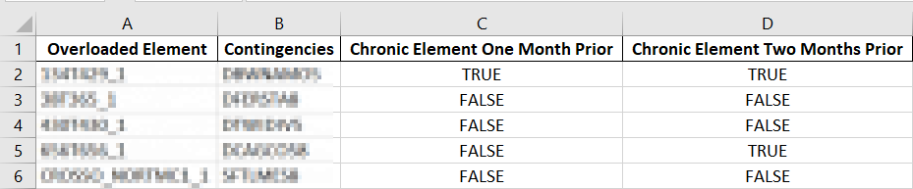
Update to Chronic Congestion File – “3” Month Lookback
Two new columns have been added to the verification Excel file
  Chronic Element One Month Prior
  Chronic Element Two Months Prior
Example – For reports sent out in July
  Each row of the report is chronically congested elements found in June
  The “Chronic Element One Month Prior” column corresponds to May congestion
  The “Chronic Element Two Months Prior” column corresponds to April congestion

Slide 12
ICCP Handbook

Slide 13
Current Attempt – Identify Binding Language in ICCP Handbook
Update references to Handbook to properly reflect that is should be use as a guide
Review Handbook to identify candidate language to add to a new binding document.
1
Binding
Non-Binding
2
Binding

Slide 14
NDSWG Book Club – ICCP Handbook
ERCOT proposes a phased review of the ICCP Handbook
Sections 1 and 2 (discuss findings during August NDSWG meeting)
  Equipment, equipment interconnections, connection procedures and physical layer protocols necessary to physically connect a Market Participant’s systems to ERCOT’s systems.
Sections 3 and 5 (discuss in September meeting)
  ICCP parameters, standards, and conventions required for every Market Participant to successfully communicate with ERCOT.
Sections 4, 6, and Appendix (discuss in October meeting)
  ICCP parameters and data exchange requirements for each type of Market Participant (QSE or TSP) to reliably exchange operational data with ERCOT on a day to day basis.
Goal is to identify any language that should become binding/required for ERCOT or MPs.

Slide 15
ECEII

Slide 16
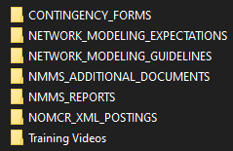
Additional ECEII Changes – Moving More Files to ECEII Location
NOMCR_XML_POSTINGS folder will be moved to ECEII locations

Slide 17
Appendix

Slide 18
Review ICCP Handbook for Binding Language

Slide 19
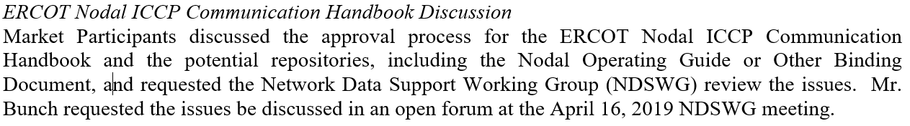
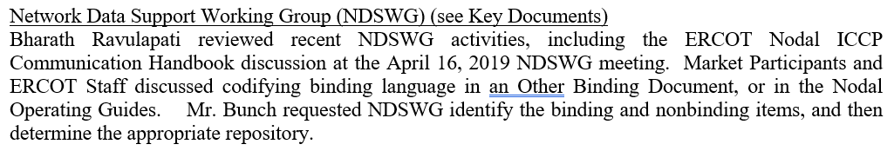
Background
At the April and May 2019 ROS meetings, it was requested that NDSWG review the the ICCP Handbook
  Determine what is binding/non-binding
  Determine the proper repository for the binding language
  Update references to ICCP Handbook to new repository
April Notes
May Notes

Slide 20
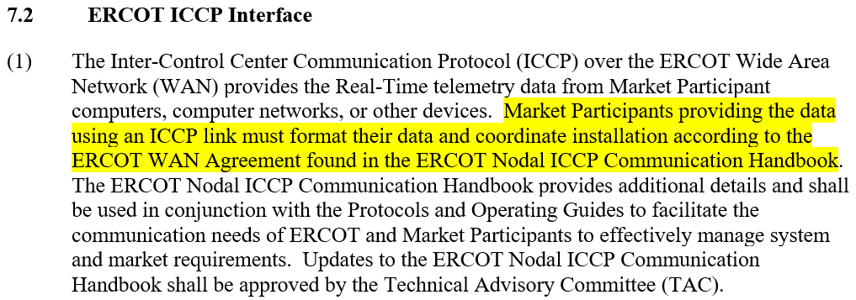
Main Issues
ERCOT Nodal ICCP Communication Handbook may have language that should be binding
At least one binding document, the Nodal Operating Guides, refers to the non-binding Handbook in a “binding fashion” (e.g. “must”)
Nodal Operating Guides

Slide 21
Attempt #1 – Pull NOG-Referenced Language Into New* Doc
ERCOT’s initial attempt was to pull all sections of the ICCP Handbook referenced by the Nodal Operating Guides into a new binding document.
Binding
Non-Binding
Binding

Slide 22
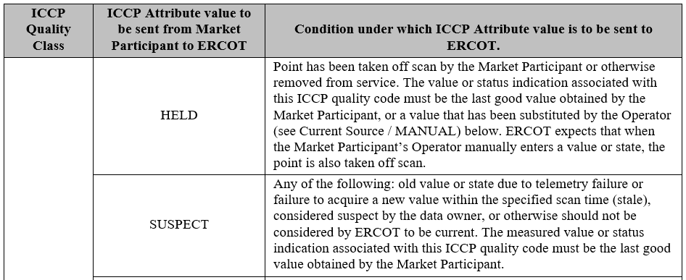
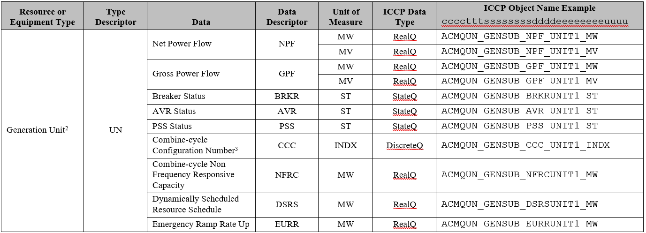
Attempt #1 – Sample ICCP Sections Referenced by NOG
Quality Codes
Not all systems send every quality code
Object name syntax is a suggestion and not a rule
Data Exchange Tables

Slide 23
Current Attempt – Identify Binding Language in ICCP Handbook
Update references to Handbook to properly reflect that is should be use as a guide
Review Handbook to identify candidate language to add to a new binding document.
Binding
Non-Binding
Binding

