Slide 1
Credit Exposure Update
Spoorthy Papudesi
Credit Work Group
ERCOT Public
Jul 21, 2021

Slide 2
Monthly Highlights May 2021- June 2021
Market-wide average TPE increased from $ 594.12 million in May to $ 610.6 million in June
  TPE increased mainly due to
    higher Forward Adjustment Factors on 06/15/2021 and
    higher Real-Time prices 06/13/2021 and higher Day-Ahead prices on 06/15/2021
Discretionary Collateral is defined as Secured Collateral in excess of TPE,CRR Locked ACL and DAM Exposure
  Average Discretionary Collateral increased from $1,230.5 million to $1,791.3 million
  The increase in Discretionary Collateral is largely due to increase in Secured Collateral.
Short pay entities are excluded from the above calculations to remove data skew
No unusual collateral call activity

Slide 3
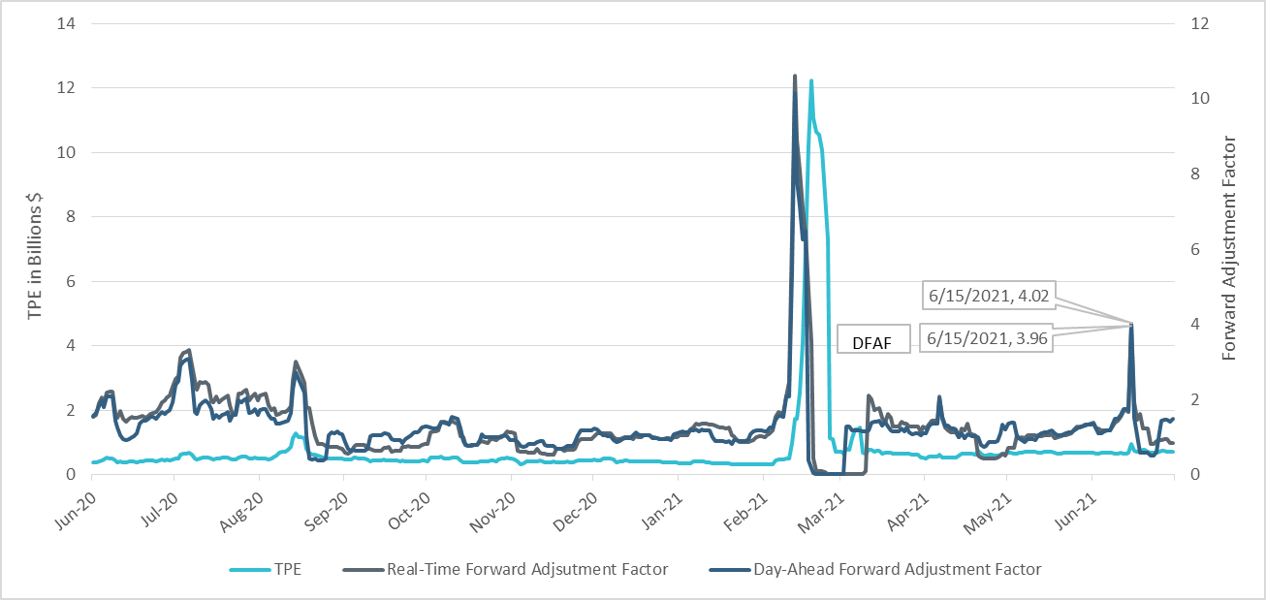
TPE and Forward Adjustment Factors June 2020- June 2021
RFAF
*Short pay entities are excluded from the above calculations to remove data skew

Slide 4
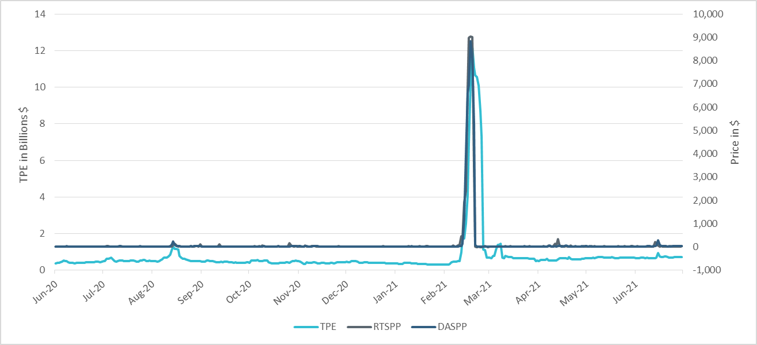
TPE/Real-Time & Day-Ahead Daily Average Settlement Point Prices for HB_NORTH June 2020- June 2021
*Short pay entities are excluded from the above calculations to remove data skew

Slide 5
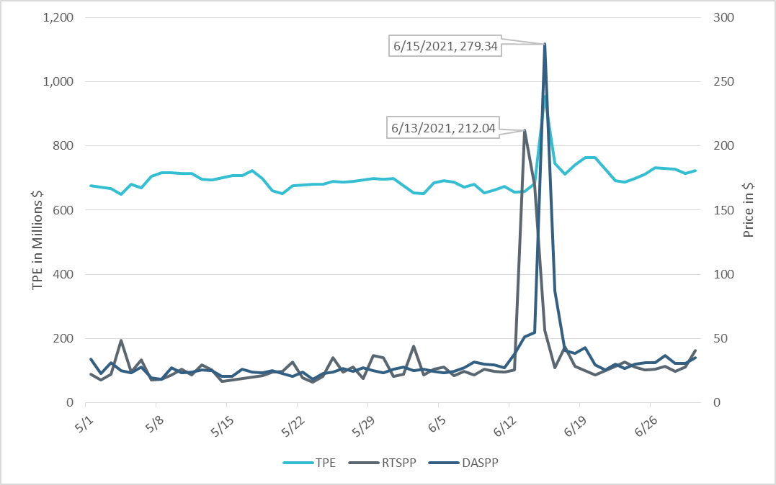
TPE/Real-Time & Day-Ahead Daily Average Settlement Point Prices for HB_NORTH May 2021- June 2021
*Short pay entities are excluded from the above calculations to remove data skew

Slide 6
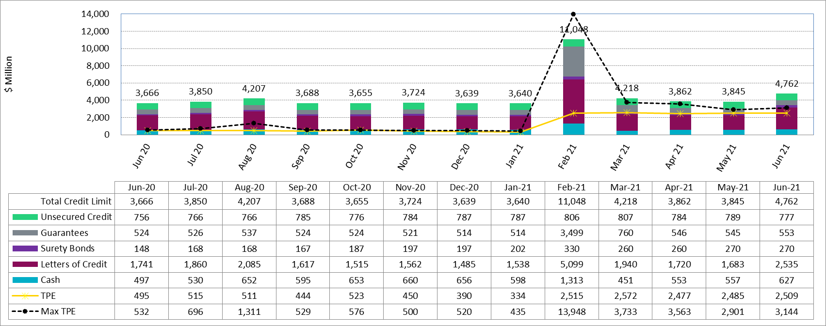
Available Credit by Type Compared to Total Potential Exposure (TPE) June 2020- June 2021
* Numbers are as of month-end except for Max TPE

Slide 7
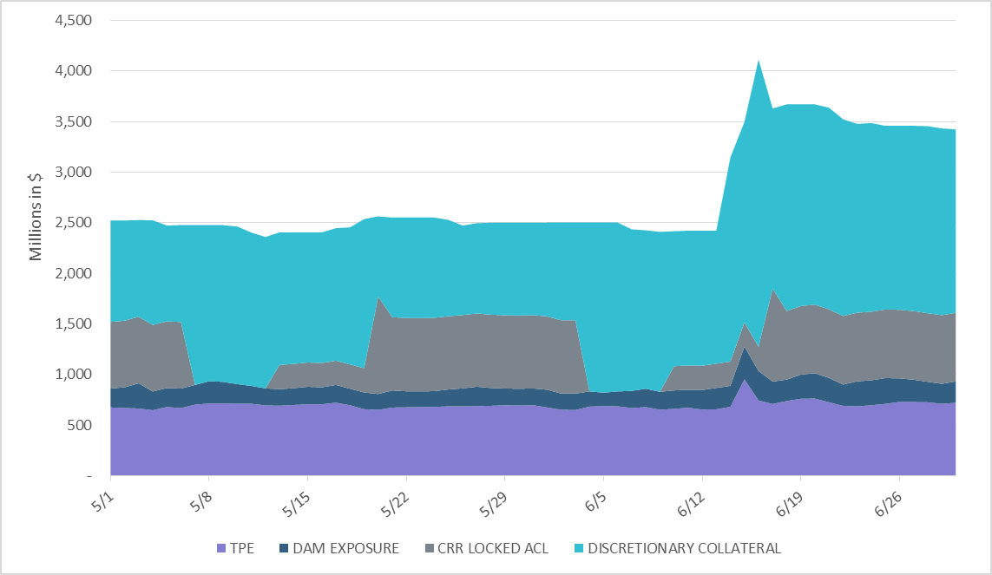
Discretionary Collateral May 2021 - June 2021
*Discretionary collateral doesn’t include Unsecured Credit Limit or parent guarantees
*Short pay entities are excluded from the above calculations to remove data skew

Slide 8
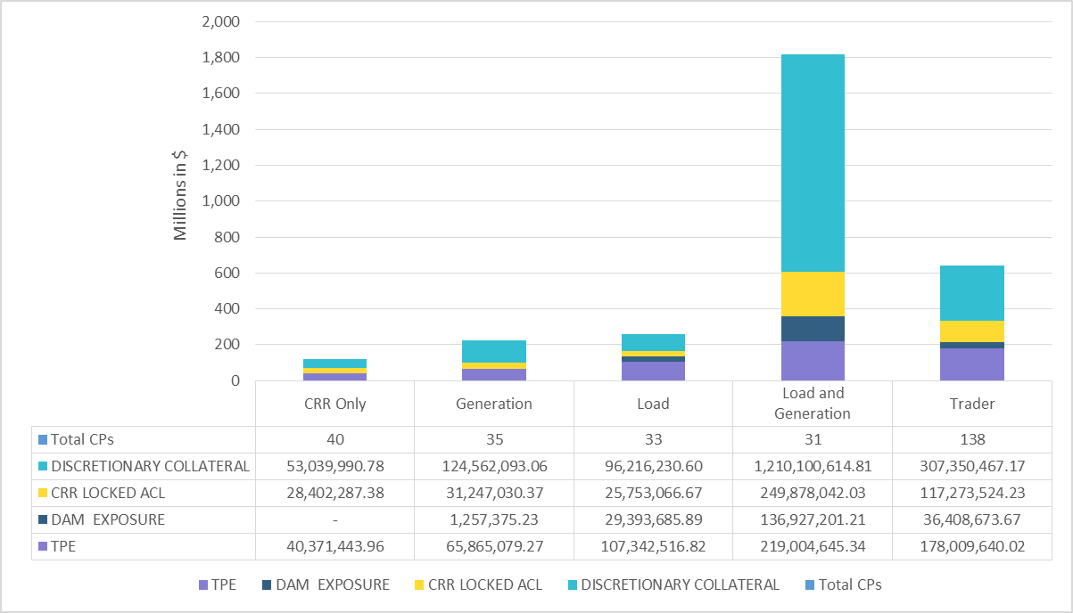
TPE and Discretionary Collateral by Market Segment- June 2021*
Load and Generation entities accounted for the largest portion of discretionary collateral
*Discretionary collateral doesn’t include Unsecured Credit Limit or parent guarantees
*Short pay entities are excluded from the above calculations to remove data skew

Slide 9
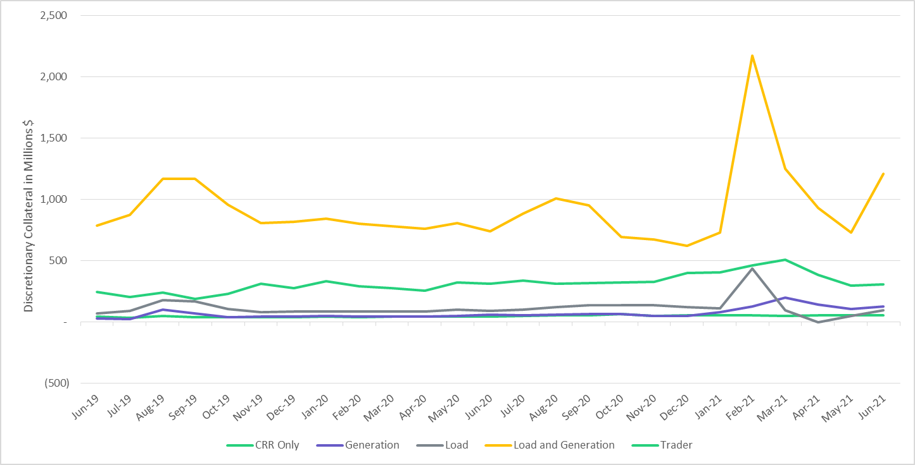
Discretionary Collateral by Market Segment June 2019- June 2021
*Short pay entities are excluded from the above calculations from March 2021 to remove data skew

Slide 10
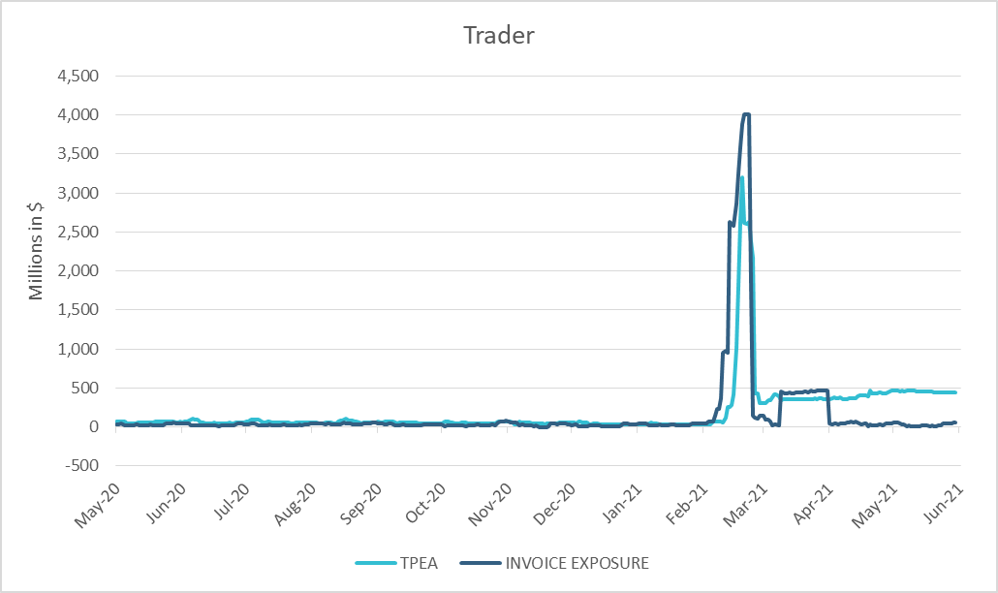
TPE Coverage of Settlements May 2020 - May 2021
*TPEA generally exceeds invoice exposure
*During the 2021 winter event, invoice exposure was slightly higher than TPEA

Slide 11
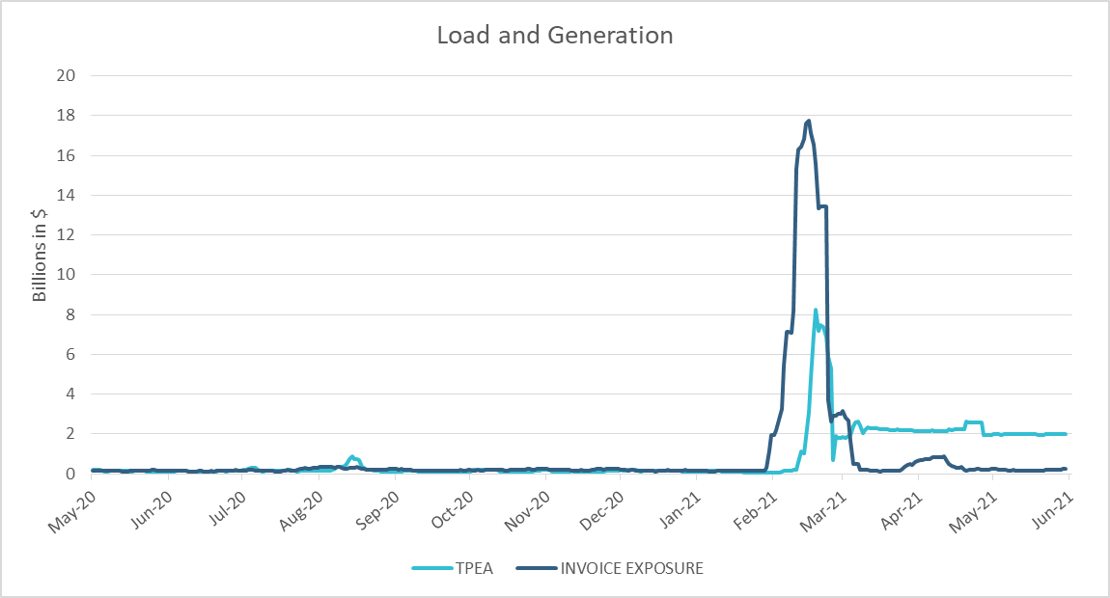
TPE Coverage of Settlements May 2020 - May 2021
*During the 2021 winter event, invoice exposure was higher than TPEA

Slide 12
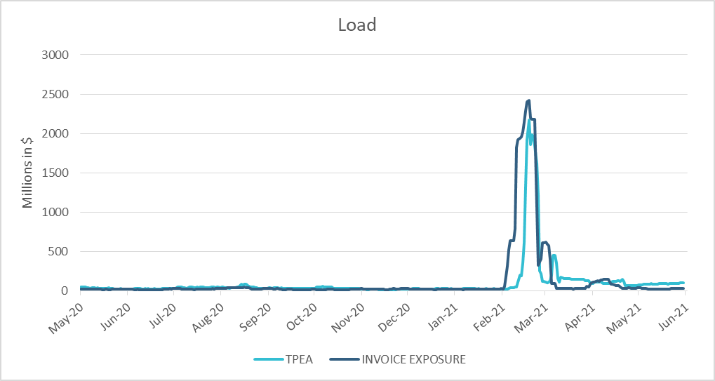
TPE Coverage of Settlements May 2020 - May 2021
*TPEA closely approximates invoice exposure except during the winter 2021 event

Slide 13
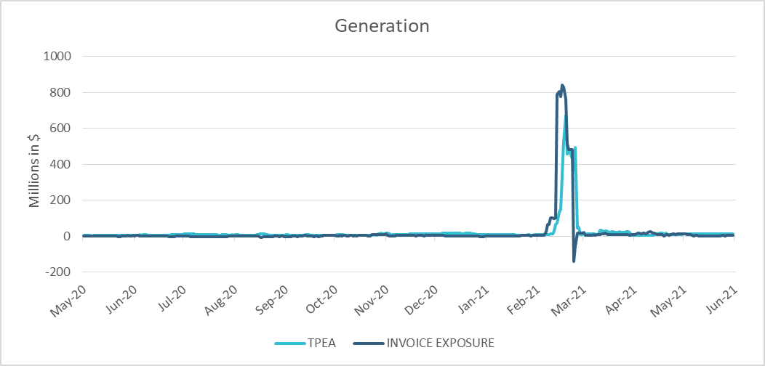
TPE Coverage of Settlements May 2020 - May 2021
*TPEA generally exceeds invoice exposure except during the 2021 winter event

Slide 14
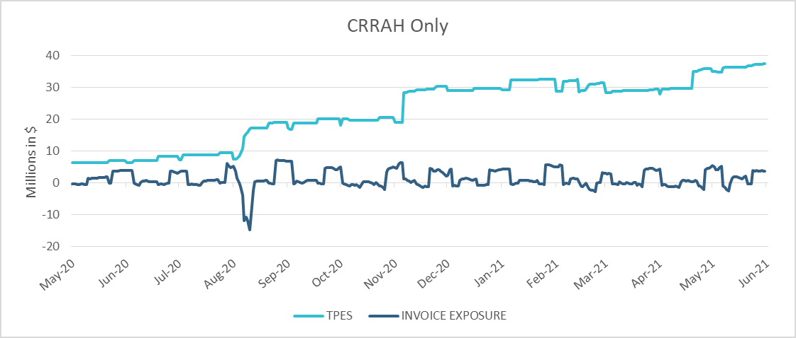
TPE Coverage of Settlements May 2020 - May 2021
*TPES mostly exceeds actual/invoice exposure

Slide 15
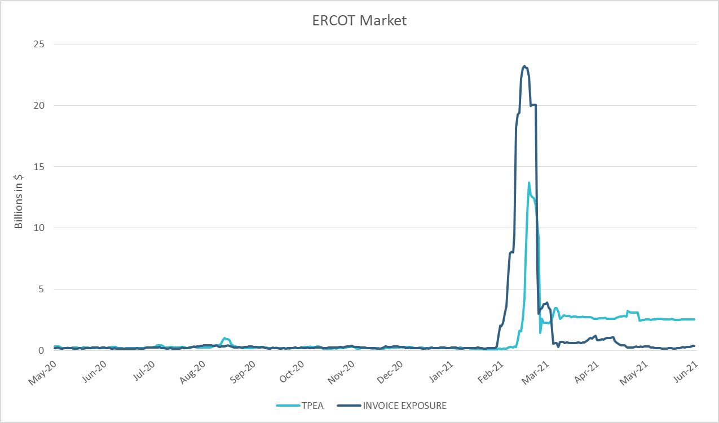
TPE Coverage of Settlements May 2020 - May 2021
*TPEA closely approximates actual/invoice exposure except during the 2021 winter event

Slide 16
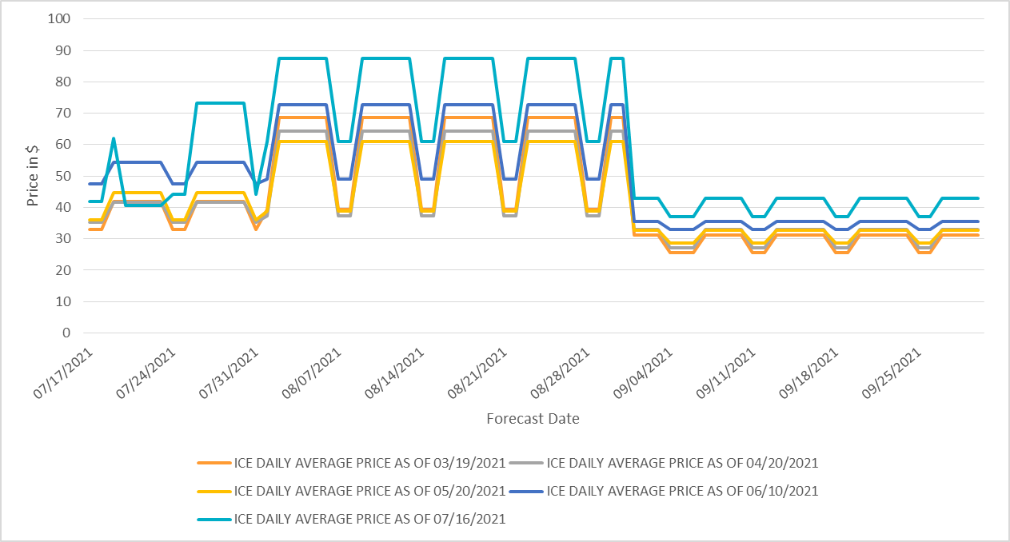
ICE Daily Average Future Prices Jul 2021 - Sep 2021

Slide 17
Appendix

Slide 18
Summary of Distribution by Market Segment*
*Excess collateral doesn’t include Unsecured Credit Limit and is defined as Collateral in excess of TPE
*Short pay entities are excluded from the above calculations to remove data skew

Slide 19
Summary of Distribution by Rating Group*
*Short pay entities are excluded from the above calculations to remove data skew

Slide 20
Distribution of TPE by Rating and Category*
*Short pay entities are excluded from the above calculations to remove data skew

Slide 21
Distribution of Excess Collateral by Rating and Category*
*Excess collateral doesn’t include Unsecured Credit Limit
*Short pay entities are excluded from the above calculations to remove data skew

Slide 22
TPE Coverage of Settlements
  TPEA covers Settlement/Invoice exposure and estimated Real-Time and Day- Ahead completed but not settled activity (RTLCNS and UDAA)
  The analysis was performed for the period, May 2020 - May 2021
  Only Settlement invoices due to ERCOT are considered in the calculation
  M1 values as of May 28, 2020 were used for the period Feb 2020- May 2020 and M1 values effective as of each day were used since Jun 2020
  Example
  For business date 2/1/2020, if a Counter-Party has M1 value of 20, then all the charge invoices till 2/21/2020 including RTLCNS and UDAA as of 2/1/2020 is summed up to arrive at “Invoice Exposure”

Slide 23
Questions

