Slide 1
Working Group to Develop GIC Model
Chu Liang
5/18/2021

Slide 2
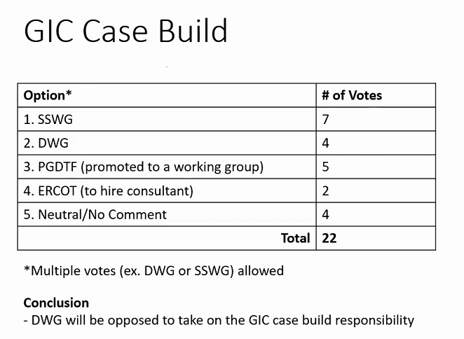
DWG Feedback
GIC is not a dynamics case, it’s a steady state case.
SSWG have more knowledge on data related to GIC model build.

Slide 3
SSWG Feedbacks
Favors DWG to take on the model build.
SSWG doesn’t have the expertise to track GIC data.
Only have one month in the year free to work on other case.
Develop the model more often to add more work for scope of PGDWG.

Slide 4
Next Step?

