Slide 1
Update on ERCOT’s Reserves Process
ERCOT Staff
July 19, 2021
CMWG

Slide 2
Introduction
As described at the June 30, 2021 Special TAC meeting, beginning July 12, 2021 ERCOT has started procuring additional Ancillary Services.
ERCOT is procuring 2800 MW of Responsive Reserve Service (RRS) over the peak hours and has increased Non-Spinning Reserve Service (NSRS) quantities such that a total of 6500 MW of Up Ancillary Services (Regulation Up (Reg Up), RRS and NSRS) are being procured.
ERCOT will continue to maintain a margin of 6,500 MW between committed generation capacity and active load forecast.
To the extent that the additional Ancillary Services are not sufficient to maintain this margin, ERCOT will continue to use the RUC process.
ERCOT will continue to work with stakeholders on refining its processes and is bringing forth this analysis of the RUCs in the week of July 12 to the July 19, 2021 Congestion Management Working Group meeting.

Slide 3
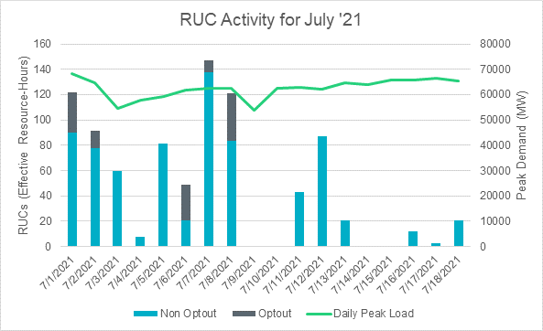
RUC Activity in July 2021
There is a visible reduction in the RUC activity since the July 12th transition.

Slide 4
Summary of Activities on July 12, 2021
To maintain a margin of 6,500 MW between committed generation capacity and active load forecast during all hours on Operating Day (OD) July 12, 2021, following RUCs were conducted
~1,200 MW capacity following the 00:03 RUC execution for HE14 through HE20
~1,390 MW capacity following the 01:03 RUC execution for HE12 through HE21
~843 MW capacity following the 04:03 RUC execution for HE15 through HE18
On July 12 till about noon, the tools that ERCOT uses along with RUC to assess the margin between committed generation capacity and active load forecast for any given OD were setup to only account for total scheduled online generation capacity as committed capacity.
As a result, the RUC decisions from this day did not take into account the offline generation capacity that were providing NSRS in ERCOT’s margin assessments.
These tools were updated the to include offline generation capacity that is providing NSRS in the committed generation capacity calculation on July 12, 2021 in the afternoon.

Slide 5
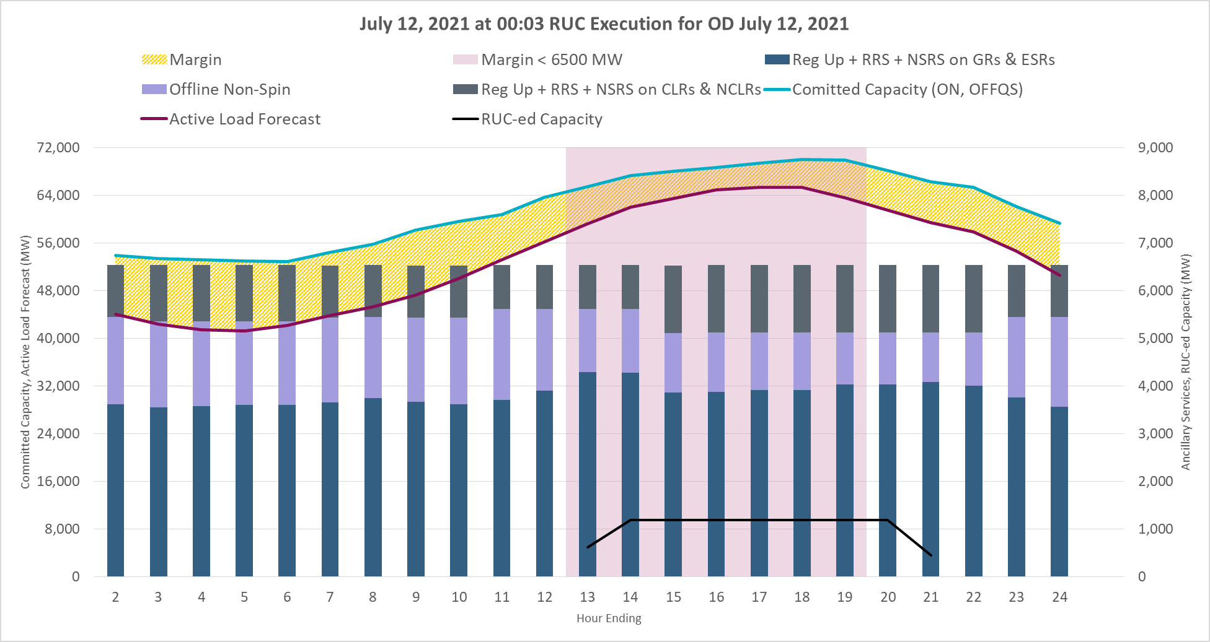
Mid-night RUC execution on July 12, 2021
Margin for peak hours was below 6,500 MW and additional capacity was RUC-ed.

Slide 6
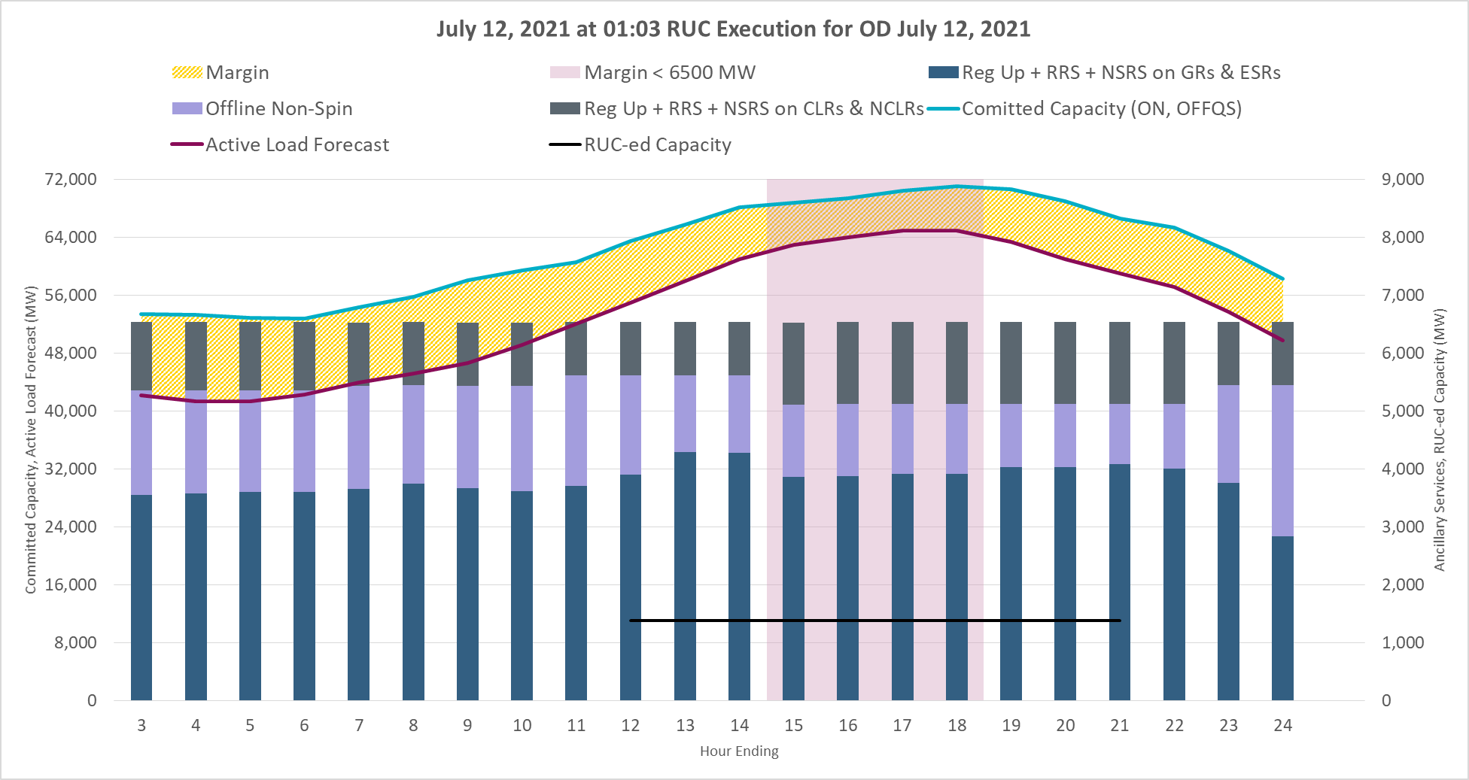
1am RUC execution on July 12, 2021
Margin for peaks hours was below 6,500 MW and additional capacity was RUC-ed.

Slide 7
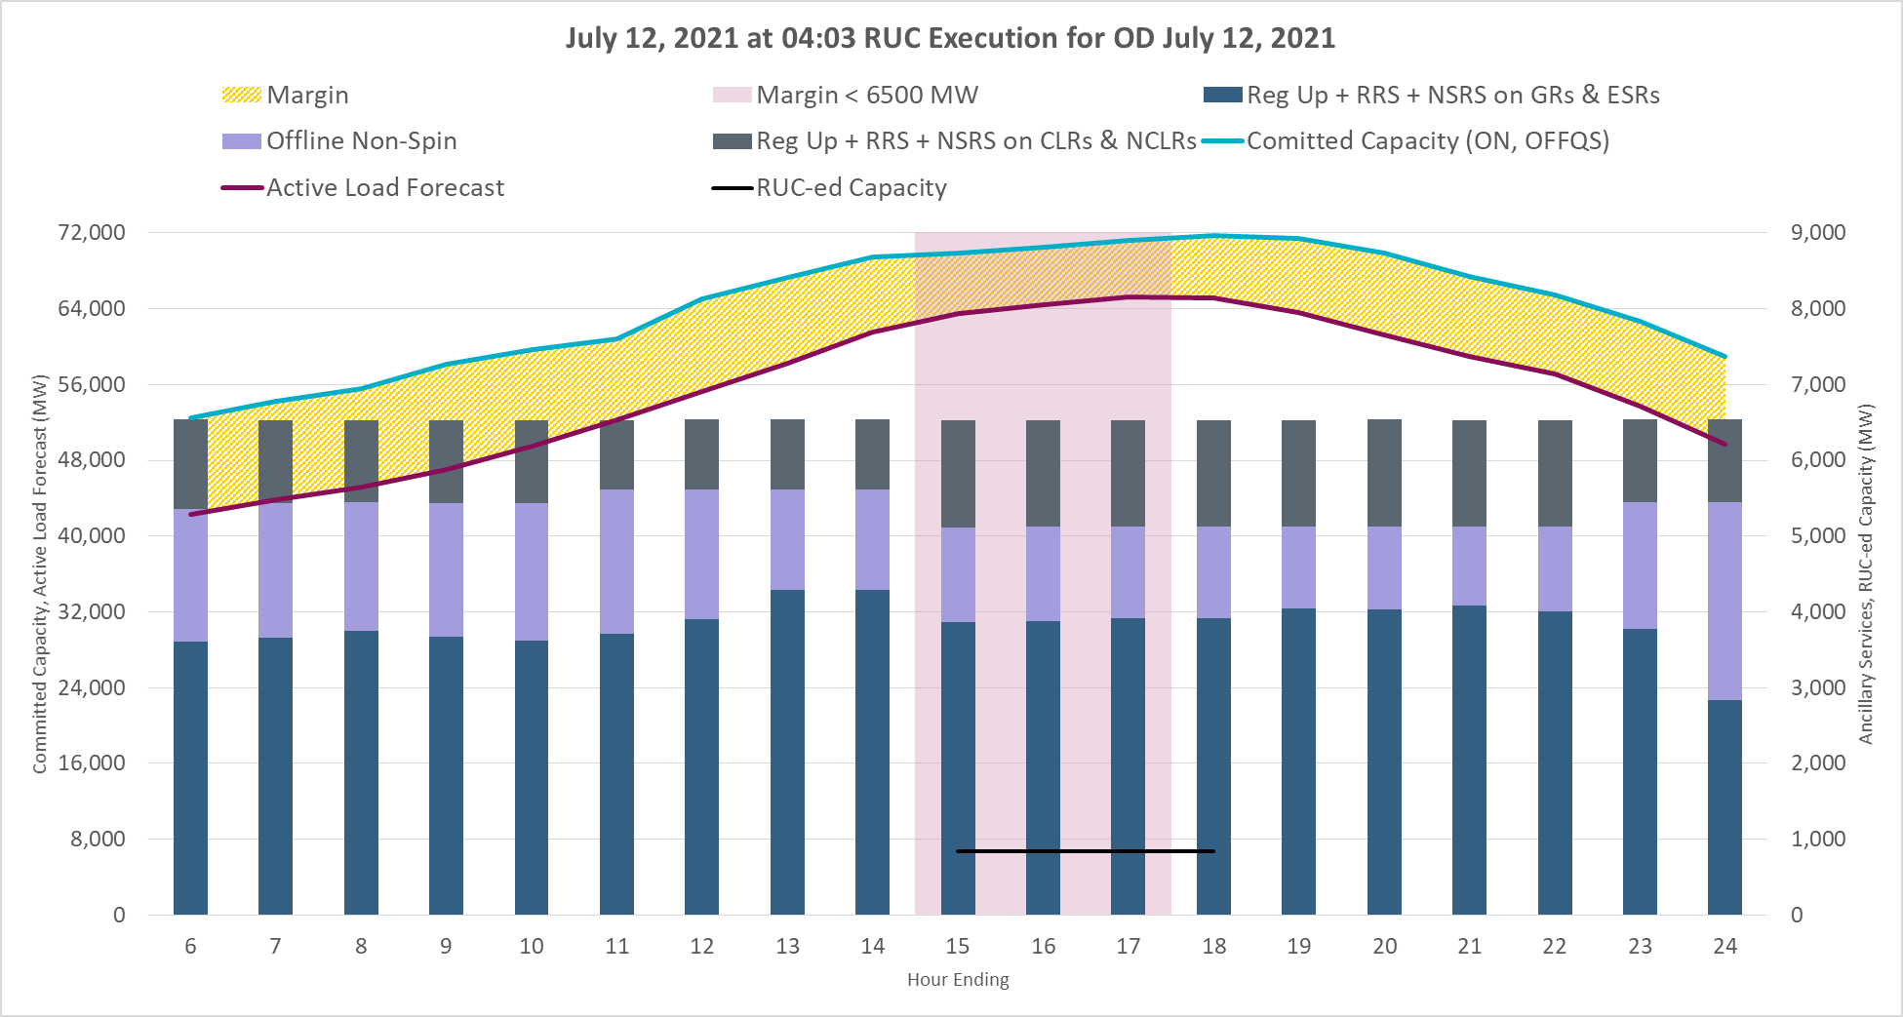
4am RUC execution on July 12, 2021
Margin for peaks hours was below 6,500 MW and additional capacity was RUC-ed.

Slide 8
Summary of Activities for July 13, 2021
To respect minimum runtime and maintain a margin of 6,500 MW between committed generation capacity and active load forecast during all hours on Operating Day (OD) July 13, 2021, following RUCs were conducted.
~375 MW capacity following the 20:03 RUC (07/12/2021) execution for HE01 through HE12 to meet minimum runtime of 24 hours.
~375 MW capacity following the 04:03 RUC execution for HE13 through HE18
~392 MW capacity following the 05:03 RUC execution for HE15 through HE17

Slide 9
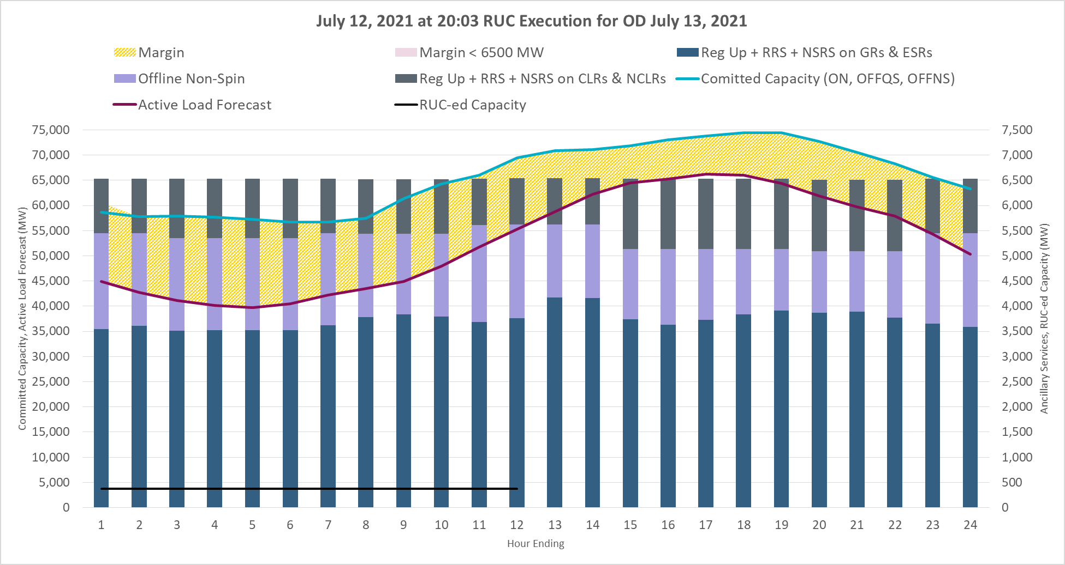
8pm RUC execution on July 12, 2021
RUC-ed to meet minimum runtime of 24 hours.

Slide 10
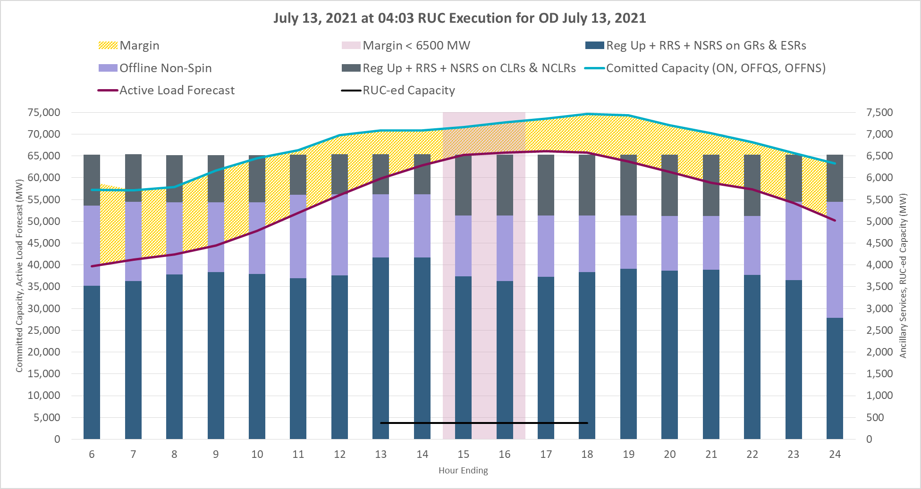
4am RUC execution on July 13, 2021
Margin for peaks hours was below 6,500 MW and additional capacity was RUC-ed.

Slide 11
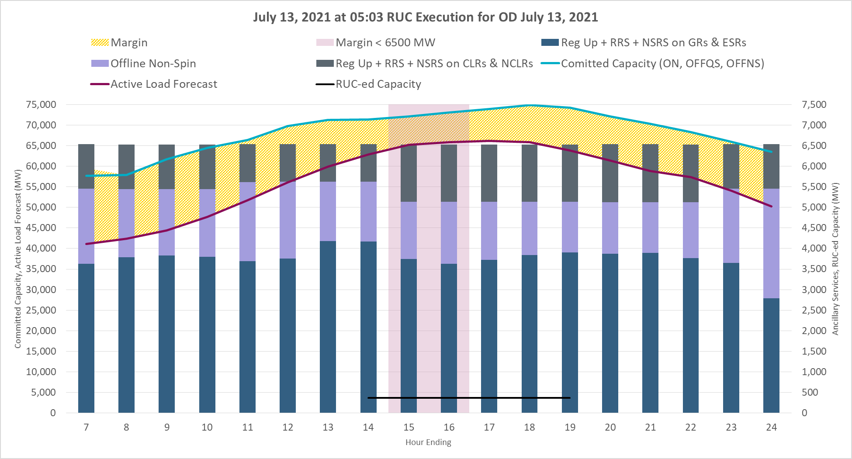
5am RUC execution on July 13, 2021
Margin for peaks hours was below 6,500 MW and additional capacity was RUC-ed.

Slide 12
Current approach for maintaining reserves
Below is a summary of ERCOT’s current approach.
ERCOT will continue to maintain a margin of 6,500 MW between committed generation capacity and active load forecast for hours ending 14 through 21.
For this assessment committed generation capacity calculation will include both total online generation capacity as well as offline generation capacity that is providing NSRS, but it will not include reserves provided by Load Resources.
ERCOT will attempt to defer RUCs till closer to the peak Operating Hours.
ERCOT will use discretion in determining the appropriate margin in all other hours.
July 16, 2021 was the next time that ERCOT had to RUC ~1185 MW capacity to maintain 6,500 MW margin during the peak hours.

Slide 13
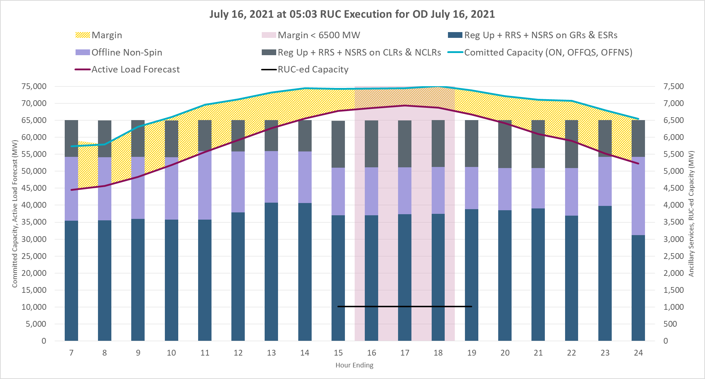
5am RUC execution on July 16, 2021
Margin for peaks hours was below 6,500 MW and additional capacity was RUC-ed.

Slide 14
7am RUC execution on July 16, 2021
Margin for peaks hours was below 6,500 MW and additional capacity was RUC-ed.

Slide 15
Summary
Beginning July 12, 2021 ERCOT has started procuring additional Ancillary Services.
ERCOT will continue to maintain a margin of 6,500 MW between committed generation capacity and active load forecast for hours ending 14 through 21.
For this assessment committed generation capacity calculation will include both total online generation capacity as well as offline generation capacity that is providing NSRS, but it will not include reserves provided by Load Resources.
ERCOT will use discretion in determining the appropriate margin in all other hours.
ERCOT will continue to work with stakeholders on refining its processes

