Slide 1
Credit Exposure Update
Spoorthy Papudesi
Credit Work Group
ERCOT Public
Jun 16, 2021

Slide 2
Monthly Highlights Apr 2021- May 2021
Market-wide average TPE increased from $ 550.8 million in April to $ 594.12 million in May
TPE increased mainly due to the removal of 15% haircut adjustment to TPE on April 20, 2021
Discretionary Collateral is defined as Secured Collateral in excess of TPE,CRR Locked ACL and DAM Exposure
Average Discretionary Collateral decreased from $1,508.7 million to $1,230.5 million
The decrease in Discretionary Collateral is largely due to increase in CRR Locked ACL.
Number of auction lock days were higher in May compared to April
Short pay entities are excluded from the above calculations to remove data skew

Slide 3
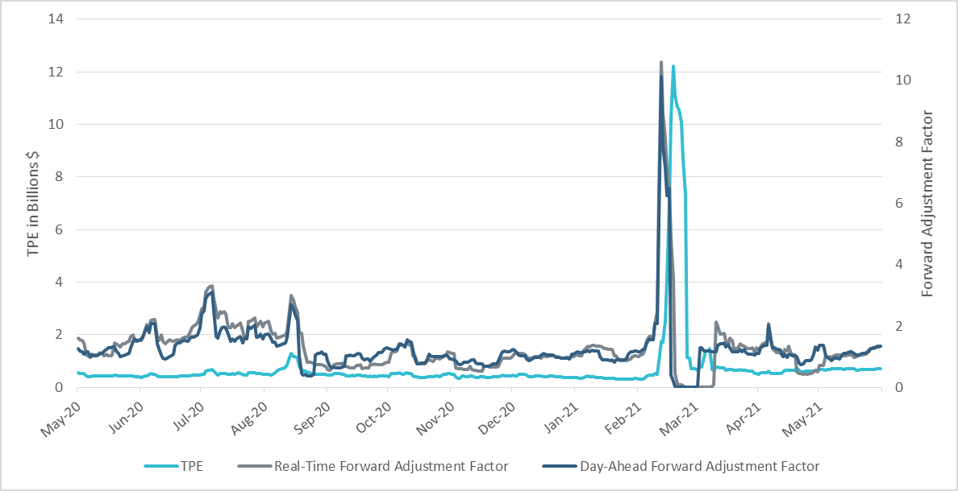
TPE and Forward Adjustment Factors May 2020- May 2021
*Short pay entities are excluded from the above calculations to remove data skew

Slide 4
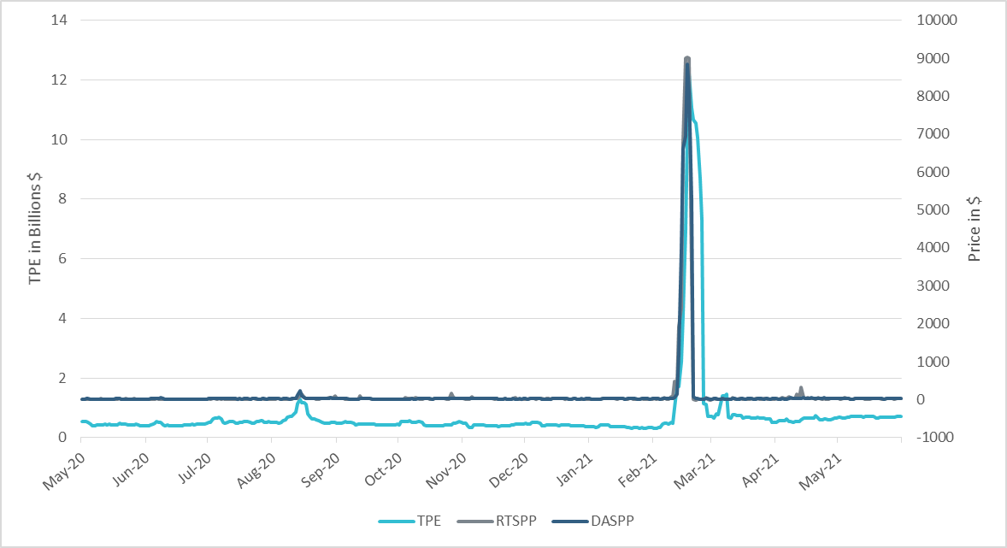
TPE/Real-Time & Day-Ahead Daily Average Settlement Point Prices for HB_NORTH May 2020- May 2021
*Short pay entities are excluded from the above calculations to remove data skew

Slide 5
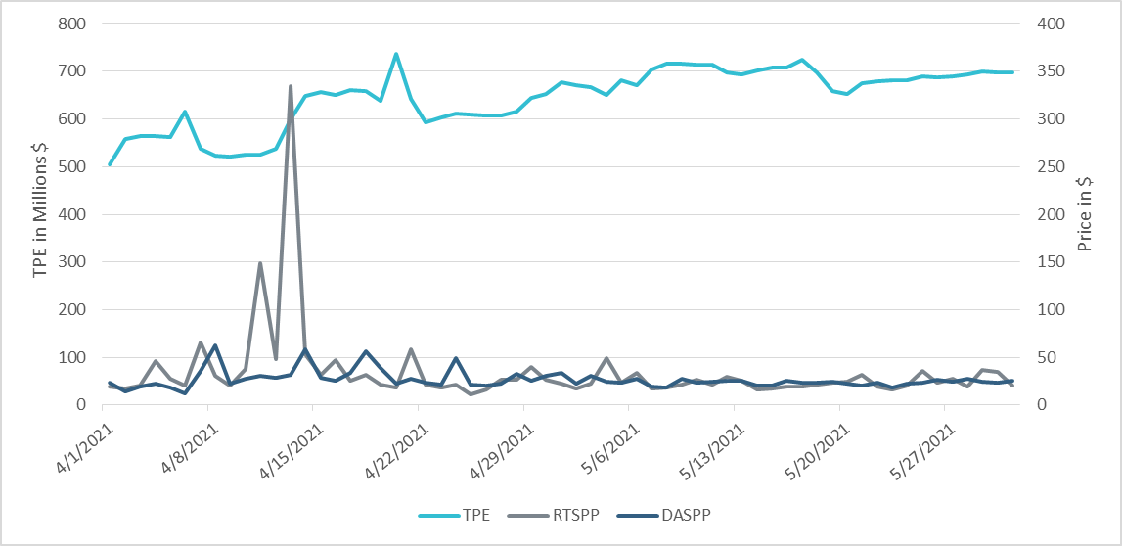
TPE/Real-Time & Day-Ahead Daily Average Settlement Point Prices for HB_NORTH Apr 2021- May 2021
*Short pay entities are excluded from the above calculations to remove data skew

Slide 6
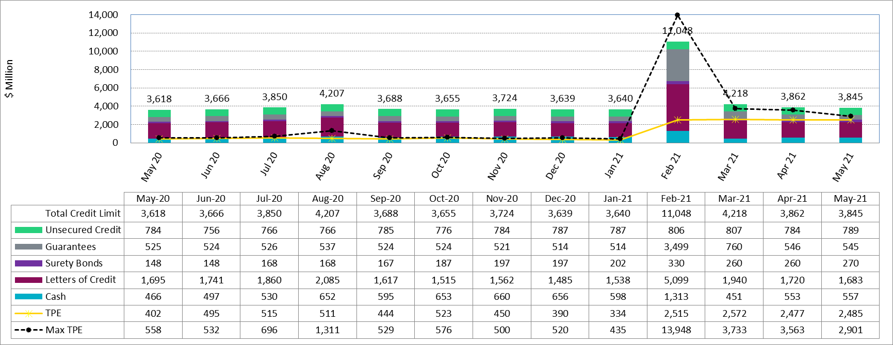
Available Credit by Type Compared to Total Potential Exposure (TPE) May 2020- May 2021
* Numbers are as of month-end except for Max TPE

Slide 7
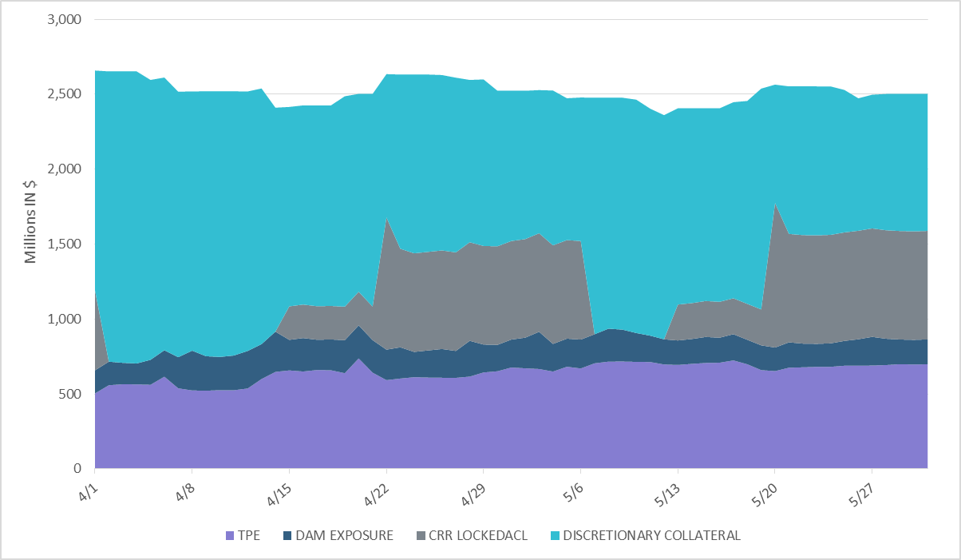
Discretionary Collateral Apr 2021 - May 2021
*Discretionary collateral doesn’t include Unsecured Credit Limit or parent guarantees
*Short pay entities are excluded from the above calculations to remove data skew

Slide 8
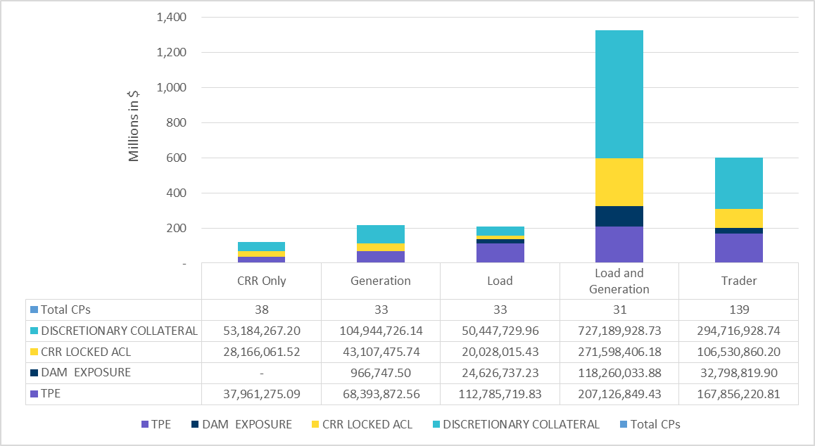
TPE and Discretionary Collateral by Market Segment- May 2021*
Load and Generation entities accounted for the largest portion of discretionary collateral
*Discretionary collateral doesn’t include Unsecured Credit Limit or parent guarantees
*Short pay entities are excluded from the above calculations to remove data skew

Slide 9
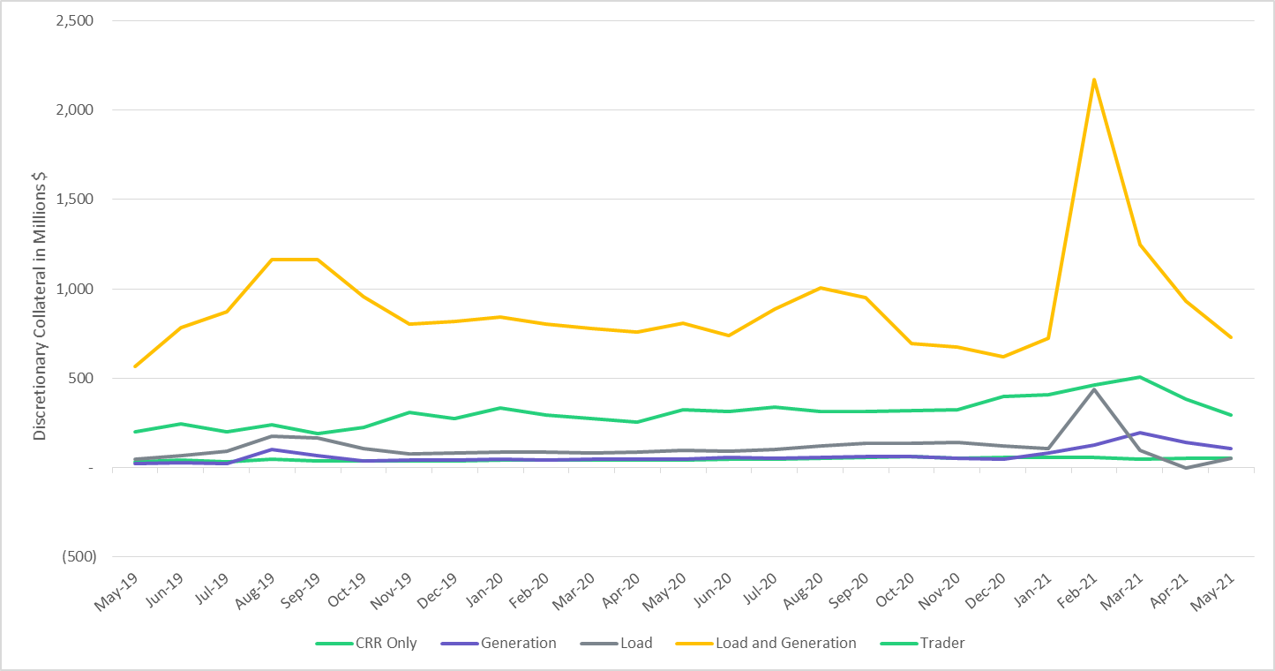
Discretionary Collateral by Market Segment May 2019- May 2021
*Short pay entities are excluded from the above calculations from March 2021 to remove data skew

Slide 10
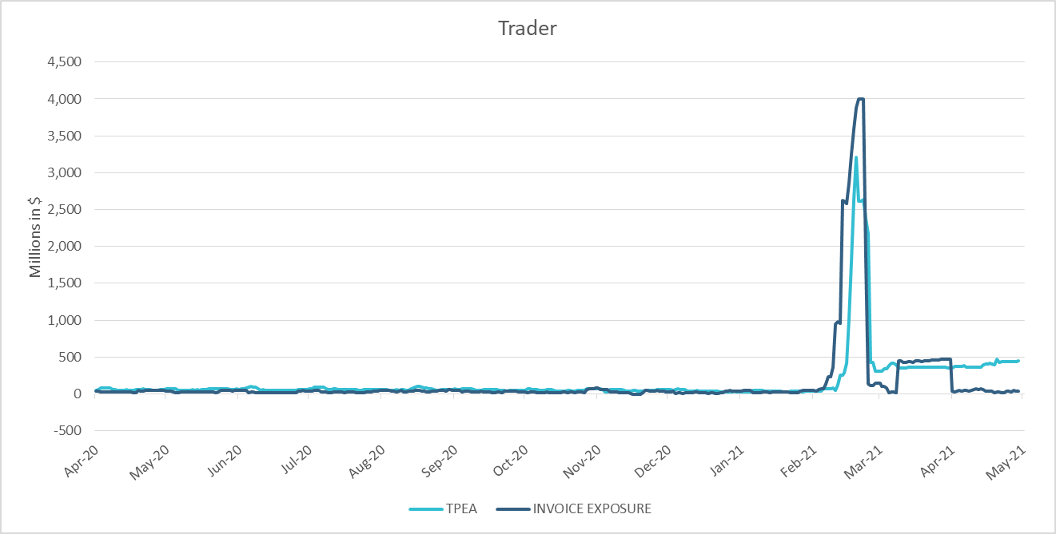
TPE Coverage of Settlements Apr 2020 - Apr 2021
*TPEA generally exceeds invoice exposure
*During the 2021 winter event, invoice exposure was slightly higher than TPEA

Slide 11
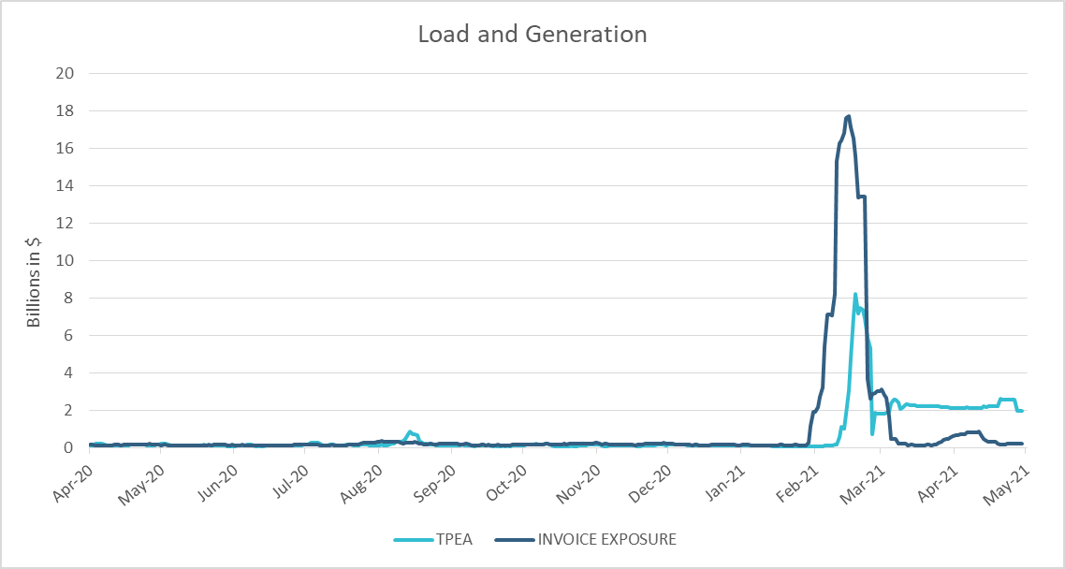
TPE Coverage of Settlements Apr 2020 - Apr 2021
*During the 2021 winter event, invoice exposure was higher than TPEA

Slide 12
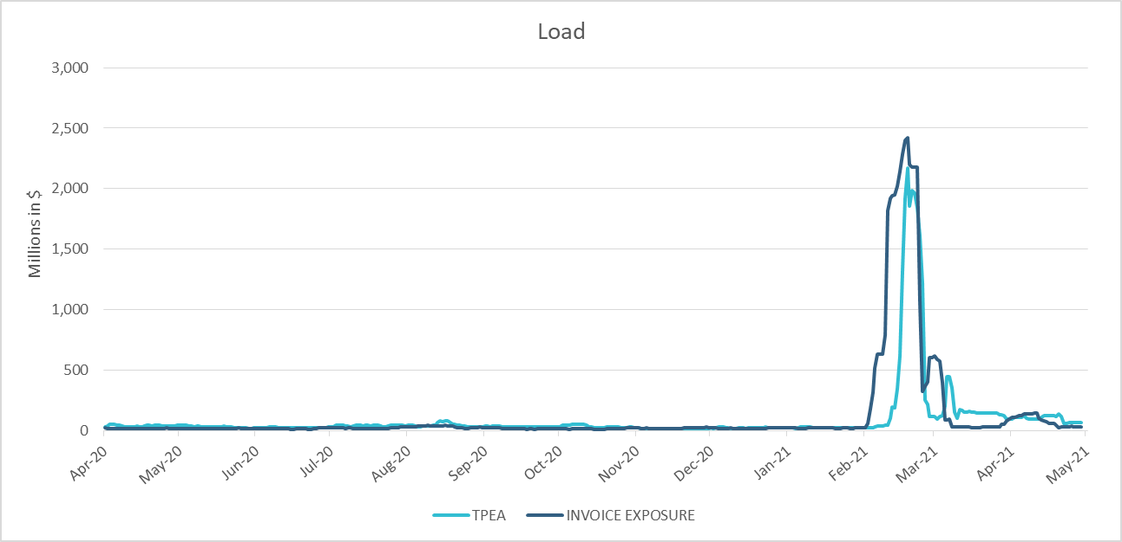
TPE Coverage of Settlements Apr 2020 - Apr 2021
*TPEA closely approximates invoice exposure except during the winter 2021 event

Slide 13
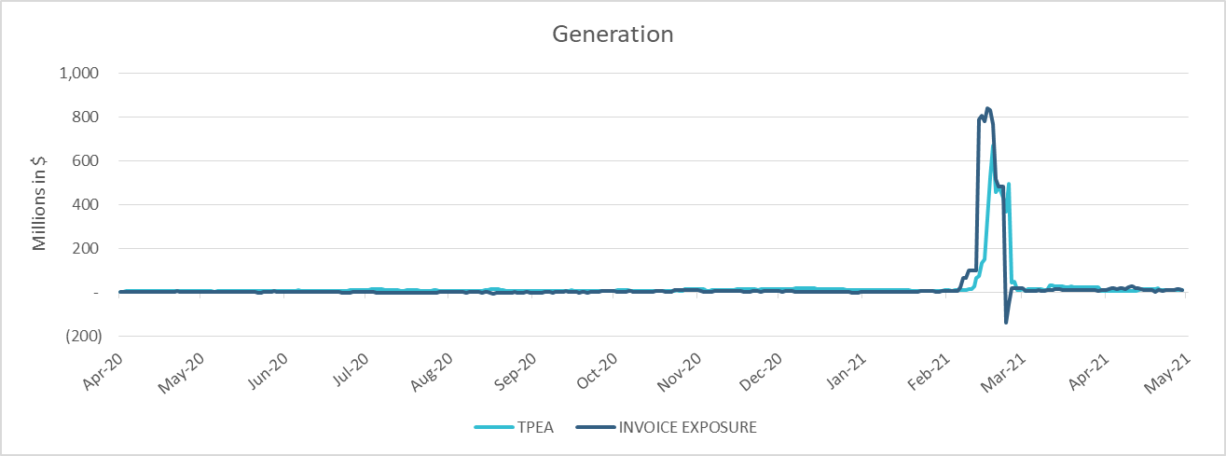
TPE Coverage of Settlements Apr 2020 - Apr 2021
*TPEA generally exceeds invoice exposure except during the 2021 winter event

Slide 14
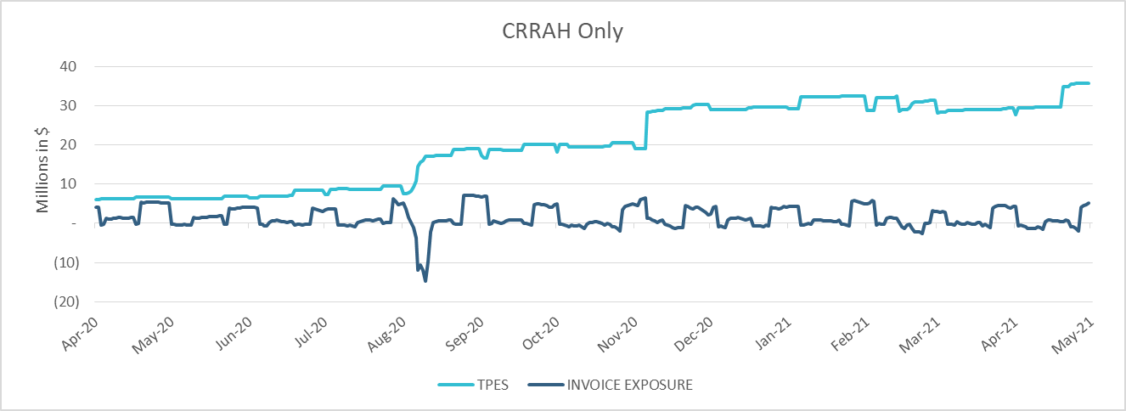
TPE Coverage of Settlements Apr 2020 - Apr 2021
*TPES mostly exceeds actual/invoice exposure

Slide 15
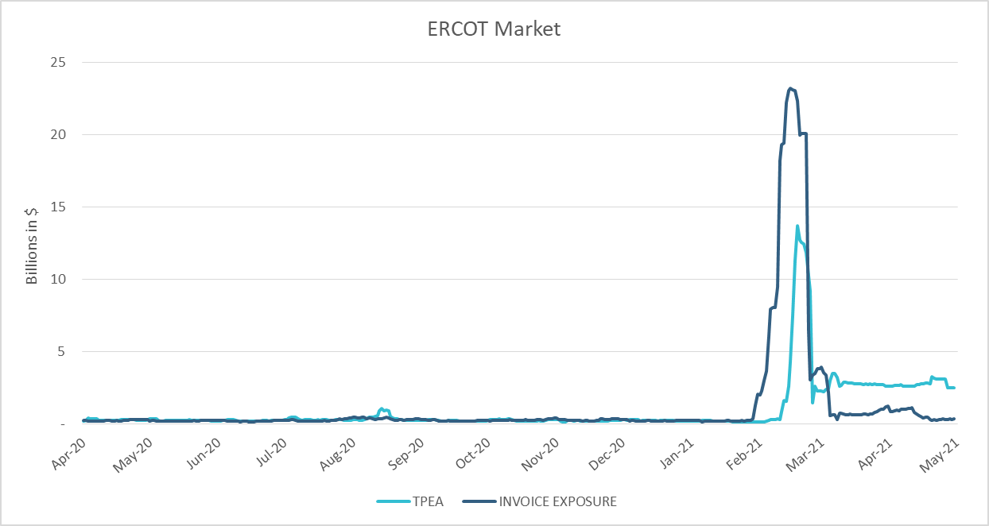
TPE Coverage of Settlements Apr 2020 - Apr 2021
*TPEA closely approximates actual/invoice exposure except during the 2021 winter event

Slide 16
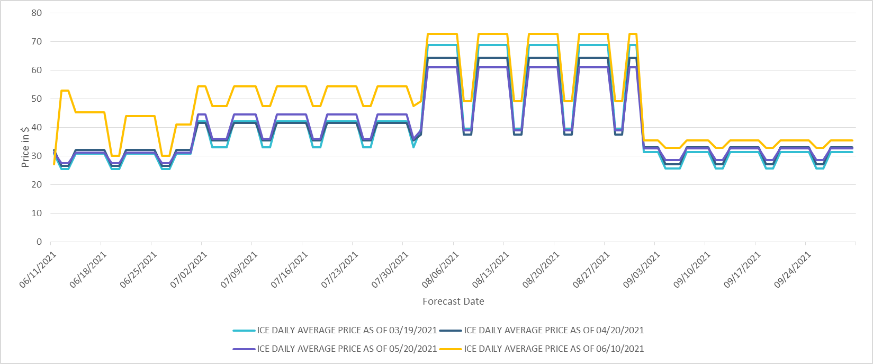
ICE Daily Average Future Prices Jun 2021 - Sep 2021

Slide 17
Appendix

Slide 18
Summary of Distribution by Market Segment*
Category | Counter-Party Distribution |  |  | Average TPE Distribution |  |  | Average Excess Collateral Distribution
 | Apr-21 | May-21 | Change | Apr-21 | May-21 | Change | Apr-21 | May-21 | Change
CRR Only | 14.13% | 13.87% | -0.26% | 5.90% | 6.39% | 0.49% | 2.81% | 3.49% | 0.68%
Generation Only | 11.52% | 12.04% | 0.52% | 10.73% | 11.51% | 0.78% | 6.98% | 7.10% | 0.12%
Load Only | 11.52% | 12.04% | 0.52% | 26.90% | 18.98% | -7.91% | 3.17% | 5.60% | 2.43%
Load and Gen | 11.9% | 11.3% | -0.58% | 31.11% | 34.86% | 3.76% | 60.64% | 56.58% | -4.06%
Trader | 50.9% | 50.7% | -0.20% | 25.37% | 28.25% | 2.88% | 26.40% | 27.23% | 0.83%
*Excess collateral doesn’t include Unsecured Credit Limit and is defined as Collateral in excess of TPE
*Short pay entities are excluded from the above calculations to remove data skew

Slide 19
Summary of Distribution by Rating Group*
*Short pay entities are excluded from the above calculations to remove data skew

Slide 20
Distribution of TPE by Rating and Category*
*Short pay entities are excluded from the above calculations to remove data skew

Slide 21
Distribution of Excess Collateral by Rating and Category*
*Excess collateral doesn’t include Unsecured Credit Limit
*Short pay entities are excluded from the above calculations to remove data skew

Slide 22
TPE Coverage of Settlements
TPEA covers Settlement/Invoice exposure and estimated Real-Time and Day- Ahead completed but not settled activity (RTLCNS and UDAA)
The analysis was performed for the period, Apr 2020 - Apr 2021
Only Settlement invoices due to ERCOT are considered in the calculation
M1 values as of May 28, 2020 were used for the period Feb 2020- May 2020 and M1 values effective as of each day were used since Jun 2020
Example
For business date 2/1/2020, if a Counter-Party has M1 value of 20, then all the charge invoices till 2/21/2020 including RTLCNS and UDAA as of 2/1/2020 is summed up to arrive at “Invoice Exposure”

Slide 23
Questions

