Slide 1
Lessons from MISO and other ideas
Planning Working Group
July 20, 2021
Kevin Hanson
Principal Analyst

Slide 2
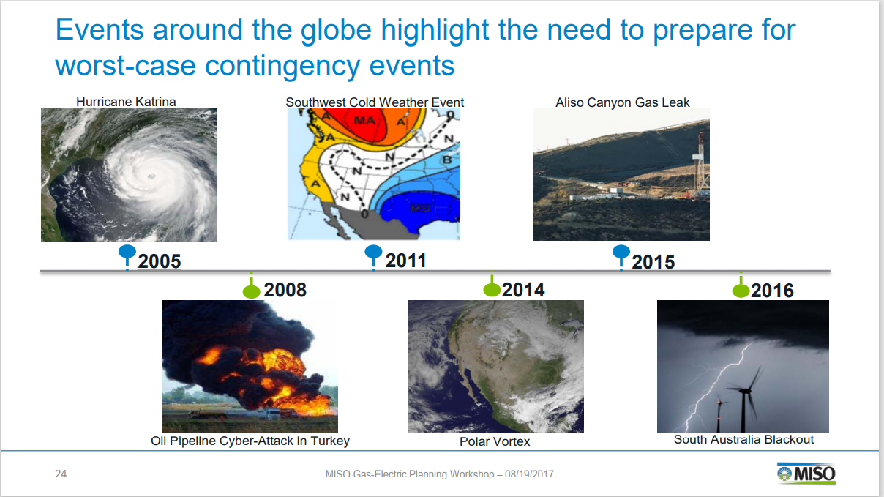
Why do we need to do something? Weather is getting more volatile.
In ERCOT, we have had:
2011 (summer was 1 in 100 event),
Three separate 500 year storms in the past 5 years (e.g. Harvey),
Uri which is somewhere between a 30 year (1989 to 2021) or a 100 year storm

Slide 3
Examples for MISO

Slide 4
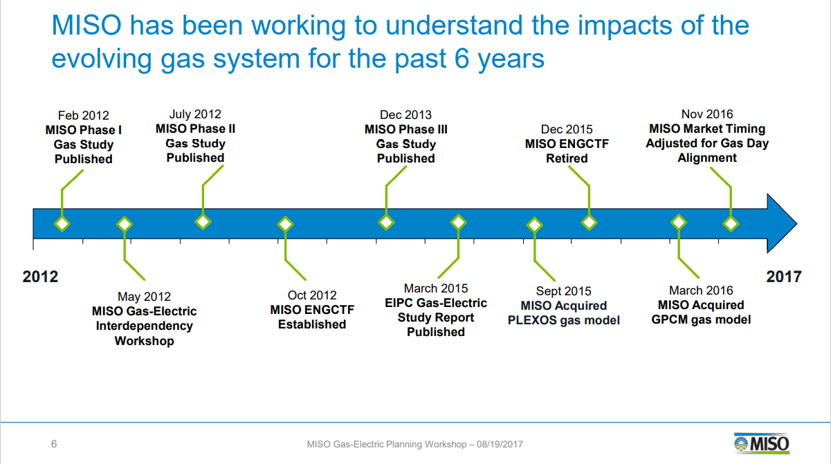
Projects Midwest ISO has done to improve the planning process
Gas Studies
Added gas models into their planning process (Plexos and GPCM gas models)

Slide 5
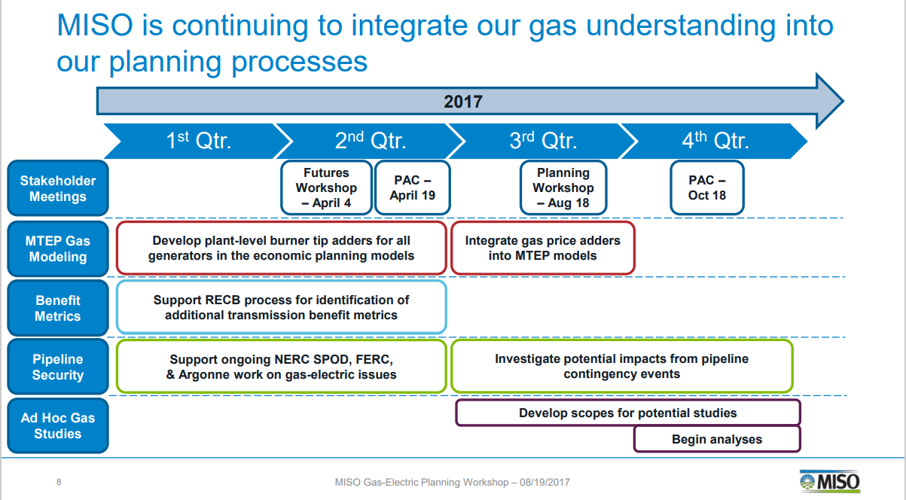
Projects Midwest ISO has done to improve the planning process
Investigating pipeline contingency events
Support ongoing work at other agencies looking at Gas-Electric Risks

Slide 6
Projects MISO has done to improve the non-planning process
MISO has improved communication & situational awareness around pipeline activities and impacts to generators
MISO’s Gas Pipeline Notifications Website provides regional insight into pipeline operating conditions
Fuel Impact Report: At Risk Units
Control Room Electric/Gas Pipeline Real Time Display
Gas Usage Profiles Project
MISO Winter Generator Survey
Generator-Pipeline Database Upgrade
    MISO now has complete database of pipeline connections and dual fuel capability for all gas generators

Slide 7
2
Ideas Presented at SAWG

Slide 8
Potential changes to the ERCOT Process initially made at the April 23, 2021 SAWG meeting
Temperature impacts on generating capability, auxiliary loads on power plants, and load forecasts
    Capabilities of power plants with HSL and LSL capabilities every 10 degrees Fahrenheit from 0 to 130
    Auxiliary load at power plants at each 10 degrees as well
    In CDR and SARA, each season would includes the span of historical temperatures from 1950 to 2021 (and ongoing) that have impact the ERCOT market. For instance, winter may be 0 to 90 degrees.
    The weighting would be based on historical locational loads per the load forecasting team at ERCOT.
    Load forecast using the temperatures and the historical weather year that represents the worst case scenarios
Powerplant access to pipelines and types of natural gas contracts
    Number of pipelines to plants and type of contracts (Firm/Interruptible) available on those pipelines
    IN CDR and SARA, incorporate details of percentage of gas power plants with none, one, or two or more pipelines with Firm contract capability

Slide 9
Example of topics for new SARA and CDR

Slide 10
3
Proposed Planning Cases

Slide 11
Proposed Planning Cases
Extreme Winter: Average 10 degrees state wide at 7 am
    Dallas would be at 5 degrees and Houston would be at 15 degrees
    Solar at 0% capacity factor
    Wind at 10% capacity factor
    30 GWs of natural gas on outage
    10 GWS of coal generation on outages
    DC Ties have no import or export capability
Extreme Summer: Average 110 degrees state wide at 5 pm
    Dallas would be at 115 degrees and Houston would be at 105 degrees
    Solar at 80% capacity factor
    Wind at 10% capacity factor
    30 GWs of natural gas on outage
    10 GWS of coal generation on outages
    DC Ties have no import or export capability

Slide 13
Description of Initials
RARF - Resource Asset Registration Form
RIOO – Resource Integration & On-going Operations
CDR – Capacity, Demand, and Reserves Report
SARA – Seasonal Assessment of Resource Adequacy
HSL – High Sustained Limit
LSL – Low Sustained Limit

