Slide 1
Feb 2021 Winter Event
Updates on PRC & ESR RFIs
Balancing Operations Staff
July 16, 2021
PDCWG

Slide 2
RFI Response Review Of PRC/HSL Telemetry During Feb 15 Early Morning

Slide 3
PRC Review Summary between 1:23 and 1:55 on Feb 15
Analysis was conducted on the 20 Generation Resources that were on an average contributing more than 10 MW to PRCGen contributing a between 678 MW to 1088 MW to PRCGen during this timeframe.
Many of these Generation Resources were either experiencing operational issues and were in the process of ramping down or tripping but hadn’t updated their HSL thus making it look like there was frequency responsive headroom OR
were operating at/near the top of their capability and were telemetering HSLs that made it look like there may be frequency responsive headroom.
It is estimated that at any given time, between 520 MW and 950 MW of PRC that was being accounted from these resources was incorrect/unavailable.

Slide 4
Summary of RFI
Status:
12 RFI’s were sent out to investigate incorrect HSL/PRC Estimation during this timeframe and 10/12 RFI responses have been received so far.
ERCOT has reviewed the responses received and is in the process of setting up follow up discussions for some of these resources.
Main RFI Questions:
Reasons for resource operating below expected generation level.
Were the HSL telemetered values an accurate reflection of the resource’s maximum generating capability during the event?
Underlying causes for limited primary frequency response during the event.
What actions have been taken to improve the accurateness of resource’s telemetry in the future?

Slide 5
Some anecdotal responses
From RFI responses that we have received thus far, during the timeframe of this assessment, factors that caused incorrect HSL telemetry to be sent to ERCOT are
Limited bandwidth of operators
RE/QSE failed to update HSL given the extreme nature of the event and high level of operational activity during the event.
Operator was focused on stabilizing the unit in manual mode in an attempt to keep the unit online due to issues caused by frozen throttle pressure impulse line and large system frequency swings.
The impact of the failed IBH valve on HSL was not discovered until after the event.
Incorrect assessment of how severe an issue the facility was facing
QSE operator made a wrong assumption of HSL being able to recover quickly and consequently failed to update HSL. (two burners out of service)
Inaccurate HSL calculation methodology and/or missed HSL update
Two GTs maintained output at a fixed set-point and did not adjust for falling ambient temperatures and increased calculated HSL.
HSL was manually overridden prior to the event by QSE. As the configuration changed due to loss of a gas turbine, the HSL did not get updated consequently.

Slide 6
Next Steps
Still waiting on 2 more responses
And will follow up discussions with X QSEs.

Slide 7
ESR RRS Responsibilities During EEA Event

Slide 8
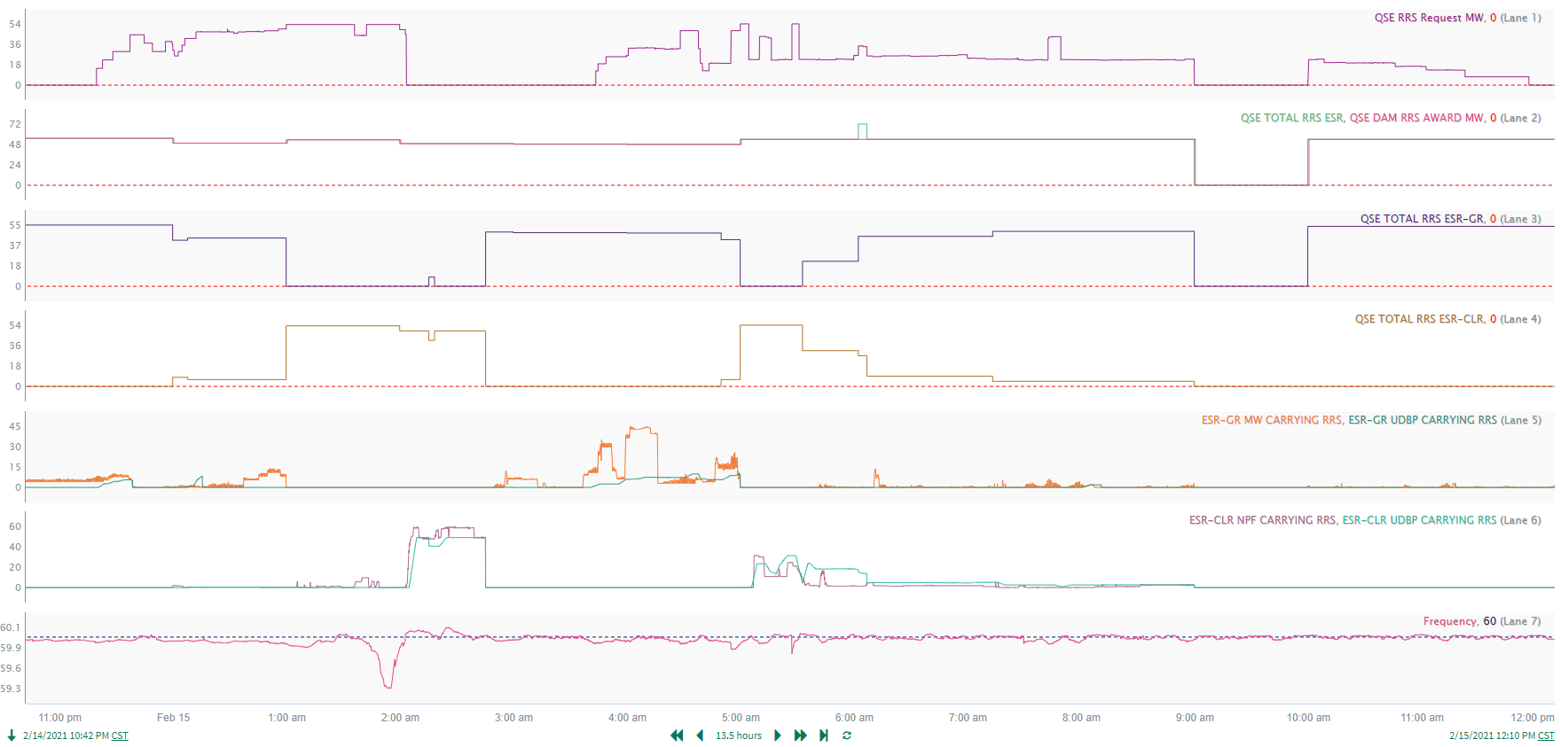
ESR RRS Responsibilities During Feb 15th
1
At approx. 01:00, QSE moves RRS responsibility from ESR-GRs to ESR-CLRs during active RRS deployment based on DAM awards. This should not occur – RRS responsibilities should not be moved during an active RRS deployment. The move to the ESR-CLR initially caused a non-zero BP to be sent to the ESR-CLRs (due to non-zero RRS schedules being telemetered at the SCED run) but with frequency being low, the UDBP remained at zero. Note that a BP would not be issued after implementing NPRR 1002.

Slide 9
ESR RRS Responsibilities During Feb 15th
2
At approx. 02:03, RRS deployment ends and the LASL/LDL of the ESR-CLRs increase such that the ESR-CLRs will receive a BP to charge at an NPF that covers the total RRS responsibility. The next SCED run at 02:05 sends the ESR-CLRs BPs to charge. Note that a BP would not be issued after implementing NPRR 1002.

Slide 10
ESR RRS Responsibilities During Feb 15th
3
At approx. 02:45, QSE moves RRS responsibility from ESR-CLR to ESR-GR.

Slide 11
ESR RRS Responsibilities During Feb 15th
4
At approx. 05:00, QSE moves RRS responsibility from ESR-GRs to ESR-CLRs during active RRS deployment based on DAM awards. This should not occur – RRS responsibilities should not be moved during an active RRS deployment.

Slide 12
ESR RRS Responsibilities During Feb 15th
5
At approx. 09:00, QSE RRS responsibility changes to zero as QSE did not have RRS obligations for HE10.

Slide 13
Summary of RFI
Status:
13 RFI’s were sent out to investigate areas of concern related to ESR performance. The review focused on the time period of February 14, 2021 to February 20, 2021, although other significant events outside of this window were reviewed, such as large frequency excursions that triggered RRS deployments.
Example RFI Questions:
Why did ESR not follow expected MW during specified period?
Why does PFR response not match expected PFR during specified period?
Why was ESR moving RRS Responsibilities during active RRS deployment?
Why was the ESR telemetering a status of OUT? Was it related to lack of deliverability (load shed, transmission outage, etc.) or lack of energy (SOC)?
Next Steps
ERCOT has reviewed the responses and is in the process of setting up follow-up discussions for some of these Resources.

