Slide 1
ERCOT Frequency Control Report
June 2021
ERCOT
Operations Planning
PDCWG | July 16th, 2021

Slide 2
Summary of June 2021
CPS1: 172.74%
Current CPS1 12-Month Rolling Average: 168.87%
2 BAAL Exceedance(s)
1 hourly CPS1 score below 100%
BAAL-003 Events have updated through 2019
2019 BAAL-003 FRM Performance: -811.14
2021 RMS1 Statistics
  Mean: 16.89 mHz
  Min: 12.01 mHz
  Max: 60.6 mHz
Energy Statistics
  Total Energy: 37,331,144 MWh
  Wind Energy: 6,965,821 MWh
  Percent Energy from Wind: 18.66%
  Solar Energy: 1,643,972 MWh
  Percent Energy from Solar: 4.40%
Minimum System Inertia
  Mean: 243,333 MW*s
  Max: 312,057 MW*s on Jun 15th
  Min: 190,893 MW*s on Jun 6th
Notes:
2018 BAAL-003 FRM Performance: -843.17

Slide 3
Frequency Control
CPS1, BAAL, & RMS1

Slide 4
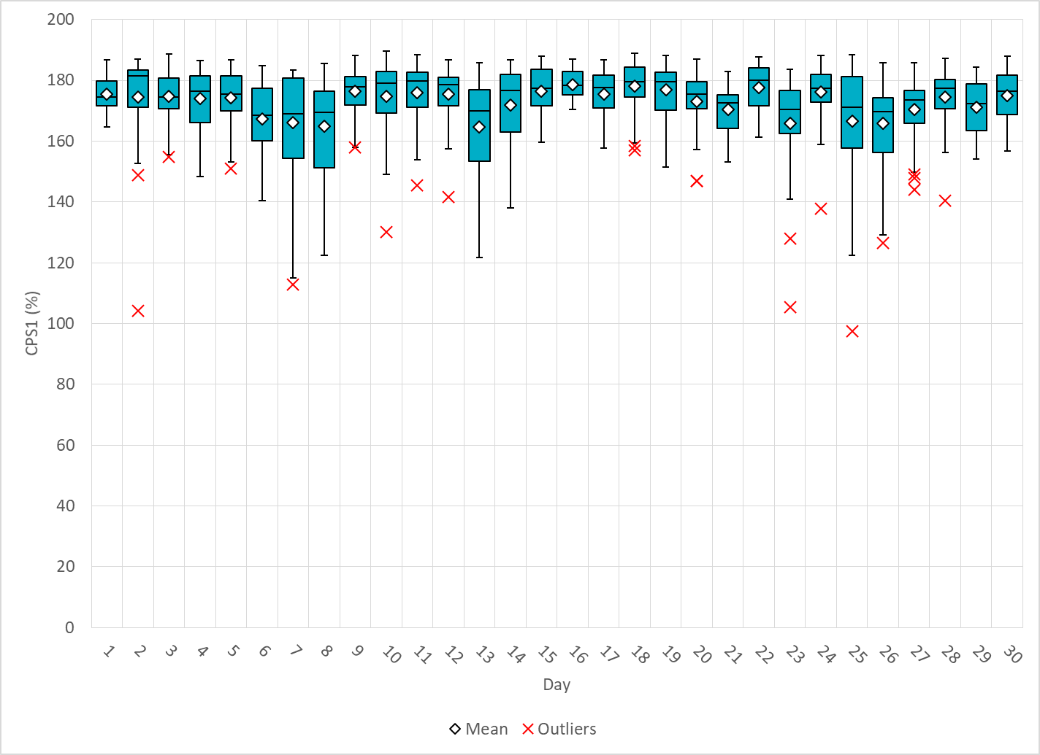
Hourly CPS1 by Day
Jun-21 CPS1 (%): 172.74
Notes:
1. 97.58% @ 06/25/2021 17:00
Expected Generation Deviation
Expected gen dev remained negative for the most part of the hour. The largest expected gen dev was -2300MW @ 17:15 with contribution from thermal, wind and solar.
IRR Ramps
Solar generation ramped down by 800 MW between 17:05 and 17:12.
LOAD:
Increase in non-conforming load by 350 MW which coincided with the solar ramp down.
Regulation: Regulation up was exhausted during the solar ramp down period
Other
SCED was run manually multiple times and Manual offset of 200 MW @ 17:11

Slide 5
BAAL Exceedances & Violations
There were 2 BAAL exceedance(s) in June
Notes:
Occurred on 06/7/2021 (2)

Slide 6
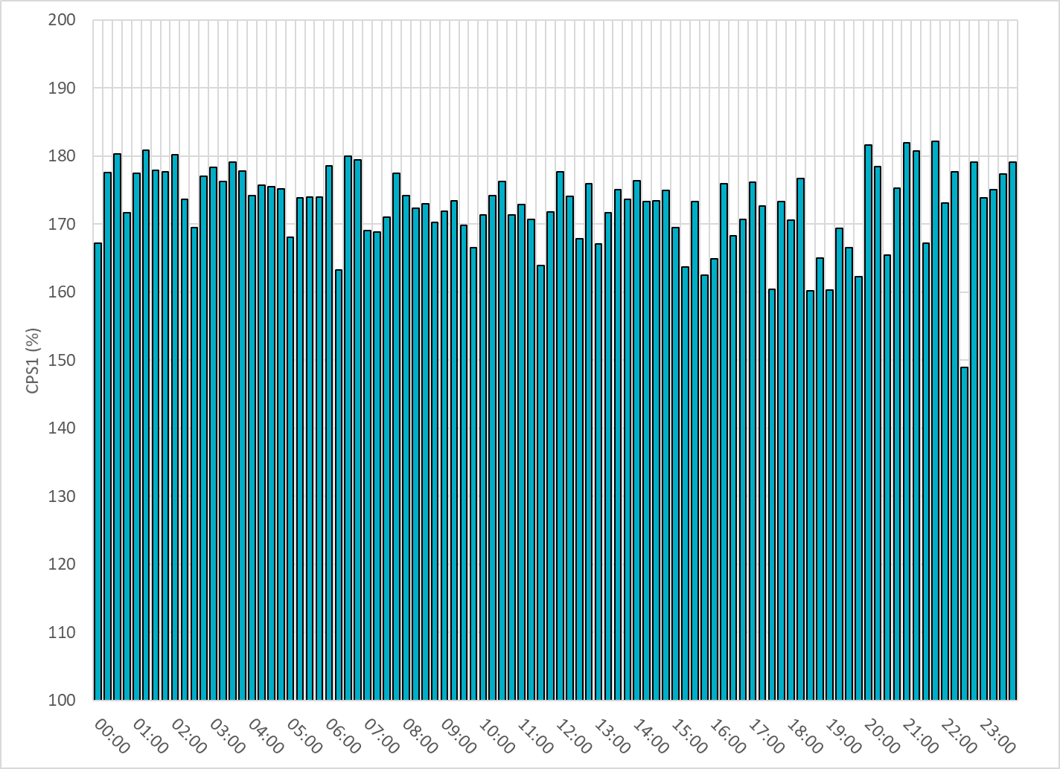
15-Minute Average CPS1%
Jun-21 CPS1 (%): 172.74

Slide 7
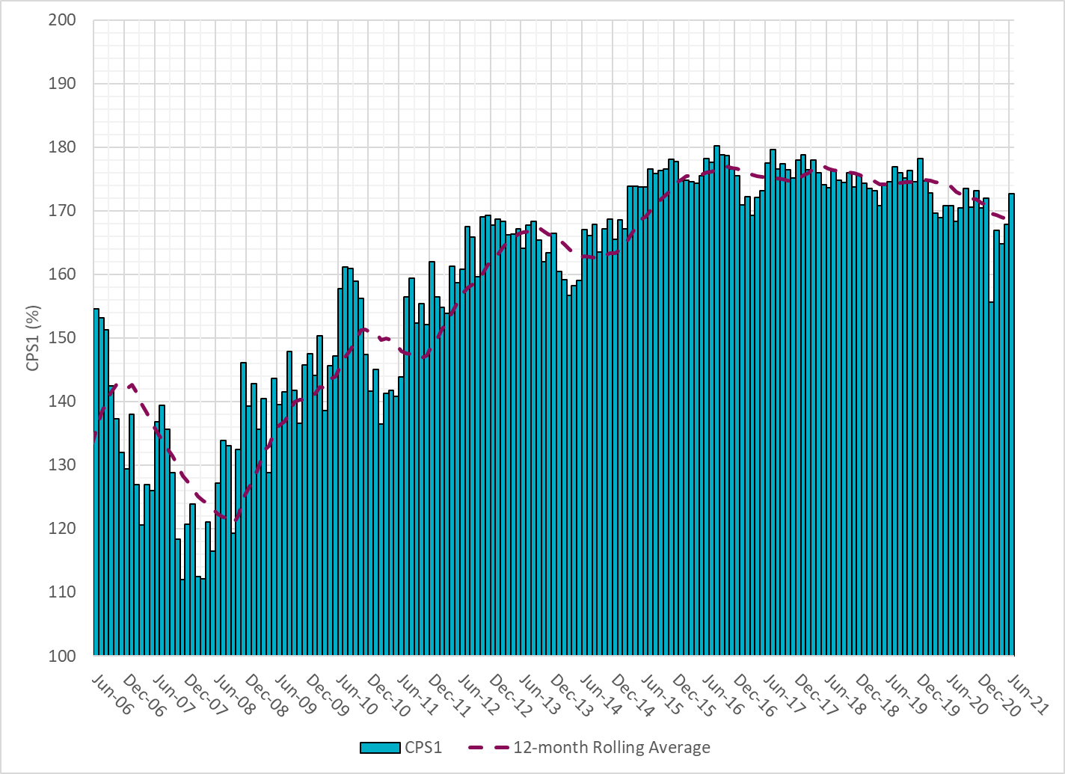
12-Month Rolling Average CPS1
Current 12-Month Rolling Average: 168.87%

Slide 8
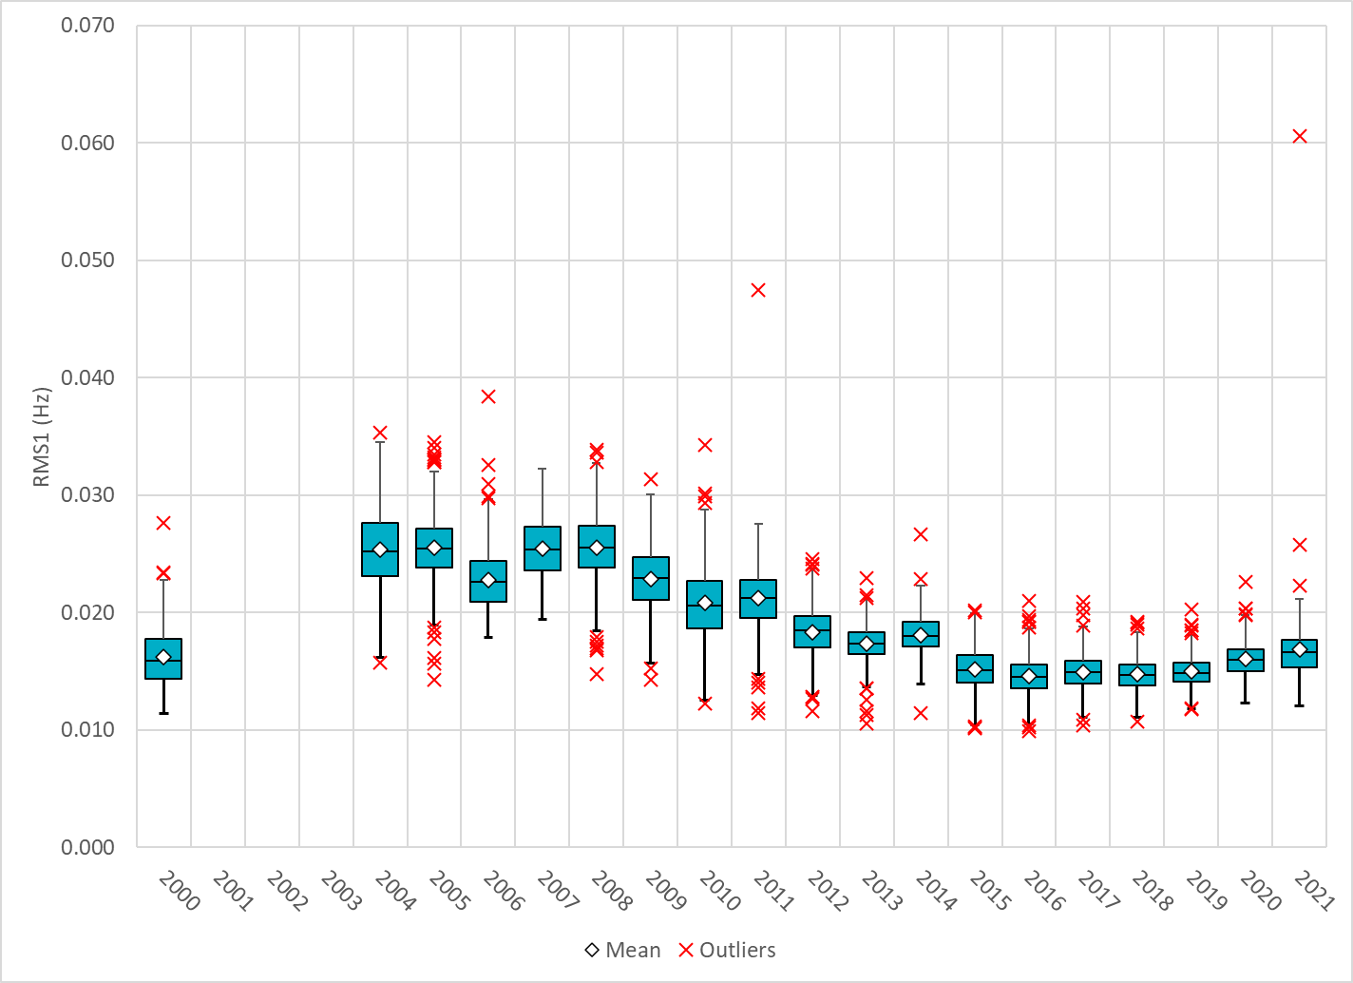
Daily RMS1 of ERCOT Frequency by Year
Notes:
Mean: 16.89 mHz
Min: 12.01 mHz
Max: 60.6 mHz

Slide 9
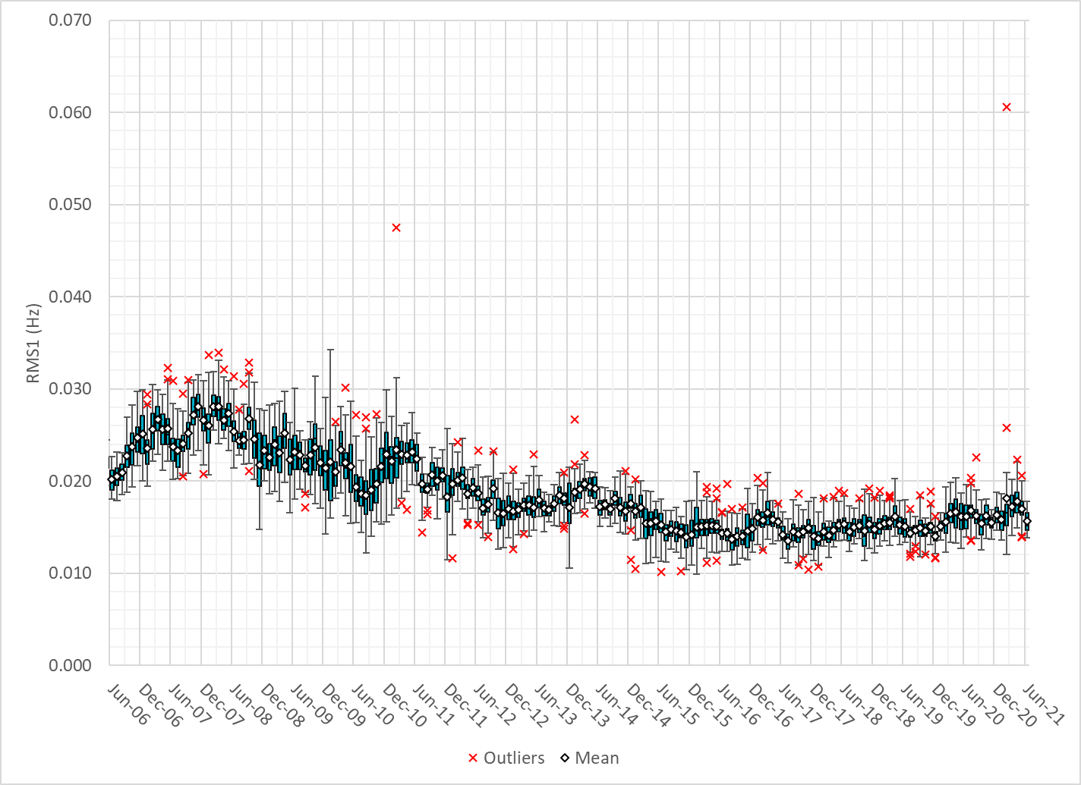
Daily RMS1 of ERCOT Frequency by Month

Slide 10
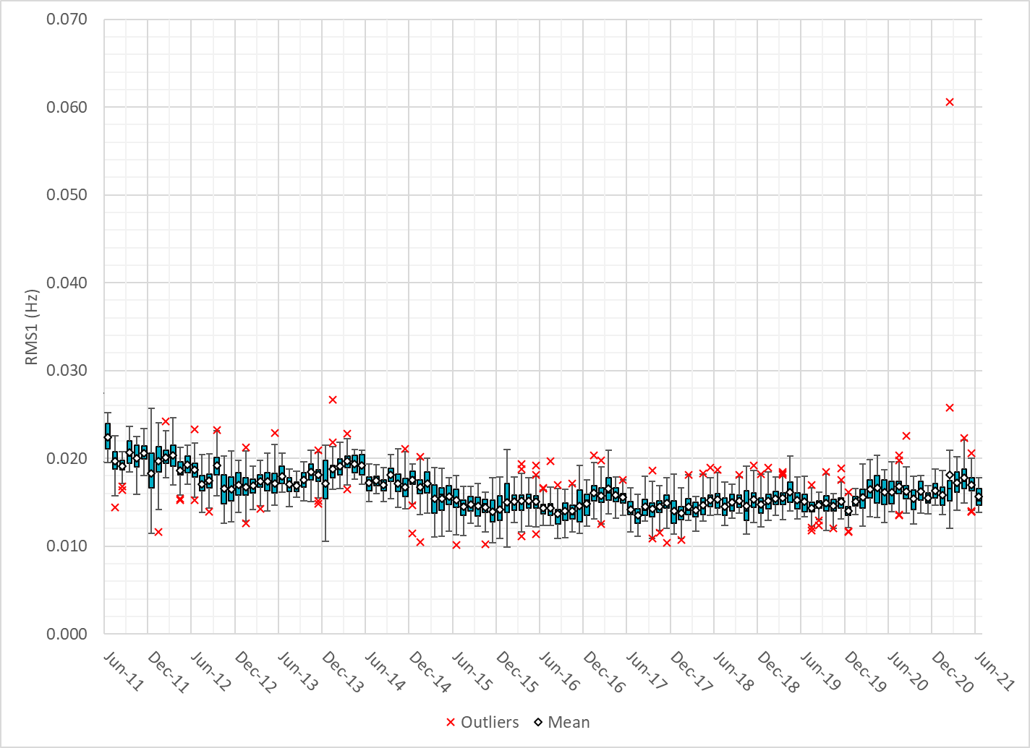
Daily RMS1 of ERCOT Frequency by Month

Slide 11
Frequency Profile Comparison

Slide 12
Frequency Profile Comparison

Slide 13
Frequency Profile Comparison

Slide 14
Time Error Correction

Slide 15
ERCOT Daily Time Error

Slide 16
Time Error Corrections Log Summary
There have been no time error corrections since December 2016

Slide 17
BAL-003 Performance

Slide 18
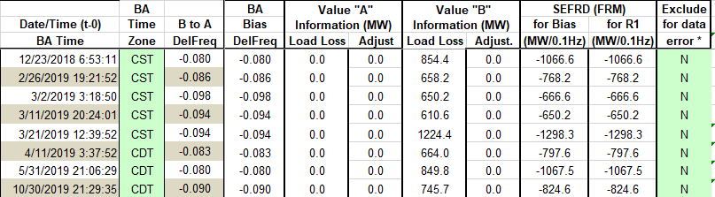
Op. Year 2019 BAL-003 Selected Events – Update
Notes:
BAL-003

Slide 19
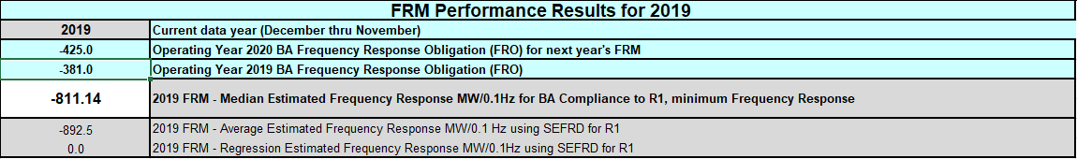
Op. Year 2019 BAL-003 FRM Performance - Update
Notes:
OP2018: FRO = -381.0, FRM_median = -843.17, FRM_average = -959.7
OP2019: FRO = -381.0, FRM_median = -811.14, FRM_average = -892.5
OP2020: FRO = -425.0,

Slide 20
ERCOT Energy Statistics

Slide 21
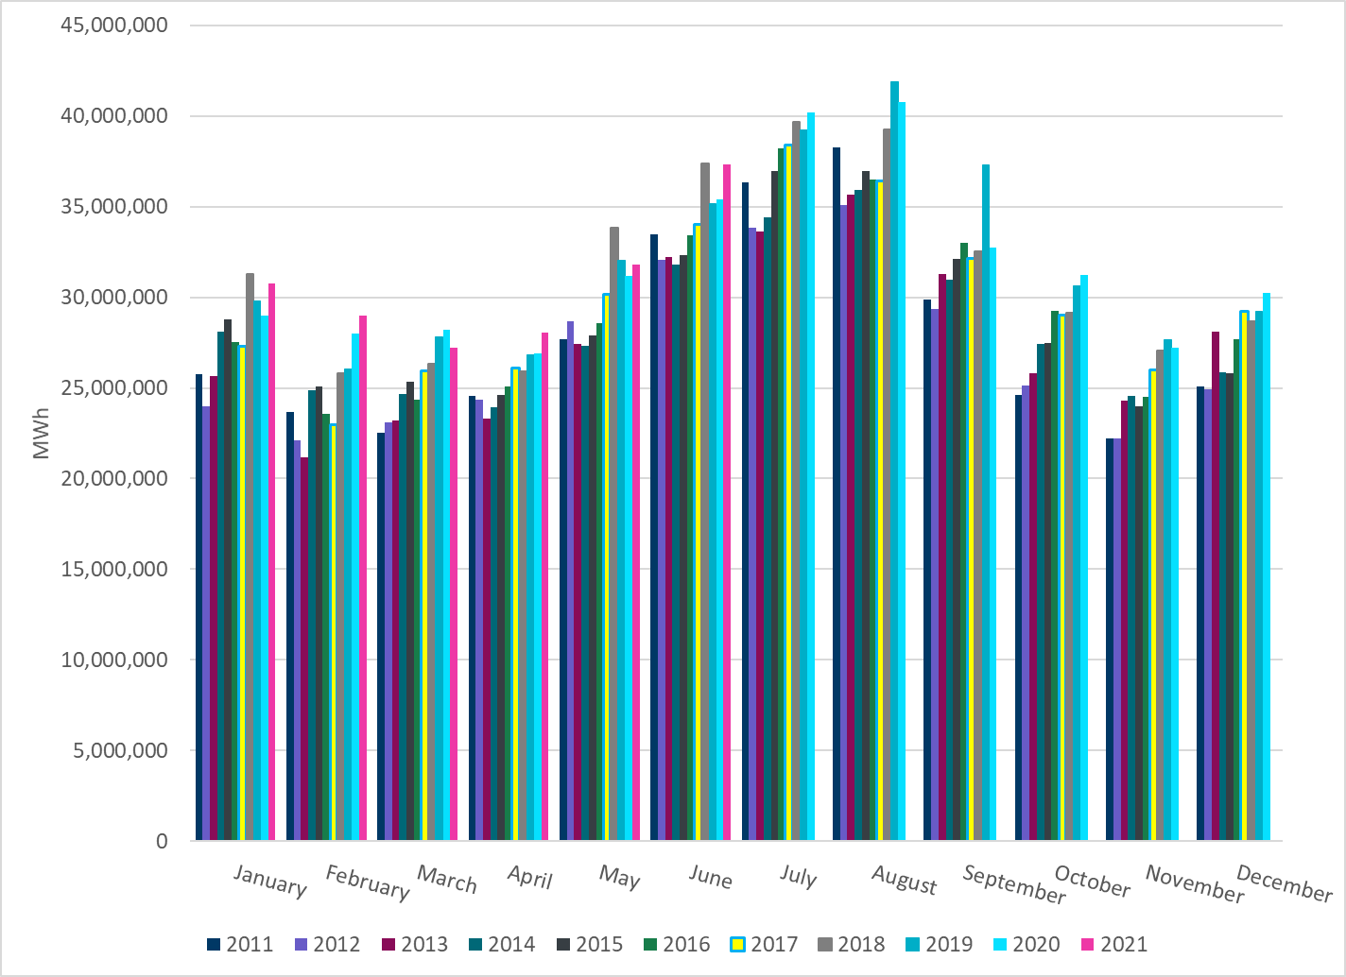
Total Energy
Notes:
37,331,144 MWh

Slide 22
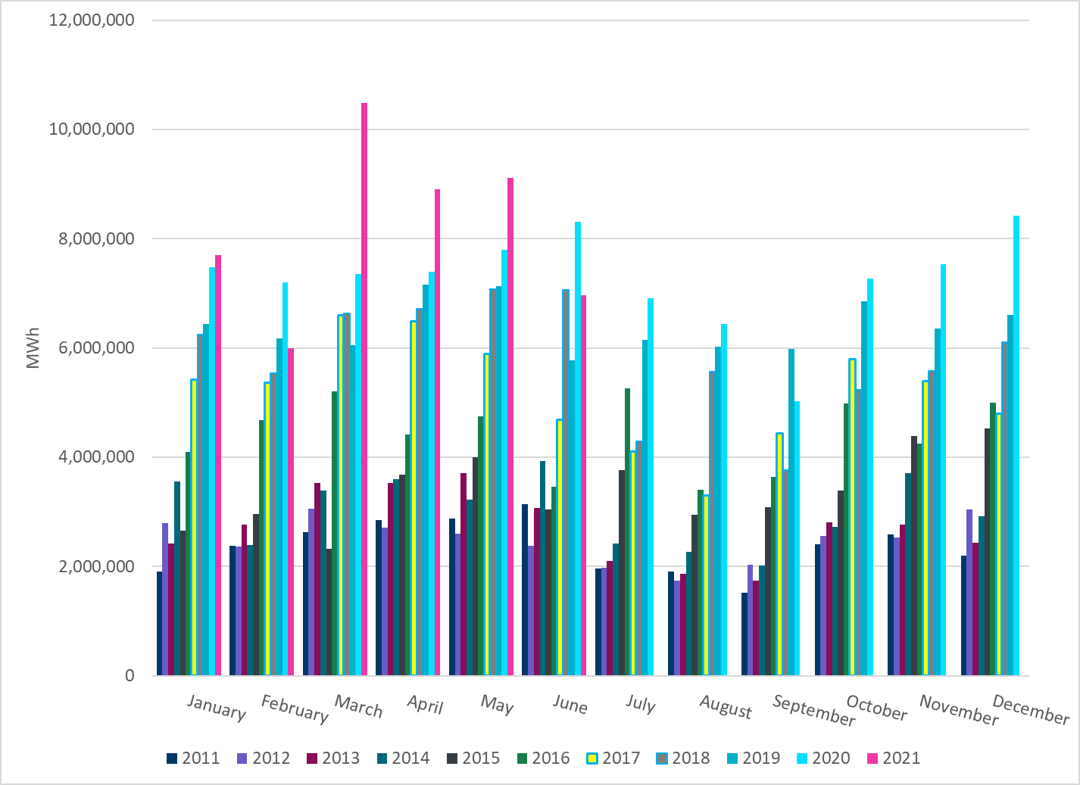
Total Energy from Wind Generation
Notes:
6,965,821 MWh

Slide 23
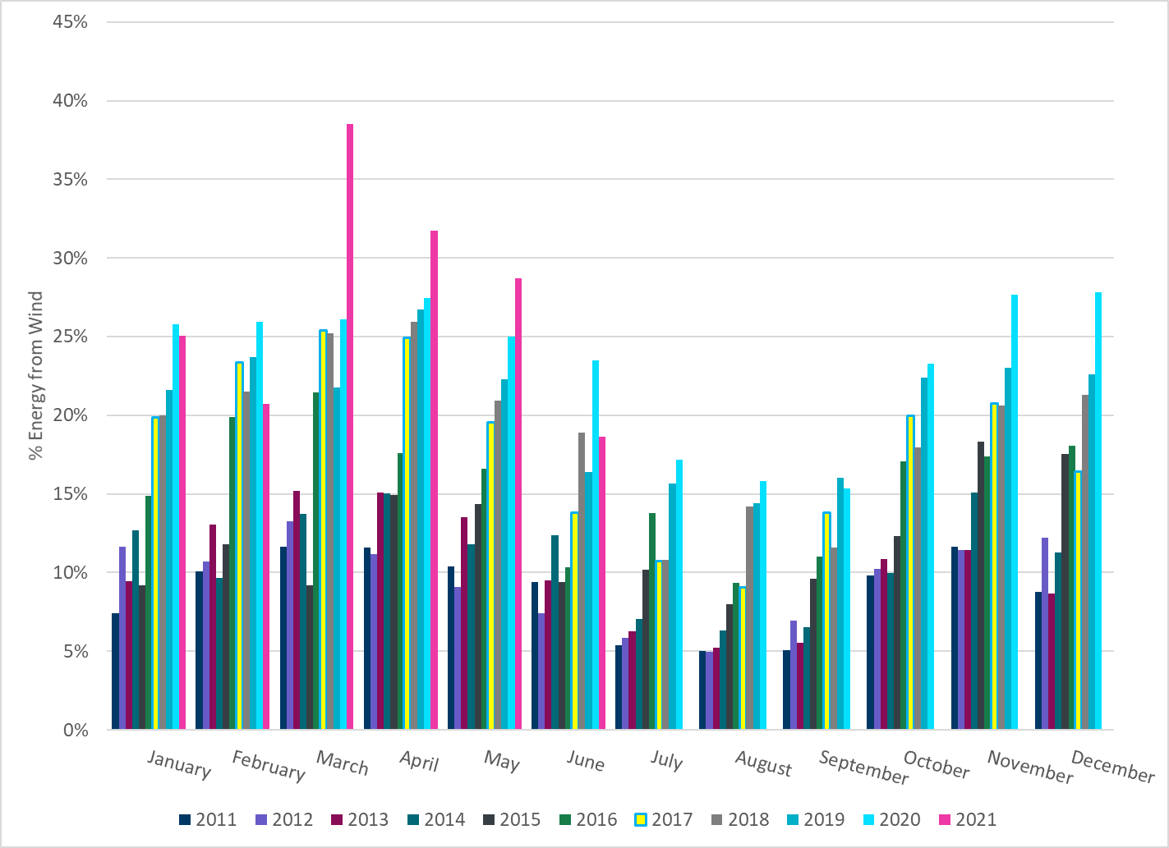
% Energy from Wind Generation
Notes:
18.66%

Slide 24
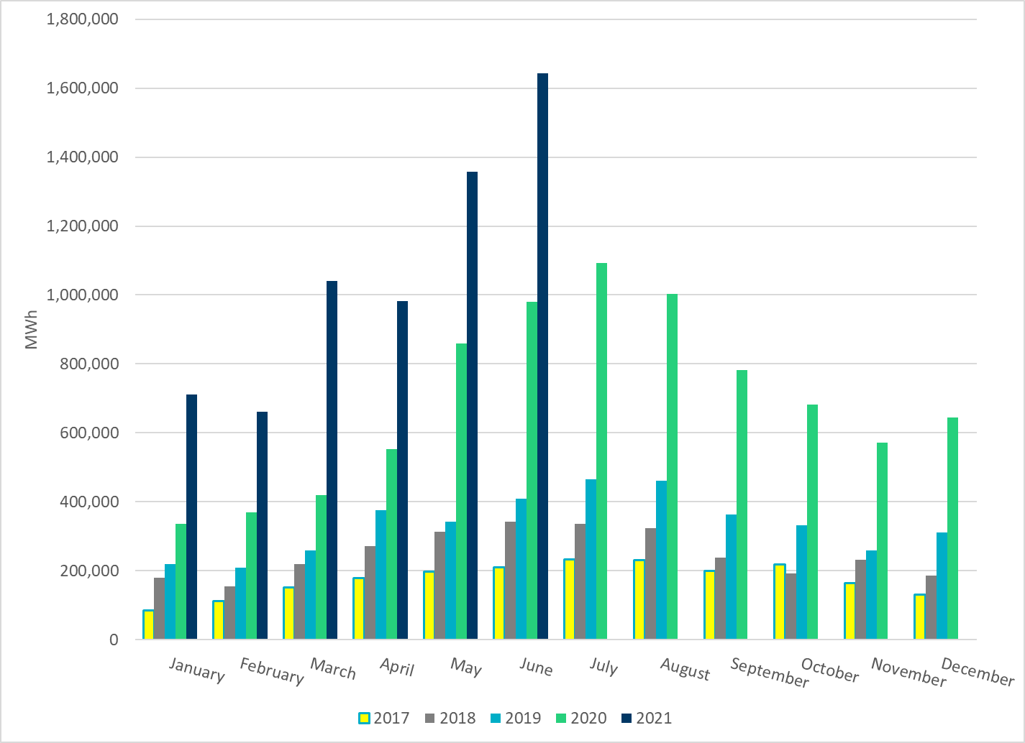
Total Energy From Solar Generation
Notes:
1,643,972 MWh

Slide 25
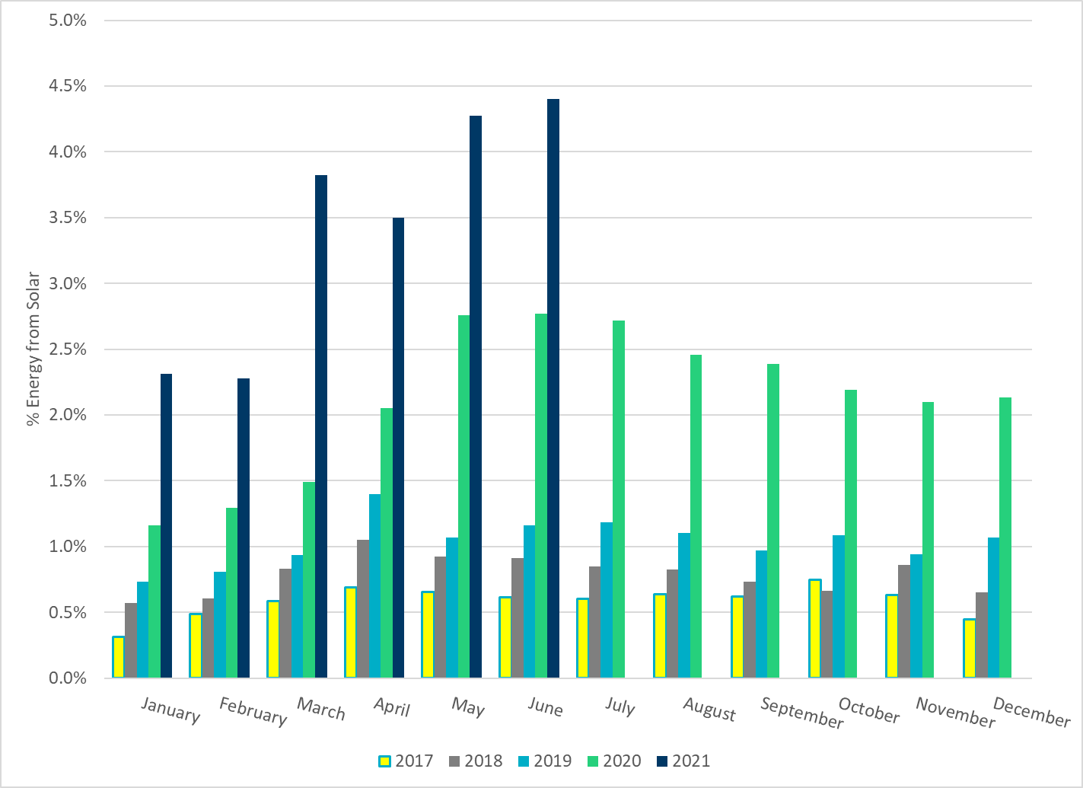
% Energy from Solar Generation
Notes:
4.40%

Slide 26
ERCOT System Inertia

Slide 27
Daily Minimum System Inertia
Notes:
Minimum Inertia = 190,893 MW*s on 6/6/2021
Previous Minimum was 109,029 MW*s on 3/22/2021
Data:
Mean: 243,333 MW*s
Max: 312,057 MW*s on Jun 15th
Min: 190,893 MW*s on Jun 6th

Slide 28
Questions?
Thank you!

