Slide 1
ERCOT Frequency Events
June 2021
ERCOT
Operations Planning
PDCWG | July 16th, 2021

Slide 2
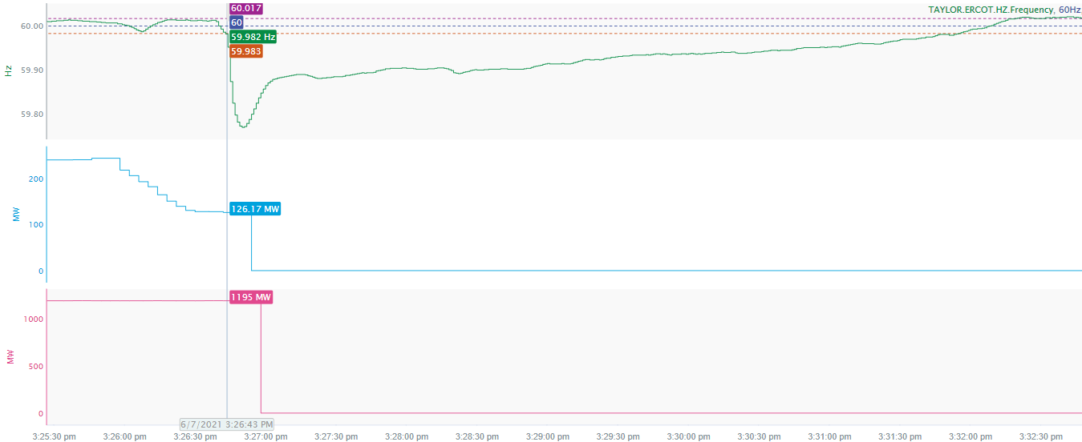
6/7/2021 15:26:43 (FME)
Notes:
Two units tripped offline while carrying a total of 1324 MW.
Starting Frequency: 59.983 Hz
Minimum Frequency: 59.77 Hz
A-C Time: 7 seconds
Recovery Time (back to deadband): 5 minutes and 12 seconds
RRS Deployed: 1420.2 MW
Trip Reason: Unit tripped due to transformer fire
Contextual Information: A total of 300 MW of regulation up was deployed and 500 MW of manual offset was applied during the event

Slide 3
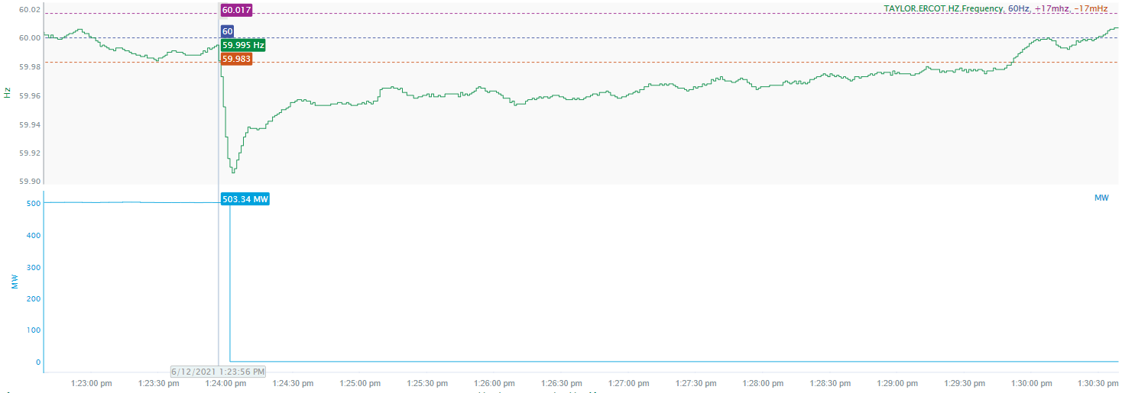
6/12/2021 13:23:56 (FME)
Notes:
Unit tripped offline while carrying 503.3 MW
Starting Frequency: 59.995
Minimum Frequency: 59.906 Hz
A-C Time: 7 seconds
Recovery Time(back to deadband): 5 minutes and 5 seconds
RRS Deployed: 0 MW
Trip Reason: Unknown at this time
Contextual Information: A total of 367 MW of regulation up was deployed during the event

Slide 4
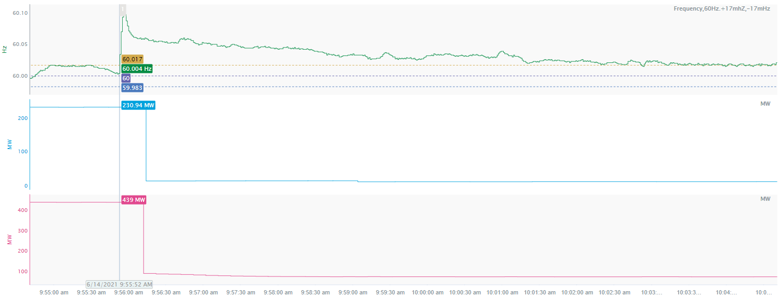
6/14/2021 9:55:52 (FME)
Notes:
Loss of 556 MW of load
Starting Frequency: 60.004 Hz
Maximum Frequency: 60.101 Hz
A-C Time: 4 seconds
Recovery Time (back to deadband): 6 minutes and 56 seconds
RRS Deployed: 0 MW
Trip Reason: TO suspects a forced transmission line outage caused the load loss
Contextual Information: Total of 279 MW of regulation down was deployed during the event.

Slide 5
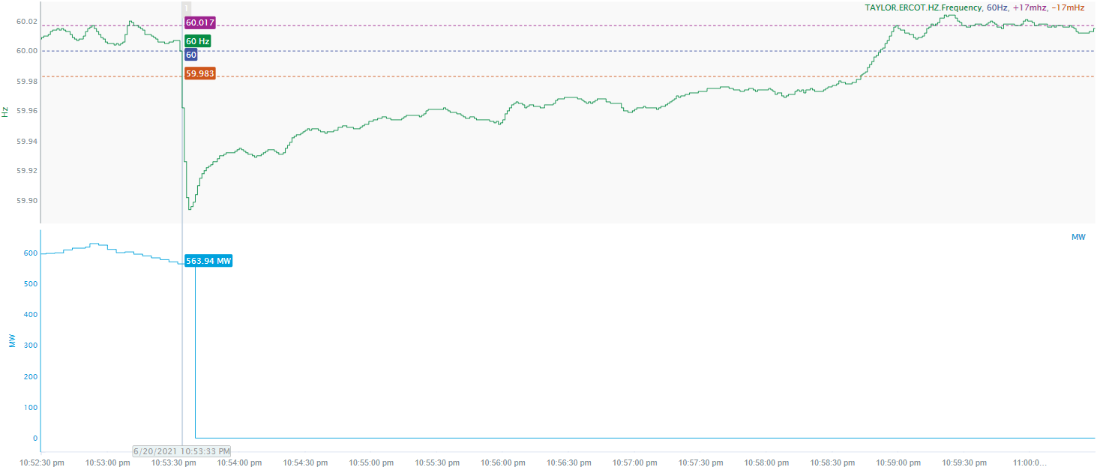
6/20/2021 22:53:33 (FME)
Notes:
Unit tripped offline while carrying 556 MW
Starting Frequency: 60 Hz
Minimum Frequency: 59.894 Hz
A-C Time: 4 seconds
Recovery Time (back to deadband): 5 minutes and 10 seconds
RRS Deployed: 587.74 MW
Trip Reason: Loss of both feed pumps
Contextual Information: Total of 173 MW of regulation up was deployed during the event.

Slide 6
6/26/2021 11:14:27 (Non-FME)
Notes:
Several inverter-based resources tripped offline or temporarily reduced their MW output for a total of loss of 518 MW. After initial frequency recovery loss of another 179 MW.
Starting Frequency: 60.016 Hz
Minimum Frequency: 59.927 Hz
A-C Time: 6 seconds
Recovery Time (back to deadband): 1 minute and 50 seconds
RRS Deployed: 1145.6 MW
Trip Reason: 345 kV transmission line outage
Contextual Information: Total of 135 MW of regulation up was deployed during the event
No Selection Reason: The frequency was oscillating at the high deadband prior to the event

Slide 7
Questions?
Thank you!

