Slide 1
Emergency items list: Telemetry
July 13th, 2021
Lori.Simpson@constellation.com (an Exelon company)
Jimmy Jackson, CPS Energy

Slide 2
Telemetry issues recommendations
Generator telemetry transparency:
    What is the problem with telemetry
    Requirements for generators to solve
    Ensure ERCOT systems use solution
    ERCOT check
Alternative system health metrics:
    HDL
Additional transparency recommendations:
    30-minute integrated ramp telemetry

Slide 3
Generator telemetry transparency:
    What is the problem with telemetry
    Requirements for generators to solve
    Ensure ERCOT systems use solution
    ERCOT check

Slide 4
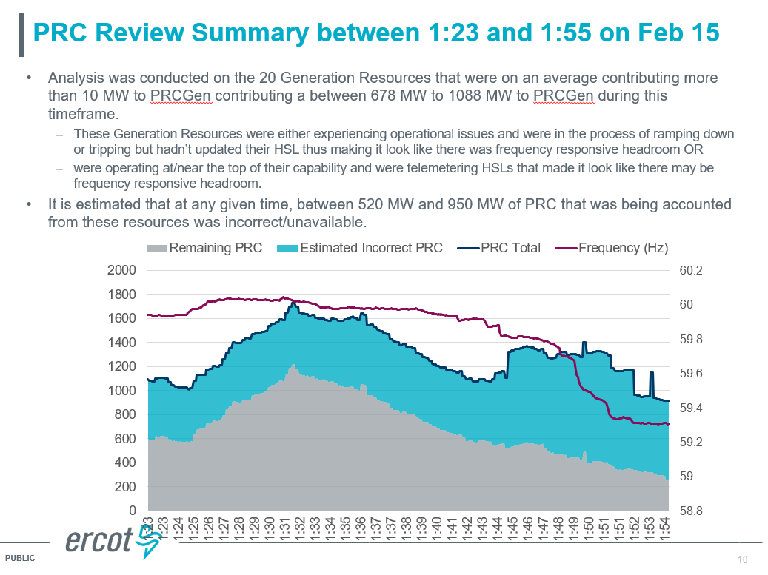
The problem with generator telemetry
ERCOT presented at PDCWG that generators had telemetry errors on 2/15 that led to overestimation of reserves. See blue area in slide

Slide 5
Solution for generators (1085)
ERCOT proposal: NPRR 1085
  Goal is to improve ERCOT’s transparency into the health of the system.
  Requires updated telemetry within 5 minutes of an issue at a plant.
What is missing from this NPRR
  Updating telemetry is too vague and does not allow generators to convey uncertainty.
  There is not specific instruction for what generators should change telemetry to.
What is needed in a solution:
  Conveyance of uncertainty
  Simplicity of solution that does distract the generator operators from their primary mission of fixing the problem in the safest manner possible.
What is the solution:
A status that a generator can quickly switch to that would trigger the headroom to be excluded from reserve calculations and the basepoint to be locked to the output: ONTEST, ONHOLD, raise block flag, etc.

Slide 6
Ensure gen solution aligns with reserve calculations
Ensure that ERCOT systems’ calculations exclude headroom when calculating reserves, HDL, etc for resources using the desired solution (ONTEST, ONHOLD, raise block flag, etc.). If not, then modify calculations.

Slide 7
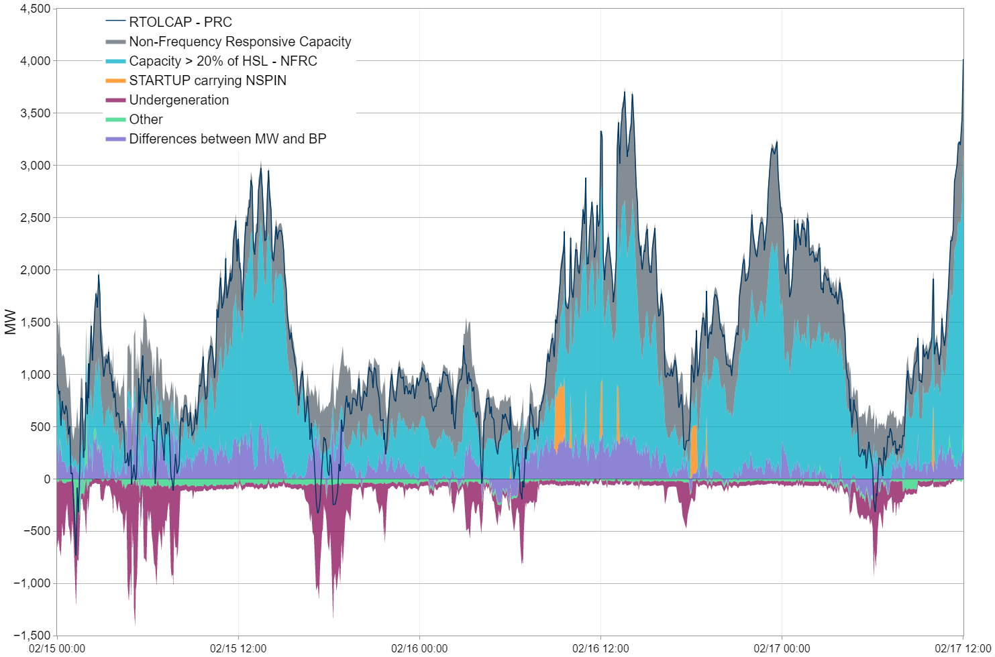
ERCOT should build a check
ERCOT should have a mechanism to track if resources are having undisclosed issues and not using the desired mechanism (ONTEST, ONHOLD, raise block flag, etc.).
For example, this check could flag resources that have not been able to achieve their basepoints over x SCED intervals.
This could trigger ERCOT to throw out the unit’s headroom in reserves calculations or request that the unit initiate the desired solution (ONTEST, ONHOLD, raise block flag, etc.).

Slide 8
Alternative system health metrics:
    HDL

Slide 9
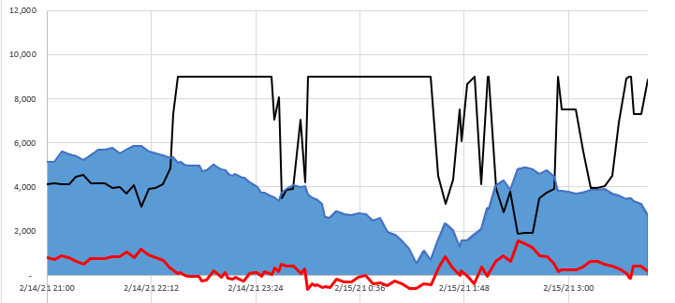
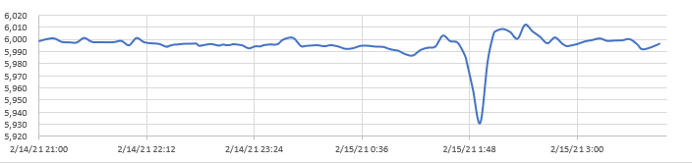
System health gauges: alternative to PRC & frequency
Reserve calculation—PRC and frequency are two mechanisms for gauging real-time health of the system. ERCOT should consider using additional mechanisms/triggers to measure the system health that is used to trigger controlled load shed. One possibility is using the HDL so as to incorporate the ramp restrictions.
Price
ORDC reserves
HDL-GTBD
Frequency

Slide 10
Additional transparency recommendations:
    30-minute integrated ramp telemetry

Slide 11
30-minute integrated ramp telemetry
The current instantaneous ramp rate gives ERCOT an indication of capability in the next 5 minutes (HDL).
There is limited visibility into integrated ramp rate for the next 30 minutes. This is part of RTC, but potentially this implementation needs to be moved forward.
It would be helpful to look at what other markets are doing in this area: when there are severe system issues in PJM, the ISO asks the Market Participants to supply information in either an Instantaneous Reserve Check (IRS) or Supplemental Status Report (SSR) to ensure the reserves the ISO thinks they have is confirmed to validate telemetry. (edart-training-irc-and-mingen.ashx (pjm.com)).

Slide 12
Other items for discussion
PBP
Congestion at the cap

Slide 13
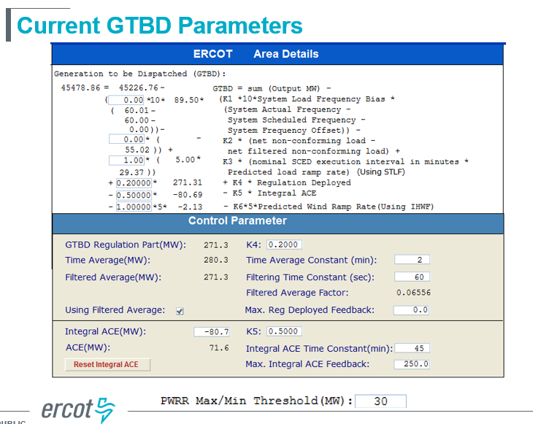
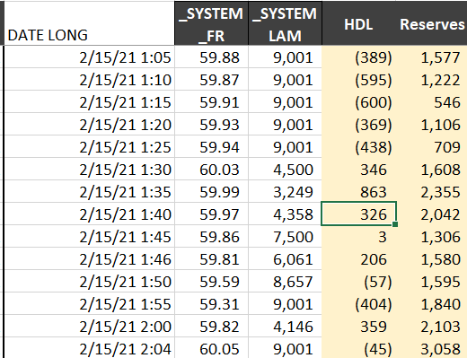
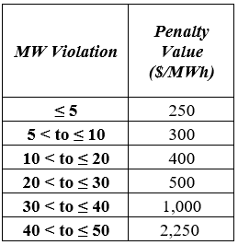
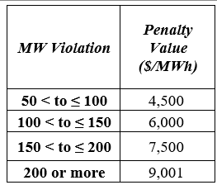
PBP
Power balance penalty is used instead of dispatching real generation (it looks like a generator in SCED). (This happened on 2/15 at 1:45am when HDL was 3mw and system lambda was $7,500).
The diff possibly has to be made up by up-reg. This could lead to undergeneration as the GTBD only uses 20% of deployed regulation.
Should the PBP simply be at the cap?

Slide 14
We observed how very small shift factors on constraints can cause bus prices to be slightly below the cap (when system lambda is at the cap). When those resources are offered at the cap, SCED has no effective way of dispatching that generator despite it having a de minimus impact on a constraint.
Does the fact that the offer cap matches the price cap make it effectively impossible to dispatch some generation offered at the cap?
De minimus congestion near the cap
EOCs at the cap 2/15
Bus prices under the cap 2/15
RESOURCE_TYPE | BASE_POINT | SCED1_CURVE_MW1 | SCED1_CURVE_PRICE1 | SCED1_CURVE_MW2 | SCED1_CURVE_PRICE2 | SCED1_CURVE_MW3 | SCED1_CURVE_PRICE3 | SCED1_CURVE_MW4 | SCED1_CURVE_PRICE4 | SCED1_CURVE_MW5 | SCED1_CURVE_PRICE5
PWRSTR | - | - | (250) | 1 | 9,000 | 30 | 9,000
PWRSTR | - | - | (250) | 1 | 9,000 | 10 | 9,000
PWRSTR | - | - | (250) | - | 9,000 | 33 | 9,000
PWRSTR | - | - | (250) | - | 8,999 | 1 | 9,000 | 1 | 9,000
PWRSTR | - | - | (250) | 1 | 9,000 | 10 | 9,000
PWRSTR | - | - | (250) | - | 9,000
PWRSTR | - | - | (250) | - | 6,500 | 10 | 6,500 | 10 | 9,000 | 10 | 9,000
PWRSTR | - | - | (250) | - | 8,999 | 10 | 9,000 | 10 | 9,000
PWRSTR | - | - | (250) | - | 8,999 | 10 | 9,000 | 10 | 9,000
PWRSTR | - | - | (250) | - | 8,999 | 10 | 9,000 | 10 | 9,000
PWRSTR | - | - | (250) | - | 8,999 | 10 | 9,000 | 10 | 9,000
PWRSTR | - | - | (250) | - | 8,999 | 10 | 9,000 | 10 | 9,000
PWRSTR | - | - | (250) | - | 8,999 | 10 | 9,000 | 10 | 9,000
PWRSTR | 2 | - | (250) | 1 | (250) | 2 | 9,000 | 2 | 9,000
PWRSTR | 10 | - | (250) | - | 8,999 | 10 | 9,000 | 10 | 9,000
PWRSTR | 0 | - | (250) | 1 | 9,000 | 2 | 9,000
LMPsc | System_ lambda | Hb_north | Windfarm 1 | Windfarm 2
2/15/21 1:00 | 9,001 | 8,905 | 8,970 | 8,968
2/15/21 1:05 | 9,001 | 8,924 | 9,023 | 9,001
2/15/21 1:10 | 9,001 | 8,924 | 9,017 | 9,003
2/15/21 1:15 | 9,001 | 8,923 | 9,016 | 9,003
2/15/21 1:20 | 9,001 | 8,714 | 8,764 | 8,737
2/15/21 1:25 | 9,001 | 8,720 | 8,828 | 8,810
2/15/21 1:30 | 4,500 | 4,182 | 4,177 | 4,139
2/15/21 1:35 | 3,249 | 2,924 | 2,919 | 2,881
2/15/21 1:40 | 4,358 | 4,087 | 4,216 | 4,189
2/15/21 1:45 | 7,500 | 5,987 | 7,228 | 7,182
2/15/21 1:46 | 6,061 |  | 5,806 | 5,780
2/15/21 1:50 | 8,657 | 8,407 | 8,533 | 8,507

