Slide 1
PDCWG Report to ROS
Chair: Chad Mulholland, NRG
Vice Chair: Jimmy Jackson, CPS
ROS
July 08, 2021

Slide 2
Report Overview & Notes
Report Overview
Meeting Minutes
BAL-001-TRE-2 FMEs & IMFR
0 FME in the month of May
Frequency Control Report

Slide 3
Meeting Minutes
PDCWG Meeting 06/16/2021
Review of Southern Cross Directive 9 White Paper (including NPRR1034)
Review of emergency conditions list from ROS
NOGRR226 discussion - Change UFLS Setting from 59.3 Hz to 59.4 Hz
Generator Modeling Discussion - Updates from ERCOT/LCRA Discussions
February cold weather event follow up discussion
ERCOT reports

Slide 4
Frequency Measurable Events Performance

Slide 5
Frequency Measurable Events
There was 0 FME in May

Slide 6
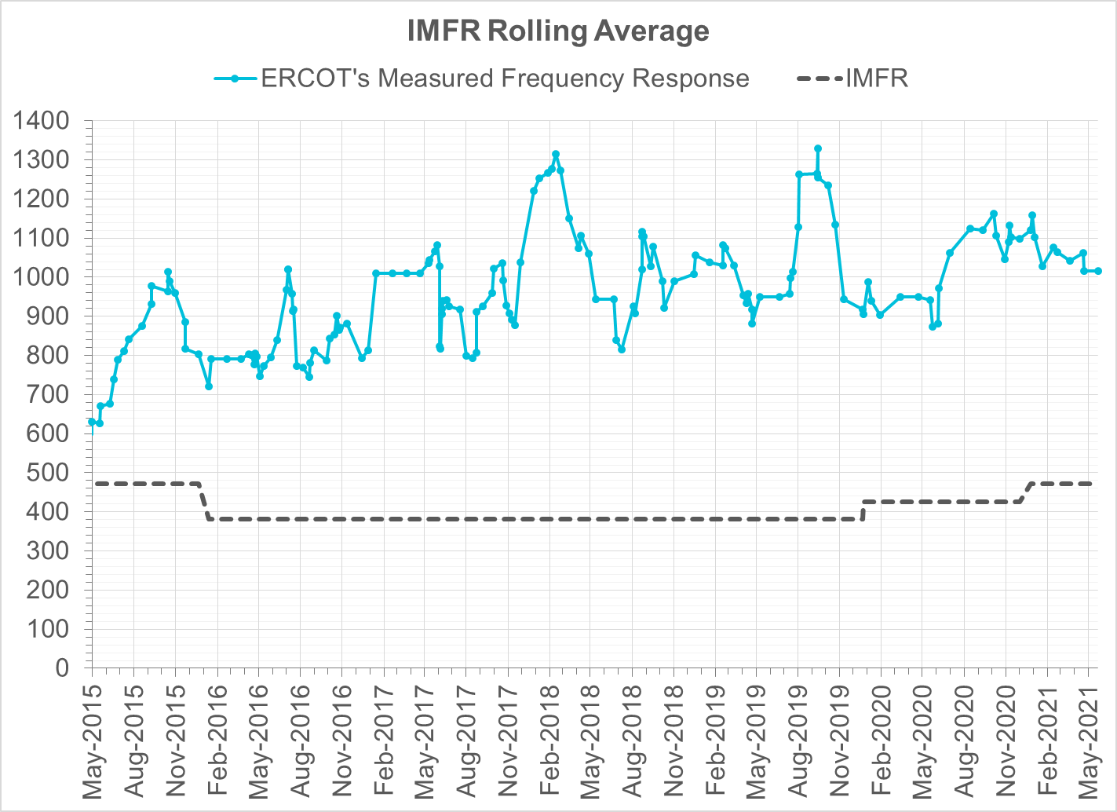
Interconnection Minimum Frequency Response (IMFR) Performance
IMFR Performance currently 1016.54 MW/0.1Hz
Frequency Response Obligation (FRO): 471 MW/0.1 Hz

Slide 7
Frequency Control Report
May 2021

Slide 8
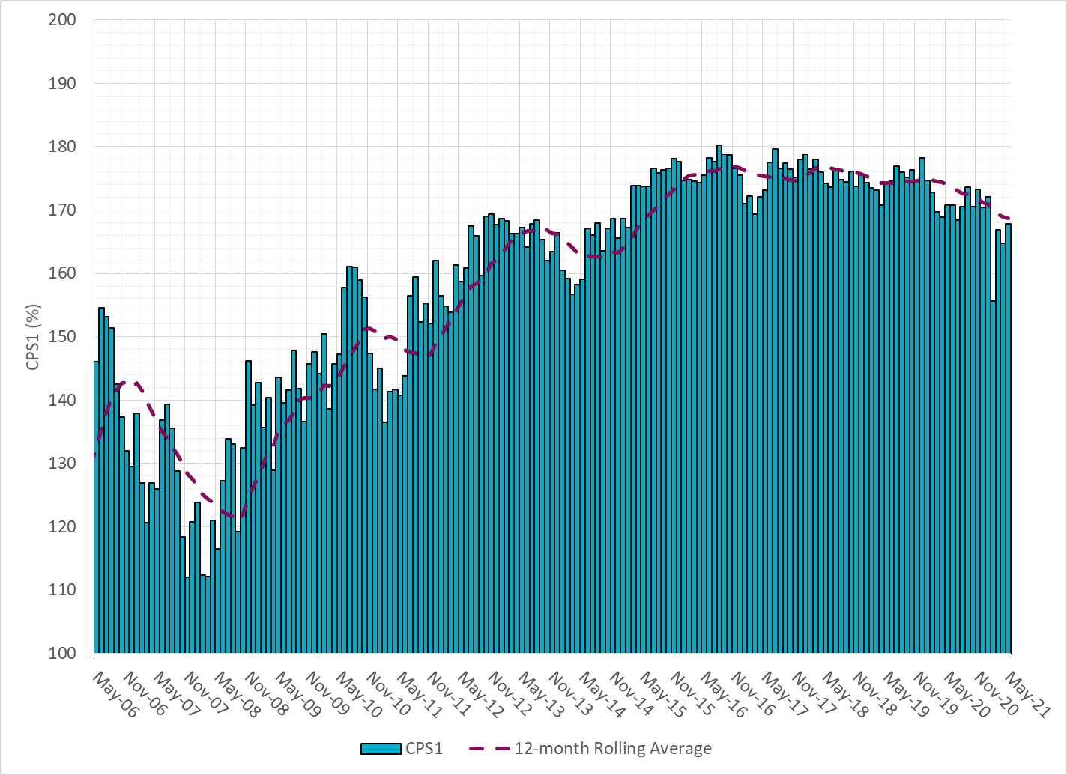
CPS1 Performance

Slide 9
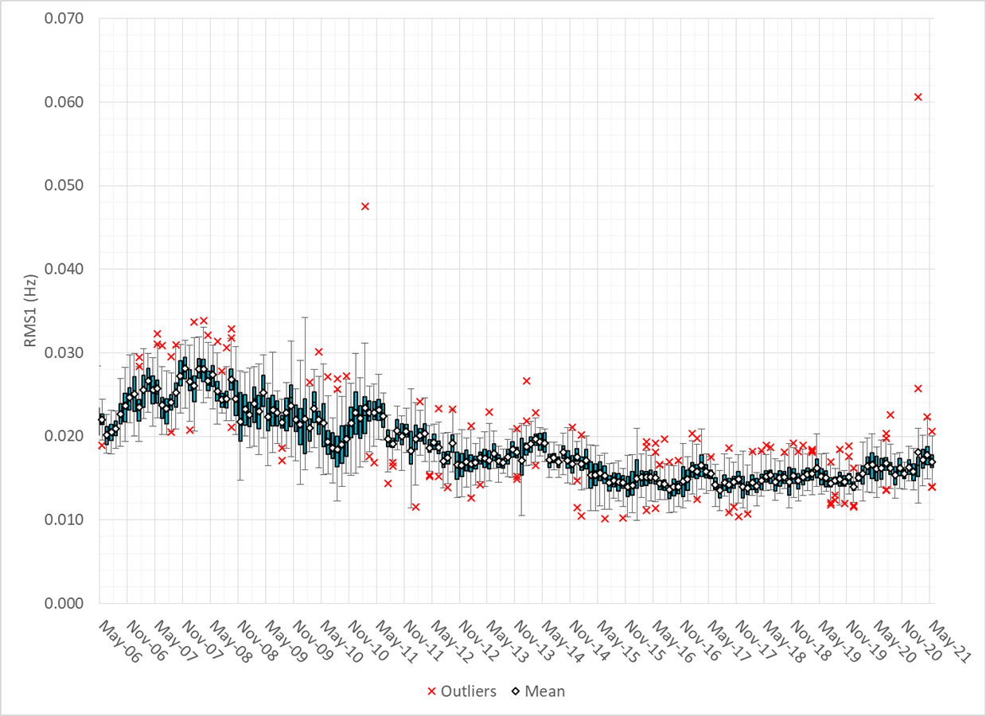
RMS1 Performance of ERCOT Frequency

Slide 10
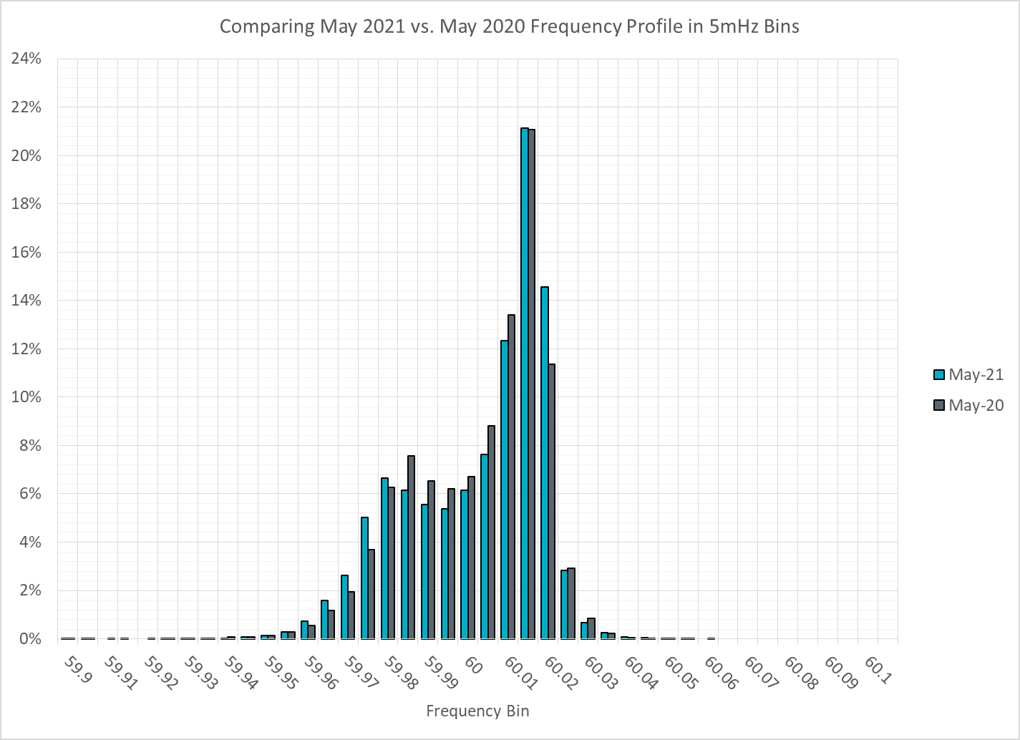
Frequency Profile Analysis

Slide 11
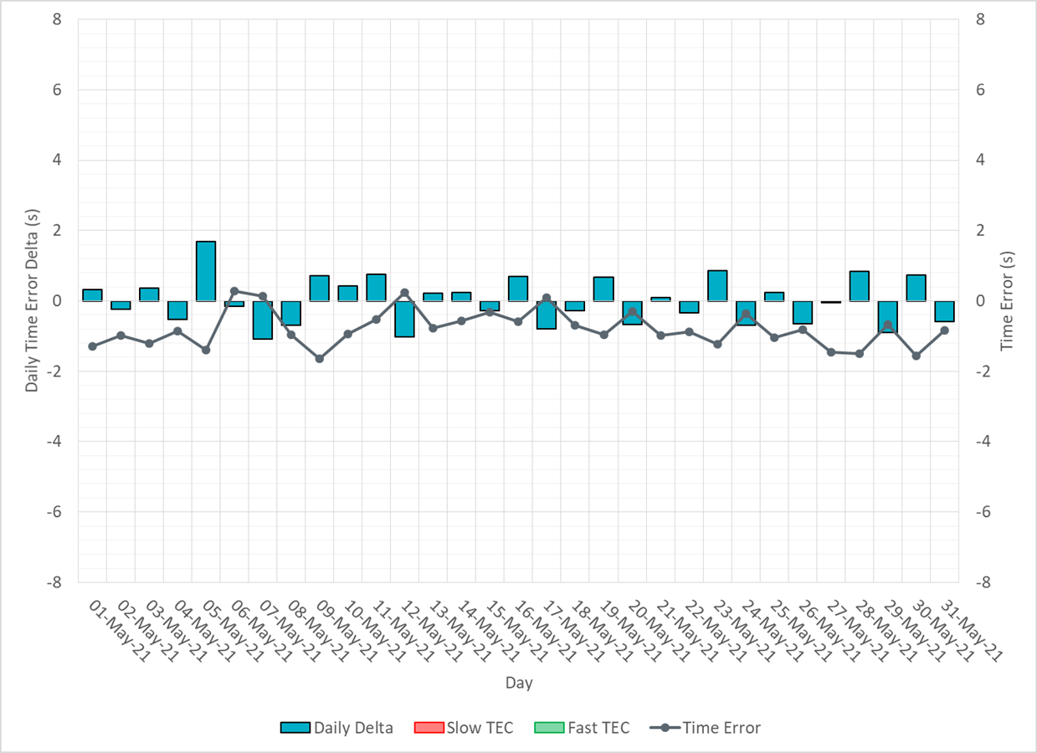
Time Error Corrections

Slide 12
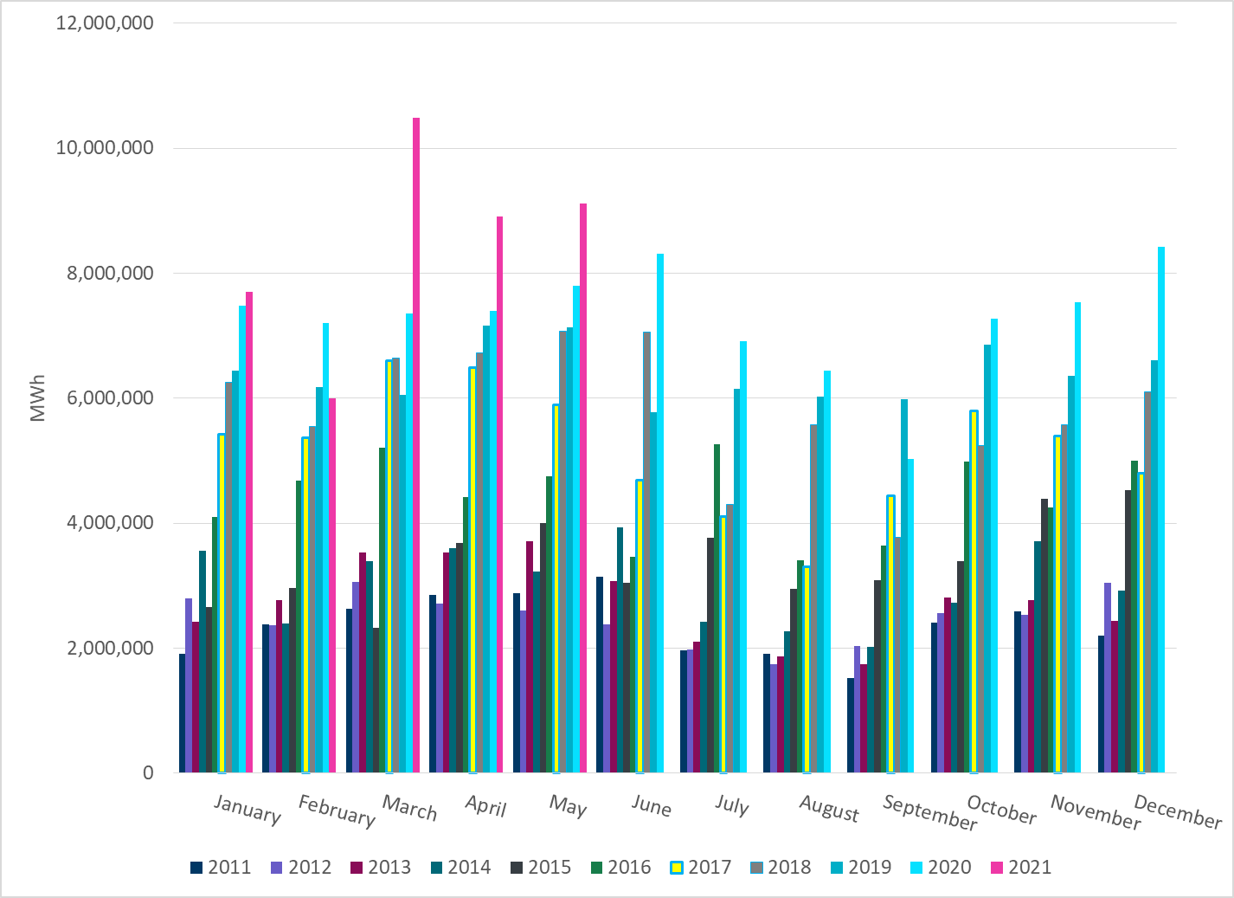
Total Energy from Wind Generation
Notes:
9,120,382 MWh

Slide 13
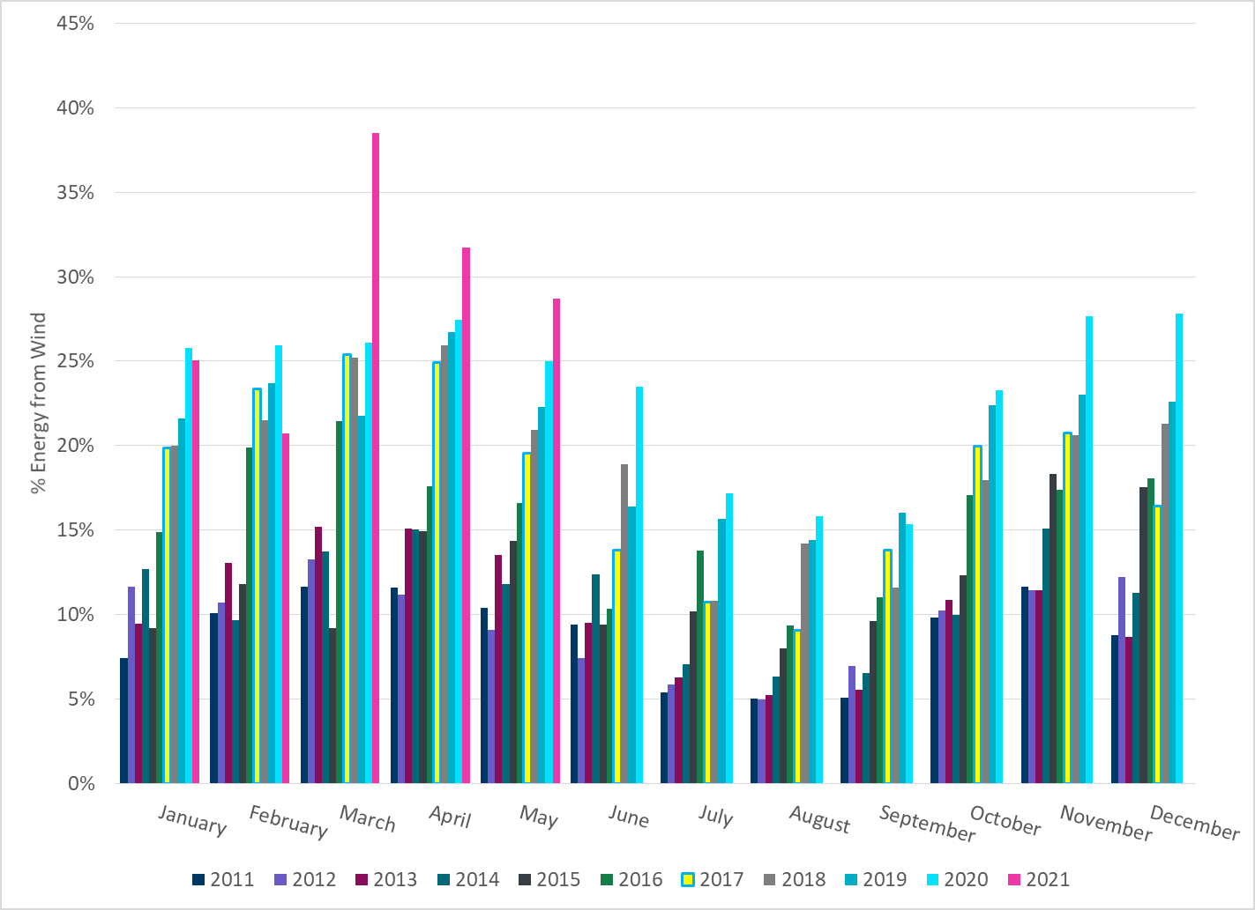
% Energy from Wind Generation
Notes:
28.68%

Slide 14
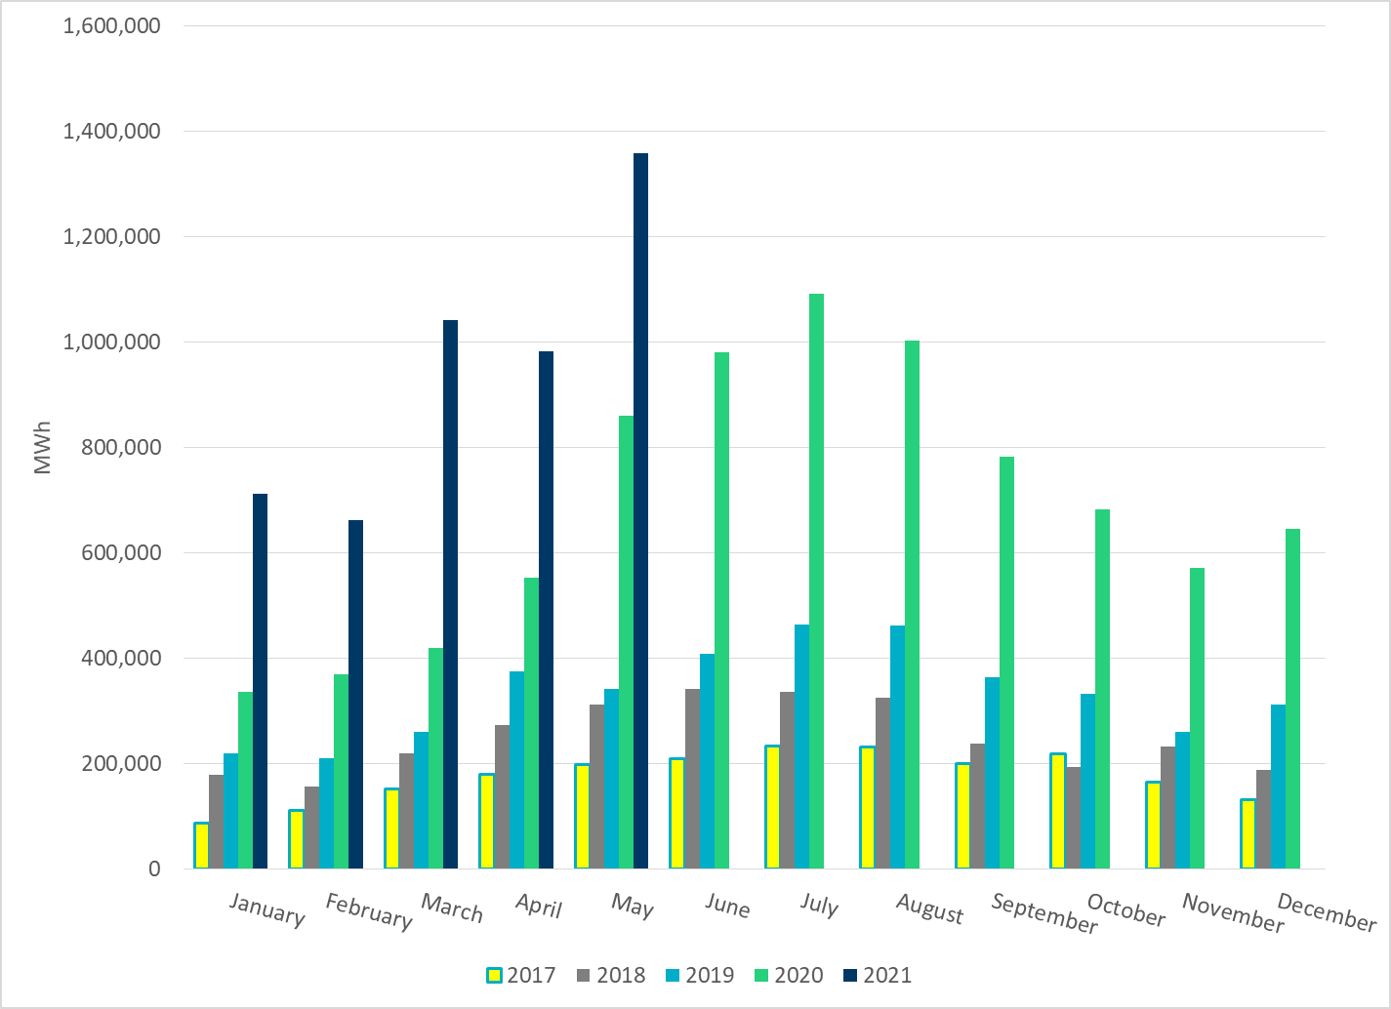
Total Energy From Solar Generation
Notes:
1,358,326 MWh

Slide 15
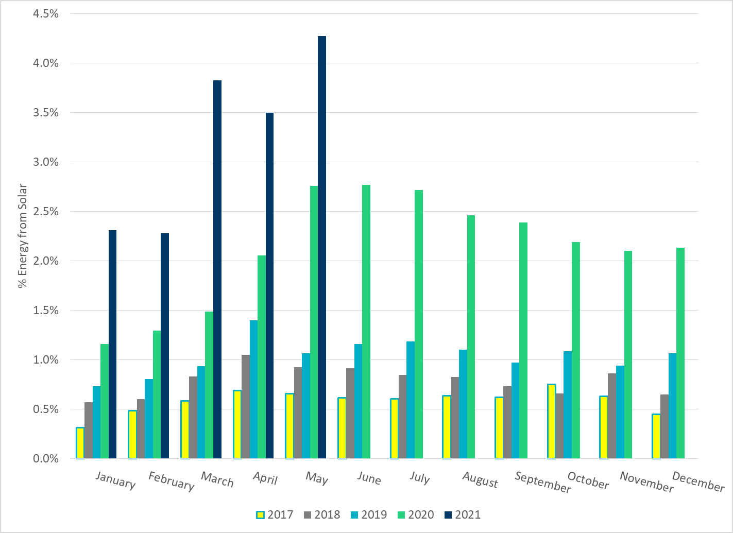
% Energy from Solar Generation
Notes:
4.27%

Slide 16
Questions?

