Slide 1
Working Group to Develop GIC Model
Chair: Chu Liang
Vice Chair: Jorge Canamar
07/08/2021

Slide 2
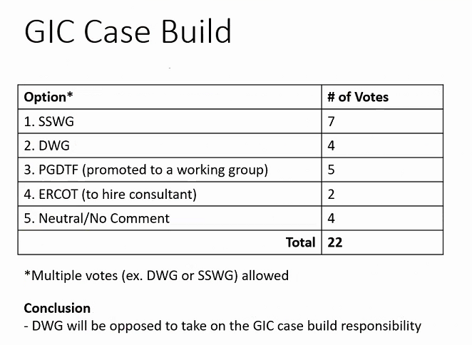
DWG Feedbacks
GIC is not a dynamics case, it’s a steady state case.
SSWG have more knowledge on data related to GIC model build.

Slide 3
SSWG Feedbacks
Favors DWG to take on the model build.
SSWG doesn’t have the expertise to track GIC data.
Only have one month in the year free to work on other case.

Slide 4
PGDTF
Experience with gathering data and building GIC model.
Limited workload.
GMDVA results
  Benchmark GMDVA had 1 low voltage violation; corrective action plan developed to fix the issue
  Supplemental GMDVA preliminary result shows no violation

Slide 5
Working Groups to Develop GIC Model
SSWG
  Experience with PSSE
  GIC case uses SSWG final case
  54 cases over 11-month timeframe
DWG
  Experience with PSSE
  3 cases over 6-month timeframe
PGDWG
  Experience with submitting data to build GIC model
  Limited workload since case is build once every 5 years

Slide 6
Conclusion
PGDTF recommends SSWG or DWG to take on the GIC model build, but neither working group have the bandwidth.

