Slide 1
Market Credit Working Group update to the Wholesale Market Subcommittee
Brenden Sager, Austin Energy, Chair
Seth Cochran, DC Energy, Vice Chair
2 June 2021

Slide 2
MCWG update to WMS
General Update
16 June 2021 Joint MCWG/CWG WEBEX Meeting
4 NPRRs reviewed for their credit impacts
NPRR 1079, 1080 and 1081 considered operational without credit impacts
NPRR 1078 the Credit WG believes this NPRR has positive credit impacts as it appropriately margins Market Participants for known credit risk related to future default allocation.

Slide 3
MCWG update to WMS
1078NPRR Clarification of Potential Uplift.
This Nodal Protocol Revision Request (NPRR) clarifies the definition of potential uplift within the calculation of a Counter-Party’s “Total Potential Exposure Any” (TPEA).
Removes and replaces language considered ambiguous by ERCOT Credit staff

Slide 4
NPRR 1078 -- Approved
Potential Uplift—Potential uplift to the Counter-Party, to the extent and in the proportion that the Counter-Party represents Entities to which an uplift of a short payment will be made pursuant to Section 9.19, Partial Payments by Invoice Recipients.
It is calculated as the sum of:
(a) Amounts expected to be uplifted within one year of the date of the calculation; and
(b) the lesser of:
(1) 25% of amounts expected to be uplifted beyond one year of the date of the calculation; or
(2) five years’ worth of uplift charges (was 10 in original proposal)

Slide 5
Uplift further discussion
Important to establish cap on default uplifts
Wanting to protect market from second wave defaults after uplift put to the market
Try to spread out defaults among market but large default (currently $3.0B total) difficult to address
Consider dividing uplifts among MP’s based on type (load, generation and CRRAH)
ERCOT Staff polled other ISO’s on their practices

Slide 6
Uplift further discussion
Consider using dollar-based activity approach versus ERCOT’s MW-based approach
For example, a purchase of 100 MW at a price of $100, phys buyers are credited with 100 MW of Market Activity – someone purchasing 100 MW of CRRs with a price of $0.50 is also credited with 100 MW of Market Activity. CRR purchasers are penalized with their $50 of activity treated the same as $1,000 of energy
Value driving this CRR’s are disproportionately low
Uplifts driven by cash invoices are better; CRR’s are being hit hard
Invoices net dollar amounts
Note: example reflects case where CRRs clear much less per MW than energy because CRRs are the cost of congestion

Slide 7
ISO Default Uplift Practices
 | ERCOT | ISO NE | MISO | CAISO | PJM
Short Payment Funding | use of financial security, withheld payments due to defaulting entity | use of offset, liquid collateral, late payment account; Payment Default Short Payment Fund ($4MM) |  | use of prepayment account and financial security; use of CAISO Reserve Account or CAISO Penalty Reserve Account (includes proceeds of drawings under banking facilities); interest is also assessed on overdue amount from due date until payment is received
Default Uplift | based on maximum MWh activity; no more than $2.5 MM on each invoice; invoice issued at least 30d apart | allocated among all participants | based on absolute value of market charges |  | based on 1) % share to total no. of participants weighted at 10% (not exceeding $10,000); and 2) % share to total market over last 3 months
Default Uplift Billing Timeline | no earlier than 90 days | subsequent weekly bill following the default | no prescribed timeline | next practicable invoices
Potential Uplift Collateralization | up to $2.5MMM per month or $30MM per year | none | none

Slide 8
MCWG update to WMS
Market-wide average TPE increased from $ 550.8 million in April to $ 594.12 million in May
TPE increased mainly due to the removal of 15% haircut adjustment to TPE on April 20, 2021
Discretionary Collateral is defined as Secured Collateral in excess of TPE,CRR Locked ACL and DAM Exposure
Average Discretionary Collateral decreased from $1,508.7 million to $1,230.5 million
The decrease in Discretionary Collateral is largely due to increase in CRR Locked ACL.
Number of auction lock days were higher in May compared to April
Short pay entities are excluded from the above calculations to remove data skew

Slide 9
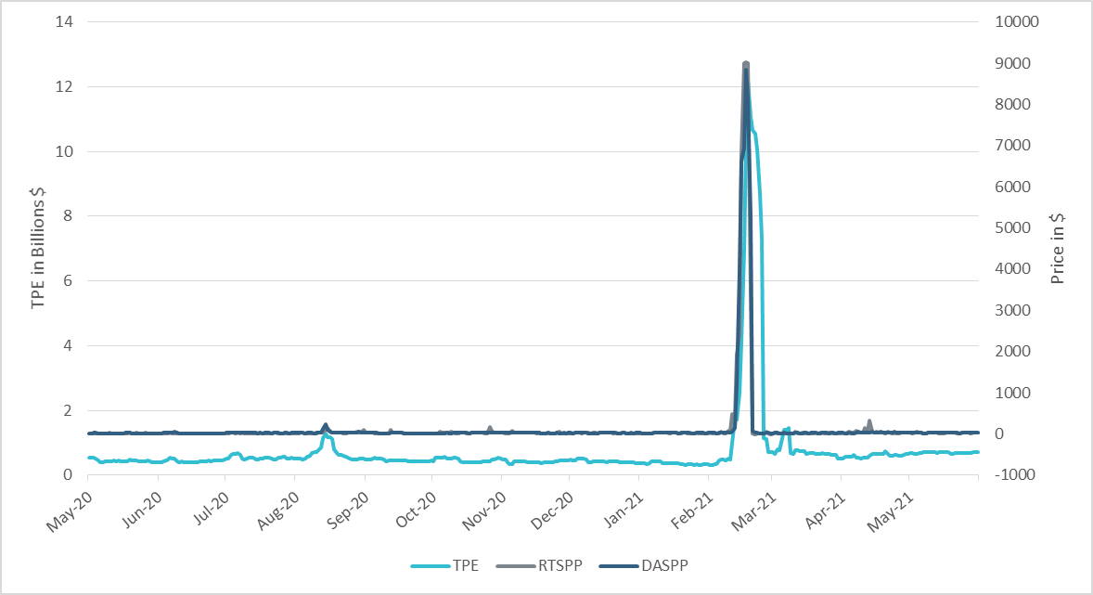
TPE/Real-Time & Day-Ahead Daily Average Settlement Point Prices for HB_NORTH May 2020- May 2021
*Short pay entities are excluded from the above calculations to remove data skew

Slide 10
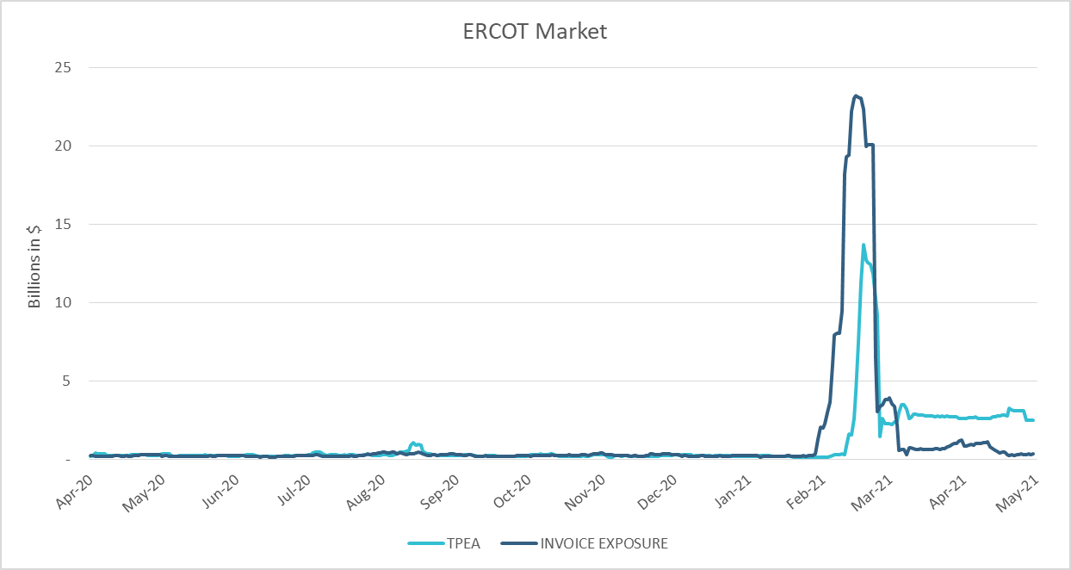
TPE Coverage of Settlements Apr 2020 - Apr 2021
*TPEA closely approximates actual/invoice exposure except during the 2021 winter event

Slide 11
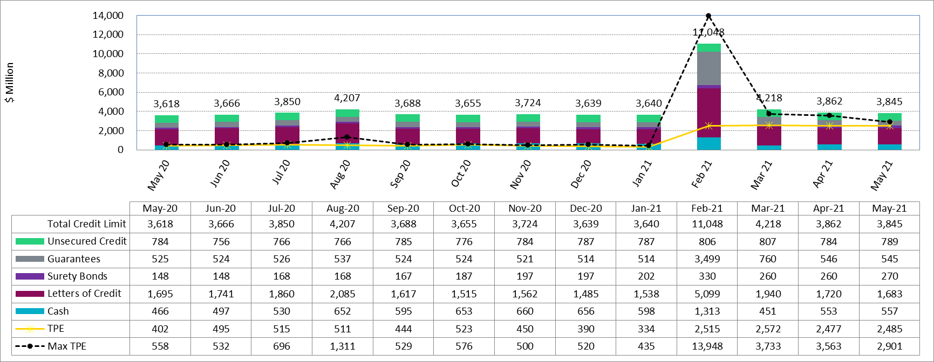
Available Credit by Type Compared to Total Potential Exposure (TPE) May 2020- May 2021
* Numbers are as of month-end except for Max TPE

Slide 12
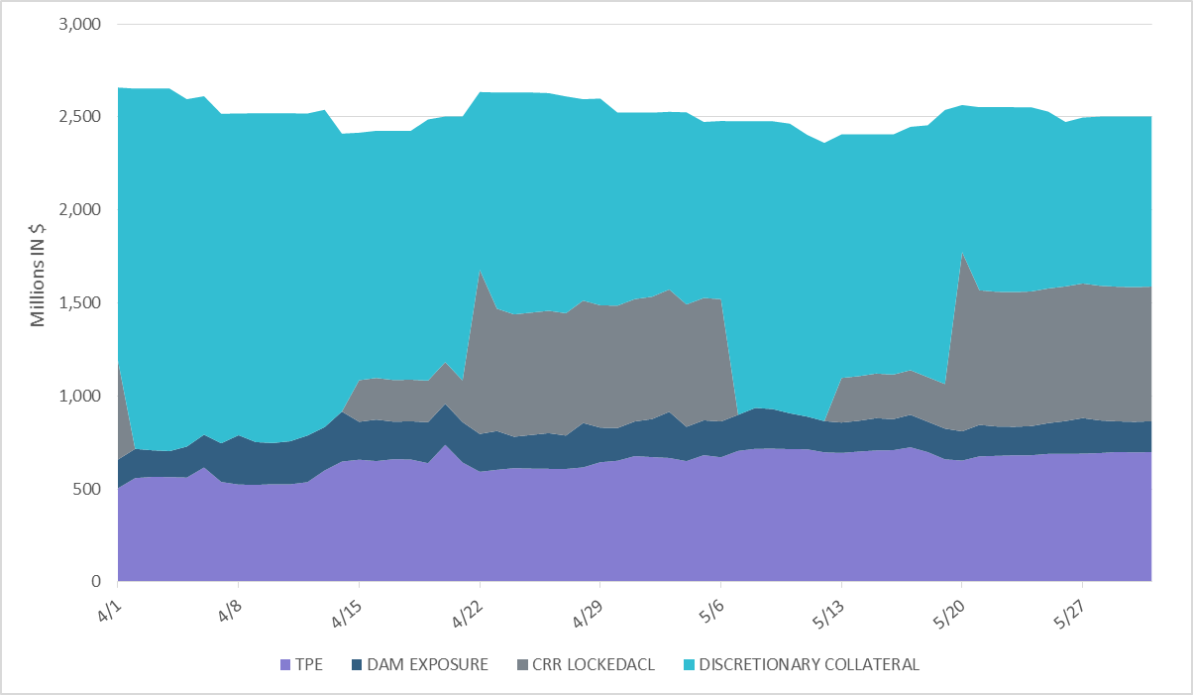
Discretionary Collateral Apr 2021 - May 2021
*Discretionary collateral doesn’t include Unsecured Credit Limit or parent guarantees
*Short pay entities are excluded from the above calculations to remove data skew

