Slide 1
PsCad Auto Run (PCAR) Tool for PSCAD Model Quality Test
Xiaoyu (Shawn) Wang
ERCOT Transmission Planning
RIWG
06/22/2021

Slide 2
Disclaimer:
The purpose of this tool is to facilitate PSCAD model quality tests; there is no obligation to use this tool to meet the requirements specified in the ERCOT Protocols
Any issue(s) identified in the tests should be checked with Resource Entities and/or manufacturers to confirm if the models produce an accurate representation of the field equipment per the site design

Slide 3
Outline
Background
PCAR Tool Development
Next Steps

Slide 4
PSCAD Model Review Necessity and Challenges
In general, PSCAD models are expected to better reflect the Inverter-based Resources (IBRs) under weak grid conditions
PSCAD model quality and accuracy need to be validated and verified to 1) improve the fidelity of the system level study and 2) be used as a reference to benchmark positive sequence models (like PSS/e)
The model review and update process often requires support from Resource Entities (REs), developers, manufacturers, consultants, and Transmission Service Providers (TSPs)
Large scale PSCAD study is complex and time consuming

Slide 5
Current Dynamic Model Requirements
Generation Interconnection
QSA
Commissioning
Operations
Provide PSS/e model
PSS/e model quality tests
PSCAD model quality tests
PSCAD model validation
Benchmark PSS/e↔PSCAD using model quality tests onwards
Verification of key settings of PSCAD models
Model quality tests are required for any model or setting changes during Commissioning
Keep dynamic models up to date
Verification of key settings within two years and every ten years thereafter or if there is a settings change
Model quality tests and verification are required for any model or setting changes
Resource Entities are responsible for all these requirements, from model validation, model quality tests, to model verification
Planning Guide section 6.2
Planning Guide section 5.7.1
Dynamics Working Group DWG Procedure Manual section 3.1
Model Quality Guide published on the Resource Integration webpage
Dynamic Model Templates published on the Resource Integration webpage

Slide 6
PCAR Tool for PSCAD Studies
ERCOT developed PCAR (PsCad Auto Run), a python-based tool for managing large scale system wide PSCAD studies. Notable features applicable to PSCAD model quality tests include:
  Include functions for PSCAD model quality test to facilitate model quality test and performance review
  Automatically create and consolidate the simulation plots, including adding both PSS/e and PSCAD plots in a single platform for easier benchmarking comparisons

Slide 7
PCAR Tool for PSCAD Model Quality Tests
PSCAD and Python Libraries
PCAR

Slide 8
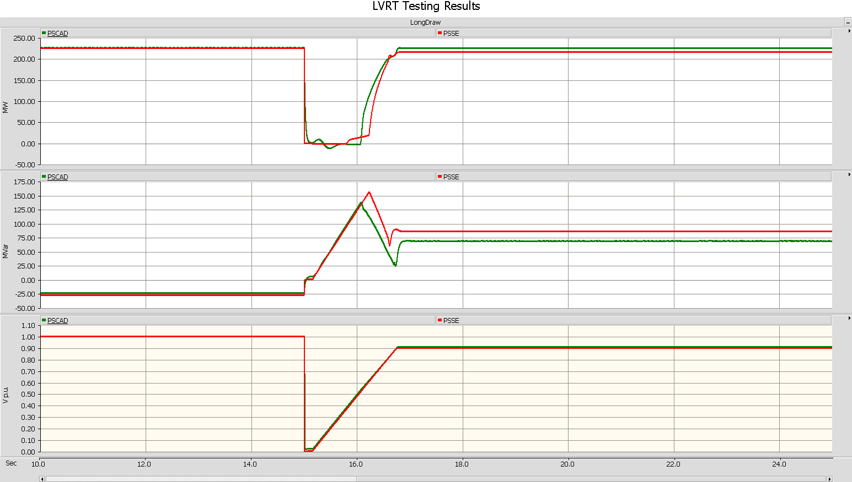
Voltage Ride Through Test Result Comparison in PCAR – Acceptable Responses
P (MW)
Q (MVar)
Consistent responses between PSS/e and PSCAD
V (p.u.)
PSS/e results
PSCAD results

Slide 9
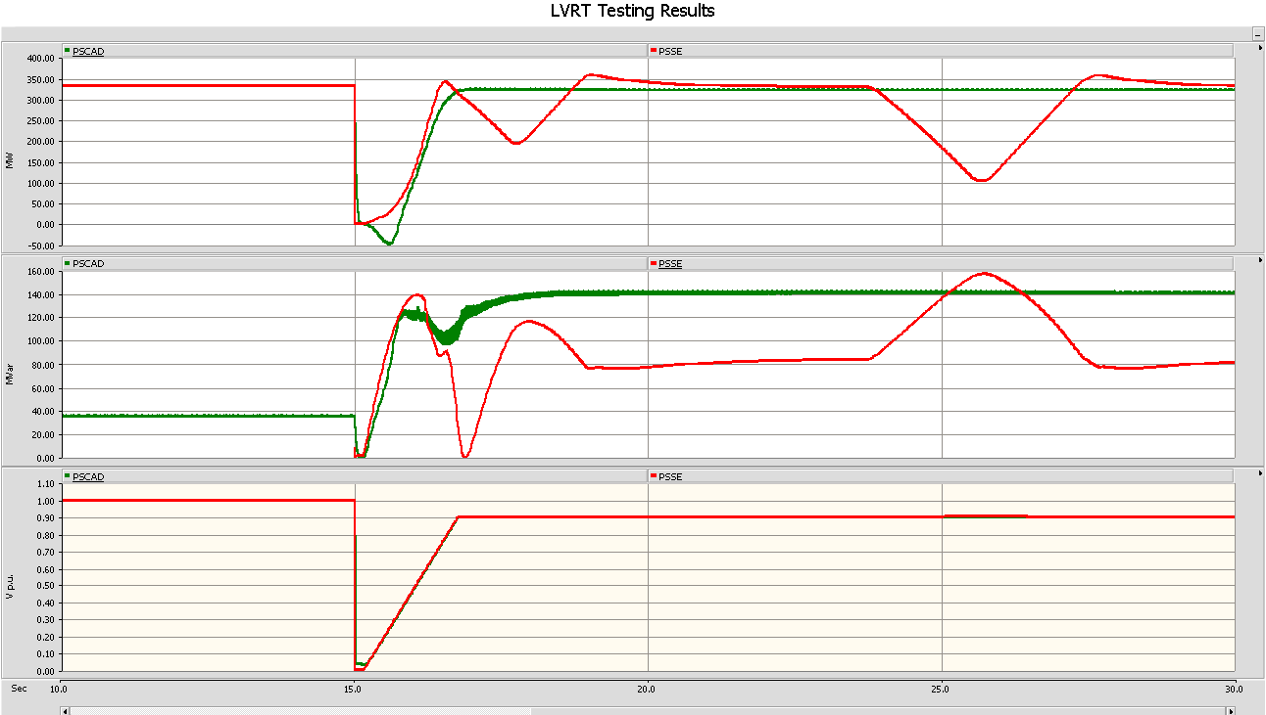
Voltage Ride Through Test Result Comparison in PCAR – Suspicious Responses
P (MW)
Suspicious PSS/e response
Q (MVar)
V (p.u.)
PSS/e results
PSCAD results

Slide 10
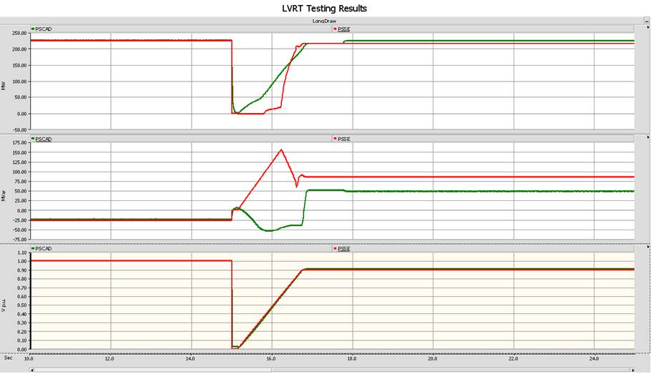
Voltage Ride Through Test Result Comparison in PCAR – Suspicious Responses
P (MW)
Q (MVar)
PSCAD model provides wrong dynamic Var response
V (p.u.)
PSS/e results
PSCAD results

Slide 11
Next Steps
If sufficient interest, a live demo for the PCAR tool can be scheduled
Feedback or suggestions are welcome
Link to PCAR tool package:
  https://github.com/toolsite/PCAR

