Slide 1
June 23, 2021 RMS Update to TAC
Jim Lee
RMS Chair

Slide 2
June 9th Highlights
Approved:
RMGRR165, Modify ERCOT Pre-Launch Responsibilities in a Mass transition
RMGRR166, Create Switch Hold Repository
Granted Urgency to file Draft SCR, MarkeTrak Administrative Enhancements -- in order to make the August BOD to align and sync with ERCOT’s MarkeTrak Tech Refresh timeline

Slide 3
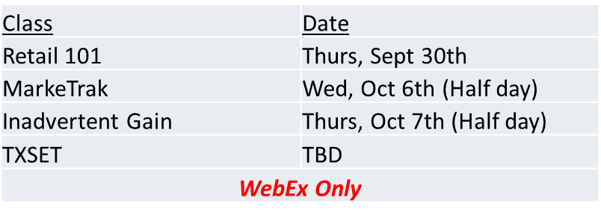
RMS WG/TF Updates
Retail Market Training Task Force (RMTTF):
Upcoming Retail training classes:
Retail Emergency Conditions Task Force (RECTF):
Continue ECL discussions

Slide 4
RMS WG/TF Updates
TDTMS (TX Data Transport & MarkeTrak Systems):
Adding ERCOT Listserv performance metrics into SLA document
Discuss API architecture request submitted to ERCOT Web Services for ERCOT MIS API
TXSET
Final review and approval of NPRRs and RMGRRs needed to support TXSET 5.0 release
TXSET 5.0 release details on following slides

Slide 5
TXSET 5.0: Summary of Changes (1/3)
Inadvertent Switch (IAS) transactional solution
Adds indicators within the Move-In transaction for Inadvertent Gain/Loss “IA” and Customer Rescission “CR” so that TDSP systems can identify and accept the backdated transaction from REP involved in an Inadvertent Gain/Loss scenario without manual intervention. Allows for TDSP automation of subsequent cancel/rebill activities.
Adding Premise Type/ESI ID Attributes
TDSPs will assign a Premise Type identifier to an ESIID for easier identification when REPs enroll or service Customers. Will display on ERCOT MIS and TDSP ESIID Extract for REP consumption.
Bi-Directional RC/DC Notification
Allows REP to issue RC/DC from direct Customer request. Particularly useful during weather or Force Majeure events when Customer contacts the TDSP directly for RC/DC as opposed to contacting the REP.

Slide 6
TXSET 5.0: Summary of Changes (2/3)
Add County name to Customer Address
Supports PUCT Subst. R. 25.483(j) for Disconnection during Extreme Weather where a Weather Moratorium is declared by County. Helps REPs identify ESIIDs that are under Disconnect Moratorium.
Adding Construction Hold identifier
TDSP will use “CHP” to add transparency and identify locations for which Construction Hold is needed. Improves Customer experience.
Customer Authorization for TDSP Outage Notification enrollment
Allows REPs to pass Customer’s authorization to enroll for TDSP Outage Notifications. After receiving authorization, TDSP will reach out to Customer to complete enrollment.
Adding Continuous Service Agreement (CSA) Validations
Clean up of CSA transactions, timing and processes between ERCOT, REPs, and TDSPs to improve Customer experience.

Slide 7
TXSET 5.0: Summary of Changes (3/3)
Enhancing point-to-point 650 transactions between TDSP & REP to align transactional communication with real life field activities
Differentiate situations which require standard Move Out vs. Move Out w/ Meter Removal
Specify how a REP shall Reconnect an ESIID when they did not send the Disconnect
TDSP to inform REP when using a meter at a different location
Reject and Unexecutable Code Clean Up
Instances where a customer has installed DG without an Automatic Transfer Switch (ATS) and/or without a signed IA with the TDSP
TDSP Code Clearance violations
Standardizing common Reject codes that were once “free form” entries
ERCOT reject of Standard Switch when pending MVO exists

Slide 8
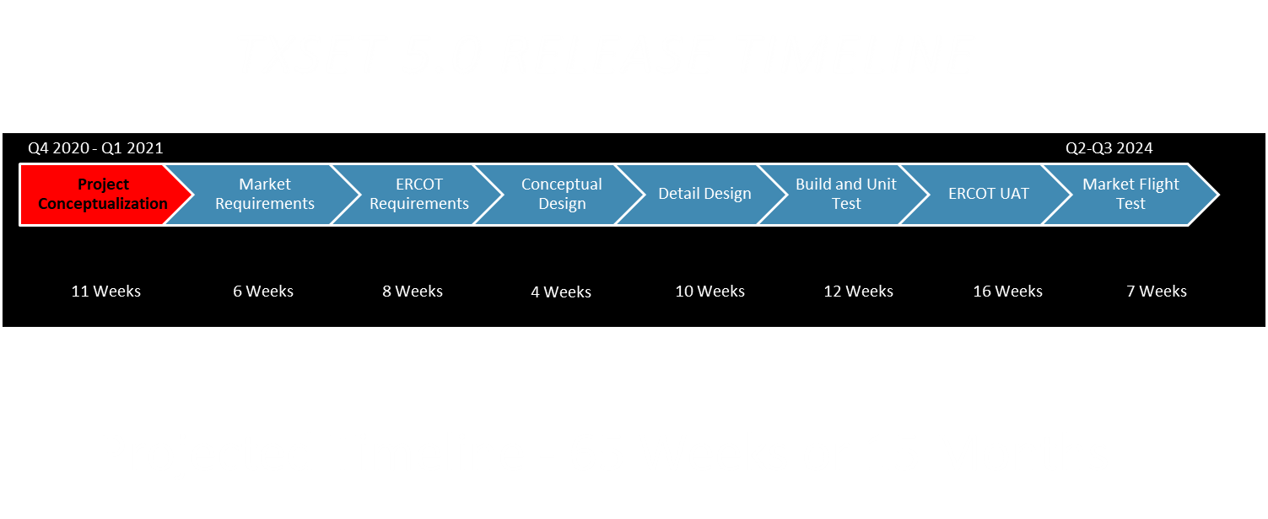

Slide 9
Questions?
Next RMS Meeting – July 13, 2021

