Slide 1
ERCOT Frequency Control Report
May 2021
ERCOT
Operations Planning
PDCWG | June 16th, 2021

Slide 2
Summary of May 2021
CPS1: 167.82%
Current CPS1 12-Month Rolling Average: 168.70%
2 BAAL Exceedance(s)
3 hourly CPS1 score below 100%
BAAL-003 Events have updated through 2019
2019 BAAL-003 FRM Performance: -811.14
2021 RMS1 Statistics
Mean: 17.15 mHz
Min: 12.01 mHz
Max: 60.59 mHz
Energy Statistics
Total Energy: 31,795,191 MWh
Wind Energy: 9,120,382 MWh
Percent Energy from Wind: 28.68%
Solar Energy: 1,358,326 MWh
Percent Energy from Solar: 4.27%
Minimum System Inertia
Mean: 176,245 MW*s
Max: 226,022 MW*s on May 28th
Min: 136,572 MW*s on May 15th
Notes:
2018 BAAL-003 FRM Performance: -843.17

Slide 3
Frequency Control
CPS1, BAAL, & RMS1

Slide 4
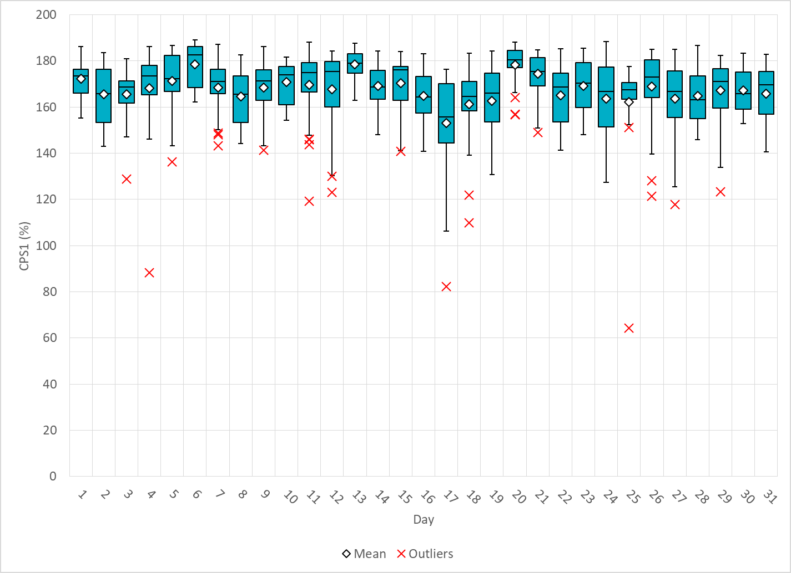
Hourly CPS1 by Day
May-21 CPS1 (%): 167.82
Notes:
1. 88.28% @ 05/4/2021 19:00
Expected Generation Deviation
Expected gen dev remained negative for entire hour. The largest expected gen dev was -1237 MW @ 19:34 mostly due to wind and solar.
IRR Ramps
Wind generation consistently ramped down for the entire hour from 4230MW to 3252 MW.
Solar generation consistently ramped down for the entire hour from 4066MW to 582 MW.
Regulation: Regulation up exhausted for the most part of the hour
Other
SCED Manual offset of 200 MW @ 19:34
2. 82.41% @ 05/17/2021 2:00
Expected Generation Deviation
Expected gen dev remained negative for entire hour. The largest expected gen dev was -2522 MW @ 2:42 mostly due to wind
IRR Ramps
Wind generation consistently ramped down for the second half of the hour from 16486 MW to 14291 MW.
Regulation: Regulation up exhausted for roughly 20 minutes starting from 2:30
Other
SCED Manual offset of 350 MW @ 2:40
3. 64.24% @ 05/25/2021 7:00
Expected Generation Deviation
The largest expected gen dev was -1678 MW @ 7:02 mostly due to thermal unit and wind
Frequency Event
Loss of 471 MW of Gen @ 5/25/2021 7:02:17 AM
IRR Ramps
Starting from the top of the hour, Wind generation consistently ramped down about 10 minutes from 9200 MW to 8700 MW.
Regulation: Regulation up exhausted for roughly 10 minutes starting from 7:00 am
Other
SCED Manual offset of 444 MW @ 7:05
1145 MW of RRS deployed @7:02:28 AM

Slide 5
BAAL Exceedances & Violations
There were 2 BAAL exceedance(s) in May
Notes:
Occurred on 05/25/2021 (2)

Slide 6
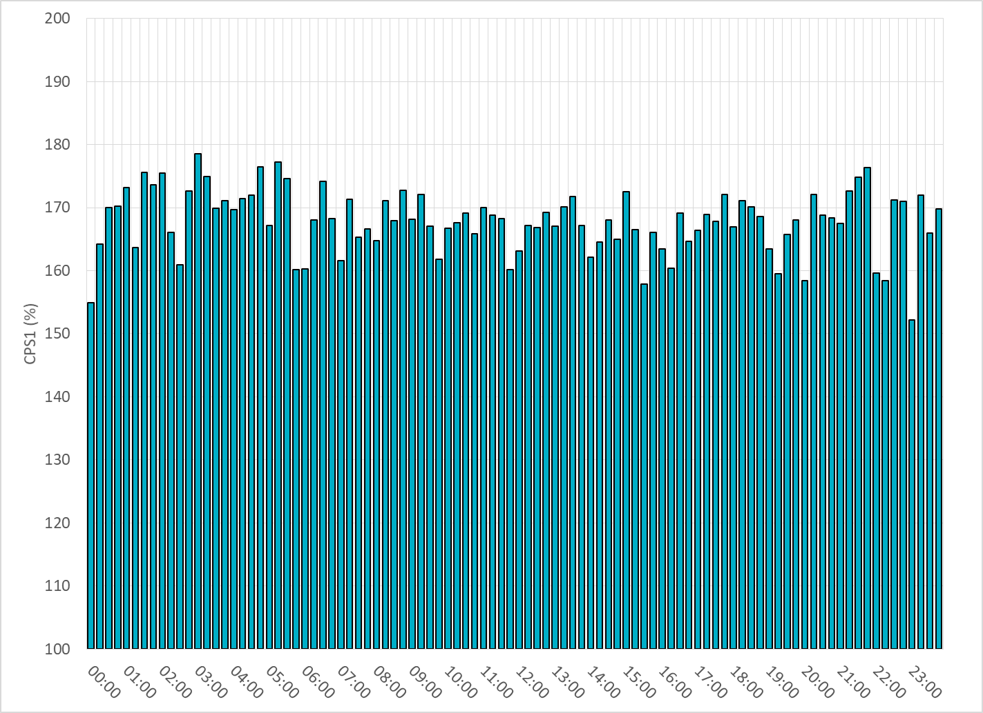
15-Minute Average CPS1%
May-21 CPS1 (%): 167.82

Slide 7
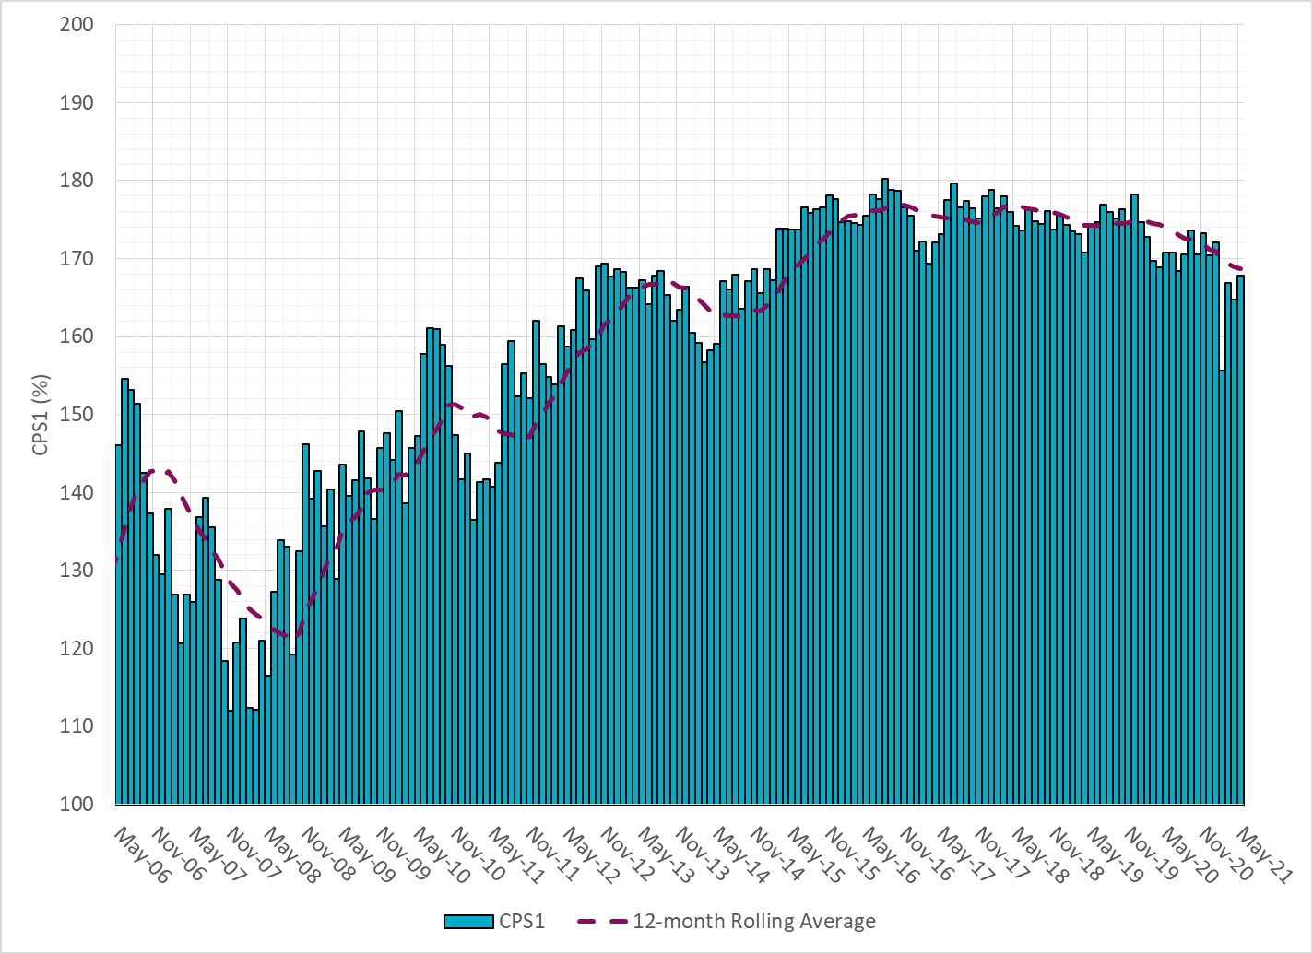
12-Month Rolling Average CPS1
Current 12-Month Rolling Average: 168.70%

Slide 8
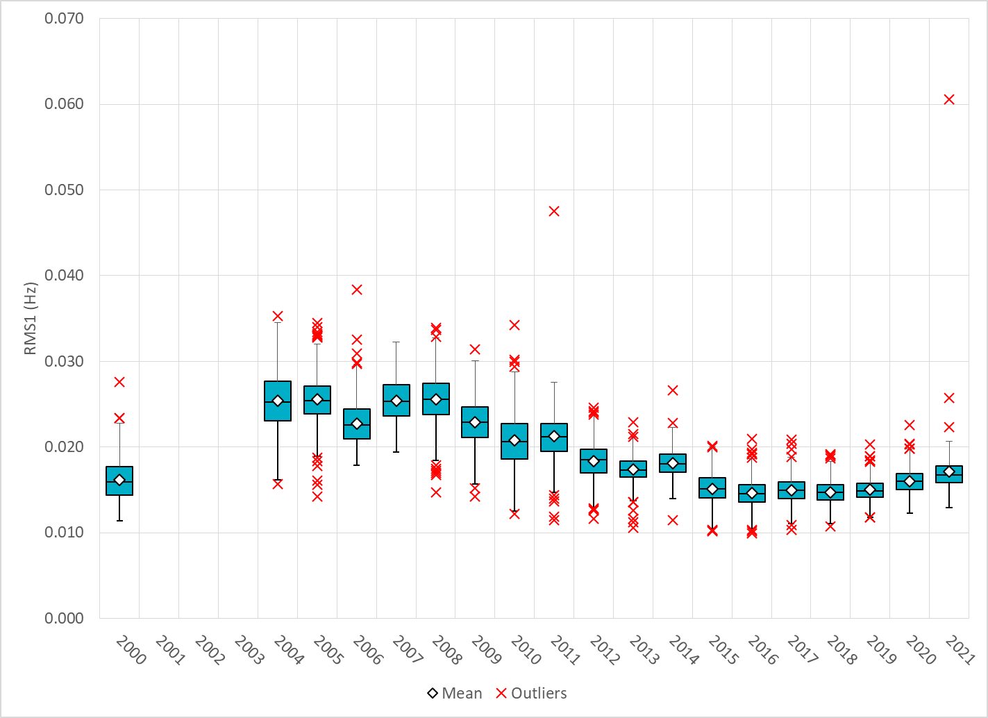
Daily RMS1 of ERCOT Frequency by Year
Notes:
Mean: 17.15 mHz
Min: 12.01 mHz
Max: 60.59 mHz

Slide 9
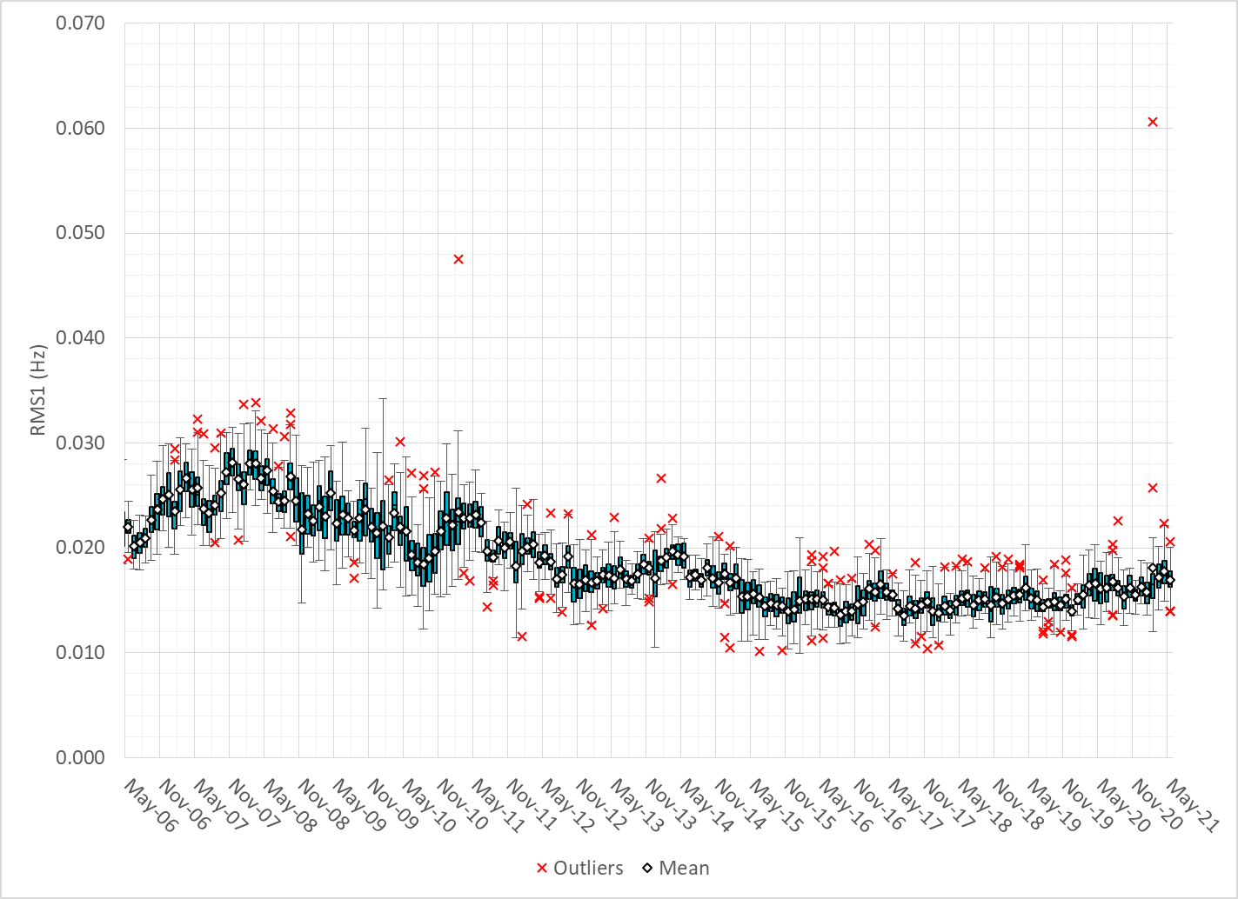
Daily RMS1 of ERCOT Frequency by Month

Slide 10
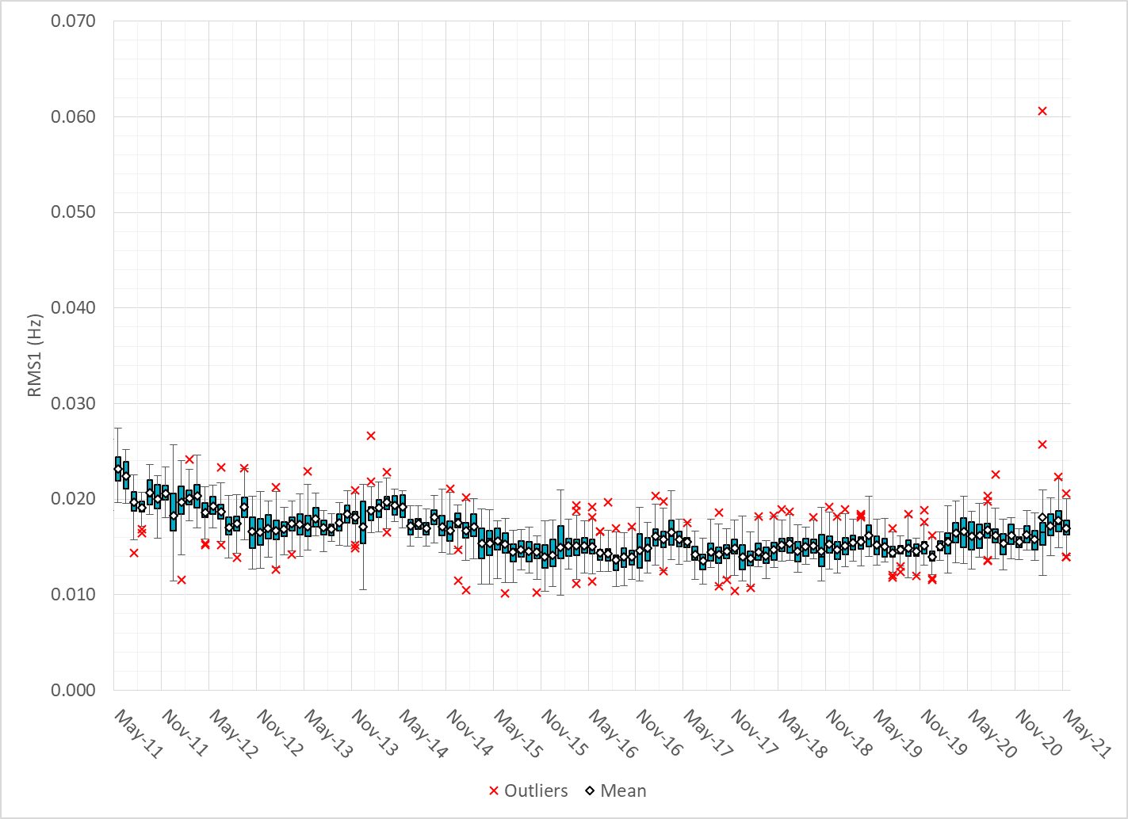
Daily RMS1 of ERCOT Frequency by Month

Slide 11
Frequency Profile Comparison

Slide 12
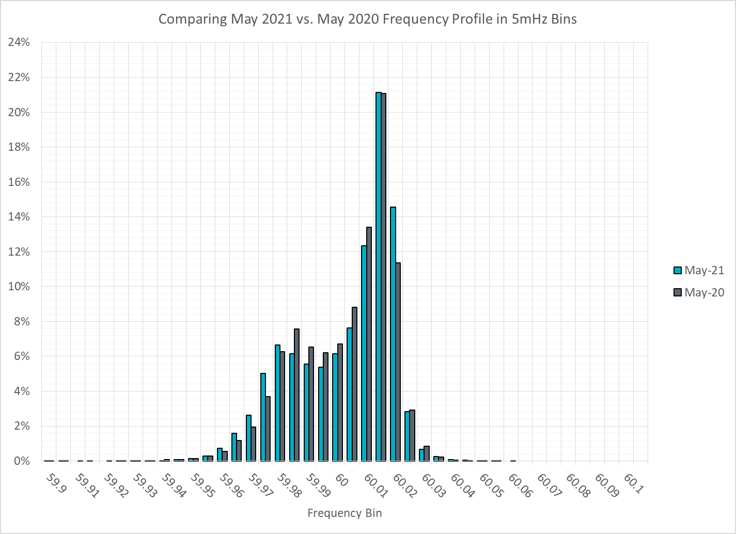
Frequency Profile Comparison

Slide 13
Frequency Profile Comparison

Slide 14
Time Error Correction

Slide 15
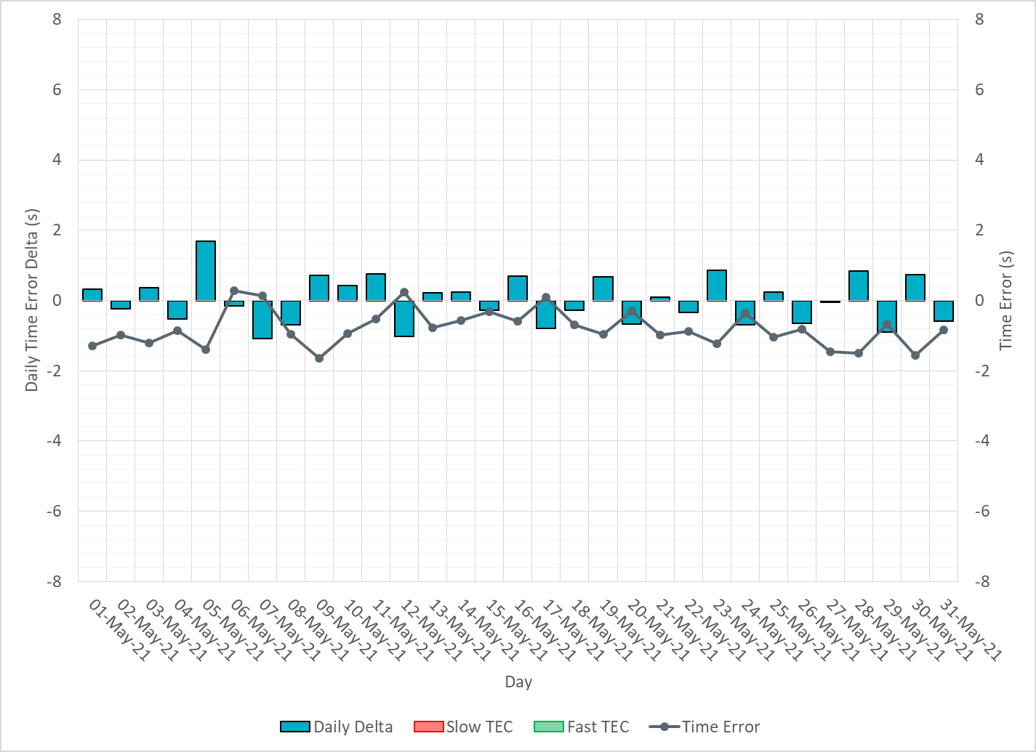
ERCOT Daily Time Error

Slide 16
Time Error Corrections Log Summary
There have been no time error corrections since December 2016

Slide 17
BAL-003 Performance

Slide 18
Op. Year 2019 BAL-003 Selected Events – Update
Notes:
BAL-003

Slide 19
Op. Year 2019 BAL-003 FRM Performance - Update
Notes:
OP2018: FRO = -381.0, FRM_median = -843.17, FRM_average = -959.7
OP2019: FRO = -381.0, FRM_median = -811.14, FRM_average = -892.5
OP2020: FRO = -425.0,

Slide 20
ERCOT Energy Statistics

Slide 21
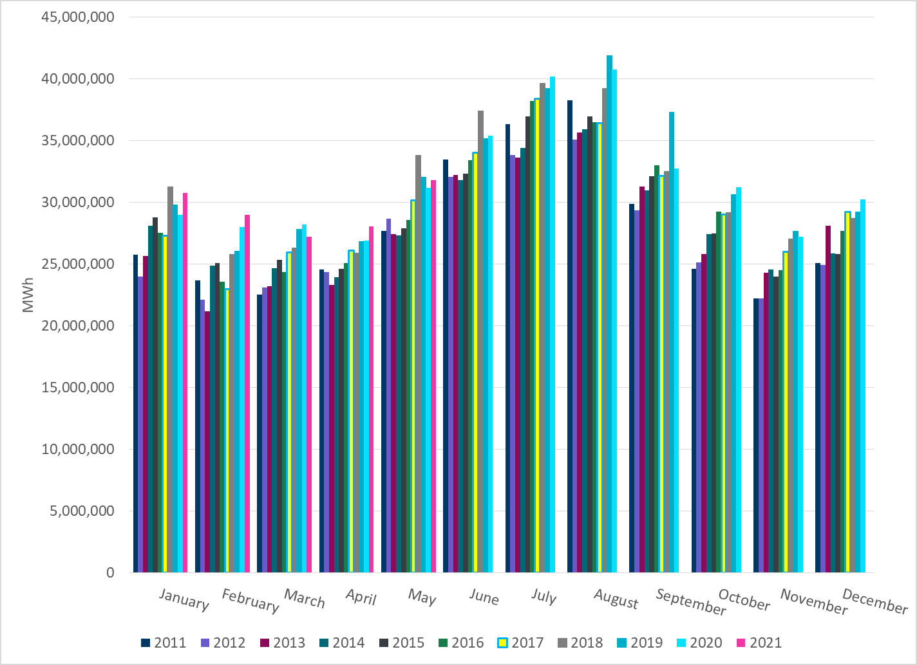
Total Energy
Notes:
31,795,191 MWh

Slide 22
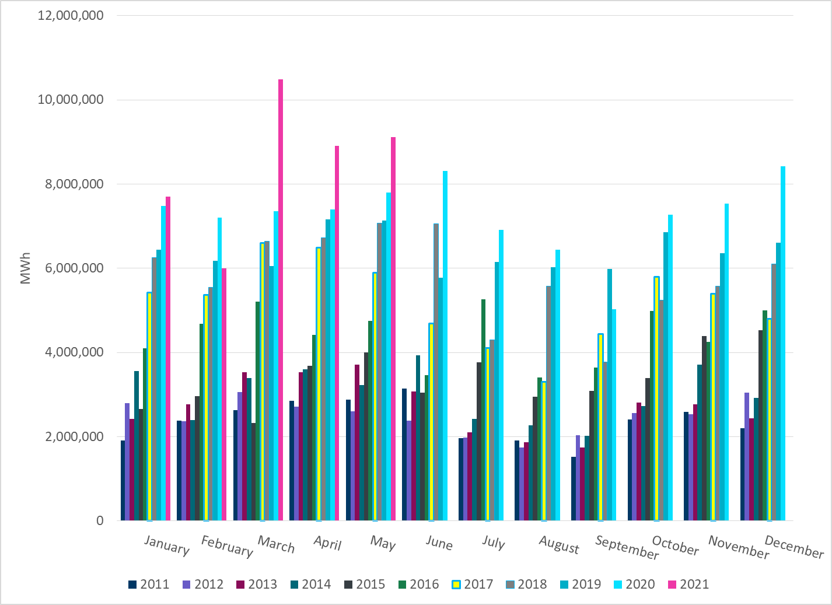
Total Energy from Wind Generation
Notes:
9,120,382 MWh

Slide 23
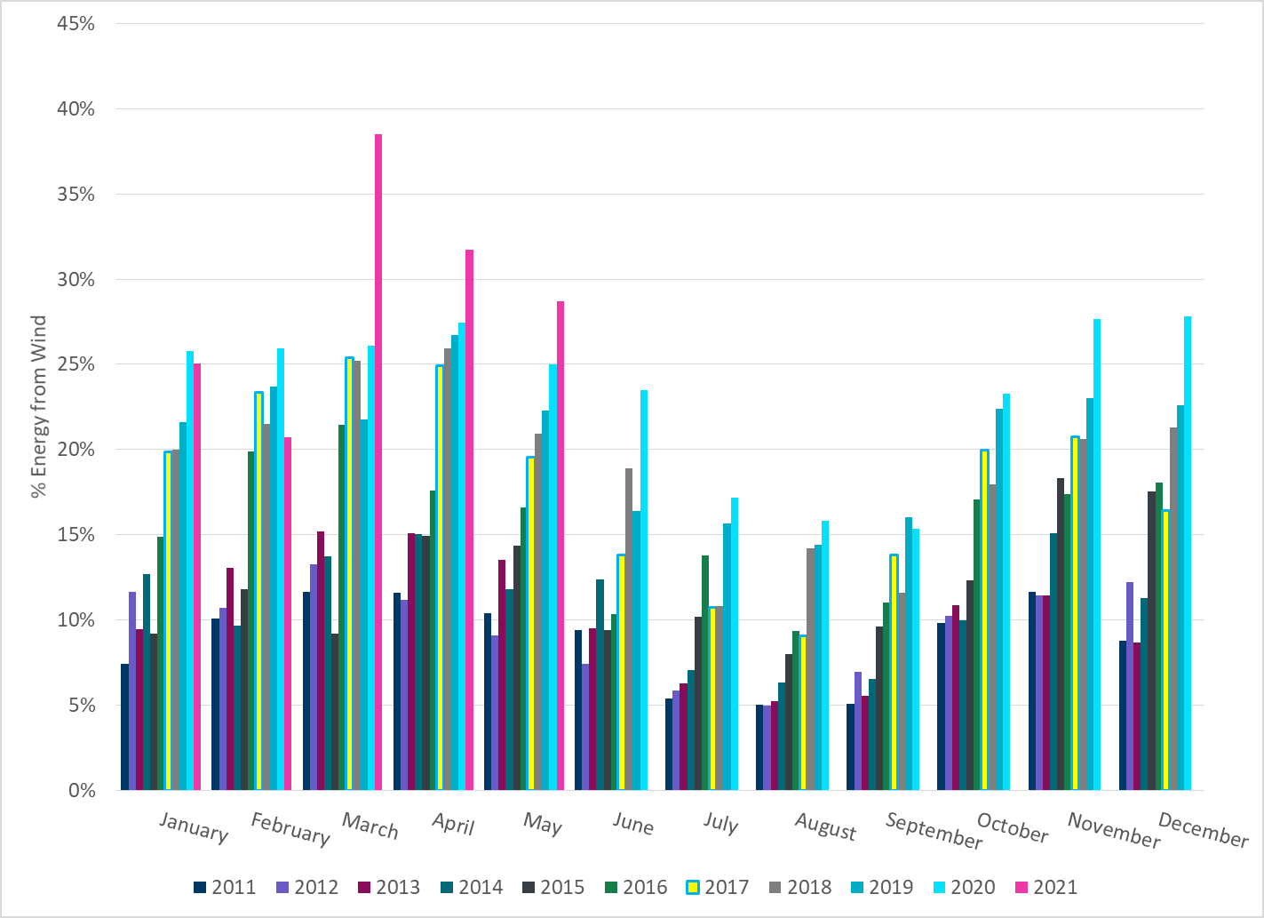
% Energy from Wind Generation
Notes:
38.52%

Slide 24
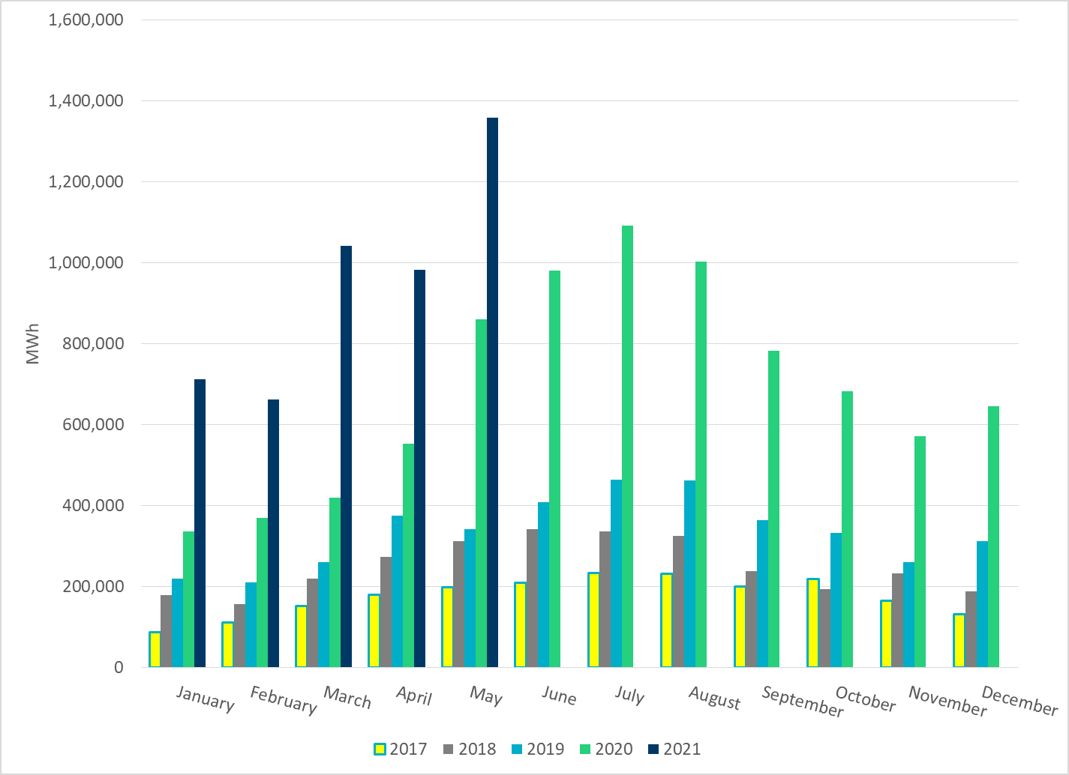
Total Energy From Solar Generation
Notes:
1,358,326 MWh

Slide 25
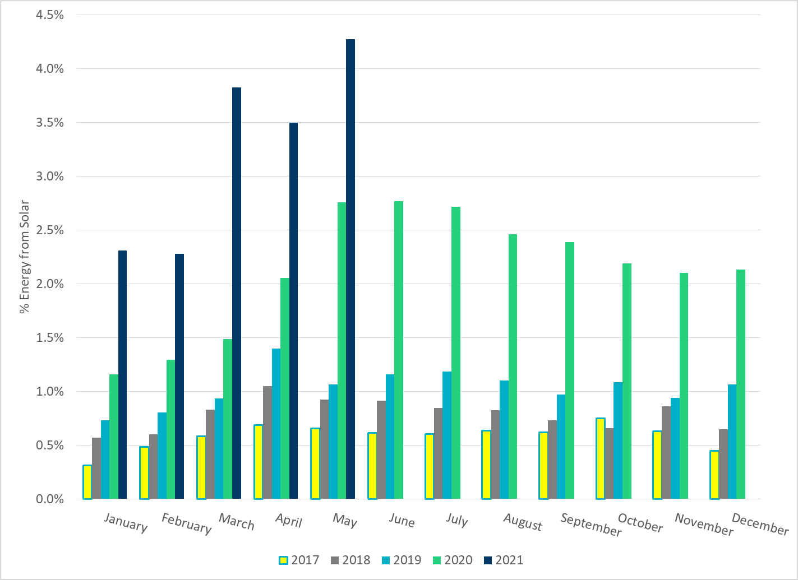
% Energy from Solar Generation
Notes:
4.27%

Slide 26
ERCOT System Inertia

Slide 27
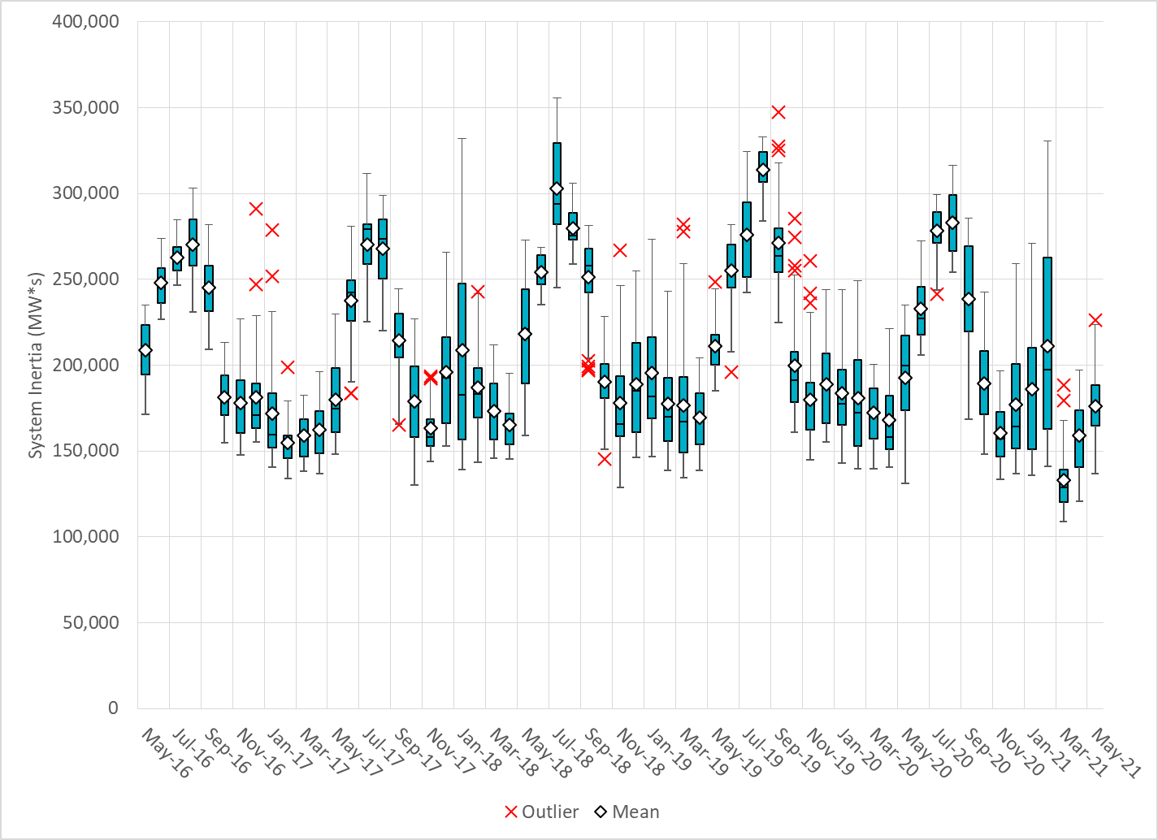
Daily Minimum System Inertia
Notes:
Minimum Inertia = 136,572 MW*s on 5/15/2021
Previous Minimum was 109,029 MW*s on 3/22/2021
Data:
Mean: 176,245 MW*s
Max: 226,022 MW*s on May 28th
Min: 136,572 MW*s on May 15th

Slide 28
Questions?
Thank you!

