Slide 1
ERCOT Frequency Events
May 2021
ERCOT
Operations Planning
PDCWG | June 16th, 2021

Slide 2
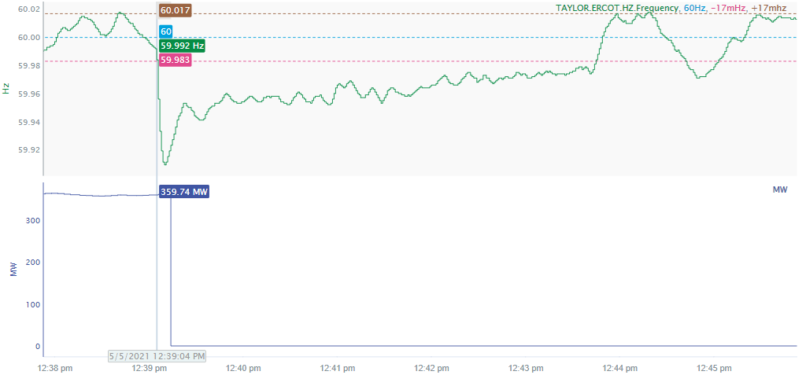
5/5/2021 12:39:04 (Non-FME)
Notes:
Unit tripped offline while carrying 360 MW.
Starting Frequency: 59.992 Hz
Minimum Frequency: 59.909 Hz
A-C Time: 6 seconds
Recovery Time (back to deadband): 4 minutes and 49 seconds
RRS Deployed: 0 MW
Trip Reason: Unit tripped due to feed pump and voltage issues
Contextual Information: A total of 508 MW of regulation up was deployed during the event.
No Selection Reason: Net MW lost is too small and frequency is not stable before unit tripped

Slide 3
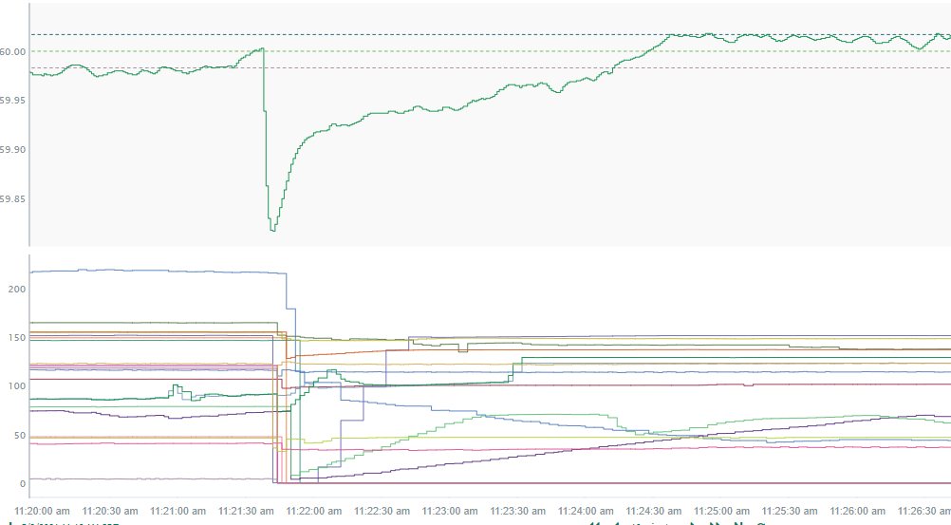
5/9/2021 11:21:37 (Non-FME)
Notes:
Several units tripped offline or reduced their output totaling a generation loss of approximately 1300 MW
Starting Frequency: 60.003Hz
Minimum Frequency: 59.817 Hz
A-C Time: 7 seconds
Recovery Time(back to deadband): 2 minutes and 49 seconds
RRS Deployed: 859.13 MW
Trip Reason: Low voltage event on the grid
Contextual Information: A total of 462 MW of regulation up was deployed during the event
No Selection Reason: The frequency was oscillating at the lower deadband prior to the event
Notes: RFI’s were sent out for this event.

Slide 4
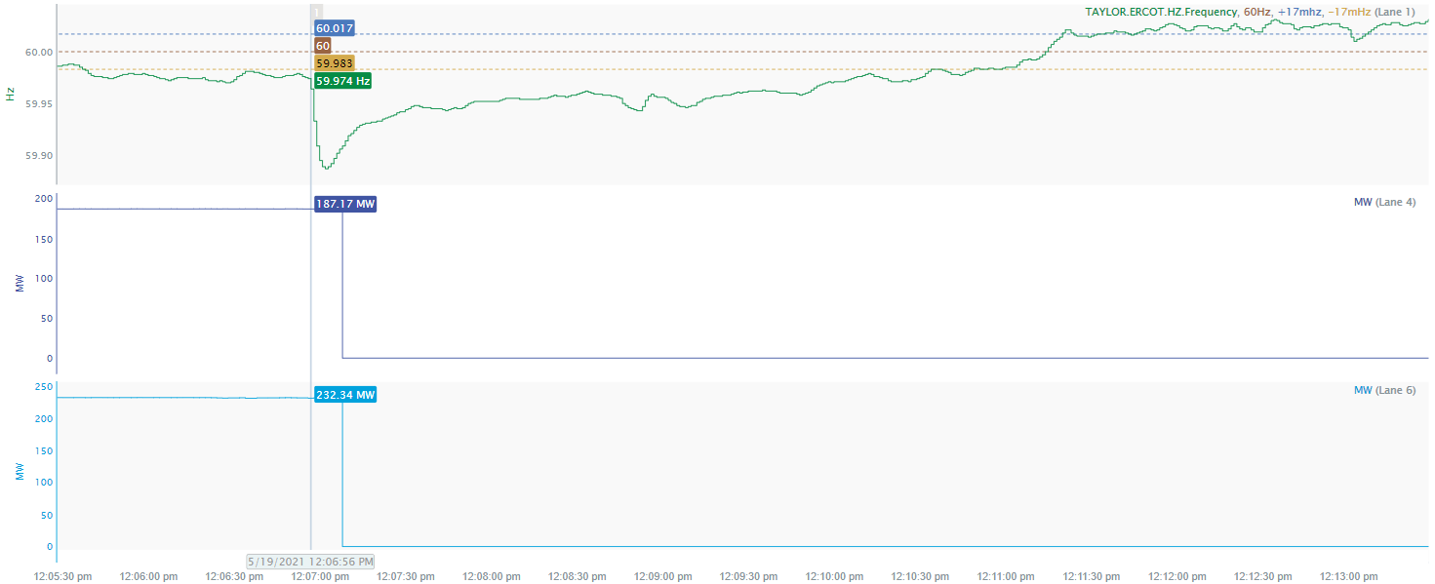
5/19/2021 12:06:56 (Non-FME)
Notes:
Two units tripped offline while carrying a total of 420 MW
Starting Frequency: 59.974 Hz
Minimum Frequency: 59.887 Hz
A-C Time: 6 seconds
Recovery Time (back to deadband): 3 minutes and 38 seconds
RRS Deployed: 514.42 MW
Trip Reason: Unknown at this time
Contextual Information: Total of 497 MW of regulation up was deployed during the event.
No Selection Reason: The starting frequency is outside the lower deadband

Slide 5
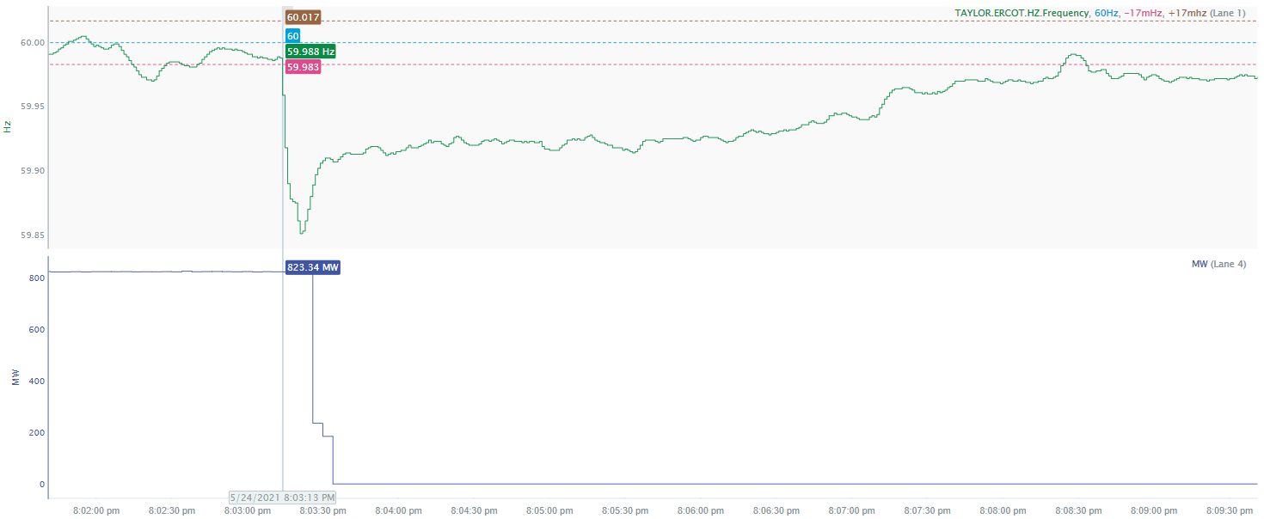
5/24/2021 20:03:13 (Non-FME)
Notes:
Unit tripped offline while carrying 823 MW
Starting Frequency: 59.988 Hz
Minimum Frequency: 59.851 Hz
A-C Time: 8 seconds
Recovery Time (back to deadband): 5 minutes and 10 seconds
RRS Deployed: 913.44 MW
Trip Reason: Reheat protection trip due to an intercept valve issue
Contextual Information: Total of 253 MW of regulation up was deployed during the event.
No Selection Reason: The unit trip is not clean.

Slide 6
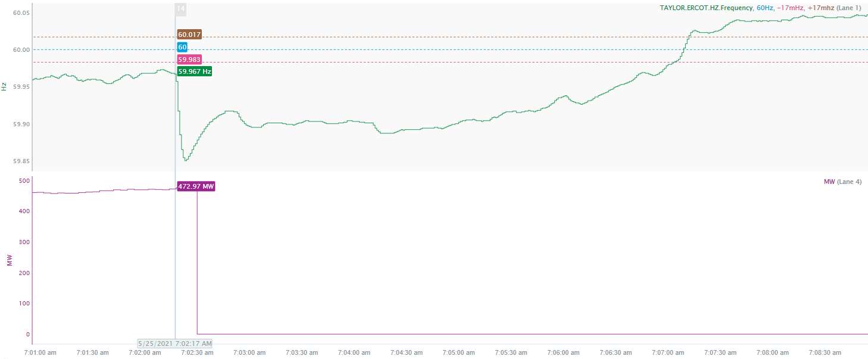
5/25/2021 7:02:17 (Non-FME)
Notes:
Unit tripped offline while carrying 480 MW
Starting Frequency: 59.967 Hz
Minimum Frequency: 59.85 Hz
A-C Time: 6 seconds
Recovery Time (back to deadband): 4 minutes and 46 seconds
RRS Deployed: 1145.6 MW
Trip Reason: Unknown at this time
Contextual Information: Regulation up was exhausted before the event and 450 MW of manual offset was applied
No Selection Reason: The starting frequency is outside the lower deadband

Slide 7
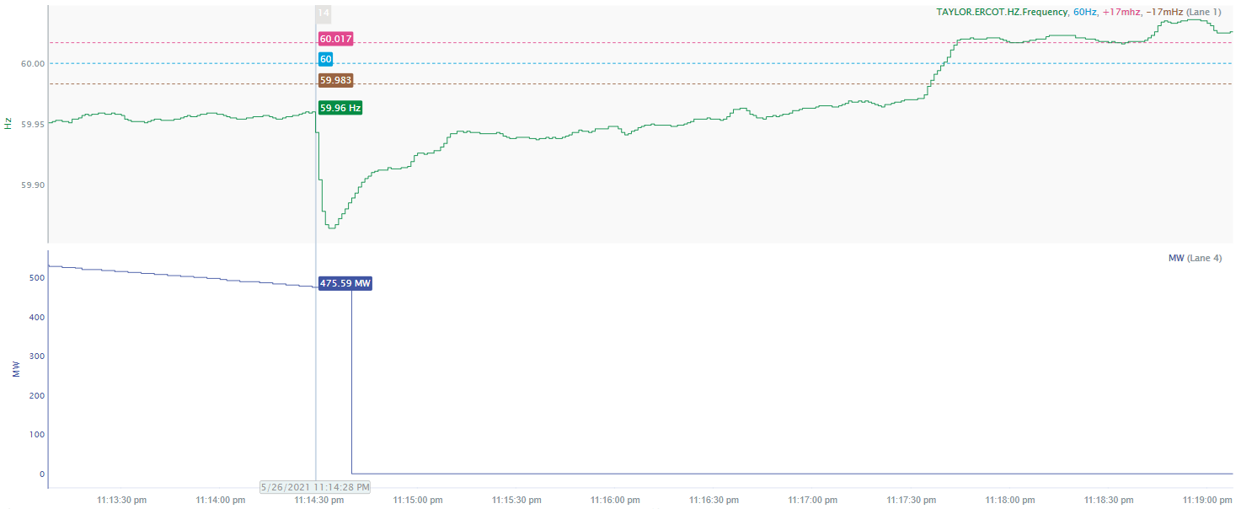
5/26/2021 23:14:28 (Non-FME)
Notes:
Unit experienced runback and tripped offline while carrying 475 MW
Starting Frequency: 59.96 Hz
Minimum Frequency: 59.864 Hz
A-C Time: 6 seconds
Recovery Time (back to deadband): 3 minutes and 8 seconds
RRS Deployed: 955.28 MW
Trip Reason: The plant reported hydrogen leak before tripping
Contextual Information: Regulation up was exhausted before the event and 500 MW of manual offset was applied
No Selection Reason: The starting frequency is outside the lower deadband

Slide 8
Questions?
Thank you!

