Slide 1
NDSWG: ECEII and ICCP Handbook
Koepke – 06/14/21

Slide 2
ECEII Implementation in NMMS_POSTINGS

Slide 3
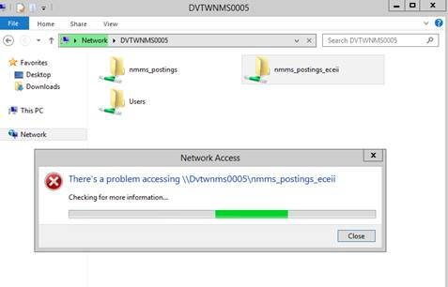
New ECEII Folder
Digital certificate must have the role NMMS_POSTINGS_ECEII to access new folder
A “Network Access” error will be show if permissions have not been provisioned

Slide 4
Changes to “NMMS_POSTINGS” Folder
General Cleanup
Old folders and miscellaneous files have been removed
Reorganization of content
Moved to ECEII
Market Models
NMMS_45_DAY_POSTINGS to ECEII_NMMS_45_DAY_POSTINGS
Production Models
NMMS_MODELS to ECEII_NMMS_MODELS
“Raw” Models
SCRATCH to ECEII_RAW_MODELS

Slide 5
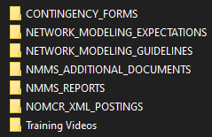
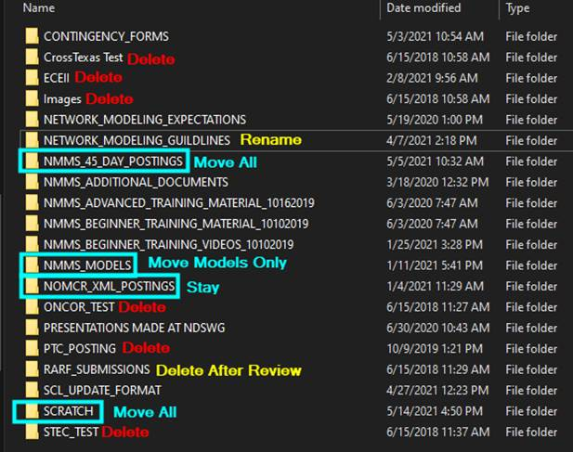
Before and After
NMMS_POSTINGS
Original NMMS_POSTINGS
NMMS_POSTINGS_ECEII

Slide 6
Review ICCP Handbook for Binding Language

Slide 7
Background
At the April and May 2019 ROS meetings, it was requested that NDSWG review the the ICCP Handbook
Determine what is binding/non-binding
Determine the proper repository for the binding language
Update references to ICCP Handbook to new repository
April Notes
May Notes

Slide 8
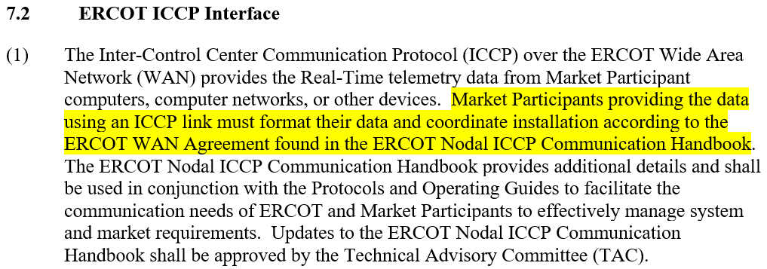
Main Issues
ERCOT Nodal ICCP Communication Handbook may have language that should be binding
At least one binding document, the Nodal Operating Guides, refers to the non-binding Handbook in a “binding fashion” (e.g. “must”)
Nodal Operating Guides

Slide 9
Attempt #1 – Pull NOG-Referenced Language Into New* Doc
ERCOT’s initial attempt was to pull all sections of the ICCP Handbook referenced by the Nodal Operating Guides into a new binding document.
Binding
Non-Binding
Binding

Slide 10
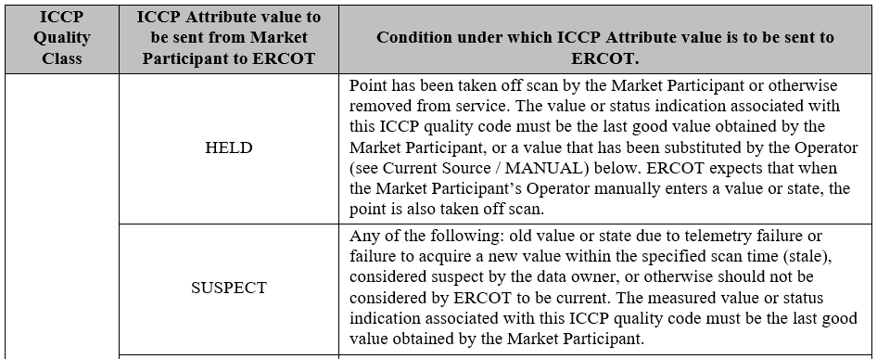
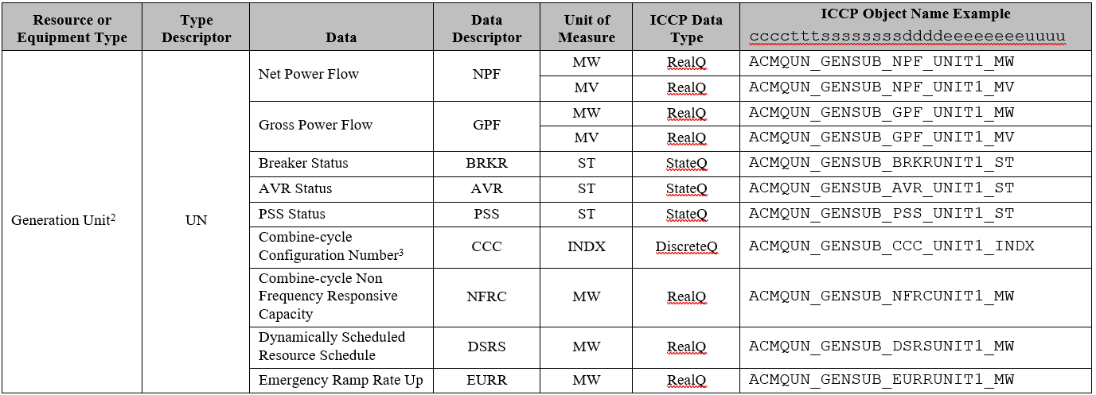
Attempt #1 – Sample ICCP Sections Referenced by NOG
Quality Codes
Not all systems send every quality code
Object name syntax is a suggestion and not a rule
Data Exchange Tables

Slide 11
Current Attempt – Identify Binding Language in ICCP Handbook
Update references to Handbook to properly reflect that is should be use as a guide
Review Handbook to identify candidate language to add to a new binding document.
Binding
Non-Binding
Binding

Slide 12
EMSWG Requested Action Items
Review the ICCP Handbook for concepts or language that may be candidates to become binding
Discuss the above findings at future EMSWG and NDSWG meetings
If desired, more frequent meetings can be held

Slide 13
SCR813 – Jointly-Rated Coordination

Slide 14
SCR813 Recap – 06/15/21
Basic summary of changes to NMMS:
“Checkbox” requesting confirmation of coordination when jointly-rated equipment changes are detected
Improved NOMCR Status emails to all parties of a jointly-rated device
ROS awaiting NDSWG feedback on initial ERCOT proposal
Keep SCR as is?
Reject SCR?
Propose modifications to SCR (could kick off new round of Impact Analysis)?

Slide 15
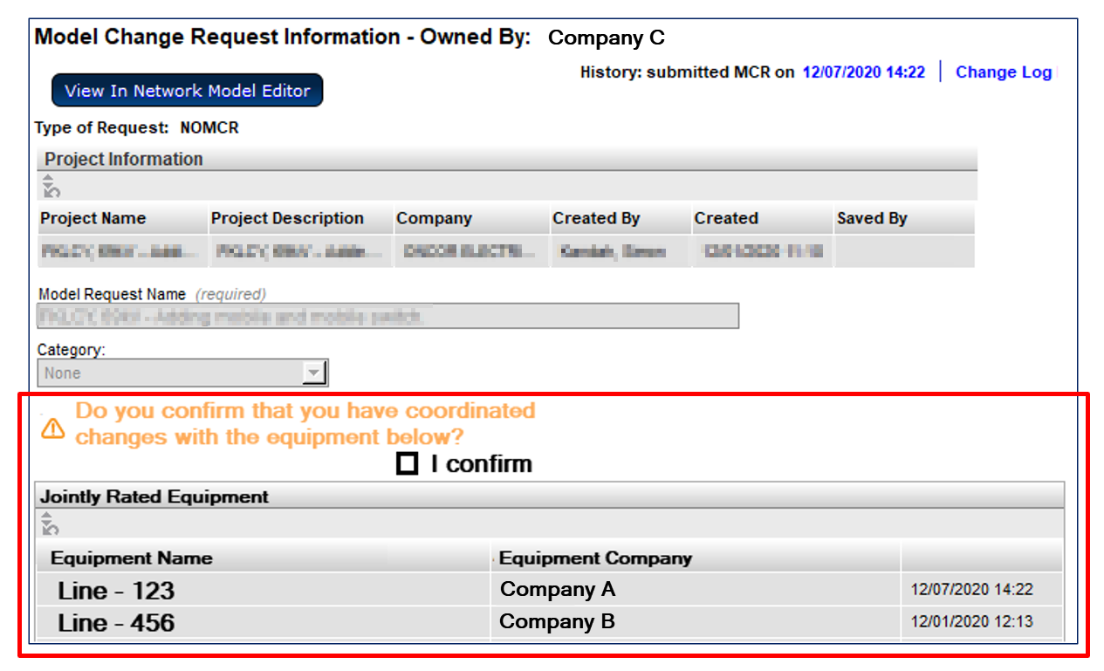
SCR813 - Submitter Shown Jointly-Rated Equipment and Coordination Confirmation Requested

Slide 16
SCR813 - Enhanced Notifications – “Walking the Tree”
Add functionality to send notifications to model-instance owners when “nearby” changes are made.
Currently notifications are only sent to owners of modified instances
Ratings sets are only owned by one company
Each company will have their own ratings set if jointly owned
Example
A notification would be sent to Company B if Ratings Set #1 were modified by Company A
Changing the impedance will send a notification to Company A and Company B
Changing the ratings in Ratings Set #1 will only send a notification to Company A
Changing the ratings in Ratings Set #1 will only send a notification to Company B

Slide 17
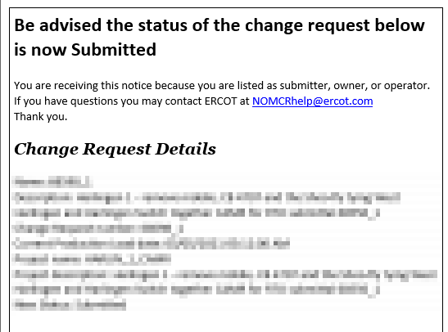
SCR813 - Additional Notification
The notification currently sent when a NOMCR is submitted would also be sent to all associated companies

